Slide 1
Recall section 2.4
Sequences and summation

Slide 2

Sequences and summations
A sequence is a function from a subset of the set of integers to a set S.
Use {a_{n}} to describe the sequence.
EX) a_{n} = .
The list of the term of this sequence is
a₁, a₂, a₃, a₄, . . . = 1, ½, 1/3, ¼, …

Slide 3
Sequence types
Geometric sequence
a, ar, ar², ar³, . . . , ar^{n}
EX) b_{n} = (-1)^{n}, c_{n} = 2⋅5^{n}, d_{n} = 6(1/3) ^{n}
Arithmetic sequence
a, a+d, a+2d, a+3d, . . . , a+nd, . . .
EX) S_{n} = -1 + 4n, t_{n} = 7 – 3n.

Slide 4
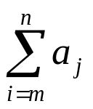
summation
a_{m} + a_{m+1} + a_{m+2} + . . . + a_{n} =

Slide 5
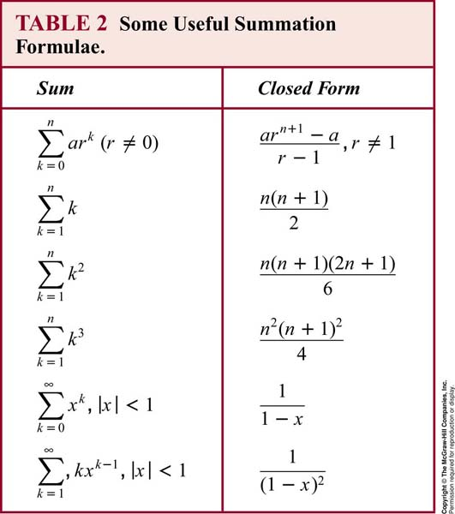

Slide 6
Induction
Can be applied to prove many theorems that state that P(n) is true for all positive integers n.
EX) 1 + 2 + 3 + . . . + n = n(n+1)/2
Basic step: P(1) is true, since 1(1+1)/2 = 1
Inductive step: assume P(k) holds, i.e.,
1 + 2 + 3 + . . . + k = k(k+1)/2.
Show that p(k+1) is true.

Slide 7
examples
Conjecture a formula for the sum of the first n positive odd integers, then prove it.
1 + 2 + 2² + 2³ + . . . + 2^{n-1} = 2^{n} -1, for all nonnegative integers n.
Sum of geometric sequence:
a + ar + ar² + . . . + ar^{n-1} = (ar^{n}-a)/(r-1)
4) n < 2^{n} for all positive integers n.

Slide 8
exercises
prove that 2n < n! for every positive integer n with n ≥ 4.
3|(n³-n) for all positive integer n.
(hint: reduce to (k³-k) + 3(k²+k). Then, both terms are divisible by 3.

Slide 9
recursion
Recursively defined functions.
Basic step: specify the value of the function at zero.
Recursive step: give a rule for finding the values later items.
EX) f(0) = 3, f(n+1) = 2f(n) + 3.
What are the f(1), f(2) , f(3) ?
EX) give an inductive definition of the factorial function F(n) = n!
Ans: F(n+1) = (n+1)F(n)

