Slide 1
Basics of counting
Two basic counting rules: product rule and sum rule.
1) Product rule: applied when a procedure is made up of separate (independent) tasks. Suppose a procedure can be broken down into a sequence of two tasks. If there are n₁ ways to do the first task and for each of these ways of doing the first task, there are n₂ ways to do the second task, then there are n₁n₂ ways to do the procedure.

Slide 2
Product rule
EX 1) There are 12 available offices. Find the number of ways to assign different offices to two employees.
EX 2) using a letter and a positive integer not exceeding 100, how many chairs can be labeled differently?
EX 3) How may different bit strings of length 7?
EX 4) number of different license plates with 3 letters followed by 3 digits.

Slide 3
Product rule
EX 5) how many one-to-one functions from a set with m elements to one with n elements? m ≤ n.

Slide 4
Sum rule
If a task can be done either in one of n₁ ways or in one of n₂ ways, where none of the set of n₁ ways is the same as any of the set of n₂ ways, then there are n₁+n₂ ways to do the task.
EX 1) choosing a representative from 37 faculty members and 83 students.
EX 2) choosing a project from one of the three lists. The three lists contain 23, 15, and 19 possible projects. No overlapped project. In the lists.

Slide 5
Complex counting
Mixture of sum and product rules.
Ex) In BASIC, rules for naming variables are
A string of one or two characters from alphanumeric characters.
Must begin with a letter.
Must different from the five strings of two characters that are reserved.
How many different variables?

Slide 6
Complex counting
Ex 2) a password consists of 6 to 8 characters, where each character is an uppercase letter or digit. Each password must contain at least one digit.
How many different passwords?

Slide 7
Inclusion-exclusion principle
There are n₁ ways or n₂ ways to do a task, but some of them are are overlapped. Then, n₁+n₂ – (n₁∩ n₂).
EX 1) How many bit strings of length 8 start with 1 or end with 00? 2⁵
Ex 2) Among 350 applicants, 220 CS majors, 147 business majors, and 51 are both CS and business majors. How many are neither CS nor business majors?

Slide 8
permutations
A permutation of a set of distinct objects is an ordered arrangement of these objects.
An ordered arrangement of r elements is called an r-permutation.
EX 1) the number of ways 3 students from a group of 5 students to stand in line for a picture. How about all 5? (60 and 120)
EX 2) S = {1, 2, 3}. 3, 2, 1 is a permutation of S. 3, 2 is a 2-permutation of S.

Slide 9
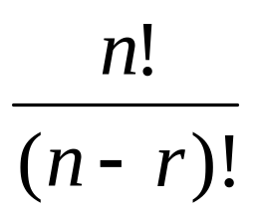
permutation
Use P(n, r) to denote the number of r-permutations of a set with n elements.
EX 1) S = {a, b, c}. 2-permutations of S are the ordered arrangements a, b; a, c; b, a; b, c; c, a; c, b. P(3, 2) = 3⋅2 = 6.
In general, P(n, r) = n(n-1)(n-2) . . . (n-r+1) =

Slide 10
permutation
EX 1) number of ways to select a first-prize winner, second-prize winner, and third-prize winner from 100 people.
EX2) The number of permutations of the letters ABCDEFGH contain the string ABC. (6!)

Slide 11
combination
An r-combinations of a set is an unordered selection of r elements from the set.
EX 1) S = {1, 2, 3, 4}. Then {1, 3, 4} is a 3-combination from S.
EX 2) The number of different committees of three students from a group of 4.

Slide 12
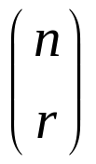
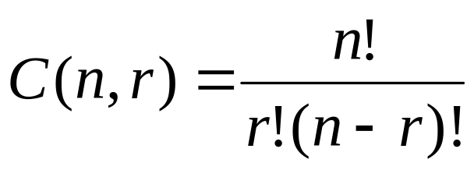
Combination (cont.)
The r-combinations of a set with n distinct elements is denoted by C(n, r) or
Called binomial coefficient.
EX 1) {A, B, C, D}. C(4, 2) = 6. What are those?

Slide 13
examples
EX 1) How many poker hands can be dealt from a standard deck of 52 cards?
C(52, 5) = 52!/(5!47!)
C(52, 47) = ?
EX 2) the number of ways to select 5 players from 10 members.
EX 3) how many bit strings of length n contain exactly r 1s?
EX 4) 9 members in Math dept. and 11 in CS. The number of ways to select committee consists of 3 from math and 4 from CS.

Slide 14
corollary
C(n, r) = C(n, n-r)

Slide 15
Binomial coefficients
(a+b)² = a² + 2ab + b².
(a+b)³ = ?
(a+b)^{n} = ?
Binomial theorem:
(x+y)^{n} = C(n,0)x^{n} + C(n,1)x^{n-1} y+ C(n,2)x^{n-2} y²+ . . . + C(n,n)y^{n}.
EX) (a+b)³ = ? (a+b)⁴ = ?
EX) what is the coefficient of x¹² y¹³ in the expansion of (x+y)²⁵ = ?.

Slide 16
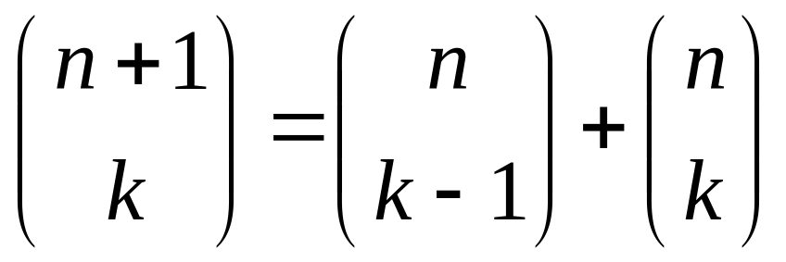
More examples
EX) what is the coefficient of x¹² y¹³ in the expansion of (2x-3y)²⁵ = ?
Pascal’s identity:
Let n,k be positive integers with n ≥ k. then,

Slide 17
Generalized P and C
Elements can be used repeatedly, for example, a letter or digit can be used more than once in a license plate.
Permutation with repetition
Theorem: the number of r-permutations of a set of n objects with repetition allowed is n^{r}.
Combination with repetition
EX) the number of ways to select 4 pieces of fruit from apples, oranges and pears. Order does not matter, only type of fruit and not the individual piece matters. There are at least 4 pieces of each type.

Slide 18
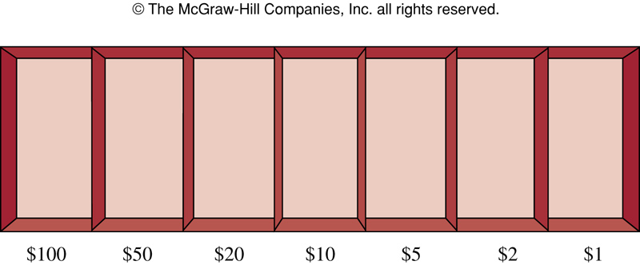
example
Ways to select 5 bills from cash box containing $1 bills, $2 bills, . . . , $100 dollars bills, as shown below.

Slide 19
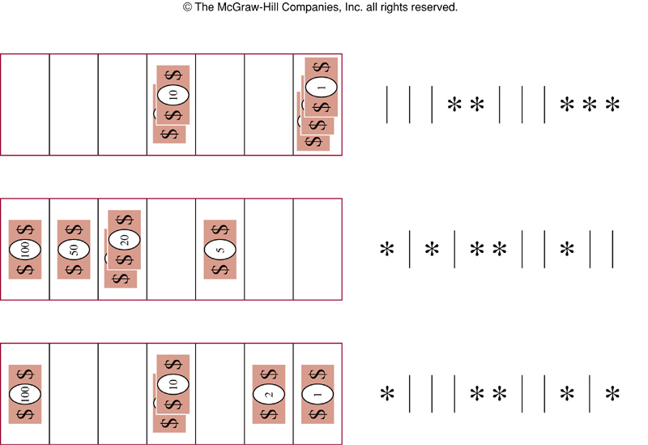
continue
= number of ways to select positions of the five stars from
11 possible positions = C(11, 5)

Slide 20
theorem
There are C(n+r-1, r) = C(n+r-1, n-r)
r-combinations from a set of n elements when repetition of elements are allowed.
EX) a cookie shop has 4 different kinds of cookies. How many different ways can 6 cookies be chosen?
C(9, 6)

Slide 21
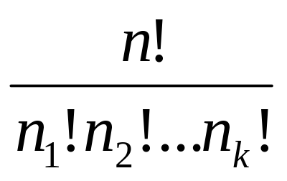
Permutations with indistinguishable objects
EX) how many different strings can be made by reordering SUCCESS?
Ans: C(7,3)C(4,2)C(2,1)C(1,1) = 420.
Where C(7,3) for S, C(4,2) for C, etc.
Theorem: the number of different permutations of n objects, where there are n₁ indistinguishable object of type1, where there are n₂ indistinguishable object of type2, . . .up to n_{k}, is

