Slide 1
finite probability
Experiment – procedure that yields one of a given set of possible outcomes.
Sample space – of the experiment is the set of possible outcomes.
Event – a subset of the sample space.
If S is a finite sample space of equally likely outcomes, and E is an event, then the provability of E is p(E) = |E|/|S|

Slide 2
examples
EX 1) An urn contains 4 blue balls and 5 red balls. What is the prob that a ball chosen is blue?
EX 2) When two dice are rolled, the probability of the sum is 7. (1/6, why?)
EX 3) In lottery of 4 digits, the prob of 4 digits match. 3 digits match. (ans: 0.0001, 36/10000)
EX 4) In lottery, prob of correctly choosing a set of 6 numbers out of the first 40 positive integers.
Ans: only one winning combination. Total number of ways = C(40, 6). Thus, 1/C(40, 6)

Slide 3
example
1) What is the probability that a card selected from a deck is a K.
2) What is the probability that a card selected from a deck is a K or a club.
3) What is the probability that a five-card poker have contains exactly one K.

Slide 4
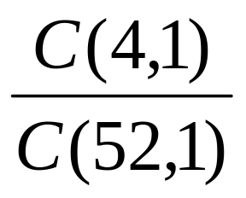
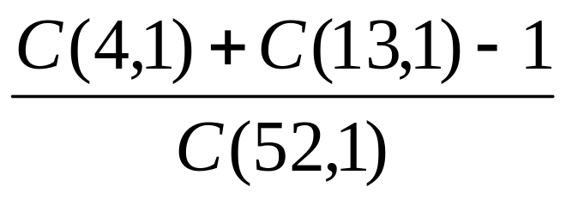
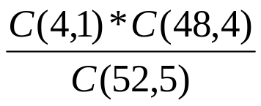
Ans:

Slide 5
examples
Probability of 1 pair.
Prob. of two pairs.

Slide 6
answers
1 pair
C(13, 1)*C(4, 2)*C(12, 3)C(4,1)³/C(52,5)
2) 2 pairs
C(13, 2)*C(4, 2)* C(4, 2)* C(44, 1)/C(52,5)

Slide 7
More examples
EX 1) prob that a hand of 5 cards in poker contains 4 cards of one kind. C(13,1)C(4,4)C(48,1)/C(52,5)
EX 2) prob of having full house.
P(13, 2)C(4,3)C(4,2)/C(52,5)
Note: order matters here since xxxyy is different from xxyyy.
C(4, 3) and C(4, 2), because choose 3 and 2 from xxxx and yyyy.

Slide 8
More example
EX 3) prob that the numbers 11, 4, 17, 39, and 23 are drawn in that order from a bin containing 50 balls. What if ball selected is returned to the bin before the next ball is selected. (ans: 1/P(50, 5), 1/50⁵)

Slide 9
Prob of combinations of events
Counting technique can be used to find the prob of events derived from other events.
Theorem: Let E be an event in a sample space S. The probability of the event E’, the complement of event E, is
p(E’) = 1 – p(E)
proof: p(E’) = (|S|-|E|)/|S| = 1-|E|/|S| = 1 – p(E).

Slide 10
example
EX) A sequence of 10 bits is randomly generated. What is the prob that at least one of these bits is 0?
ANS: 1 - 1/2¹⁰
Theorem: P(E₁∪E₂) = p(E₁) + p(E₂) –p(E₁∩E₂)
Ex 2) prob that a positive integer selected from a set of positive integers not exceeding 100 that is divisible by either 2 or 5.
Ans: p(E₁) + p(E₂) –p(E₁∩E₂) = 50/100+20/100-10/100 = 3/5

Slide 11
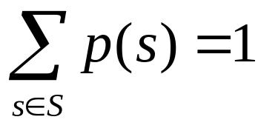
Assigning prob
S: sample space of an experiment with a finite or countable number of outcomes. p(s) is a probability assigned to each outcome s. Two conditions are required to be met:
0 ≤ p(s) ≤ 1 for each s ∈ S
Function p from the set of all outcomes of the sample space S is called a probability distribution.

Slide 12
Examples
Ex 1) What prob should be assigned to the outcomes H (head) and T (tail) when a fair coin is flipped?
Ans: Since the outcomes are equally likely, P(H) = ½, P(T) = ½.
Ex 2) what if the coin is biased so that heads come up twice as often as tails?
Ans: P(H) = 2/3, P(T) = 1/3.

Slide 13
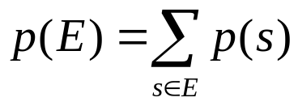
definitions
Def 1: S is a set of elements. The uniform distribution assigns the prob 1/n to each element of S.
Def 2: The prob of the event E is the sum of the probs of the outcomes in E. That is,
EX) A die is biased so that 3 appears twice as often as each other number but that the other 5 outcomes are equally likely. What is the prob that an odd number appears? 4/7

Slide 14
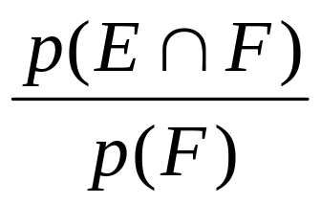
Conditional probability
EX) Suppose flip a coin three times, and all 8 possibilities are equally likely. Suppose we know that the event F, that the first flip comes up tails, occurs. Given this info, what is the prob of the event E, that an odd number of tails appears?
ANS: ½, given F occurs.
Def: Let E and F be events with p(F) > 0. the conditional prob of E given F, P(E|F) =

Slide 15
Examples of conditional prob.
EX) A bit string of length 4 is generated at random so that each of the 16 bit strings are equally likely. Prob that it contains at least two consecutive 0s, given that its first bit is a 0?
Ans: E – event that a string contains at least 2 consecutive 0s.
F = event that the first bit of a string is a 0.
E∩F = {0000, 0001, 0010, 0011, 0100}
P(E|F) = (5/16)/(1/2) = 5/8

Slide 16
Examples (cont.)
EX) What is the cond prob that a family with two children has two boys, given they have at least one boy? Assume that BB, BG, GB, and GG are equally likely.
ANS: (¼)/(3/4) = 1/3.

Slide 17
independence
The event E and F are independent iff p(E∩F) = p(E)p(F). Or p(E|F) = p(E).
EX 1) coin flipped three times. Does knowing the first flip comes up tails alter the prob that tails comes up an odd number of times? That is, p(E|F) = p(E)? No. p(E|F) = ½ = p(E)
EX 2) E: event that a randomly generated bit string of length 4 begins with 1
F: event that this bit string contains an even number of 1s. Are E and F independent if 16 bit strings are equally likely?
Ans: p(E) = p(F) = 8/16. p(E∩F) = ¼ = (1/2)(1/2) = p(E)p(F).

Slide 18
Examples of independence
EX) Assume that BB, BG, GB, and GG are equally likely. E: a family with two children has two boys. F: a family with two children has at least one boy. Are E and F independent?
Ans: p(E) = ¼. p(F) = ¾. p(E∩F) = ¼.
p(E)p(F) = ¼⋅¾ = 3/16. Not independent.
EX) E: family with three children has children of both sexes, and F: the family has at most one boy. Independent? Equally likely.
Ans: p(E∩F) = 3/8. p(E) = ¾. p(F) = ½. Therefore, independent.

Slide 19
Bernoulli trials
Bernoulli trial - each performance of an experiment with two possible outcomes.
EX) coin flip, binary bit.
The two outputs are called success and failure.
If p is the probability of success and q us the probability of failure, p+q = 1.
Bernoulli trials are mutually independent.

Slide 20
Bernoulli trials
EX) A coin is biased and p(H) = 2/3. What is the prob that exactly 4 heads come up when the coin is flipped 7 times, assuming that the flips are independent?
Ans: prob of each outcome with exactly 4 heads is (2/3)⁴(1/3)³. There are C(7, 4) of them. Therefore, prob of exactly 4 head appearance is C(7,4)(2/3)⁴(1/3)³ = 560/2187.

Slide 21
Theorem
The prob of exactly k successes in n independent Bernoulli trials, with prob of success p and prob of failure q = 1-p, is
C(n, k)p^{k}q^{n-k}.
Also called binomial distribution and denoted as b(k; n,p)
EX) prob that 0 bit is generated is 0.9. and bit are generated independently. What is the prob that exactly eight 0 bits are generated when 10 bits are generated?
Ans: b(8; 10, 0.9) = C(10, 8) (0.9)⁸(0.1)².

Slide 22
Random variables
A random variable is a function from the sample space of an experiment to the set of real numbers. That is, a random variable assigns a real number to each possible outcome.
EX) a coin flipped three times. Let X(t) be the random variable that equals the number of heads that appears when t is the outcome. Then,
X(HHH) = 3, X(HHT) = X(HTH) = X(THH) = 2, etc.

Slide 23
Distribution of X
Usually described by specifying p(X=r) for each r ∈ X(S).
EX) From the example described in previous slide, p(X=3) = 1/8, p(X=2) = 3/8, p(X=1) = 3/8, p(X= 0) = 1/8.
EX 2) X: the sum of the numbers that appear when a pair of dice is rolled. What are the values of this random variable for outcome (i, j)?
X((1, 1) = 2, X((1, 2) = X((2, 1) = 3, … , X((1, 6) = X((2, 5) = X((3, 4) = X((6, 1) = X((5, 2) = X((4, 3) = 7, . . ., X((6, 6)) = 12.

Slide 24
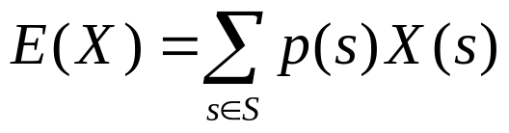
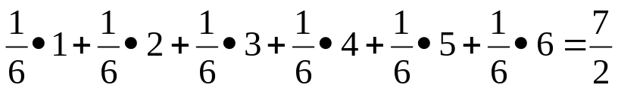
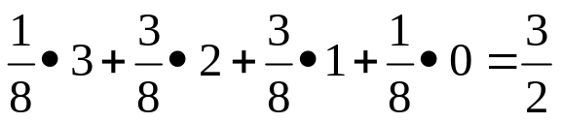
Expected value
The expected value (or expectation) of the random variable X(s) on the sample space S is equal to
EX 1) Expected value of a die. X: the number that comes up when a die is rolled. What is the expected value of X?
E(X) =
EX 2) A fair coin flipped three times. S: sample space of 8 possible outcomes, and X: number of heads in this outcomes.
E(X) =

