Slide 1

Particle Filters and their Use
by: Micah Chambers

Slide 2
Introduction
  Also known as Sequential Monte Carlo Methods
  Comparable to Kalman/Extended Kalman filters for Non-linear and Non-Gaussian signals
  Can be thought of as an online version of Markov Chain Monte Carlo (MCMC)
  Used for tracking in noisy systems especially when the system or noise are non-gaussian
  Type of Bayesian filter, estimate posterior probability:
    P(X_t | Y_0:t-1)
    X_t is current time, Y_0:t-1 is all previous observations

Slide 3
Common Uses
  Robotics
  Signal Smoothing and Estimation
  On-line Parameter Estimation

Slide 4
Sequential Importantce Sampling (SIS)
  Most Basic Type of Particle filter
  Also known as
    Survival of the Fittest
    Bootstrap Filtering
    The Condensation Algorithm
    Interacting Particle Approximations
  Goal is the estimate posterior probability using a set of random samples, which have been weighted based on their previous accuracy

Slide 5
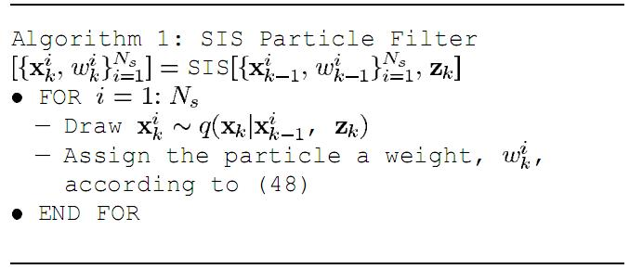

SIS Algorithm

Slide 6
SIS Algorithm continued
  The distribution, q, is known as the proposal or, importance distribution.
  q is typically used to move the particles based on what is known about the underlying system
  A quick look at the SIS algorithm shows that the particles will typically diverge and most particles will have near zero weights.

Slide 7
SIS Algorithm continued
  The weight, w, is typically chosen to be proportional to the error, ie. q(Xk | X, Z) = p(Xk | X), so that two terms can be dropped.
    This is an ease of implementation and speed issue, which does degrade the algorithm to a point.
    q needs to be true posterior, heavy tailed.
    Typically normal distribution.

Slide 8
Solving Degeneracy
  Degeneracy is inherant in the SIS algorithm, so modifying the core algorithm alone will not fix the problem
  Instead, we add on a second process where degenerated particles are replaced, "Re-sampling"
  Some methods of re-sampling:
    Re-sample only degenerated particles.
    Re-sample all particles, based on weight (Sample-Importance Re-sample, SIR)

Slide 9
Sampling-Importance Resampling, SIR Algorithm
  Importance Distribution is set to P(X | Xp)
  Flexible, and requires less prior knowledge about the system.
  Sample from proposal (importance) distribution
  Calculate weights
  Normalize weights
  Re-draw particles from calculated posterior

Slide 10
SIR Algorithm Cont'd

Slide 11
Example Videos
Car Movement
Known Start
Uknown Start

Slide 12
Car Movement
Known Start
Uknown Start

