Slide 1


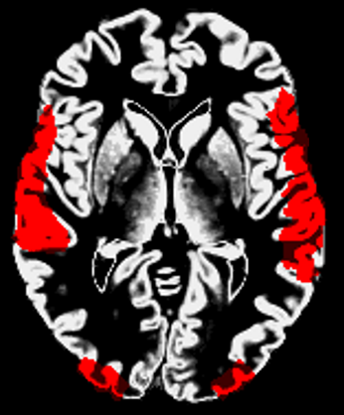
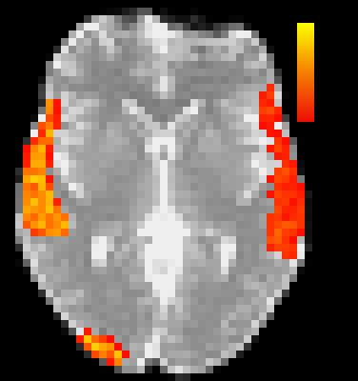
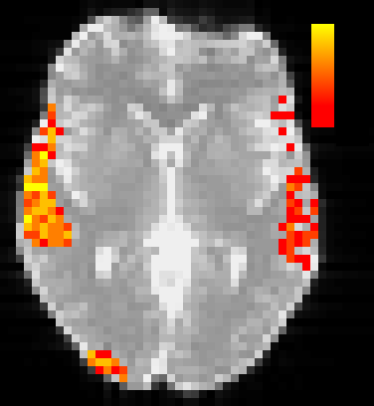
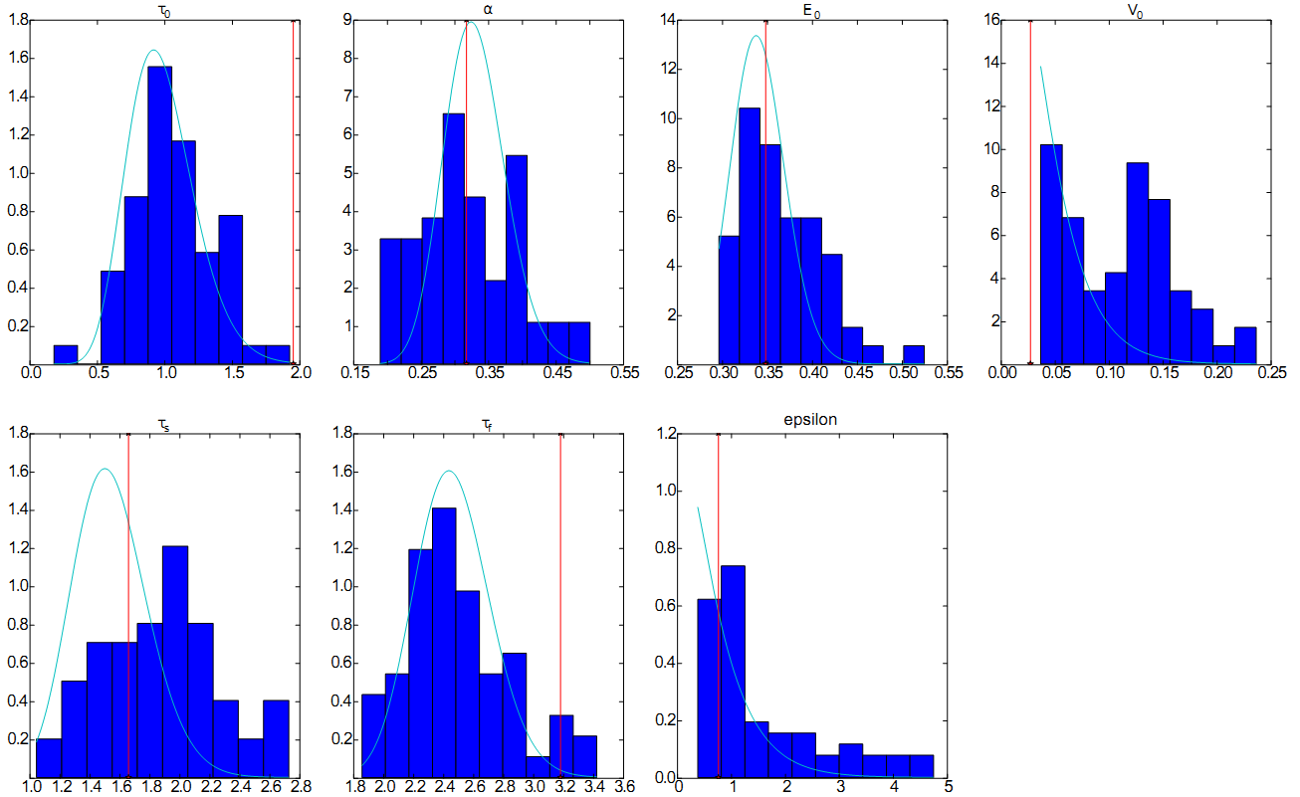
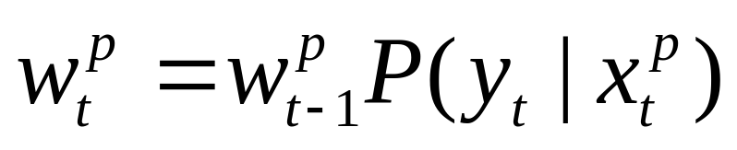
AN ANALYSIS OF BLOOD-OXYGEN-LEVEL-DEPENDENT SIGNAL PARAMETER
ESTIMATION USING PARTICLE FILTERS
Micah C. Chambers ¹ and Christopher L. Wyatt ²
¹ Department of Bioengineering, University of California, Los Angeles; ² Department of Electrical and Computer Engineering, Virginia Tech;
¹ University of California, Los Angeles – Laboratory of NeuroImaging
² Virginia Tech - Wake Forest University School of Biomedical Engineering and Sciences
SCHOOL of MEDICINE
COLLEGE of ENGINEERING
Introduction
Time 0
6dB
.61
Functional MRI measures changes in Oxygenated Hemoglobin brought about increases in neural activity. Precise characterizations of the Blood-Oxygen-Level-Dependent (BOLD) signal exist, but model complexity has made deconvolution difficult. Any optimization method must be robust to non-gaussian, be capable of optimizing nonlinear models with 7+ dimensions, and express the uncertainty inherent in the parameters. Various methods have been proposed but each either makes strong assumptions or needs excessive computation. This poster describes one method of optimizing parameters of the BOLD model of Friston et al. and the implications of the results [1].
0) Initial Particles
3
-20dB
.15
1) Measure Error
2
2) Re-Weight
3) Resample
Stimulus
4) Smooth
1
Regions
4
Time 1
Signal-to-Noise Ratio
Mutual Information
Neural Activity
5) Model Time
Increased Cerebral Metabolic Rate of Oxygen
Increased Cerebral Blood Flow
1) Measure Error
Results
Deoxy/Oxy Hemoglobin
Cerebral Blood Volume
Single Timeseries Analysis
Results showed that the particle filter converged to parameters that give good estimates of the true (pre-noise) simulated signal. In 20 simulations, the Root-Mean-Squared Error was always less than the Root-Mean-Squared Residual (σ = .5% for Wiener steps and σ = 1% for Gaussian white noise, compared to 1-3% BOLD signal level). Processing took 5 minutes per 10 minute signal. Using the particle cloud at the end of a 40-minute single timeseries test, the correlation matrix of model parameters was calculated; shown below.
fMRI Measure
Methods
A particle filter as described in Arulampalam et al. was used to estimate the parameters driving the measured BOLD signal [2]. The particle filter consists of 5 steps per timestep: 1) Measurement, 2) re-weighting of Particles, 3) (optional) re-sampling from the estimated distribution, 4) smoothing the re-sampled distribution, and 5) propagating each particle’s state variables forward in time. Particle weights were updated using:
Where p is the particle index, t is the time index, x is the state of particle p, and y is the measured value. P(y_{t}|x_{t}^{p}) = y_{t} – f(x_{t}^{p}), where f(.) is the BOLD output, is assumed to be Gaussian with mean 0. At the conclusion, the cloud of particles represents an empirical distribution of parameters based on a timeseries. After de-trending, the particle filter was applied to each voxel/time-series independently. To ease computation, 16,000 particles were drawn from the prior distribution, but at the first re-sample point, only 1,000 particles were drawn. Tests were performed on single-timeseries simulations, generated using a true set of parameters with the BOLD model. Gaussian white noise and a Wiener noise process were added to the single voxel simulation. A modified version of the POSSUM (FSL) tool was used to generate region-based activity with known parameters.
 | τ₀ | α | E₀ | V₀ | τ_{s} | τ_{f}
α | 0.89
E₀ | -0.77 | -0.52
V₀ | 0.62 | 0.42 | -0.80
Τ_{s} | 0.62 | 0.30 | -0.75 | 0.34
τ_{f} | -0.00 | -0.40 | -0.43 | 0.20 | 0.70
ε | 0.62 | 0.66 | -0.64 | 0.28 | 0.45 | -0.10
Conclusion
This work shows that high accuracy BOLD estimates may be achieved at reasonable speeds. However, parameters of the BOLD model are not observable within 10 minute simulated fMRI signals, for the region of parameters tested. The correlation of parameters across particles in the 40-minute signal indicate that the 7 parameters may not be identifiable given the limited measurements. Variances of final parameter estimates that approach the prior distribution in region 2 of the POSSUM simulated fMRI data also indicate the slack in the model parameters. Reduction of BOLD model parameters would reduce complexity and increase observability.
Simulated fMRI Volume Analysis
On the top right, the signal to noise ratio calculated at each voxel is compared with the mutual information of the estimated BOLD signal with the simulated (with noise) BOLD signal. Each region (1-4) had a different set of parameters, leaving region 4 below the noise floor. On the bottom right, final parameter estimates (histogram) are compared with the prior (green line) and the true parameter used in simulation (red).
References
[1] Friston, K. J., Mechelli, A., Turner, R., & Price, C. J. (2000). Nonlinear Responses in fMRI: the Balloon Model, Volterra kernels, and other Hemodynamics. NeuroImage, 12, 466-477.
[2] Arulampalam, M. S., Maskell, S., Gordon, N., & Clapp, T. (2002). A tutorial on particle filters for online nonlinear/non-Gaussian Bayesian tracking. IEEE Transactions on Signal Processing, 50(2), 174-188. doi: 10.1109/78.978374.
Presented at 28th International Conference of the Engineering in Medicine and Biology Society

