Slide 1
PrintShop: Assessing OS and Capabilities of Serial Print Devices
Micah Flack
12/07/2023

Slide 2
Conferences & Requirements

Slide 3
Introduction
Federal Trade Commission (FTC) reports:
  37,932 reports of credit card fraud in 2012
  87,451 reports in 2022.
    30.5% over the decade for reported credit card fraud.
  Between 2020 and 2022 the increase was 14.6%
  In 2022 alone, there were around 5.1 million fraud, identity theft, and miscellaneous reports in total.
Critical to secure payment process and endpoints
  Financial point-of-sale are not the only case (e.g., ICS, HMI, etc...)

Slide 4
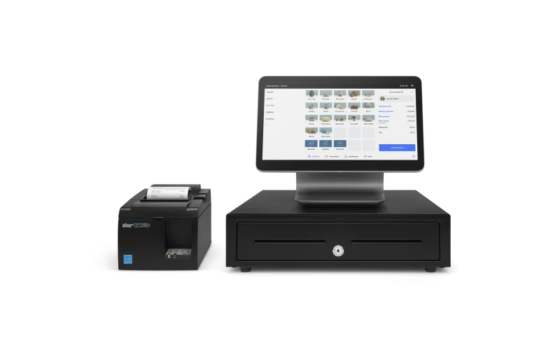
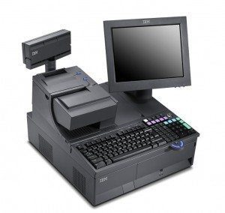
Point of Sale (PoS) Systems with Serial Printers

Slide 5
Related Works
R. Benadjila, M. Renard, P. Trebuchet, P. Thierry, and A. Michelizza, “Wookey : Usb devices strike back,” 2018. [Online]. Available: https://api.semanticscholar. org/CorpusID:199552896.
W. D. Yu, D. Baheti, and J. Wai, “Real-Time Operating System Security,”
Y. He, Z. Zou, K. Sun, et al., “RapidPatch: Firmware Hotpatching for Real- Time Embedded Devices,” presented at the 31st USENIX Security Symposium (USENIX Security 22), 2022, pp. 2225–2242, isbn: 978-1-939133-31-1. Available: https://www.usenix.org/conference/usenixsecurity22/presentation/he-yi
J. Tian, N. Scaife, D. Kumar, M. Bailey, A. Bates, and K. Butler, “SoK: ”Plug & Pray” Today – Understanding USB Insecurity in Versions 1 Through C,” in 2018 IEEE Symposium on Security and Privacy (SP), May 2018, pp. 1032–1047. doi: 16 10.1109/SP.2018.00037. Available: https://ieeexplore.ieee.org/document/8418652

Slide 6
Proposed Research - Objectives
The goal of this research is to understand the hardware and software capabilities of serial print devices.
  Can the hardware support adding unintended functionality at the application and physical layers?
  And, with what we know about the USB standard and developing real time operating systems, can that functionality be used to create a dual purpose device?
Research Q’s are more specific

Slide 7
Proposed Research - Questions
• RQ1: What is the baseline or minimum hardware these devices are running?
RQ2: What software is being used on these devices? OS, libraries...
• RQ3: Can the software/firmware be modified? FreeRTOS/ReconOS/VXWorks.
• RQ4: If so, how much can be modified in memory? Is manually reflashing possible?
• RQ5: Assuming reflashing is possible, can the original OS keep original functions and be used as a HID clone or hub?
The answers will be drawn from surveyed data (e.g., datasheets, technical specs, in-memory).

Slide 8
Methodology
Research process has several parts:
  Identify sample population (e.g., most popular and available printers)
  Technical specification and datasheet gathering
    Pull information regarding hardware, capabilties, and I/O
  Hardware teardown and documentation
    Take photos throughout process and identify hardware components
    E.g., SNBC BTP-S80 has ARM Cortex M4, NXP LPC4078FET208
  Using debug tools, gather firmware and bootloader information

Slide 9
Methodology - Approach
Quantitative
Cross sectional surveys
Small sample of population specifications
  Serial printer device
  SoC/flash memory datasheets
Best for gathering and comparing data in-time, not over long periods.

Slide 10
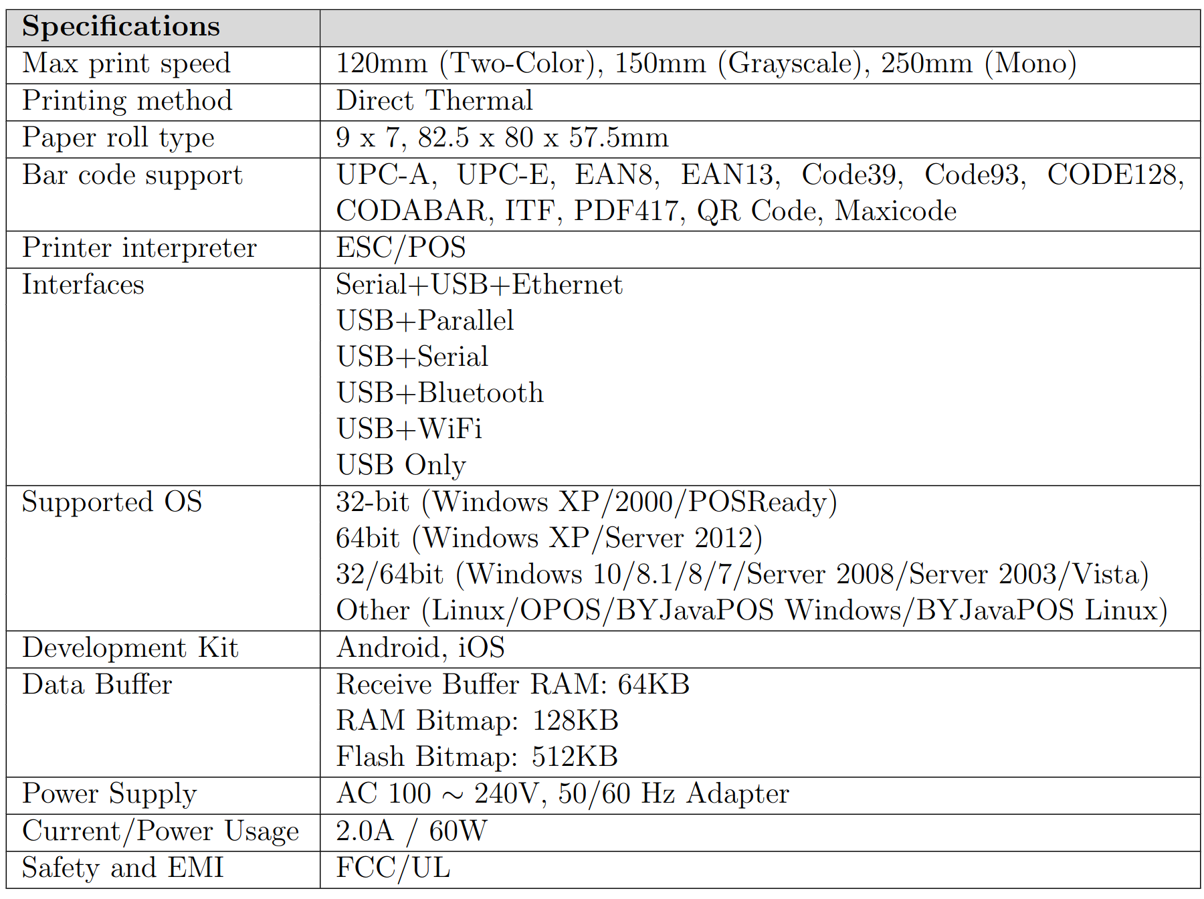
Example of Surveyed Device Specifications

Slide 11
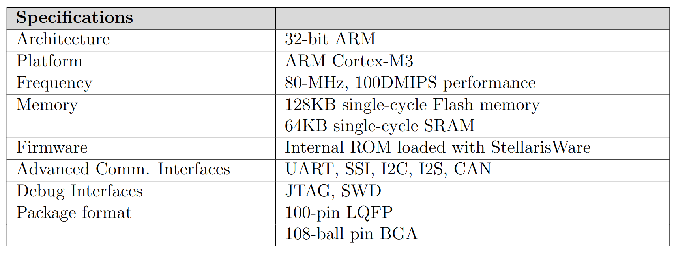
Example of Surveyed SoC Datasheet

Slide 12
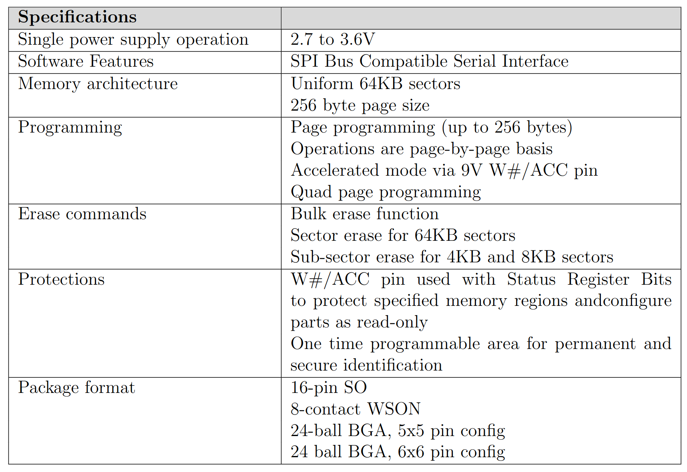
Example of Surveyed Memory Datasheet

Slide 13
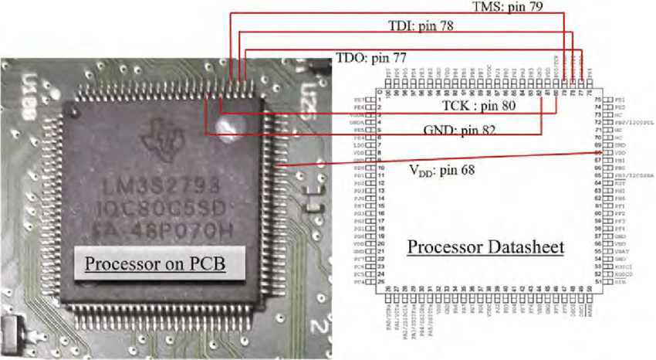
Hardware Disassembly and Analysis

Slide 14
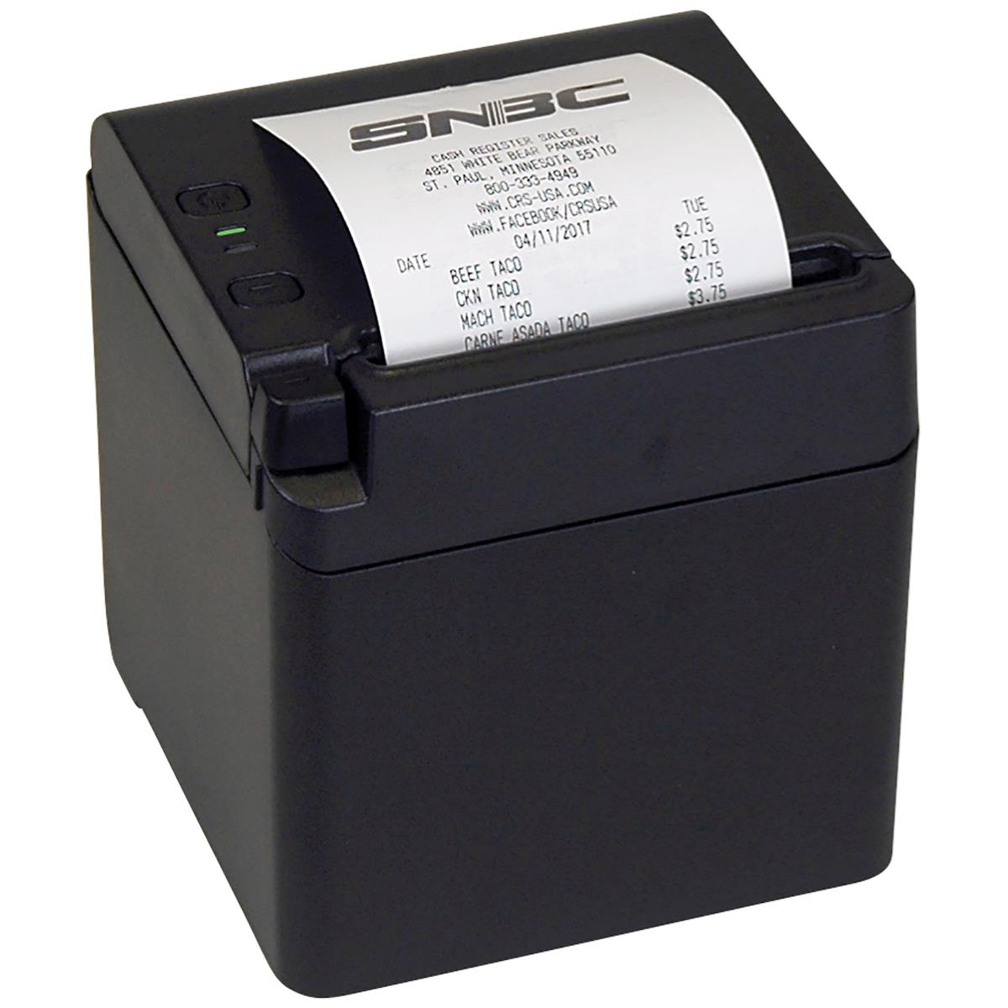
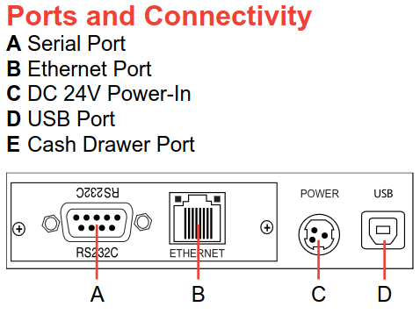
Example Serial Printer – SNBC BTP-S80

Slide 15
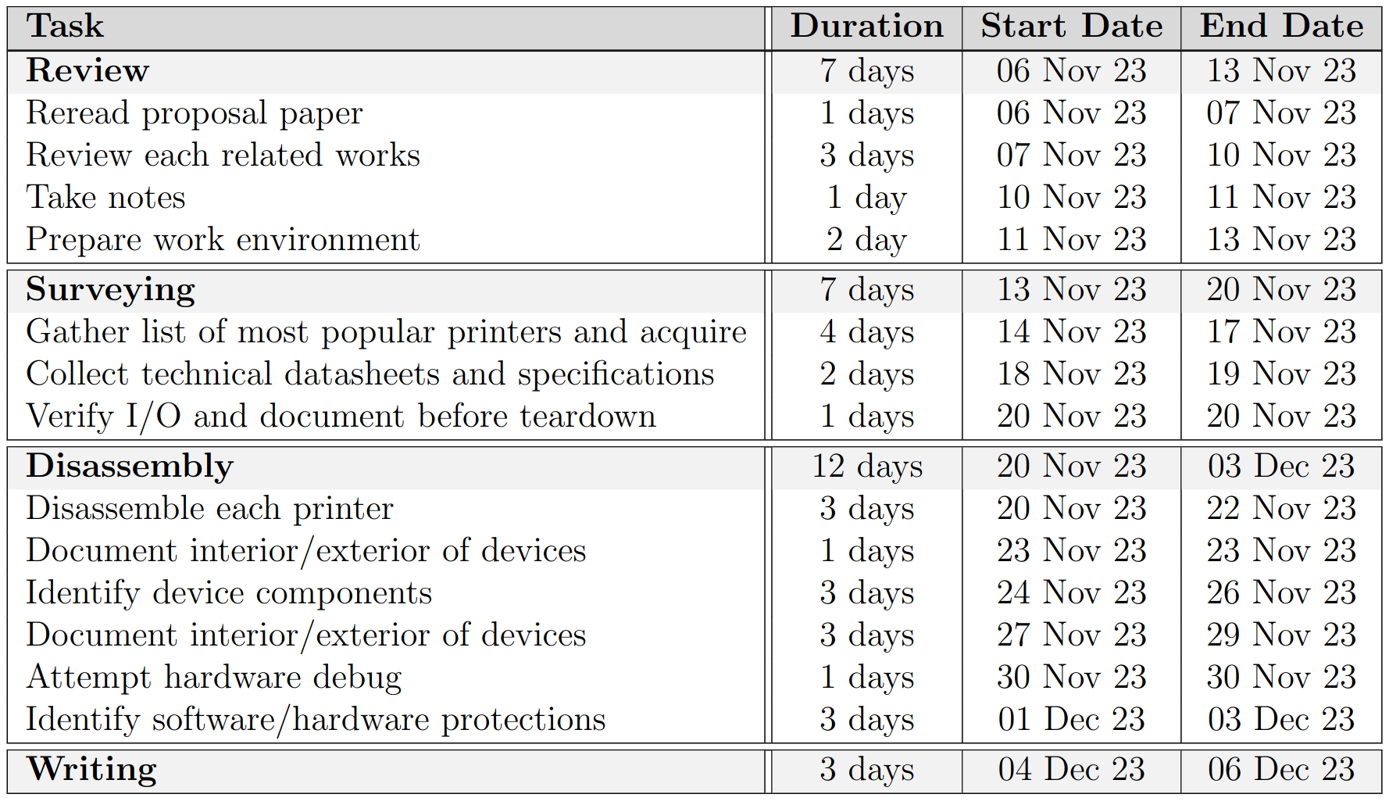
Research Timeline

Slide 16
Conclusion
Financial cybercrime is a growing concern as more criminals target those systems and their customers. Although, PoS systems are not a key component for those crimes it is important to secure them and investigate potential concerns before they do. The accessory devices that these systems use can be leveraged, specifically insecure or poorly designed printer devices.
Using the data surveyed through this research, we will be able to determine what security protections serial printer devices have. Either through the hardware compenents and the original firmware. Ultimately, knowing what limitations or obstacles there might will later help the development of a modified FreeRTOS/RTOS firmware as a BadUSB-like device; future design artifact research.

