Slide 1
PrintShop: Assessing OS and Capabilities of Serial Print Devices
Micah Flack
12/07/2023

Slide 2
Conferences & Requirements
IEEE Latex Format
  https://www.ieee.org/conferences/publishing/templates.html
Conference for paper submission
  37th IEEE Computer Security Foundations Symposium
    https://www.ieee-security.org/TC/CSF2024/

Slide 3
Introduction
Federal Trade Commission (FTC) reports:
  37,932 reports of credit card fraud in 2012
  87,451 reports in 2022.
    30.5% over the decade for reported credit card fraud.
  Between 2020 and 2022 the increase was 14.6%
  In 2022 alone, there were around 5.1 million fraud, identity theft, and miscellaneous reports in total.
Critical to secure payment process and endpoints
  Financial point-of-sale are not the only case (e.g., ICS, HMI, etc...)

Slide 4
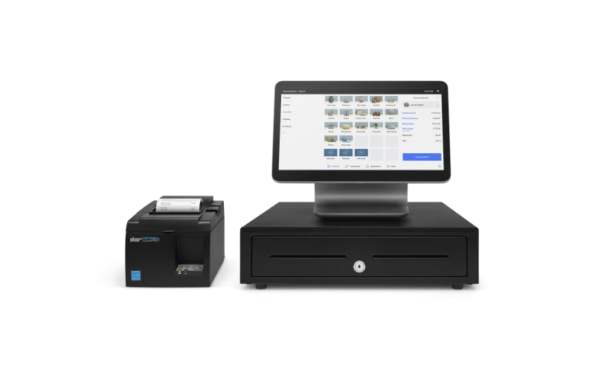
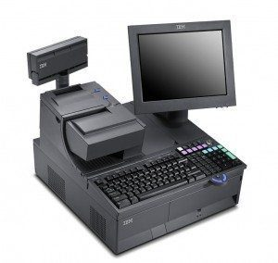
Point of Sale (PoS) Systems with Serial Printers

Slide 5
Related Works
R. Benadjila, M. Renard, P. Trebuchet, P. Thierry, and A. Michelizza, “Wookey : Usb devices strike back,” 2018. [Online]. Available: https://api.semanticscholar. org/CorpusID:199552896.
W. D. Yu, D. Baheti, and J. Wai, “Real-Time Operating System Security,”
Y. He, Z. Zou, K. Sun, et al., “RapidPatch: Firmware Hotpatching for Real- Time Embedded Devices,” presented at the 31st USENIX Security Symposium (USENIX Security 22), 2022, pp. 2225–2242, isbn: 978-1-939133-31-1. Available: https://www.usenix.org/conference/usenixsecurity22/presentation/he-yi
J. Tian, N. Scaife, D. Kumar, M. Bailey, A. Bates, and K. Butler, “SoK: ”Plug & Pray” Today – Understanding USB Insecurity in Versions 1 Through C,” in 2018 IEEE Symposium on Security and Privacy (SP), May 2018, pp. 1032–1047. doi: 16 10.1109/SP.2018.00037. Available: https://ieeexplore.ieee.org/document/8418652

Slide 6
Research Questions
• RQ1: What is the baseline or minimum hardware these devices are running?
RQ2: What software is being used on these devices? OS, libraries...
• RQ3: Can the software/firmware be modified? FreeRTOS/ReconOS/VXWorks.
• RQ4: If so, how much can be modified in memory? Is manually reflashing possible?
• RQ5: Assuming reflashing is possible, can the original OS keep original functions and be used as a HID clone or hub?
The answers will be drawn from surveyed data (e.g., datasheets, technical specs, in-memory).

Slide 7
Methodology
Research process has several parts:
  Identify sample population (e.g., most popular and available printers)
  Technical specification and datasheet gathering
    Pull information regarding hardware, capabilties, and I/O
  Hardware teardown and documentation
    Take photos throughout process and identify hardware components
    E.g., SNBC BTP-S80 has ARM Cortex M4, NXP LPC4078FET208
  Using debug tools, gather firmware and bootloader information

Slide 8
Methodology - Approach
Quantitative
Cross sectional surveys
Small sample of population specifications
  Serial printer device
  SoC/flash memory datasheets
Best for gathering and comparing data in-time, not over long periods.

Slide 9
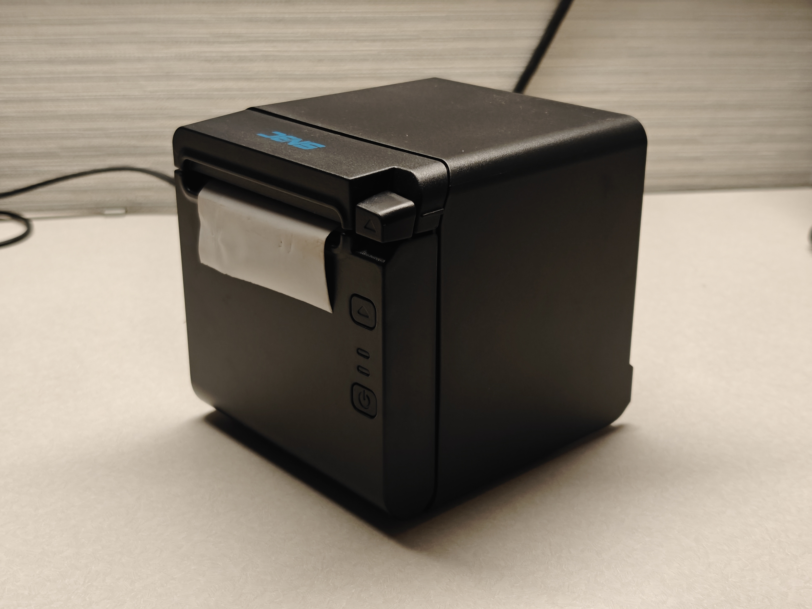
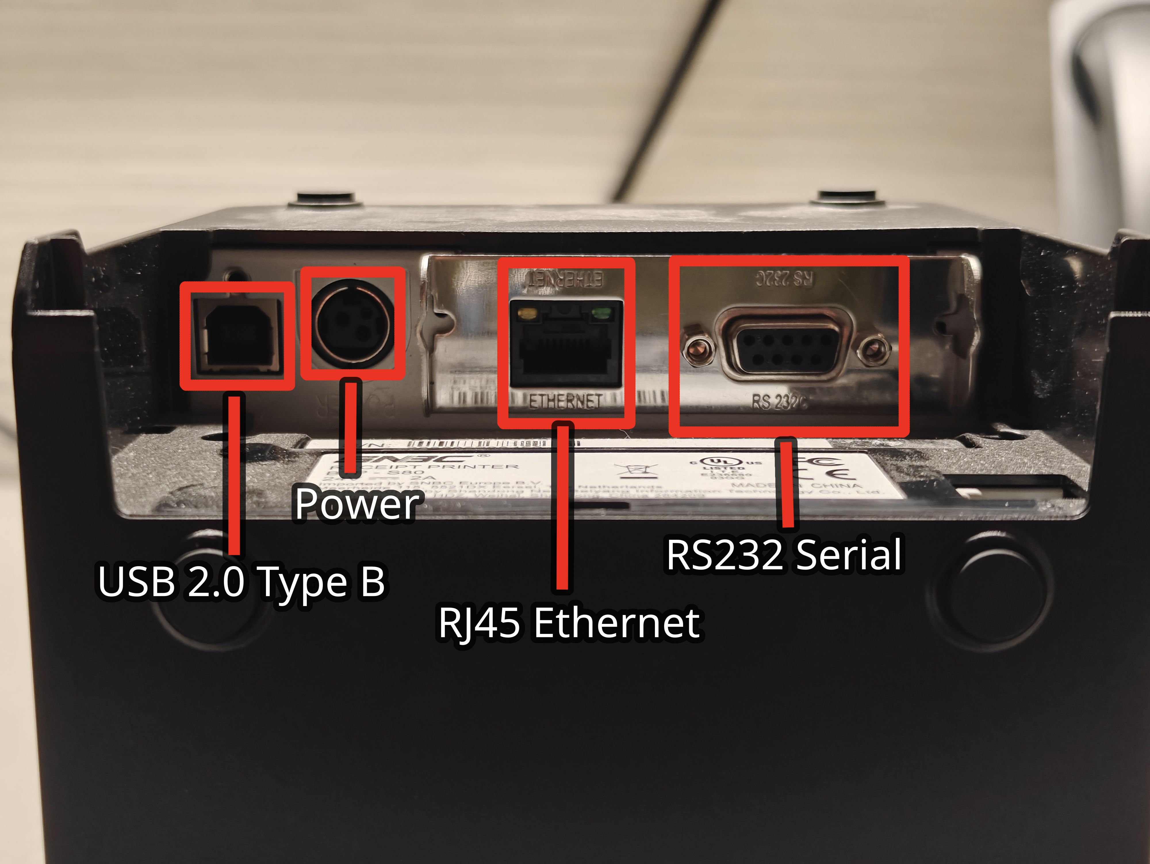
SNBC BTP-S80 (left) and labeled I/O (right)

Slide 10
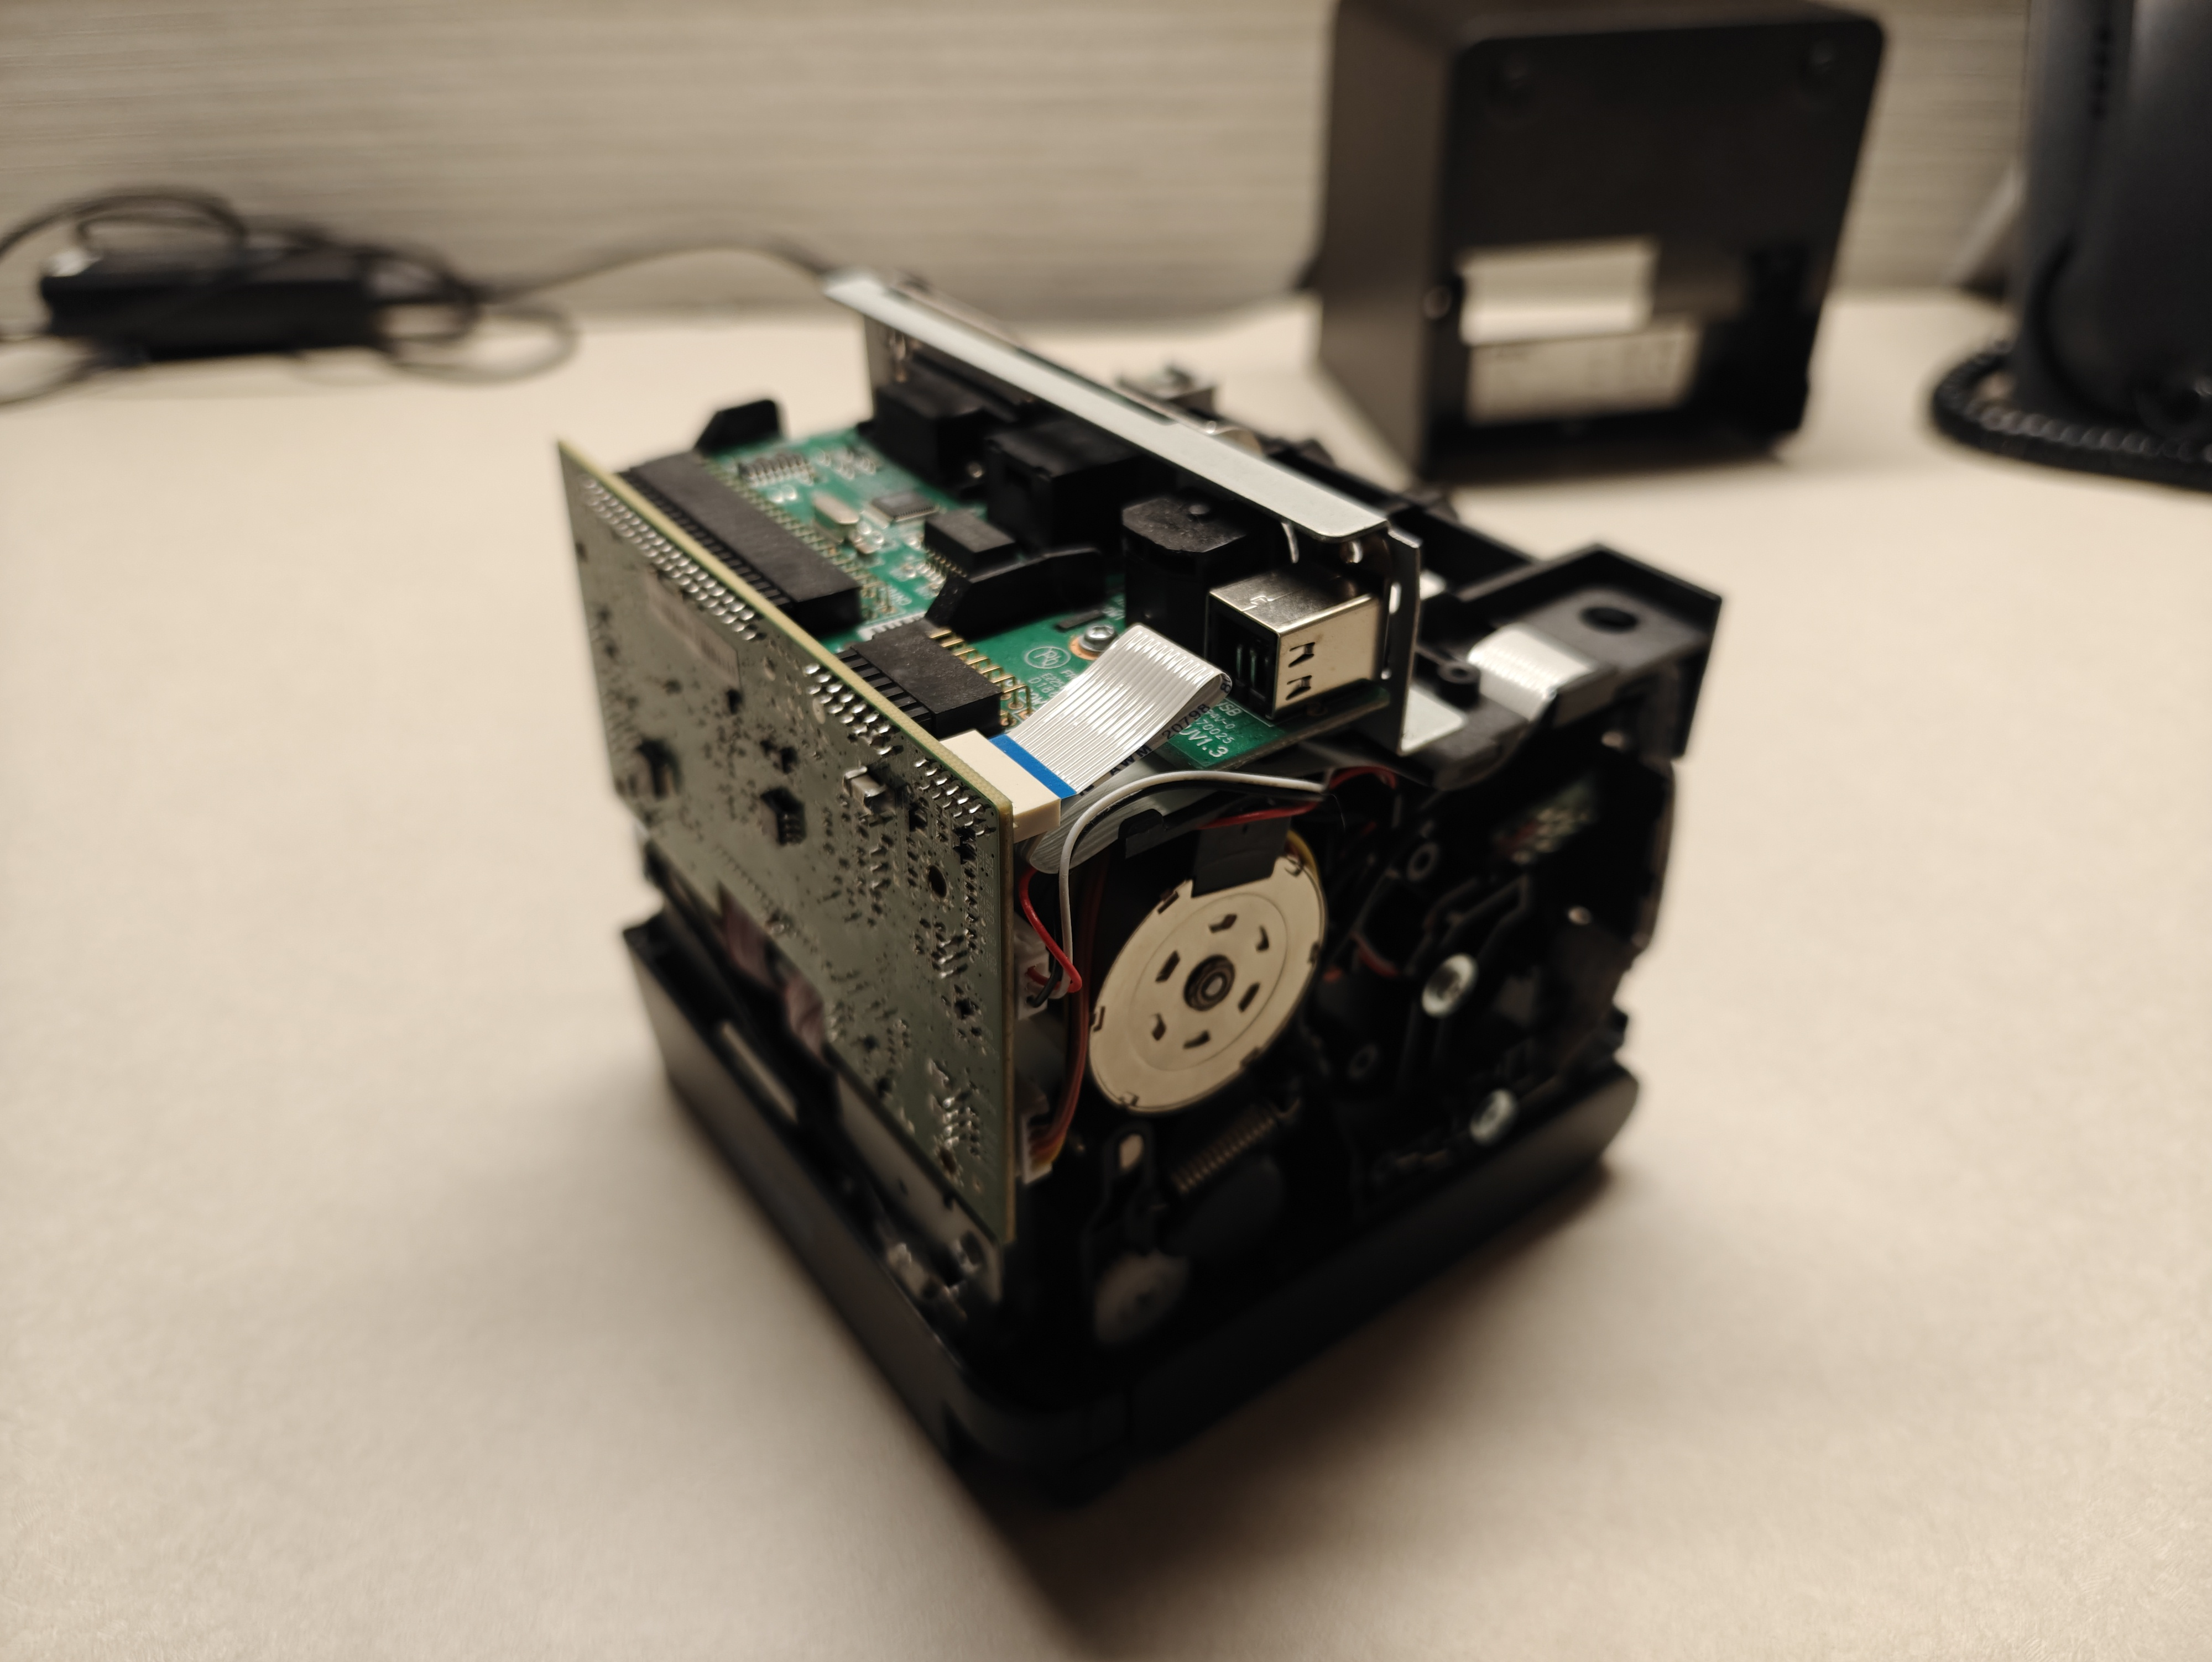
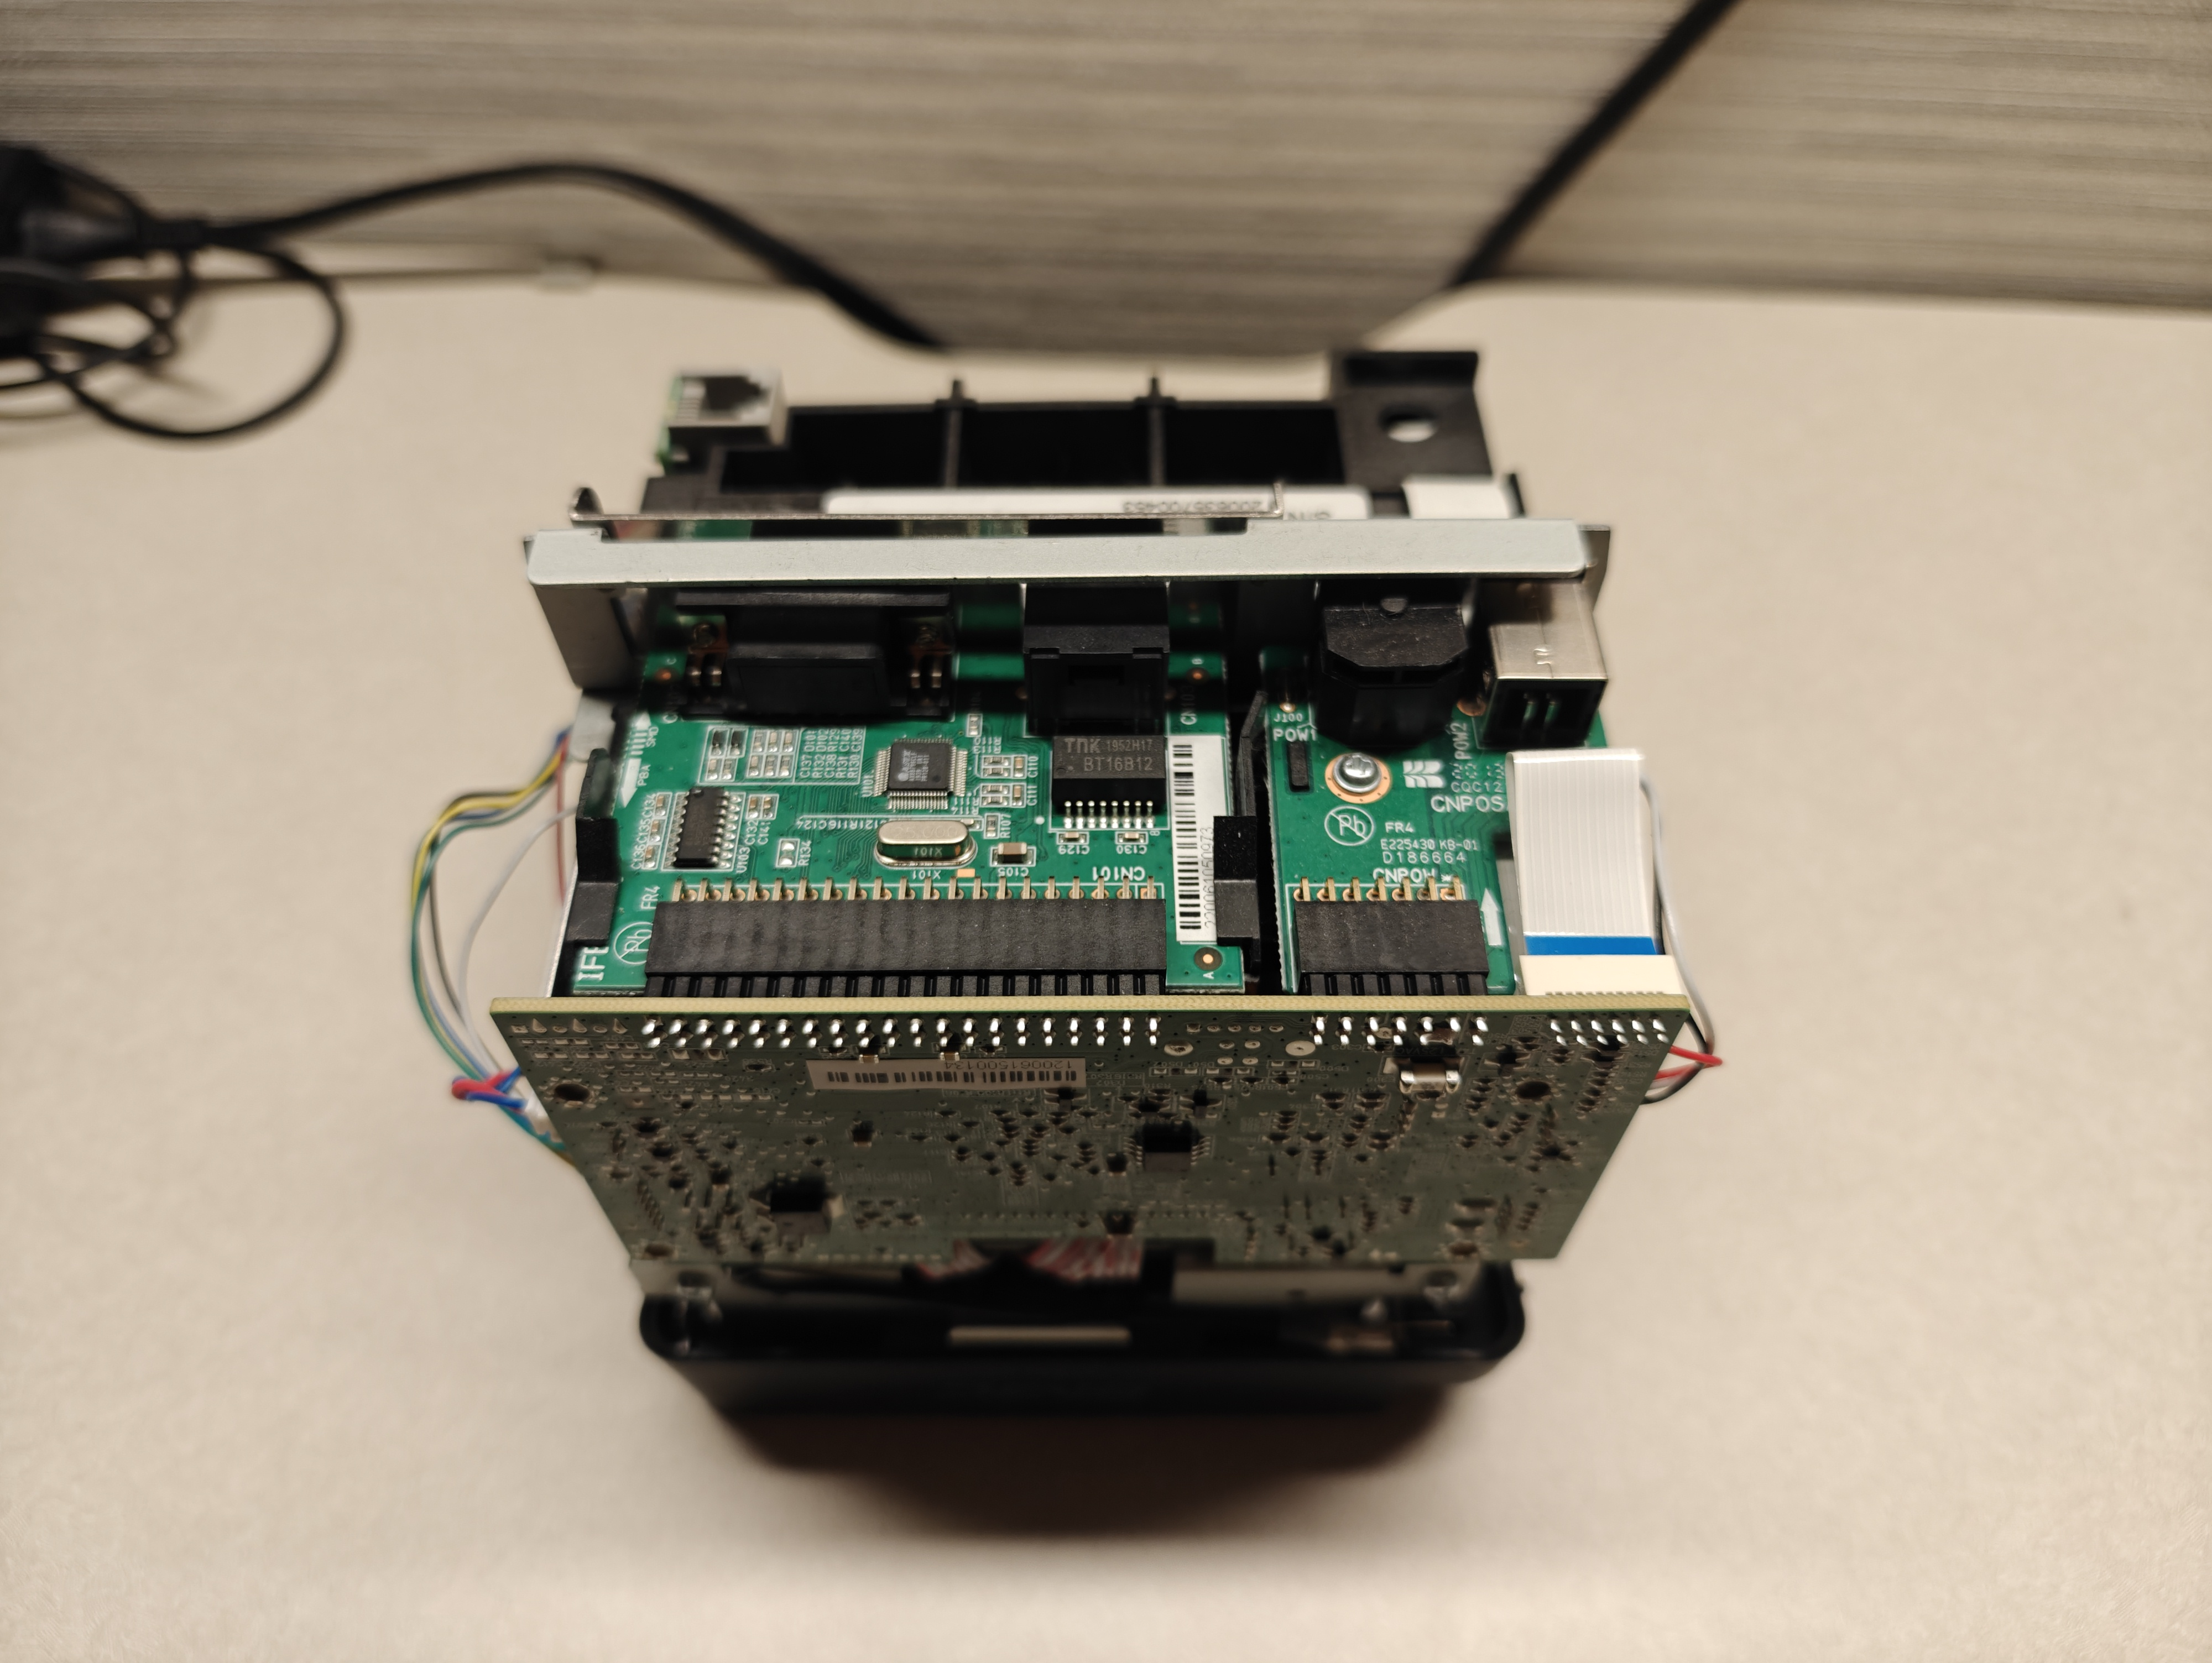
Inner chassis of the SNBC BTP-S80

Slide 11
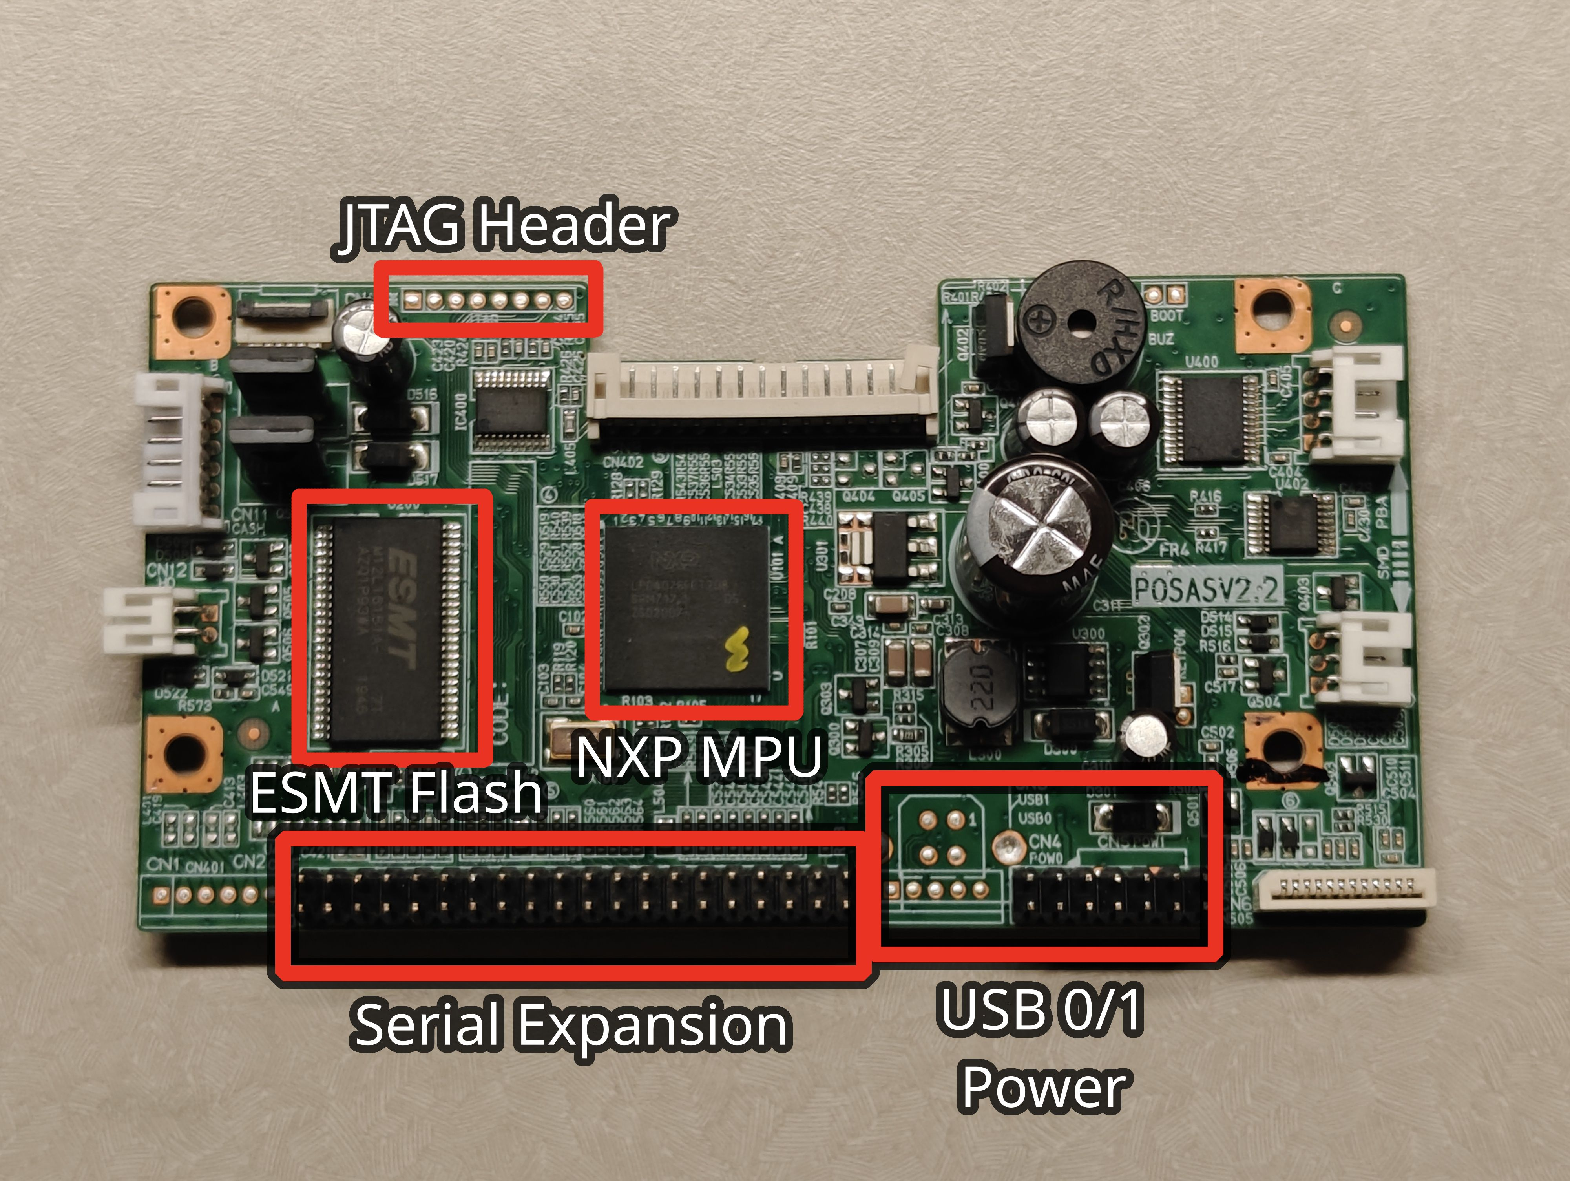
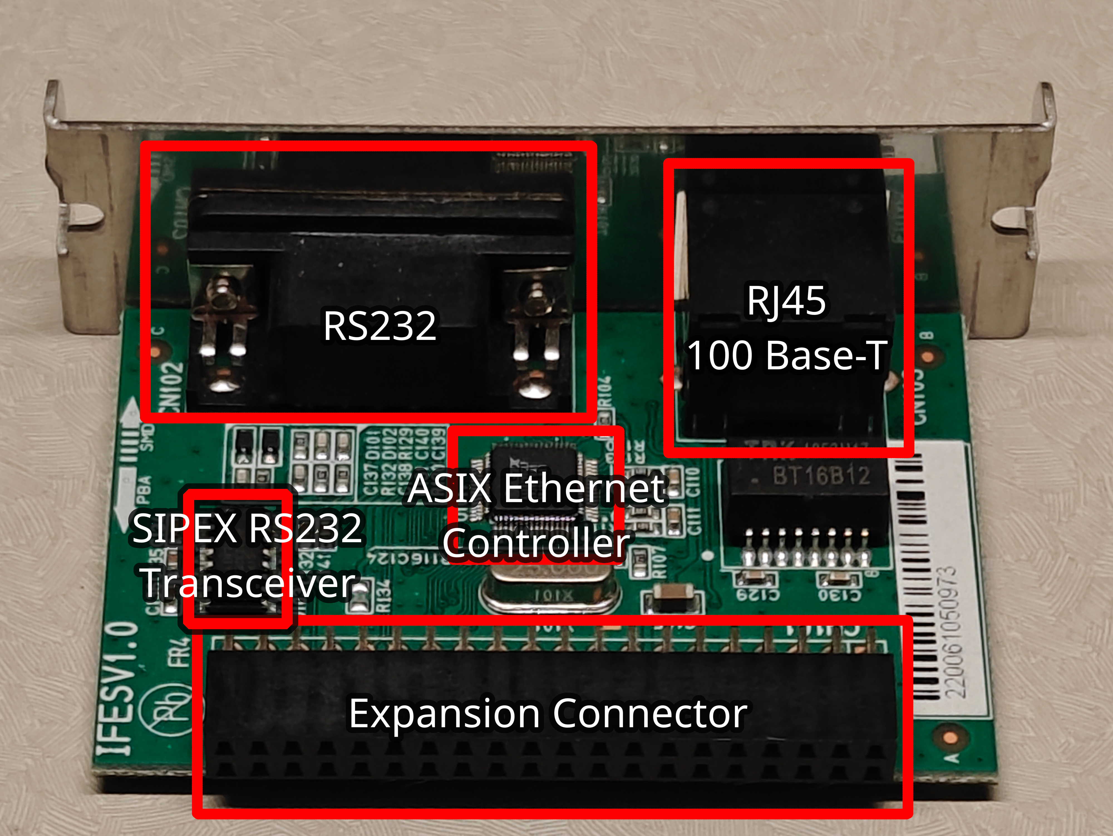
SNBC BTP-S80 motherboard (left) and serial expansion (right)

Slide 12
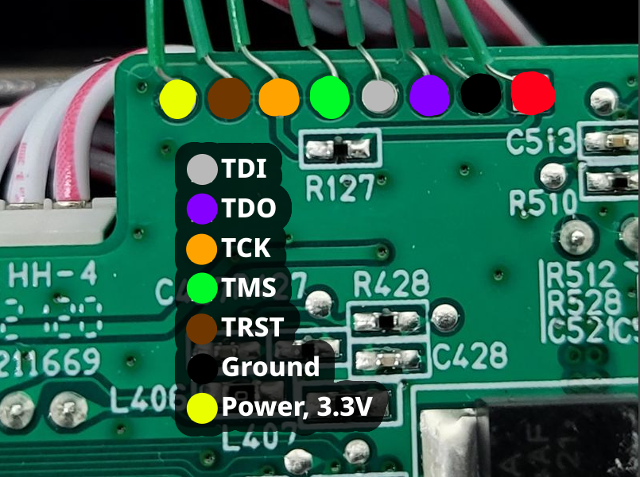
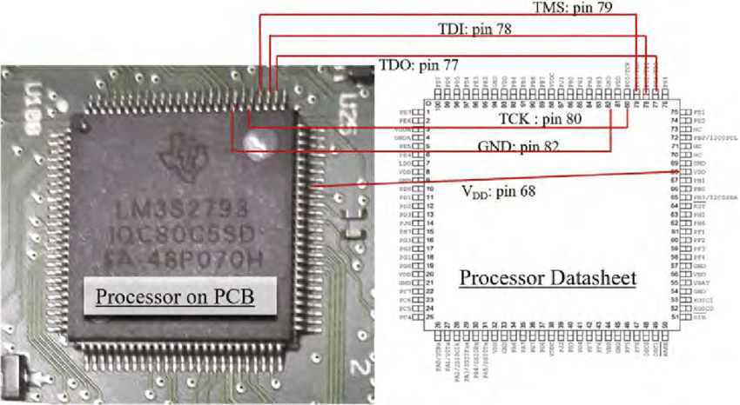
Hardware Disassembly and Analysis

Slide 13
Technical Findings
Motherboard components:
NXP 32-bit ARM Cortex-M4 MCU, LPC4078FET208
ESMT DRAM, M12L16161A-7T
Serial expansion components:
SIPEX RS-232 Transceiver, SP2209E
ASIX Ethernet Controller, AX88796C
Firmware is stored within the EEPROM of the NXP LPC4078FET208

Slide 14
Technical Findings
Analysis into the recovered memory dump revealed:
Operating system: RT-Thread RTOS
  Version FV1.040.00
  Indicators that firmware is shared across other products, SNBC BTP-2002NP
Print interpreter: Epson ESC/POS
  Version 7.00
WebNET v1.0.0
  Provides networking and webserver

Slide 15
Conclusion
In conclusion, the researcher was able to demonstrate four of the five objectives for the research.
We identified:
Baselines of the hardware and operating system used by the serial printer
The specific version of the operating system and supporting libraries
We demonstrated:
That the manufacturers have enabled minimal security protections despite the hardware supporting them
It is possible to reflash the memory utilizing the MCU hardware debug interfaces.

Slide 16
Future Research
Due to underestimating the time needed for delivery of the additional devices for the proposed sample population, only one device was assessed.
Although the SNBC BTP-S80 is a fairly common serial printer used across financial sectors as well as industrial control, the research would have been better represented with the cross-examination against several other devices.
Lastly, another goal of the research was to use the gathered data to support the proposal of future research into a design artifact for implementing BadUSB-like concepts on peripheral serial devices.

