Slide 1

Tor: Anonymity, tools, and operational security
Micah Lee
@micahflee
927F419D7EC82C2F149C1BD1403C2657CD994F73

Slide 2
What is Tor?
Tor is both a piece of open source software, and a network of servers run by volunteers (like me)
Tor allows anyone to make TCP connections over the internet while hiding their IP address
Tor onion services allow for anonymous network services (and bypass NAT)
Tor is useful for censorship circumvention, defense against surveillance, and real private browser/incognito mode

Slide 3
How does Tor work?
When you use Tor, you are part of an anonymity set of ~2,000,000 monthly active users. The network has ~6,200 volunteer nodes.
Tor Browser protects you from browser fingerprinting, and doesn’t leave a trace of your browsing history on disk
Tor circuits contain 3 nodes:
  The entry node knows who you are, but not what you’re doing
  The middle node doesn’t know who you are or what you’re doing
  The exit node doesn’t know who you are, but can see what you’re doing

Slide 4
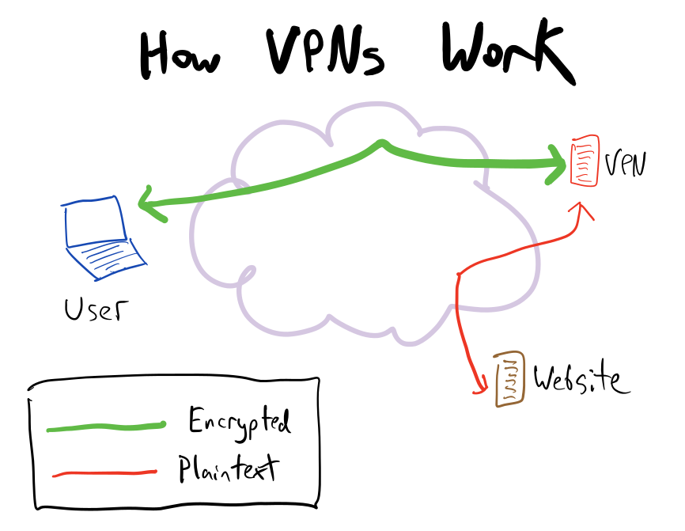

Slide 5
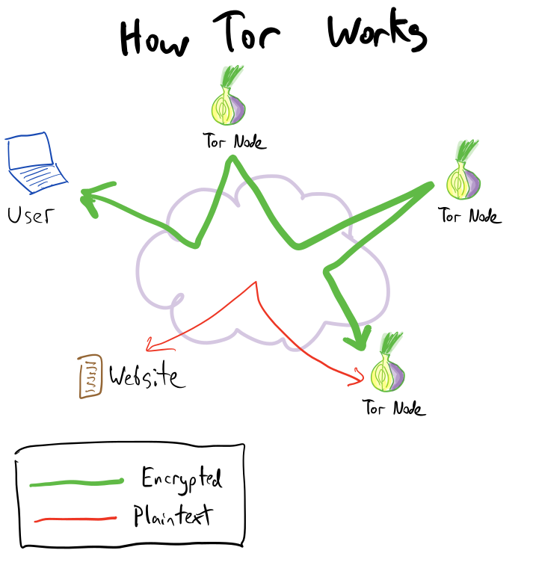

Slide 6
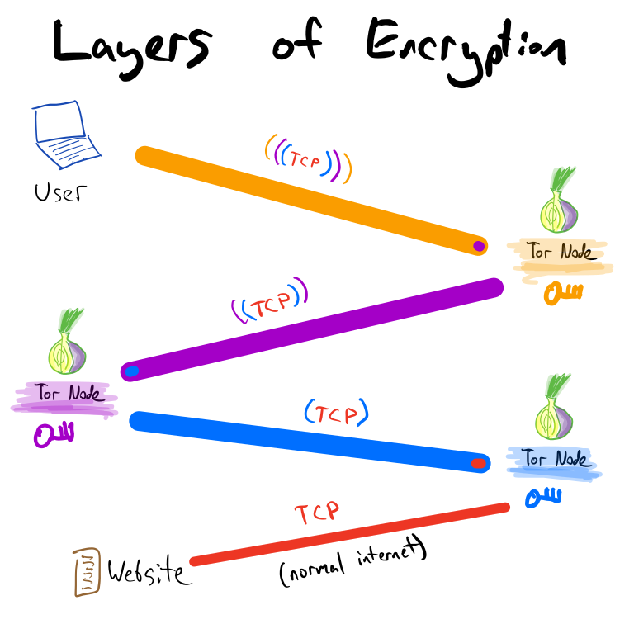

Slide 7
Tor Browser
Based on Firefox
Includes custom add-ons (Torbutton, TorLauncher), and privacy/security add-ons (HTTPS Everywhere, NoScript)
Runs tor as a background process
  SOCKS port: 9150
  Control port: 9151
It’s simple to configure Firefox, Chrome, or other browsers to use Tor, but don’t do it – Tor Browser protects from browser fingerprinting and doesn’t leave forensic traces

Slide 8
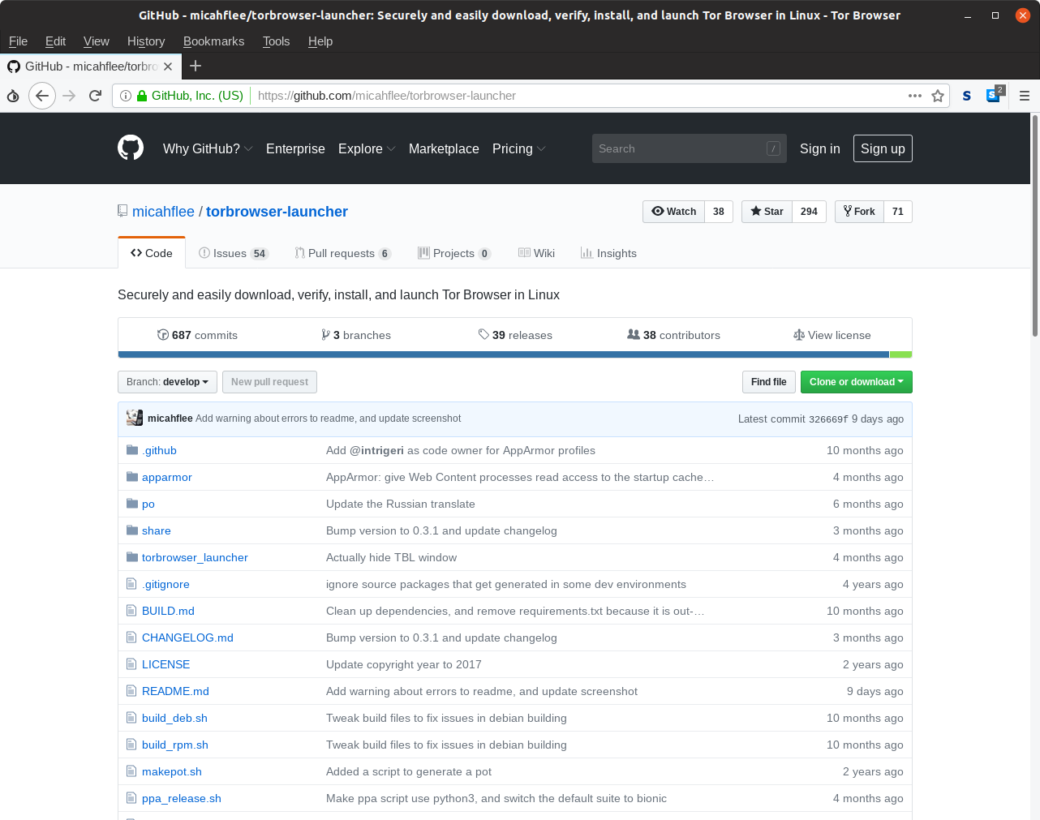

Slide 9
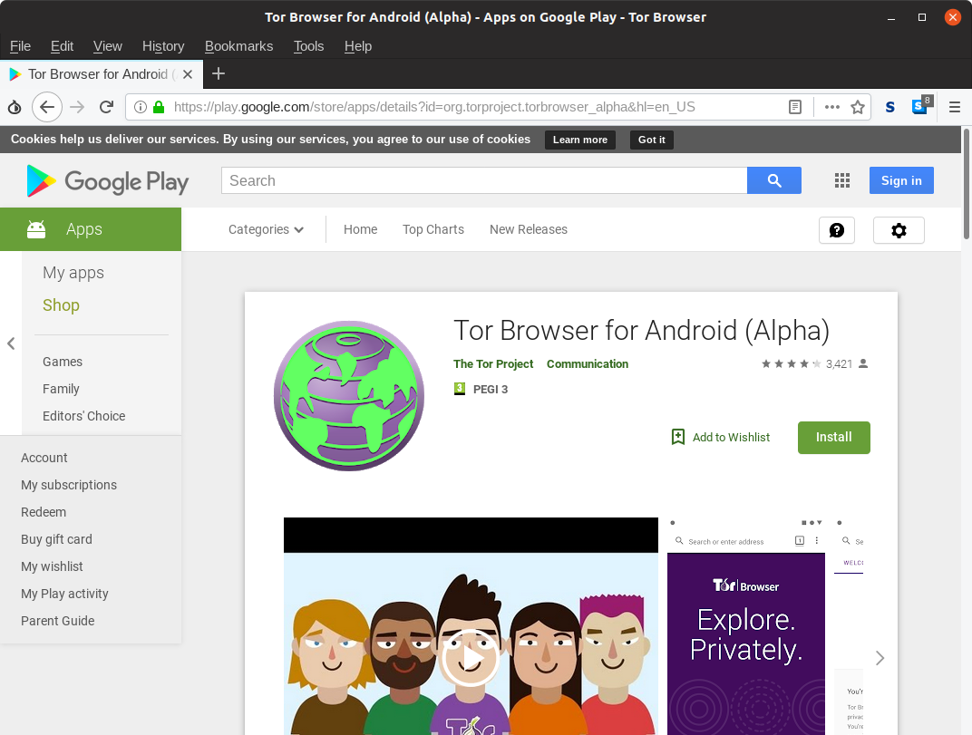

Slide 10
What are onion services?
Normally, users route traffic through the Tor network to remain anonymous (3 hops)
With onion services, the server itself routes traffic through the Tor network to remain anonymous (7 hops)
As long as you can connect to the Tor network, you can run an onion service (bypasses NAT, no port forwarding)
Use special domain names, where the name itself is a cryptographic fingerprint, so they’re self-authenticating:
  V2 onion service:
  http://elx57ue5uyfplgva.onion/
  V3 onion service:
  http://lldan5gahapx5k7iafb3s4ikijc4ni7gx5iywdflkba5y2ezyg6sjgyd.onion/

Slide 11
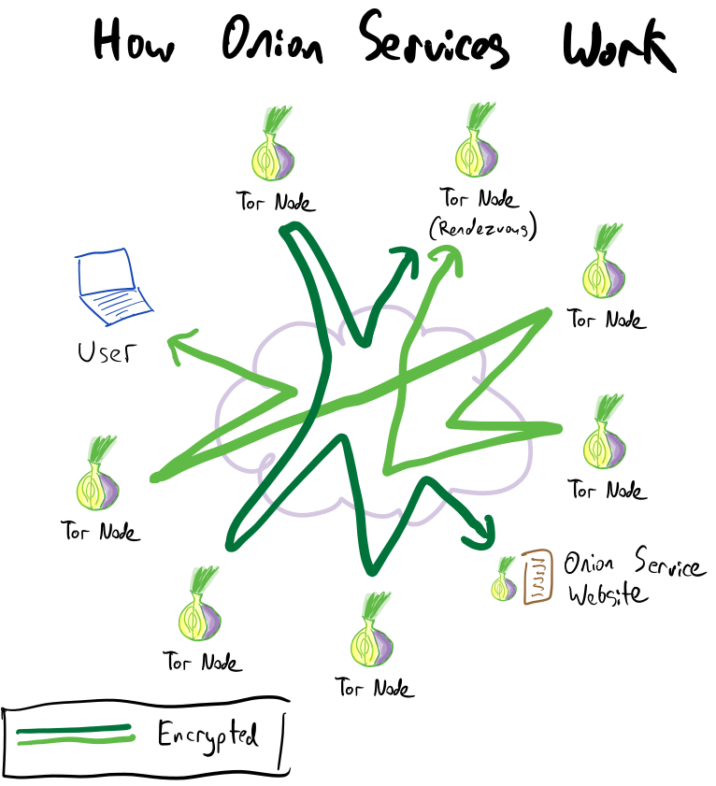

Slide 12

The most popular website on the dark web

Slide 13
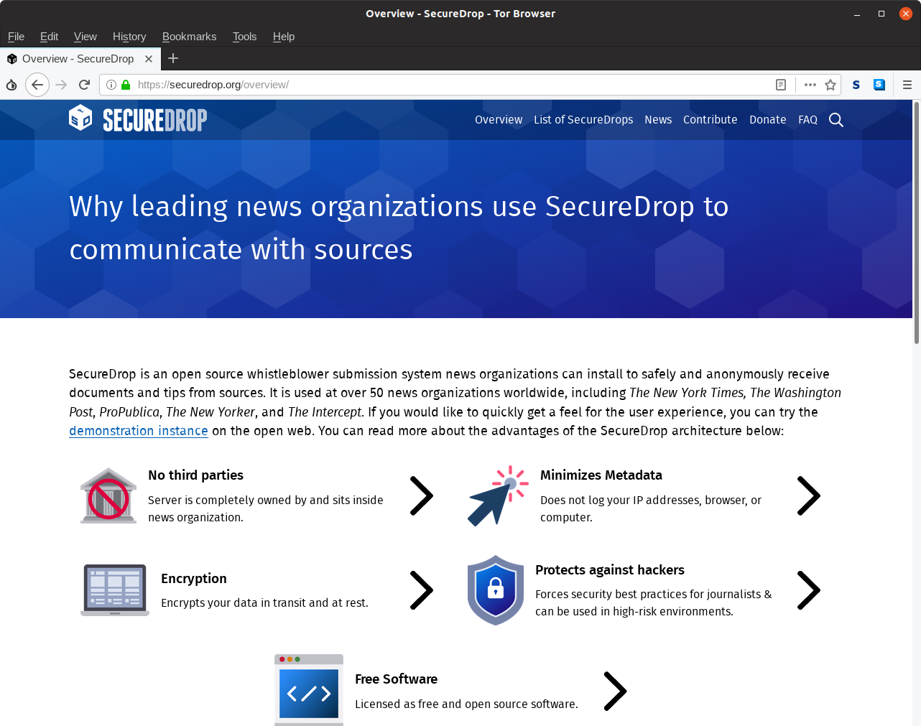

Slide 14
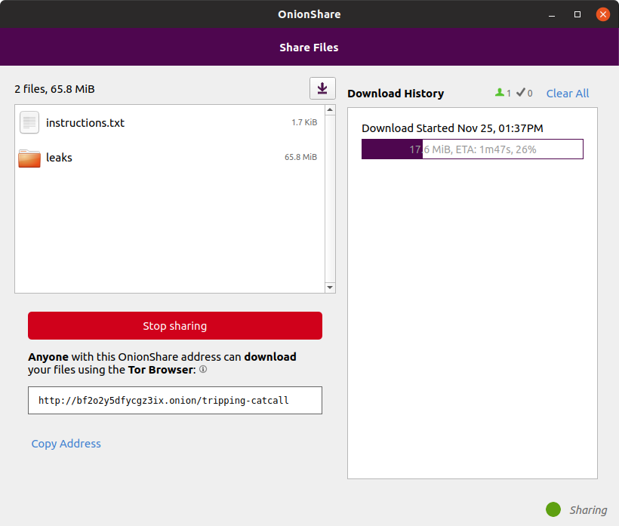

Slide 15
A simple onion service
cd to a director and start a server with:
python2 -m SimpleHTTPServer
python3 -m http.server
Edit /etc/tor/torrc and add lines like this:
HiddenServiceDir /var/lib/tor/http-onion/
HiddenServicePort 80 127.0.0.1:8000
Restart the tor service, and look at the hostname:
sudo systemctl restart tor.service
sudo cat /var/lib/tor/http-onion/hostname

Slide 16
Installing a “system tor”
Linux:
sudo apt install tor
sudo dnf install tor
MacOS:
brew install tor
brew services start tor
Windows:
Download “Tor Expert Bundle”, or use Windows 10’s Linux Subsystem. (Or just use Tor from Tor Browser, which is easy.)

Slide 17
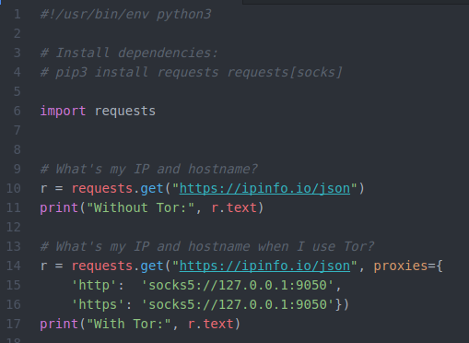
Automating anonymous HTTP requests with python

Slide 18
SOCKS proxy, torify
You can make any program that allows you to configure a SOCKS proxy (OnionShare, Pidgin, HexChat, Twitter on Android, etc.) make connections go over Tor
You can make command line programs go over Tor with torify, like:
torify curl https://check.torproject.org/

Slide 19
Tor Isn’t Magic
Tor doesn’t make you “anonymous”, it prevents servers on the internet from learning your IP address – the rest is on you
Exit nodes can see your internet traffic, so use encryption (e.g. HTTPS instead of HTTP)
Tor is vulnerable to a global passive adversary
Because Tor is meant for low latency activity like web browsing, it’s vulnerable to traffic correlation attacks
If your network is monitored*, the people watching can tell that you’re using Tor, just not what you’re doing (you can hide this using bridges)
* All internet traffic is monitored

Slide 20
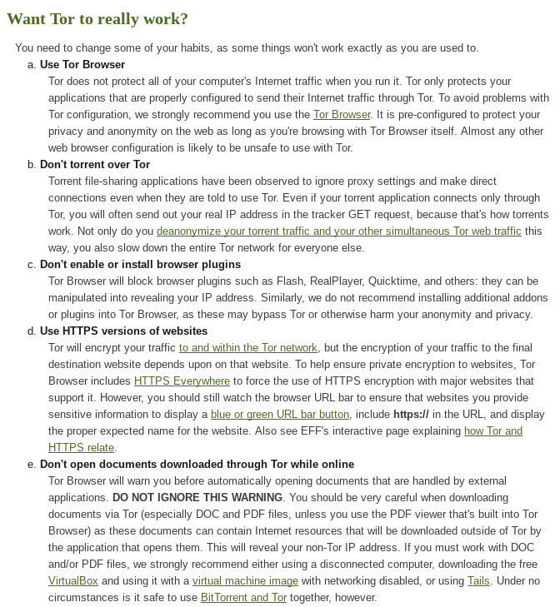

Slide 21


Slide 22


Slide 23


Slide 24
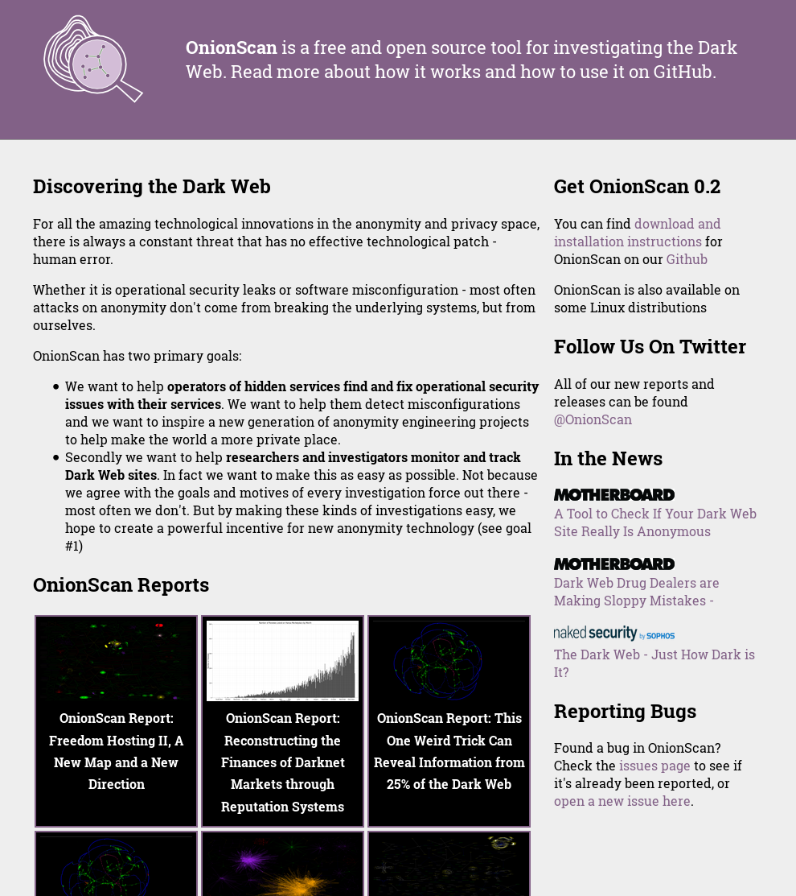

Slide 25
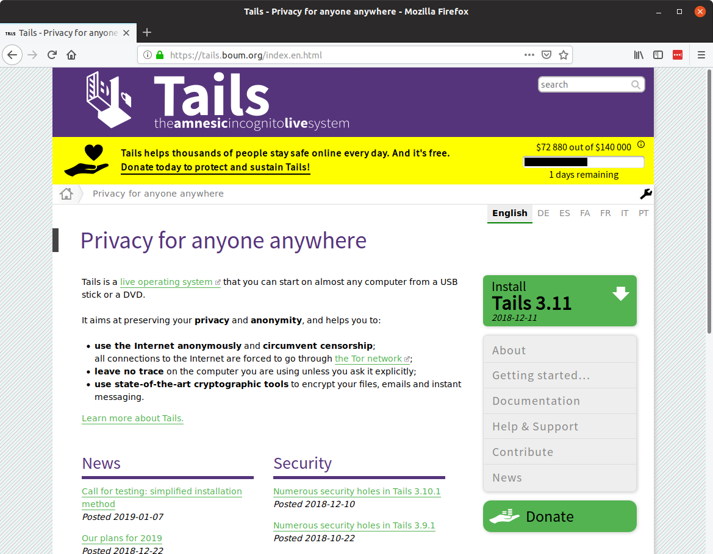

Slide 26

Qubes and Whonix https://youtu.be/f4U8YbXKwog

