Slide 1
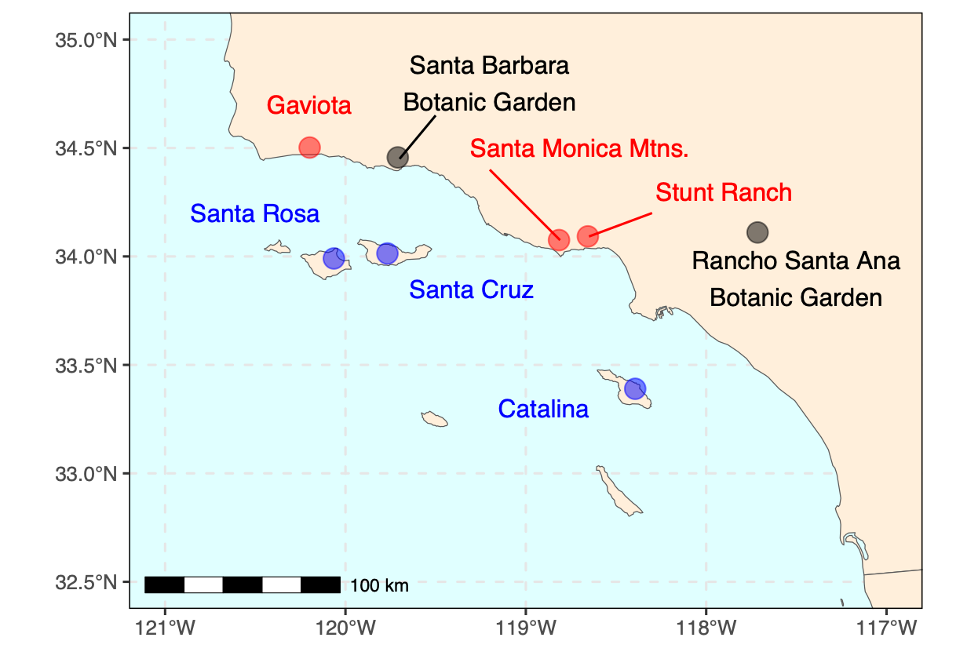
(A)
(B)
Species | Site | N | Total
Ceanothus megacarpus insularis | Catalina | 15 | 45
 | Santa Cruz | 13
 | Santa Rosa | 17
 | Botanic Garden | (3, 0) | 3
Ceanothus megacarpus megacarpus | Gaviota | 9 | 19
 | Stunt Ranch | 4
 | Santa Monica Mtns. | 6
 | Botanic Garden | (3, 1) | 4
Cercocarpus betuloides traskiae¹ / C. betuloides blancheae² | Catalina¹ | 10 | 24
 | Santa Cruz² | 14
 | Santa Rosa² | 0
 | Botanic Garden | (4, 0) | 4
Cercocarpus betuloides betuloides | Gaviota | 9 | 27
 | Stunt Ranch | 10
 | Santa Monica Mtns. | 8
 | Botanic Garden | (4, 0) | 4
Dendromecon harfordii | Catalina | 10 | 33
 | Santa Cruz | 13
 | Santa Rosa | 10
 | Botanic Garden | (2, 0) | 2
Dendromecon rigida | Gaviota | 8 | 18
 | Stunt Ranch | 0
 | Santa Monica Mtns. | 10
 | Botanic Garden | (3, 1) | 4
Heteromeles arbutifolia | Catalina | 12 | 35
 | Santa Cruz | 11
 | Santa Rosa | 12
 | Botanic Garden | (4, 0) | 4
Heteromeles arbutifolia | Gaviota | 9 | 29
 | Stunt Ranch | 10
 | Santa Monica Mtns. | 10
 | Botanic Garden | (2, 3) | 5
Prunus ilicifolia lyonii | Catalina | 10 | 35
 | Santa Cruz | 14
 | Santa Rosa | 11
 | Botanic Garden | (4, 1) | 5
Prunus ilicifolia ilicifolia | Gaviota | 9 | 30
 | Stunt Ranch | 9
 | Santa Monica Mtns. | 12
 | Botanic Garden | (5, 0) | 5
(C)
H. arbutifolia
P. ilicifolia
Mainland
Island

