Slide 1
Online Library App
By Mehdi Devjani, Anna Ernst, Chunnu Ghimire, Jonathan Gruber, Kyle Keeton, Stefan Stojanovic, Hannah Swiney, and Micah Warner

Slide 2
Project Objective
Design online library app for allowing user to check out eBooks from local library
Builds upon suggested bookshelf project mentioned in project instructions, e.g.
Adds support for user accounts
Ensures only allocated number of eBooks are lent out at any given time
Possible real-life applications include use in community outreach programs that provide services to those wanting to utilize library resources

Slide 3
Effort Estimation
Application composition model
10 screens
All simple
11 reports
All simple
8 3GL components
4 simple
2 medium
2 difficult
12.5% reused components
Nominal experience/capability and ICASE maturity/capability of developers
Effort PM = 3.5 person-months

Slide 4
Staffing Estimation
Two developers
Back-end & front-end
One UX Designer
One Part time project manager
One QA Tester

Slide 5
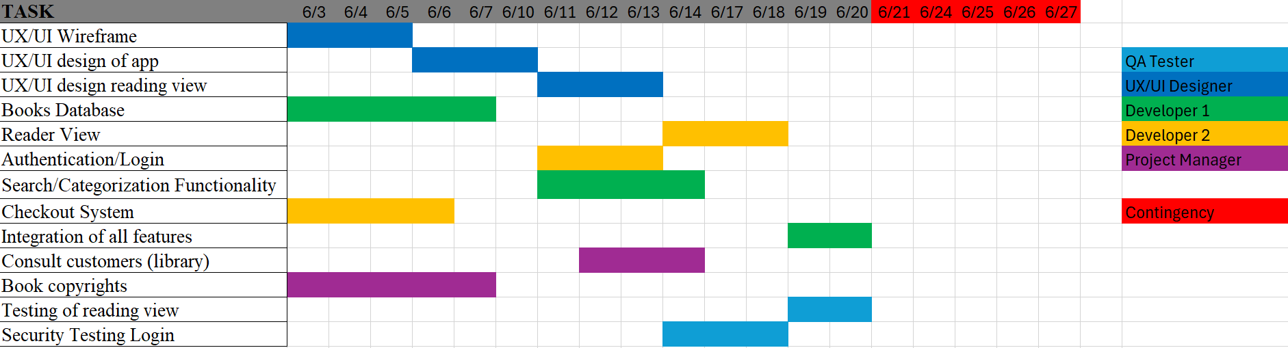
Project Timeline

Slide 6
Cost Estimation – Hardware Products
Professional Tier [1]: Main choice paired with a managed database.
$12 per month
1 CPU
1 GiB Memory
$25 per month
1 CPU
2 GiB Memory
$50 per month
2 CPUs
4 GiB Memory
$75 per month
1 CPU (dedicated)
4 GiB Memory
$150 per month
2 CPUs (dedicated)
8 GiB Memory
$300 per month
4 CPUs (dedicated)
16 GiB Memory

Slide 7
Cost Estimation – Hardware Products (cont.)
MongoDB Managed [2]: Managed NoSQL database focused on performance.
$240 per month
2 vCPUs
16 GiB Memory
440 GiB Disk
$480 per month
4 vCPUs
32 GiB Memory
890 GiB Disk
$960 per month
8 vCPUs
64 GiB Memory
1.709 TiB Disk
$1,920 per month
16 vCPUs
128 GiB Memory
3.428 TiB Disk
$2,880 per month
24 vCPUs
192 GiB Memory
5.137 TiB Disk
$3,830 per month
32 vCPUs
256 GiB Memory
6.855 TiB Disk

Slide 8
Cost Estimation – Software Products
Auth0 by Okta for authentication
Free Version:
Up to 7,500 active monthly users
Unlimited logins
Community support
Essentials Version:
500 to over 30k users
~700/month per 10k users
Community and Standard support
Account Linking

Slide 9
Cost Estimation – Staffing
 | Mid-level developer [3] | Project manager [4] | UI/UX designer [5] | QA Tester [6]
Avg Salary/year | $76,253 | $88,344 | $68,453 | $65,025
Avg Salary/day | $208.91 | $242.04 | $187.54 | $178.15
Avg salary/hour | $26.11 | $30.25 | $23.44 | $22.27
Days | 21 | 8 | 9 | 5
Amount paid | $4,387.16 | $1936.31 | $1687.88 | $890.75

Slide 10
Cost Estimation – Training
Certification | Certification Test | Hours needed | Course cost | Number trained | Price
AWS [7] | $100 | 15 | 0 | 1 | $442.55
DB/Aurora [8] | $300 | 30 | 0 | 1 | $756.74

Slide 11
Cost Estimation – Personnel
Staffing estimation (minimum) | Training costs | Maximum personal cost
$8,902.10 | $1,199.30 | $10,101.40

Slide 12
Pricing Estimation
Subscription-based model
Customer Acquisition Cost
Ideal ratio of 3:1
Profit Margin
40% is common in entertainment
$6-$10 per month

Slide 13
Representative Functional Requirements
Customer shall
Have account in system under unique username
Natural way for storing private customer-specific info
Be able to browse list of books in library catalog, possibly filtered by text query
So customer can find books in library
Be able to check books out of or back in to library
Necessary library function
Be able to read checked-out books via app
Accommodates digital readers

Slide 14
Representative Non-Functional Requirements
Product requirements
Usability requirements
Interoperability with screen readers
Accessibility to blind / visually impaired
Organizational requirements
Environmental requirements
Should work on Android, iOS, Chromium, and Firefox
Ensures wide support for application
External requirements
Regulatory requirements
Compliance with California Consumer Privacy App (CCPA), Children’s Online Privacy App (COPA), and any US similar regulations
Allows usage of app anywhere in US

Slide 15
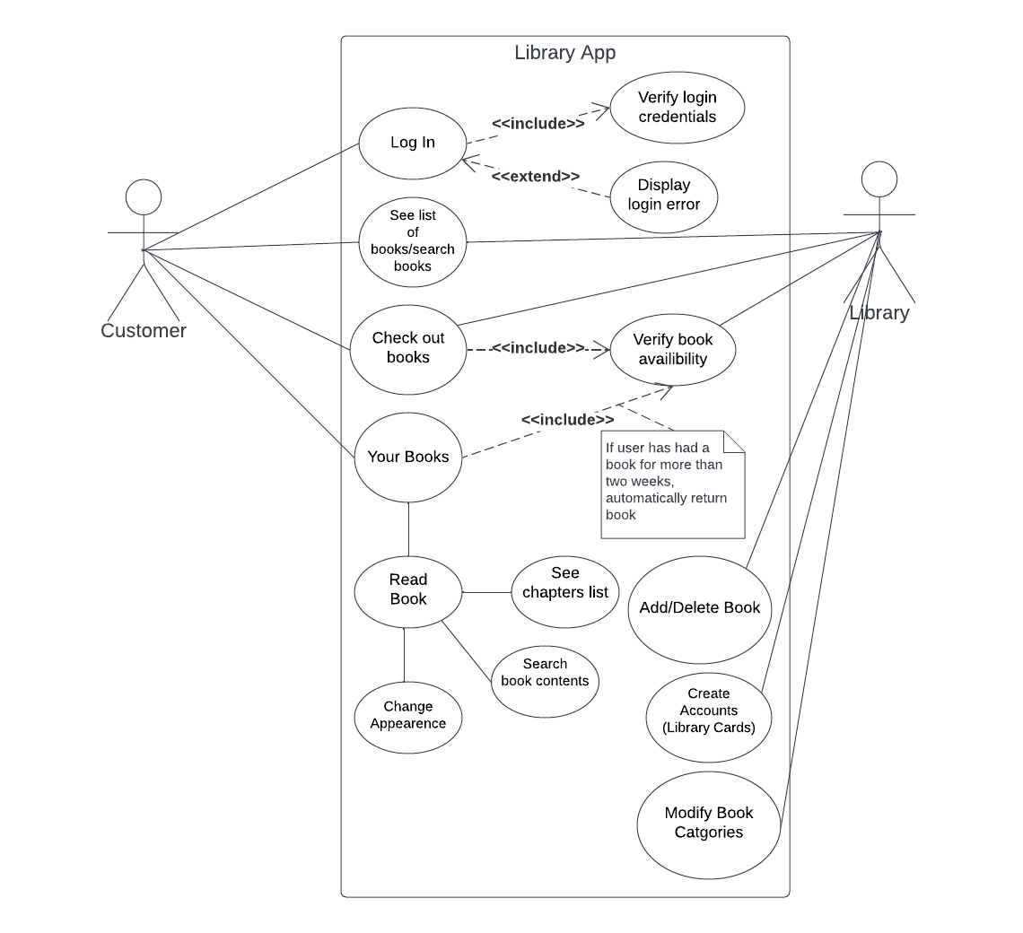
Use-Case Diagram

Slide 16
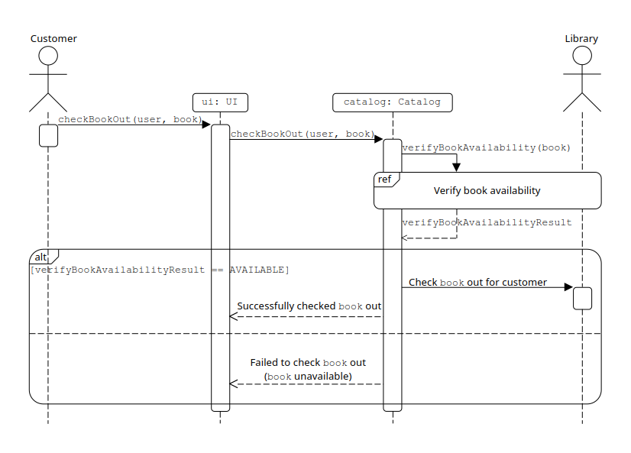
Sequence Diagrams of Representative Operation
Sequence diagrams involved in checking out a book
Check out book (right)
Verify book availability (next slide)

Slide 17
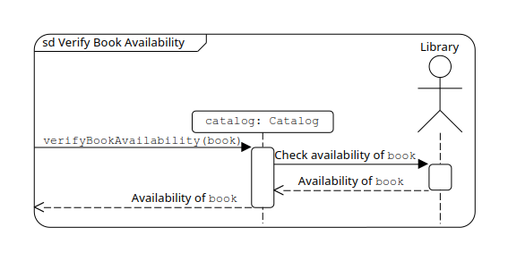
Sequence Diagrams of Representative Operation (cont.)
Sequence diagrams involved in checking out a book
Check out book (previous slide)
Verify book availability (right)

Slide 18
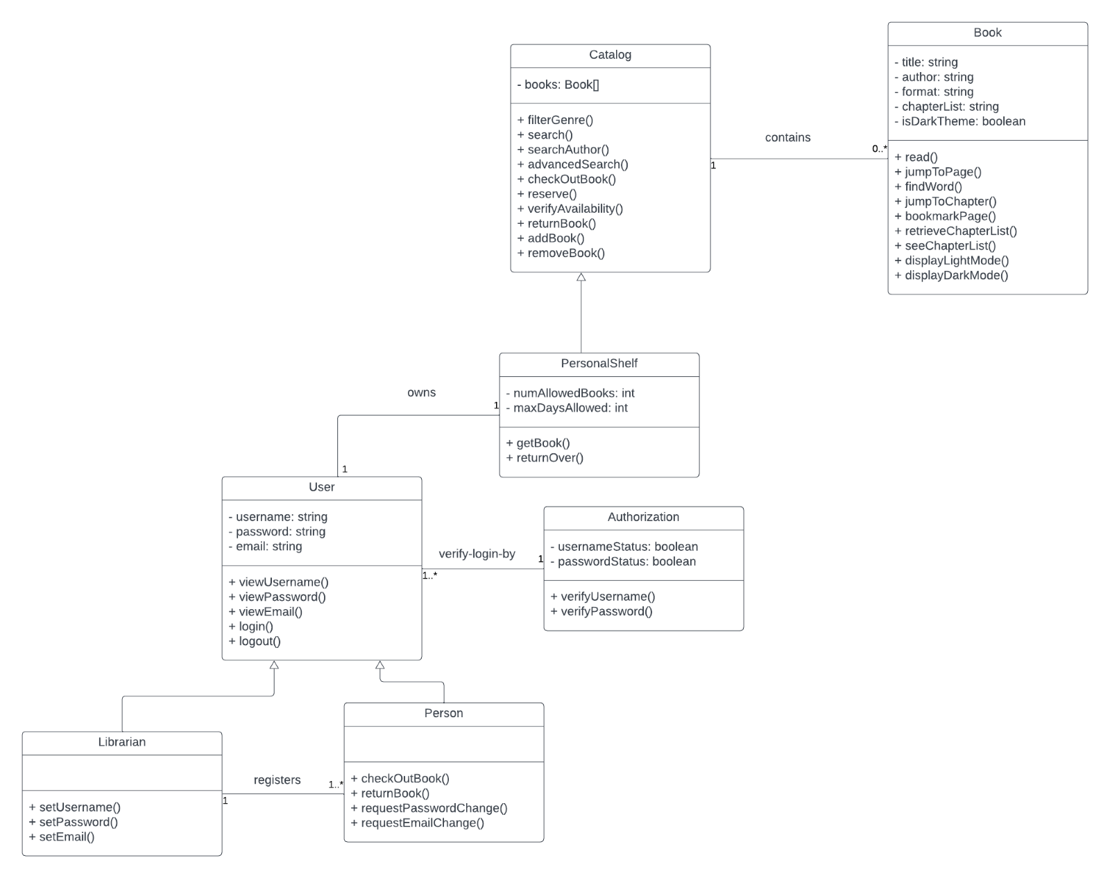
Class Diagram

Slide 19
Architectural Design
Client-server architecture
Different functionalities/services provided by different servers
Services must be accessible from anywhere by any number of users
Each server serves multiple simultaneous clients over network
Some services must be access-controlled
Authentication server verifies that client has necessary access level for a service
Unlikely target of denial-of-service attacks
Software does not provide vital or controversial services

Slide 20


Test Plan
As part of our test plan we will test two units of our software. The first is the user login. Here is the method below:
We initialized the following below for testing:

Slide 21
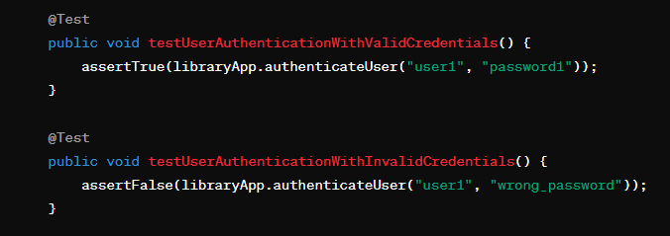
Test Plan (cont.)
Test Case 1:
Input: username = user1 Password = password1
Test Case 2:
Input: username = user1 Password = wrong_password

Slide 22
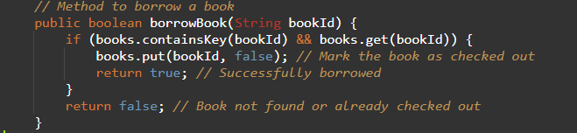
Test Plan (cont.)
The second unit we are testing is borrowing a book. Below is the code we used to test it:
We initialized the following below for testing:

Slide 23
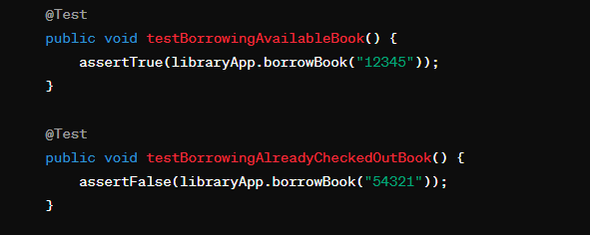
Test Plan (cont.)
Test Case 1:
Input: bookId = 12345 book is available
Test Case 2:
Input: bookId = 54321 book is not available

Slide 24
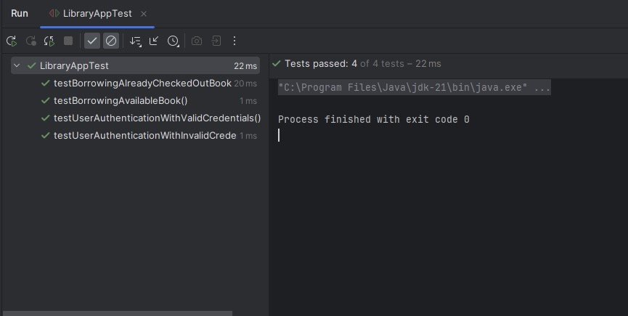
Test Plan (cont.)
We then used JUnit to test all of the code to make sure it gave the right result and they all passed as shown below:

Slide 25
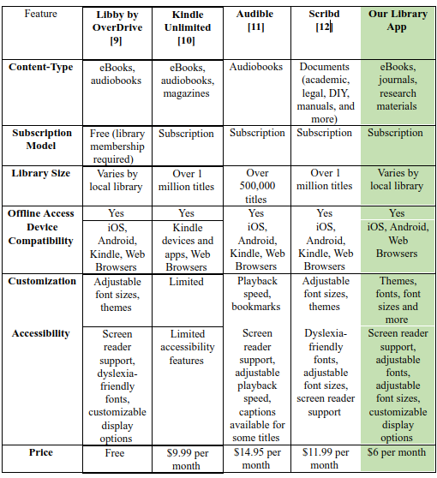
Comparison to Similar Work

Slide 26
References
[1] “App Platform Pricing.” DigitalOcean.com. Accessed: Apr. 18, 2024. [Online.] Available: https://www.digitalocean.com/pricing/app-platform
[2] “Managed database pricing.” DigitalOcean.com. Accessed: Apr. 18, 2024. [Online.] Available: https://www.digitalocean.com/pricing/managed-databases
[3] “Salary: Mid Level Programmer in United States 2024.” Glassdoor.com. Accessed: Apr. 16, 2024. [Online.] Available: https://www.glassdoor.com/Salaries/mid-level-programmer-salary-SRCH_KO0,20.htm

Slide 27
References
[4] “Project manager salary in Texas.” Indeed.com. Accessed: Apr. 16, 2024. [Online.] Available: https://www.indeed.com/career/project-manager/salaries/TX
[5] “User interface designer salary in Texas.” Indeed.com. Accessed: Apr.16, 2024. [Online.] Available: https://www.indeed.com/career/user-interface-designer/salaries/TX
[6] “Quality assurance tester salary in Texas.” Indeed.com. Accessed: Apr. 16, 2024. [Online.] Available: https://www.indeed.com/career/quality-assurance-tester/salaries/TX
[7] “AWS Certified Cloud Practitioner Certification.” AWS.Amazon.com. Accessed: Apr. 15, 2024. [Online.] Available: https://aws.amazon.com/certification/certified-cloud-practitioner/
[8] “AWS Certified Database - Specialty Certification.” AWS.Amazon.com. Accessed: Apr. 15, 2024. [Online.] Available: https://aws.amazon.com/certification/certified-database-specialty/

Slide 28
References
[9] “Read with Libby.” Overdrive.com. Accessed: Apr. 16, 2024. [Online.] Available: https://www.overdrive.com/apps/libby#Features
[10] “Join Kindle Unlimited.” Amazon.com. Accessed: Apr. 16, 2024. [Online.] Available: https://www.amazon.com/kindle-dbs/hz/subscribe/ku
[11] “About Audible.” Audible.com. Accessed: Apr. 16, 2024. [Online.] Available: https://www.audible.com/
[12] “What is Scribd?” Scribd.com. Accessed: Apr. 16, 2024. [Online.] Available: https://www.scribd.com/what-is-scribd

