Slide 1

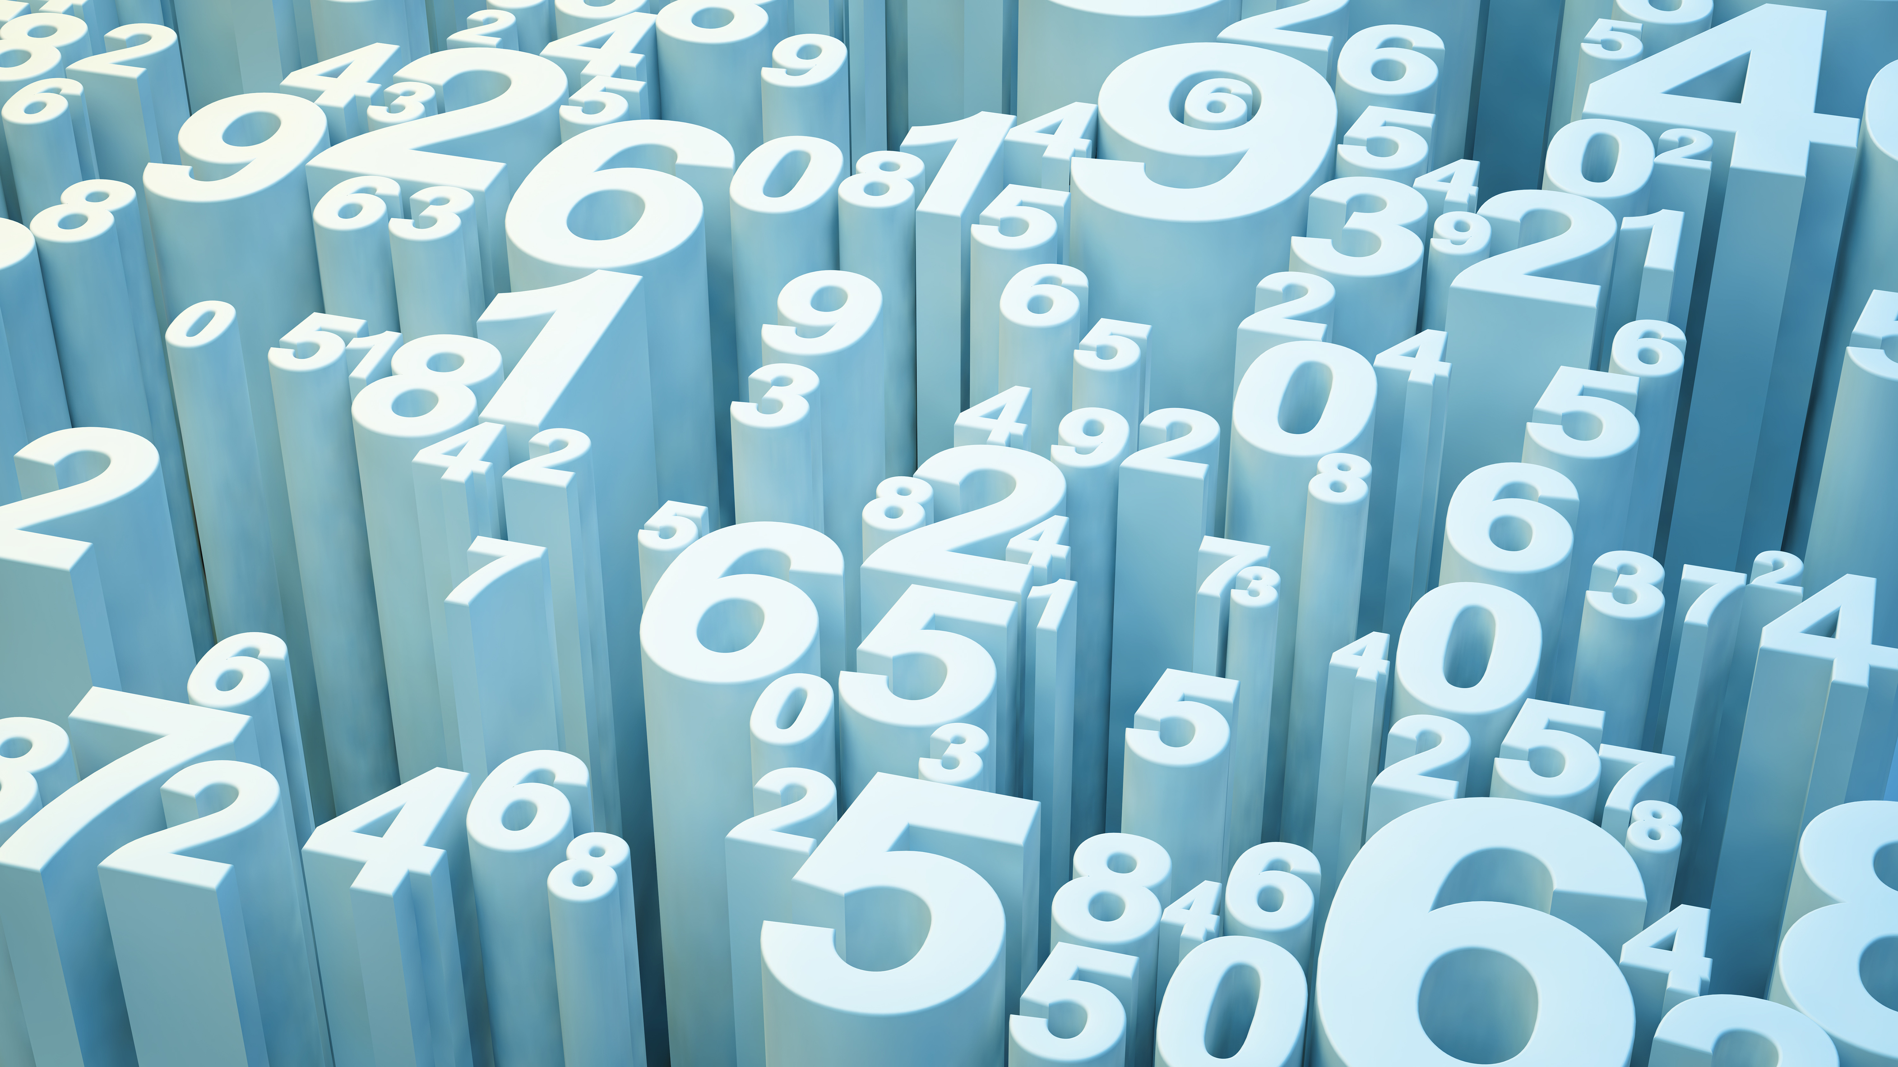

Kai M. Hall
Is driving in the DMV safe?

Slide 2
Overview
Extraction of JSON
Cleaning process
Transfer Data to database
Loading Flask
Background
Crash Data from Montgomery County
Car Crash JSON
3 Visuals of different parts of data
Further Research

Slide 3
Flask
Html – Theme- Car Crash- Safety

Slide 5
John Hopkins pic
https://www.stsci.edu/~jordan/common_pictures/Johns-Hopkins-Engineering-2.gif
HTML Template
https://www.free-css.com/free-css-templates/page260/wavefire

