Slide 1

Fit N fLOW
Capital Technology university
Professor Miranda Brown
Kai M. hall
12/8/2021

Slide 2

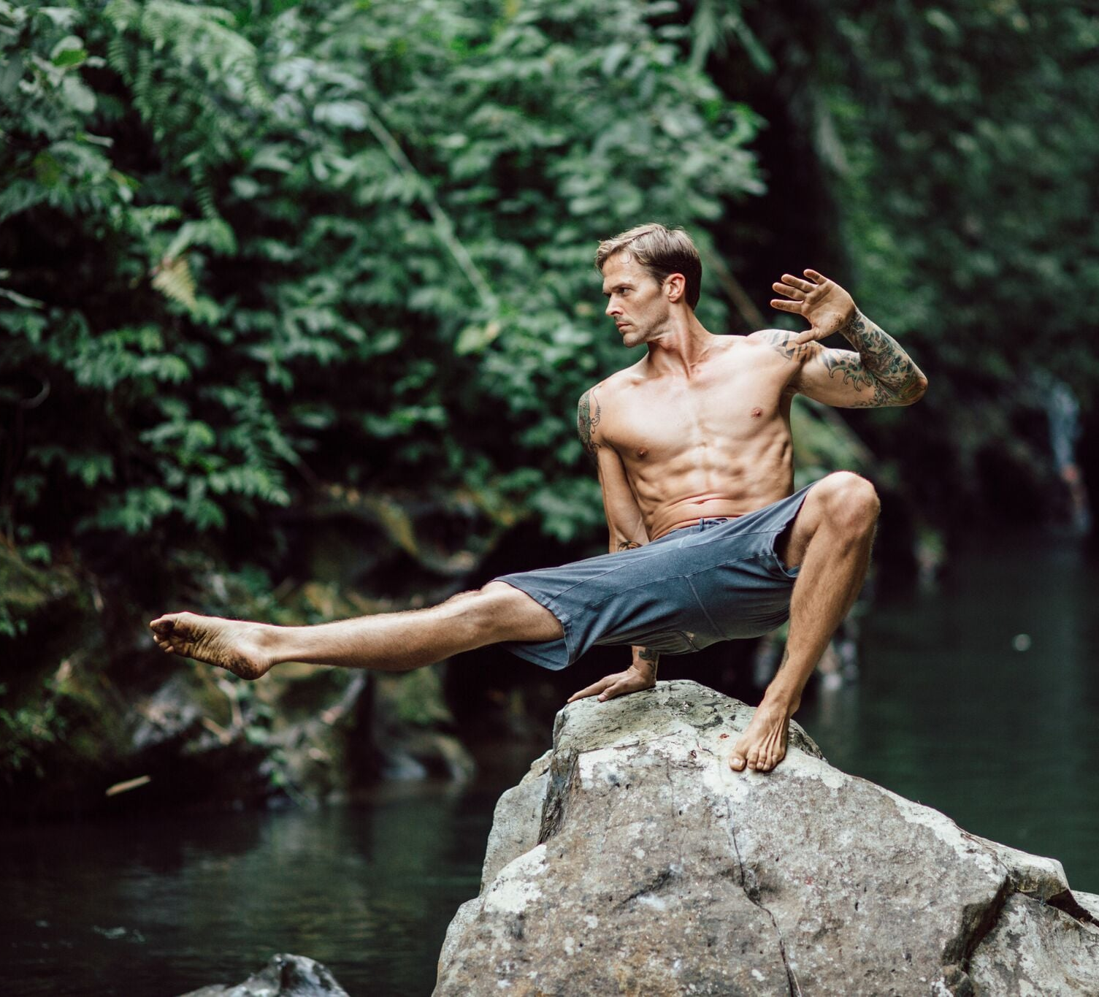
Legality first
Animal Flow is owned by Mike Finch. I as an instructor have produced this application solely for personal use and will not distribute for monetary gain and used solely the use in course CS_552 Agile Methods.

Slide 3

Problem: As A New Animal Instructor Building Flow Are Can Be Difficult And Repetitive. Randomness = Growth
User:
Needs a quick an easy way to produce random flows for creativity
Notes:
What problem they are trying to solve?
Building Flow is difficult at first because the lingo and retentiveness of familiar sequences
Randomness is a key ingredient to keep the body guessing and growing
What is your user trying to do and why?
Produce random flows quickly

Slide 4
Why Fit n Flow?
Mobile Access
Simplicity
Flexibility
A web application are agile easy to improve upon
Notes:
Why is your product the best way to solve this problem?
Mobile Device Adaptive
Simplicity
Flexibility
Why did you decide to build it the way you did?
A Web application are agile and easy to improve upon if necessary

Slide 5

The process
Started with Plan A…ended with Plan D!
Developing the Task Board and EDTL
Started with most difficult task first
Connected to live website
Starter Code HTML/CSS/Python
Procrastination
Follow though with Java Script

Slide 6

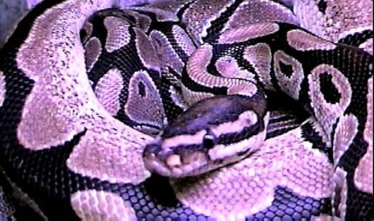

Same End Point with a different Path
Notes:
Changed complete HTML/CSS Layout
Same Random Function coding language Python to JS and D3 -Reading documentation was necessary
Bias views of Python for everything

Slide 7

More User interaction
Database to recall flows
More Guidance for the User
User login Screen
Notes:
Same output but with pictures and more instructional videos
Add more user interaction with adding Flows/Workouts to Database for recall
User Login Screen
Possibly an option to download the flow into a CSV

Slide 8
Keeping it Agile!
Responding to Change
Working Software
Welcomed changing requirements in late development
Daily Interaction with code
Choosing a partner
Next Project Agile!

Slide 9

Did You Say DEMO?

Slide 10



Help Wanted!

