Slide 1

Final Year Project: Photo Retrieval Program Using Facial Recognition
Michael Angelo Angeles C13403418

Slide 2
Table of Contents
Project Statement
Management
Design and Implementation
Risks
Solutions
Prototype

Slide 3
Statement
The main goal of the project is to deliver a working program/prototype which works as our with specifications.
The program must be complex but feasible enough
It should be easy and intuitive for the user

Slide 4
Management
A scrum based agile approach will be used
Scrums help with outputting features and backlog items consistently
Project might be subject to changes so scrum will be good at dealing with such problems
Schedule has been made with the help of a gantt chart
Product Backlog
Sprint Planning
Sprint Backlog
Sprint
Sprint Review
Potentially shippable product increment
Notes:
Reviews at end of sprints can clear up what went well and wrong in the sprint so adjustments can be made on the following sprint

Slide 5
Design and Implementation
Project is divided into 6 parts
UI and integrations of OpenCV to Android Studio
Face Detection
Analysis
Training
Comparison
Prediction and retrieval

Slide 6
Integration of OpenCV to Android Studio
This has been accomplished as of just recently
Done by importing an android compatible library of OpenCV to an android project
UI has yet to be made and photo upload function to follow
Design mock up for screens will follow in the prototype slides

Slide 7
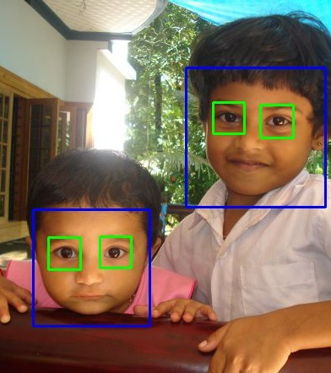
Face Detection
Face Detection has been achieved by using Haar cascade classifiers available already with the opencv package
Implementation is very simple and run time is fast enough to run in real time

Slide 8
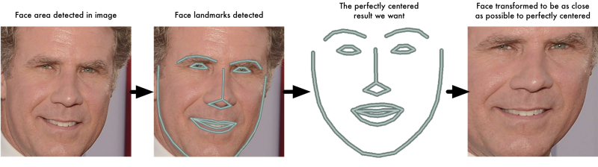
Facial Analysis
Face landmark estimation technique will be used
Will be done using the help of dlib library
Transformations will then be made to make face as centered as possible

Slide 9
Training
Done using OpenCV training function
Takes in a dataset of pictures of the same person and trains the program to recognise it
The main part of this is creating a recogniser
Can be done using different algorithms such as eigen, fisher, and LBPH
A module has to be added to OpenCV to use this function

Slide 10
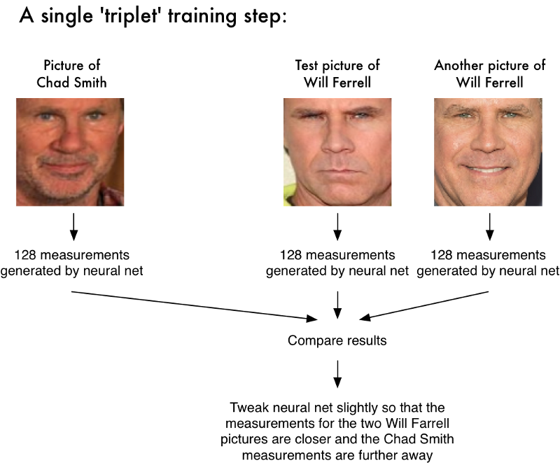
Prediction
The created recogniser in the training part also has a prediction function
This will predict which person is currently in the picture if it is the one we chose in our base picture or not if they are, then the photo is retrieved

Slide 11
Risks
Main risk of this project is not being able to deliver the program
There is a learning curve associated as the developer has no previous experience in machine learning
OpenCV is also fairly new to the user, only being taken up this start of semester
Installing libraries and other modules needed to get facial recognition part working is difficult and involves installing other components and environments
Training with a big dataset in mind can be time and possibly financially consuming
Other problems such as problems with importing OpenCV to Android Studio must be considered as a possibility

Slide 12
Solutions
Problems with installation of required libraries and modules maybe due to using old versions of python and OpenCV, A fresh installation of the latest programs may fix the issues
Rather than training our own classifier using API can save time but cut down complexity of the project. Adding a variable such as e.g. only find male faces or such may make it more complex
Instead of using a control picture to choose the subject of photo retrieval it may be better to use the camera and take pictures of the current user as the base for comparison to other pictures.

Slide 13
Android implementation was introduced for ease of use and accessibility to users in mind however if this proves to be a problem it may be dropped or replaced
Training with a large amount of images will make the face recognition more accurate however the process of training will be slower a solution would be to use Linux VPS to train our classifiers.

Slide 14


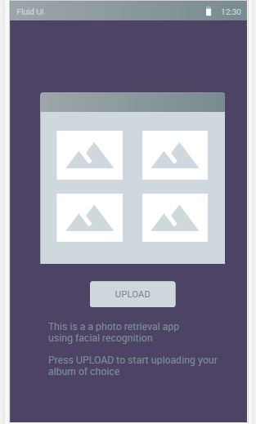
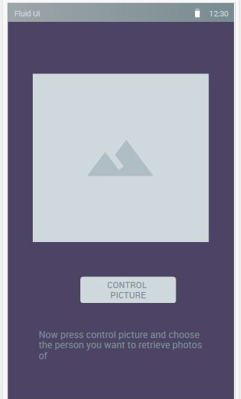
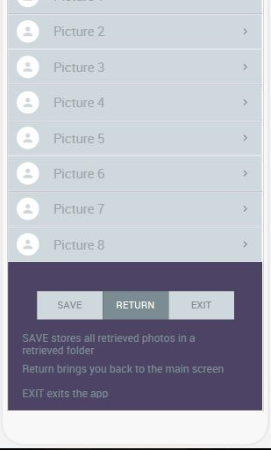



Prototype
Screen Flow

Slide 15
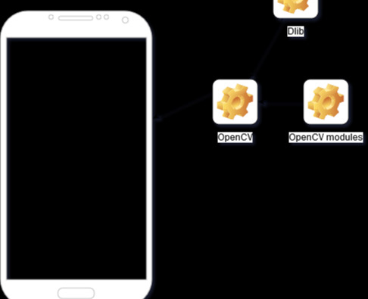
Prototype
System Architecture

