Slide 1
Entity Framework 7 New platforms, new data stores
_/\__
---==/ \\
___ ___ |. \|\
| __|| __| | ) \\\
| _| | _| \_/ | //|\\
|___||_| / \\\/\\

Slide 2
Agenda
What is EF7?
Demos
Links

Slide 3


New platforms New data stores
01010 00100 10110 00100

Slide 4
New platforms
Full .NET Framework
Windows Phone
Windows Store
ASP.NET 5
Mac
Linux

Slide 5
New data stores
Relational & non-relational
Not a magic abstraction
High level services that are useful on all/most stores
Non-common concerns handled by provider extensions
Example providers
SQL Server
SQLite
Azure Table Storage
Redis
In Memory (for testing)

Slide 6
Challenges with current code base
Long history going back ~15 years
Older APIs and design patterns
Uses APIs not available on all platforms
Seldom used code/features
Monolithic implementation
Unintuitive behaviors throughout code
Not optimized for density/devices
High memory footprint
Tight coupling to relational concepts

Slide 7
EF7 is a lightweight and extensible version of Entity Framework

Slide 8
Part v7 and part v1
EF6.x code base not setup to achieve goals
Same top level experience as EF6.x
Still DbContext/DbSet etc.
Built over a new lightweight and extensible core
Just the commonly used features
Plus many new features
Code-based modelling only
Still supports creating model from existing database

Slide 9
Finding class-to-table mapping
EF6
EF7
var metadata = ((IObjectContextAdapter)context).ObjectContext .MetadataWorkspace; var objectItemCollection = ((ObjectItemCollection)metadata .GetItemCollection(DataSpace.OSpace)); var entityType = metadata .GetItems<EntityType>(DataSpace.OSpace) .Single(e => objectItemCollection.GetClrType(e) == typeof(Blog)); var entitySet = metadata .GetItems<EntityContainer>(DataSpace.CSpace).Single() .EntitySets .Single(s => s.ElementType.Name == entityType.Name); var mapping = metadata.GetItems<EntityContainerMapping>(DataSpace.CSSpace) .Single().EntitySetMappings .Single(s => s.EntitySet == entitySet); var table = mapping .EntityTypeMappings.Single() .Fragments.Single() .StoreEntitySet; var tableName = (string)table.MetadataProperties["Table"].Value ?? table.Name;
var table = context.Model.GetEntityType(typeof(Blog)).Relational().Table

Slide 10

Demo
Phone/Store with SQLite

Slide 11
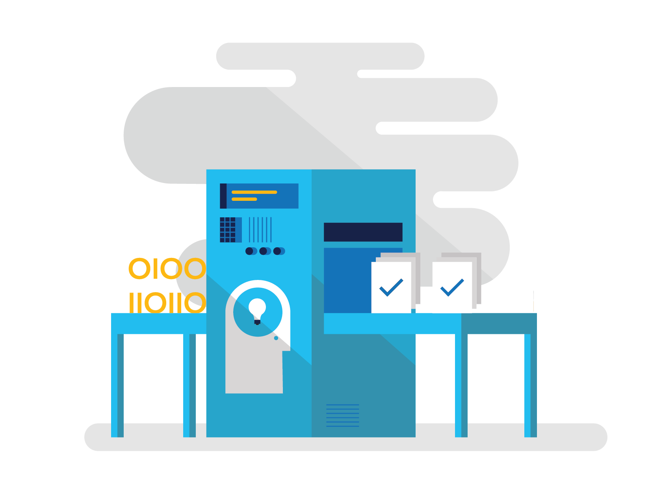
Demo
SQL generation improvements

Slide 12

Demo
Testing with InMemory data store

Slide 13

Demo
Shadow state properties

Slide 14

Demo
Azure Table Storage

Slide 15
Links
EF7 info | aka.ms/AboutEF7
EF Project | github.com/aspnet/EntityFramework
Demo code | github.com/rowanmiller/Demo-EF7

