Slide 1
<number>/17
Introduction to
Unit Tests
&
Test Driven
Development
Ján “mice” MÁC
CC BY-SA 4.0

Slide 2
About me
<number>/17
Web developer since 2005
Enterprise & SMB experience
Former full-stack, focusing on back-end lately:
  PHP, Python, SQL
  HTML, CSS, JS
Contacts:
  Web: http://mice.sk
  Twitter: @MicE_sk
  Facebook: mice.sk
  StackOverflow: mice
  GitHub: mice-sk
  LinkedIn: Ján Mác

Slide 3
Agenda
<number>/17
Introduction
  What are “tests”? Why test?
  Caveats
  Code example
Concepts
  Terminology
  Types of tests
  Test life cycle
Test Driven Development
  Live demo
Best practices: Do’s & Don’ts
Resources
Q&A

Slide 4
Before we begin...
… does any of you have any practical experience with unit tests?
<number>/17

Slide 5
Introduction
<number>/17
What are “tests”?
  The same thing you do when you test your code while writing it, but:
    Automated
    Reproducible
    Shared execution & maintenance by the whole team
Why test?
  Identify bugs when writing new code
  Identify regressions when refactoring existing code
  Enhance design of your code
  Tests document functioning state of your code base

Slide 6
Caveats
<number>/17
Investment:
  Initial development of tests
  Subsequent maintenance of tests
Return of investment during project life cycle:
  Less bugs & regressions = more time to write new features
  Safety net for refactoring
Not a dogma – consider postponing or completely
skipping tests when:
  Writing throw-away code that gets executed just once
  Experimenting
  Having insufficient understanding of your goal

Slide 7
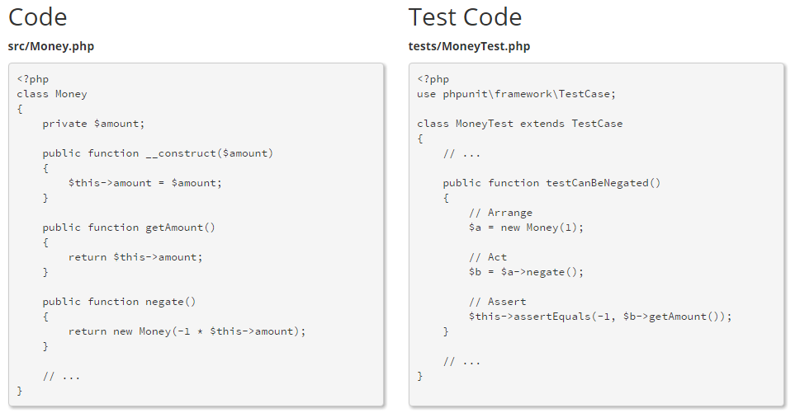
Code example
<number>/17
Source: phpunit.de

Slide 8
Terminology
<number>/17
System under test = application that is being tested
Unit = function or class method that is being tested
Assert = comparison of actual vs. expected state
Test doubles
  Dummy = objects not used in tests, but required for tests to work
  Stubs = “stupid” doubles (record call counts, but not whether they’re correct)
  Mocks = “smarter” doubles with expectations (method calls, arguments, responses)
  Fake = objects with working implementations, but not suitable for production
    e.g. in memory database, child class for testing public methods of abstract class
Fixtures = fixed data set against which tests are executed
Test suite = sequence of tests, grouped by context or test type
Code coverage = percentage of your code base that is covered by your test suites

Slide 9
Types of tests
<number>/17
Unit tests:
  The smallest amount of code you can test
Integration tests
  Test integration of two or more closely related components
System tests
  Test integration of all components, i.e. the system as a whole
Other types of tests (out of scope of this talk):
  Usability tests
  Load tests, Stress tests, etc

Slide 10
Test life cycle
<number>/17
Setup – prepare resources for test
Test – execute the code under test
Assert – verify expectations
Tear down – clean up resources

Slide 11
Test Driven Development
<number>/17
Practice of incrementally writing tests before actual code implementation
  Define/amend interface
  Write failing test
  Write smallest amount of code that passes the test
  Repeat
Live demo

Slide 12
Do's & ...
<number>/17
Make sure your tests are isolated and don’t influence each other.
Test only one thing in one test case.
  Consider a single assert per test case (but this is not practical in all scenarios).
Use a naming convention for test cases.
  E.g. CalculatorTest::testDiv_divisionByZero_throwsException
    Class and method under test
    State under test
    Expected outcome
Received a bug report? Add a test case for it, kill the bug forever.
Optimize & refactor your tests when needed. Tests are “code” too.

Slide 13
... Don'ts
<number>/17
Slow tests are useless tests.
  If unavoidable, have at least 1-2 test suites that cover core functionality that can be executed quickly during daily development.
  Delegate the rest to your continuous integration server.
Don’t mix types of tests - keep them in separate test suites that can be executed independently.
Don’t test private and protected class methods. Test public ones only.
Don’t test code with existing tests (external libs, etc). Be wary of test overlaps.
Don’t test external dependencies
  File system, database, etc
  Slow execution, risk of data loss
  Use stubs & mocks instead. Test APIs against specification (interfaces, actions & expected results).

Slide 14
Resources
<number>/17
This presentation:
  presentation, code examples: https://github.com/mice-sk/talks
  a video re-recording may eventually appear at: http://mice.sk
Other resources:
  PHPUnit: Getting Started
  Roy Osherove: Definition of a Unit Test
  StackOverflow: Fakes, Stubs & Mocks

Slide 15
<number>/17
Questions
&
Answers

Slide 16
<number>/17
Thank you

Slide 17
Disclaimer
<number>/17
This talk was prepared or accomplished by Ján Mác in his personal capacity. The opinions expressed are the author's own and do not reflect the view of any of his employers.

