Slide 1

Is Air Travel, Really Safe? Executive Summary
Michael gonzalez

Slide 2
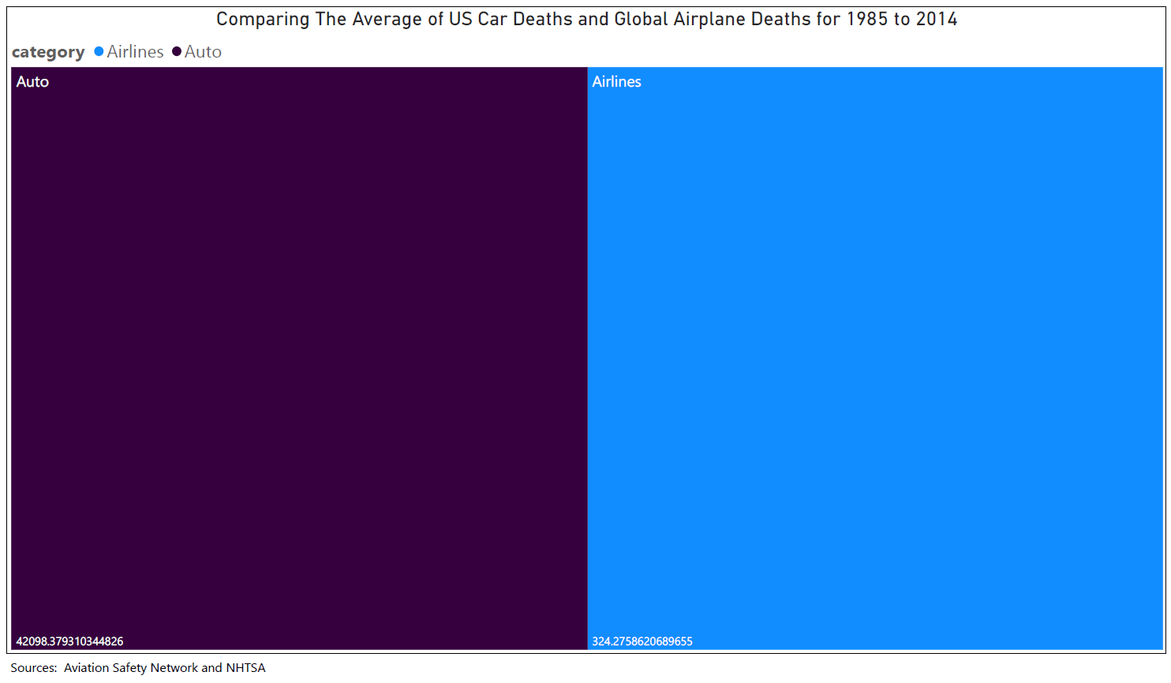
Let us Compare Some Stats!
General information on methods of travel has traveling by car as the second most used way of travel. Traveling by airplane is the sixth most used way of travel. This means that people travel by car more than airplanes. Looking at the worldwide flight's incident statistics and US road incident statistics, the average annual auto fatality is higher than the average annual due to airlines. Between the 1985-1999 and 2000-2014 timeframe.
The average annual deaths for Cars (Auto) 42,000 and Airplanes (Airlines) 324.

Slide 3
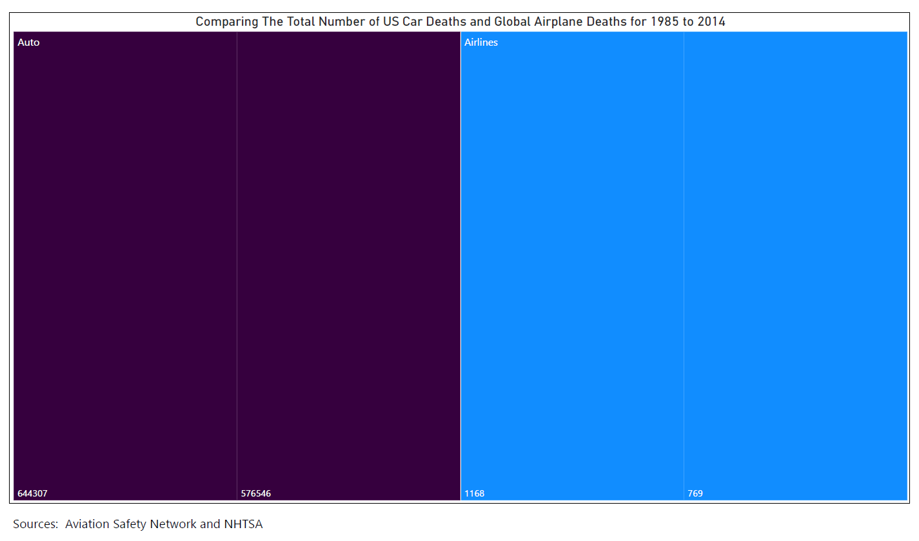
More Stats to Compare
Above is the Total number of deaths from Cars (Auto) and Airplanes (Airlines) in the years of 1985 to 2014.

Slide 4

Has Technology Helped Safety in Air Travel?
It seems that the overall deaths and accidents have been reduced consistently lower in first world countries like the US. Technology has played an important role in air travel safety.
Insights from 1985 to 1999
Insights from 2000 to 2014
Air travel deaths happened 7 times more from Airliners based in third world countries.
Air Travel deaths happened 9.25 times more from Airliners based in third world countries.
Air travel accidents happened 6.25 times more from Airliners based in third world countries.
Air travel accidents happened 3.5 times from Airliners based in third world countries.

Slide 5
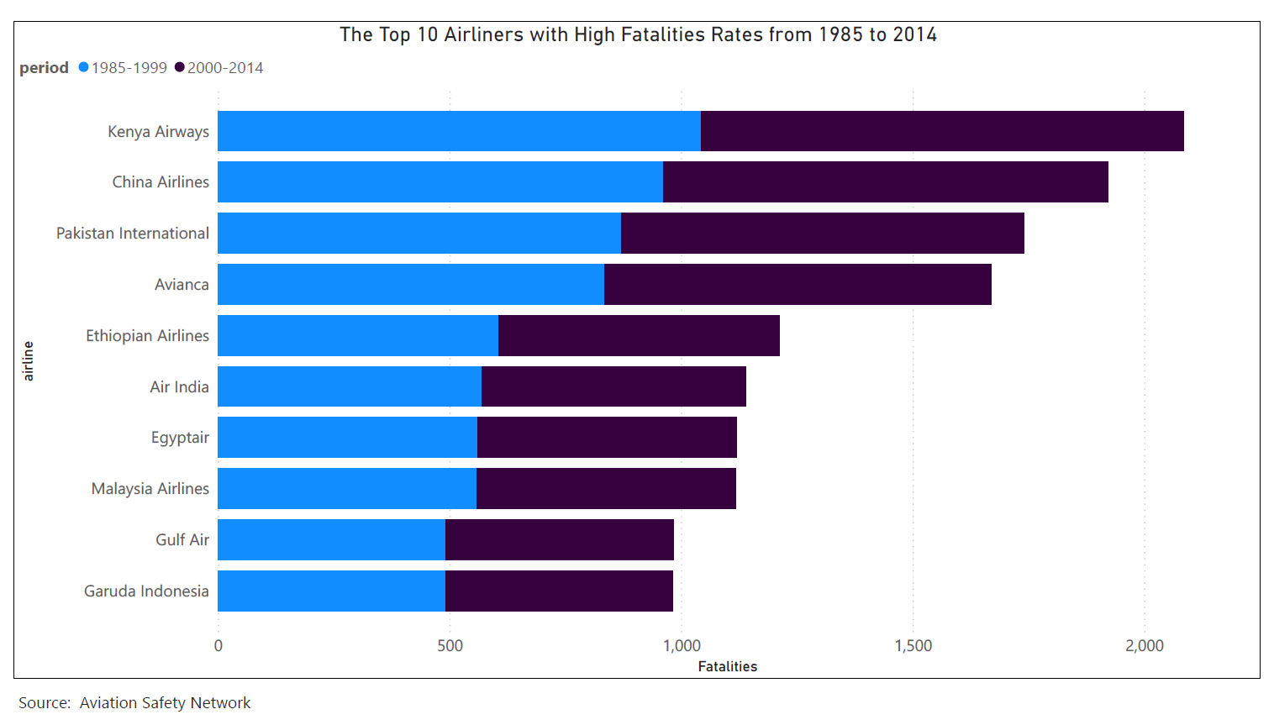
Is There a Link between Death Rates and Airliner Homebase?
Deaths
Accidents
Kenya Airways has the highest rates of death for 1985 to 2014. China Airlines has the second highest death rates for 1985 to 2014. The link between airlines and years have consistently higher rates.
Few airlines has links of high accidents and deaths in this list of top ten. From This list, Gulf Air and Garuda Indonesia are based in third world countries and has considered lower rates for 1985 to 2014.

Slide 6
Final Thoughts
There is insight from data that has information on airliner’s past safety history, which can be used to predict future accidents.
In present history, the data has shown that accident and death rates have been falling with the help of technology.
Technology is the reason for safer air travel in place like the US and other countries that are known as first world countries .
When comparing accident rates from global air travel with US road accidents rates, it shows that air travel is safer then traveling by car. It also shows that airliners that are based in first world countries have lower death and accident rates.

Slide 7
References
Fivethirtyeight/Aviation Safety Network. N. D. https://github.com/fivethirtyeight/data/tree/master/airline-safety
Aviation Safety Network. Airline Statistics by Period. N. D. https://aviation-safety.net/statistics/period/stats.php
NHTSA. Crash Stats & Reports. N. D. https://one.nhtsa.gov/Data

