Slide 1

Exploratory Data Analysis Final Term Project
DSC530
Summer 2019
Michael Gonzalez

Slide 2
Statistical Question
Can you predict the home values of the Boston area?

Slide 3
Variable Selection
Median value
Lower status pop
Rooms per house
Puil teach ratio
PCT industrialized

Slide 4
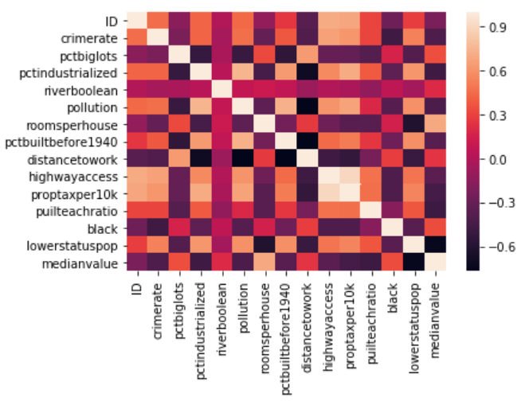
Correlation Analysis

Slide 5
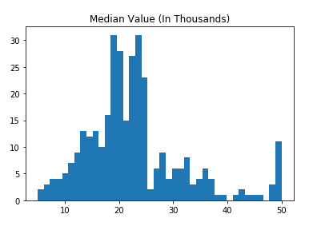
Median Value

Slide 6
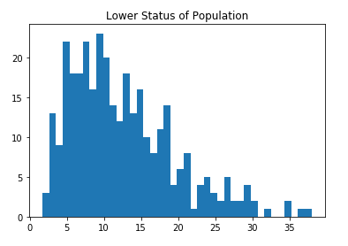
Lower Status Population

Slide 7
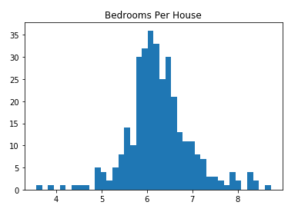
Rooms Per House

Slide 8
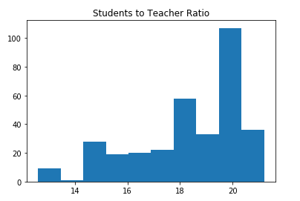
Pupils to Teacher Ratio

Slide 9
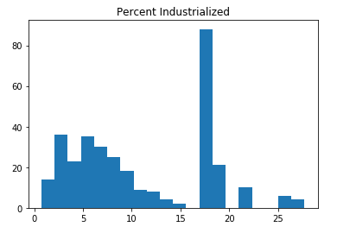
Percent Industrialized

Slide 10
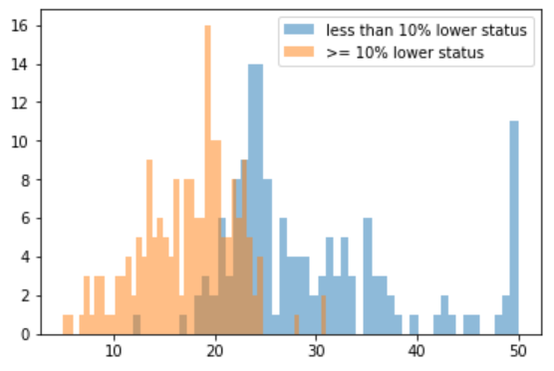
Probability Mass Function
Lower Status Population data was split at the 10% mark.

Slide 11
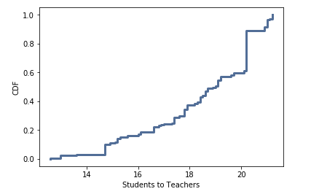
Cumulative Distribution Function
CDF of students to teacher ratio plot.

Slide 12
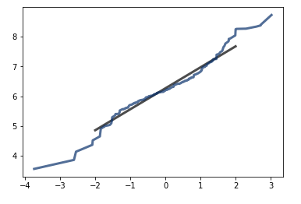
Analytical Distribution
Normal Distribution plot of the rooms per house data.

Slide 13
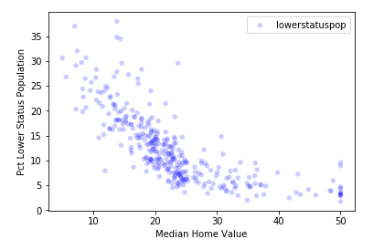
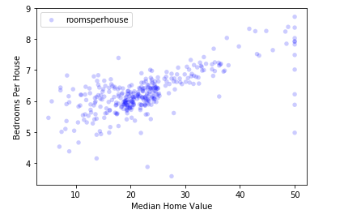
Scatter Plot Examples

Slide 14
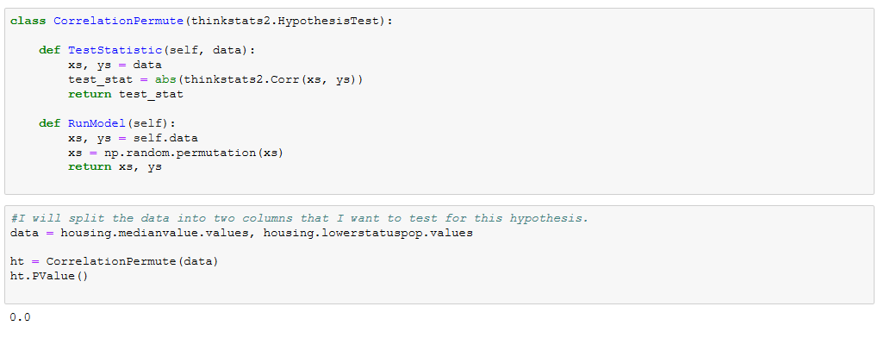
Testing The Data

Slide 15
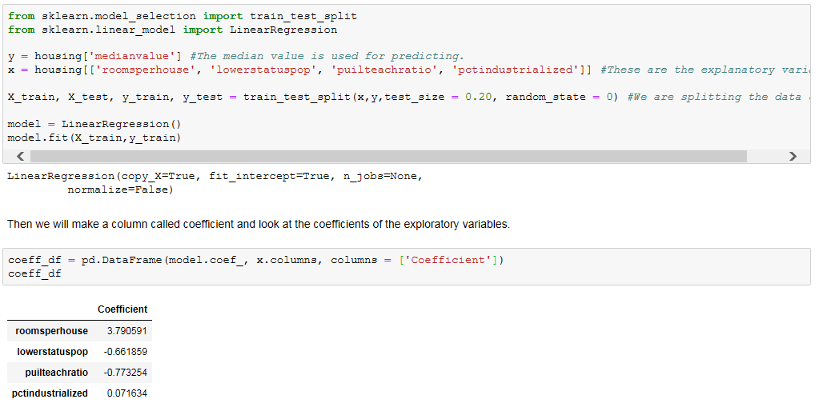
Regression Model

