Slide 1

Consumer Analysis for Enhanced Marketing Strategies
Presentation for Data Science 4 All Retail Challenge

Slide 2
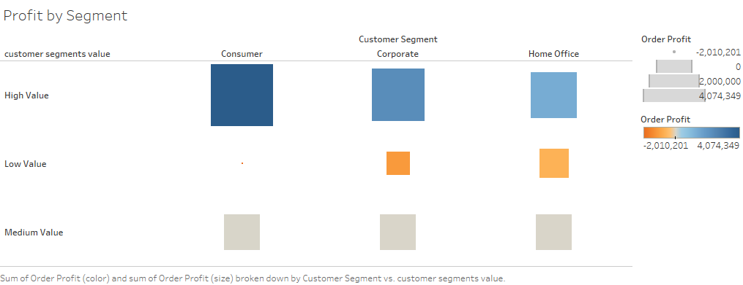

Overview
Summary
Data Science 4 All provided anonymized retail data from 2015 to 2018.
180,520 Individualized Orders from combining two datasets.
Customer Segments
Consumer
Corporate
Home Office

Slide 3
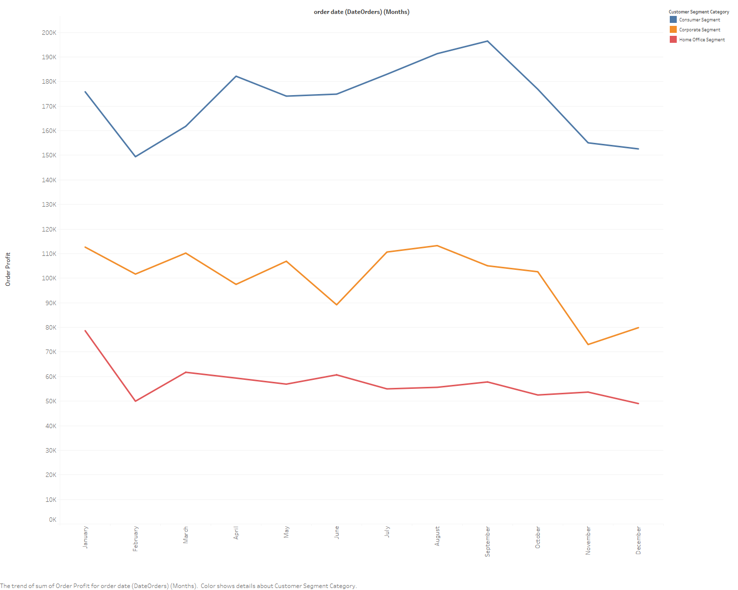
Monthly Profit
Profits were made by these segments over the months.
The blue line represents consumers, which are the most profitable.
The red line represents the home office segment, which is the least profitable.
Focusing on consumer products will lead to higher profit margins.

Slide 4
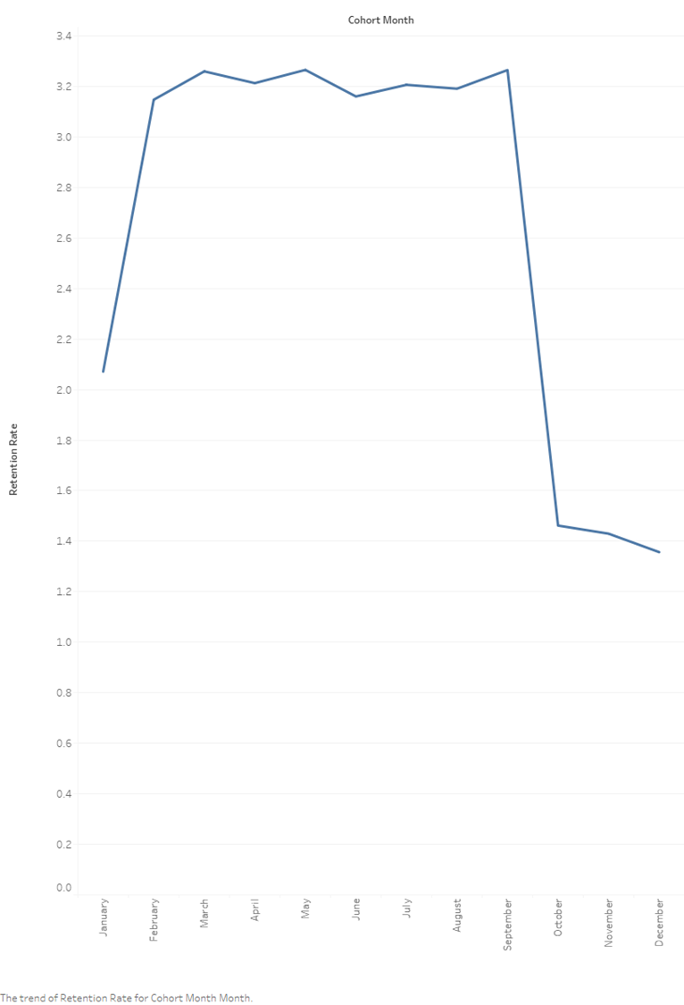
Monthly Retention Rate
Retention rates are for January to December.
March to September had high retention rates.
December had the lowest retention rate, out of all the months.
The drop was caused consumers lowering purchase due to the holidays.

Slide 5
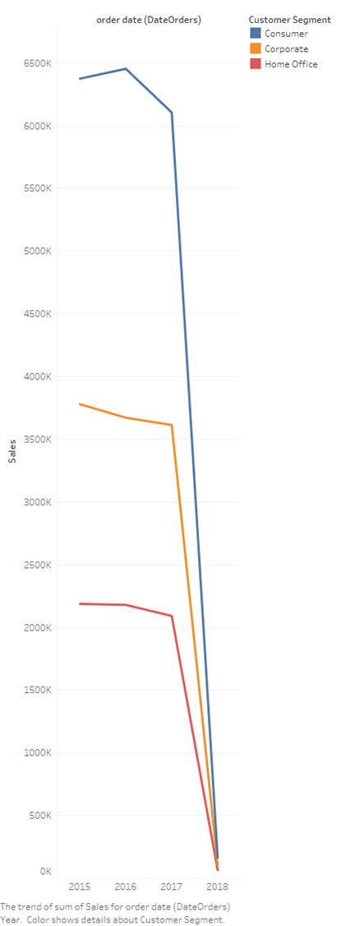
Yearly Sales
Sales made from 2015 to 2018.
This chart also shows these segments had huge sales growth then slow down.
The blue line represents consumers, which had the highest sales.
The red line represents the home office segment, which had the lowest sales.
Sales of consumer products were the highest in 2016 before slowly falling off.
Sales of corporate and home office products stayed the same before falling off.

Slide 6

Questions
If you have any comments and question about this presentation.
Please reach out to me at ds.mpg.portfolio@gmail.com

