Slide 1
Final - Space Battle
Foo Fang Jee
Michelle Chai Mei Wei

Slide 2








Character Design
Texture | Class Name | Technical aspects
 |  | Health | Movement Speed | Fire rate | Bullet Texture
 | Player | 5 | 300.0f | 300.0f | (Normal bullet) (Missile)
 | Asteroid | 1 | 100.0f | - | -
 | Turret | 10 | - | 600.0f
 | Enemy1 | 3 | 100.0f | 700.0f
 | Enemy2 | 7 | 150.0f | 300.0f
 | Boss (Level 1) | 25 | 200.0f | 250.0f, 160.0f
 | Boss (Level 2) | 50 | 200.0f | 200.0f, 160.0f

Slide 3
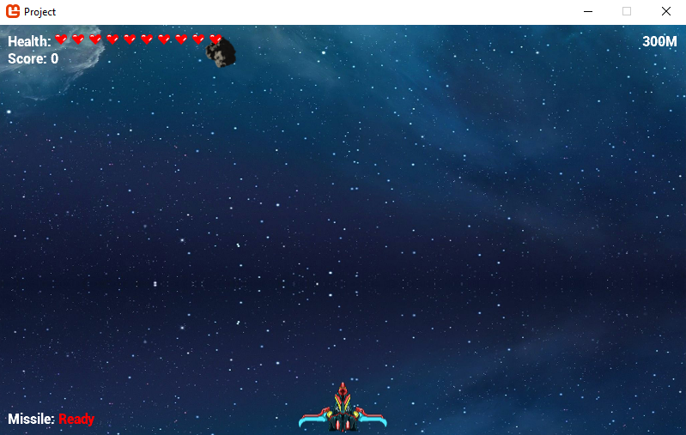
Level Design – Level 1

Slide 4
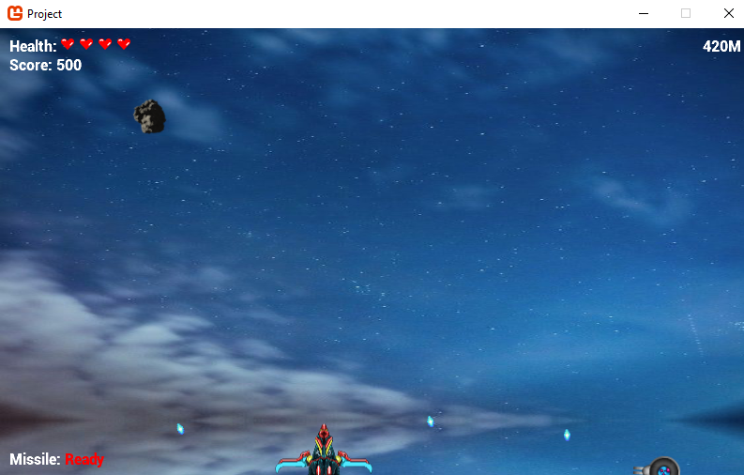
Level Design – Level 2

Slide 5
Technical Design
Movement
Kinematic seek
Dynamic wander
Pattern movement

Slide 6
Technical Design
Line of sight (all enemies)
Distance
Angle distance
Bresenham’s line check
Pathfinding
A* + Bresenham’s line algorithm)

Slide 7
Technical Design
Decision-making
Finite state machine
Boss (attack, avoid, attack faster)
Game (Main Menu, Gameplay, GameOver, Win, Tutorial)

Slide 8
Cool Features
Power Up
Change bullet pattern
Sound Effect
When enemy and player firing

Slide 9
Cool Features
Pattern Movement
Move along predefined points
Challenging Boss
Dodge bullet
Attack faster when low health

Slide 10
Changes to Original Plan
Power Up
Added in Level 2
Change bullet pattern
Tutorial
Teach player the input of the game

Slide 11
Changes to Original Plan
Pause Scene
Pause the game
Can continue the game or quit game
Player’s health
Increase from 5 to 10

Slide 12
Changes to Original Plan
Player’s fire rate
Reduce from 150 to 300 (in milliseconds)
Pathfinding
Original: too long to execute, game stutters temporarily
Enhanced: A* + Bresenham’s line algorithm

Slide 13
If we had more time
Collision between enemies
Currently, enemies’ pathfinding do not avoid from colliding against other enemies

Slide 14
Thank you!

