Slide 1
In vivo EEG/imaging setup with bells and whistles
Michelle Fogerson 9/2020

Slide 2
EEG/Control signals: Open Ephys
1 16-channel headstage with adapter to EEG leads. I used either 3 channel + ground or 2 channel + ref + ground to capture
1 BNC breakout board
hLab users: use invivoEEG config file
Set headstage to 16ch in rhythm FPGA source module

Slide 3
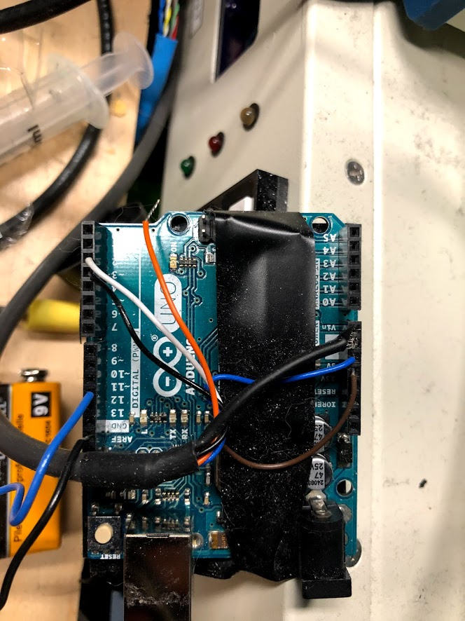
Treadmill
Rotary encoder to Arduino
Arduino output BNC to Open Ephys analog input 2
Converts gray code from encoder to PWM
Arduino/Encoder wiring:
Outputs: BNC Blue – pin 11 to BNC signal
BNC Black – GND to BNC ground
Inputs: Encoder white – pin 2
Encoder black – pin 3
Encoder thick black (shield) – GND
Encoder blue – 5V
Encoder brown – gnd
Encoder orange – not connected
Encoder
https://www.sparkfun.com/products/11102
See data sheet and example code for useful documentation

Slide 4
Pupillometry video
Turn on camera and IR light sources; camera is fitted with 800nm bandpass IR filter so that 2P excitation (920nm for GCaMP) won’t interfere
Open vimba viewer and set gain
Trigger IO must be reset to continuous to see video after running python
Can set gain; other features will be overwritten by python script
Run livestream_pymba.py
Start anaconda powershell prompt, navigate to E:/Michelle/pupilVideo, type
conda activate pupil
python –m livestream_pymba.py
Follow prompts; to have video start shortly after open ephys starts recording, respond 1 to “wait for subfolder [0/1]”
Hit “q” with cursor over video window to quit recording; data saved as frames
Exposures are sent to Open Ephys analog input 2 for synchronization

Slide 5
Piezo
Pulse pal
Open Ephys
A
Set frequency/duration/ISI in pulse pal output channel 3
Output channel 3 sent to Carl’s piezo controller, which is coupled with a voltage divider to achieve (range) variable output needed for full amplitude range input to piezo
Monitor out from Carl’s piezo controller box to open ephys analog input 6
Out 3
AIn 6
Carl’s piezo controller
Output (0-100V)
TTL Trig
Monitor (0-5V)
Vdiv
Vdiv = voltage divider 1k/10k resistor (divides output by 11)
PI piezo controller
Cmd in
(0-10V)

Slide 6
TTL control - Pulse Pal
Channel 1 – Sync pulse output to NI/Scanimage PFI0 for external start command and Open Ephys Analog in 1
Channel 2 – Air puff command pulses. Output to picospritzer and Open Ephys Analog in ***
Channel 3 – Piezo command pulses. Output to input of Carl’s custom piezo controller box.

