Slide 1
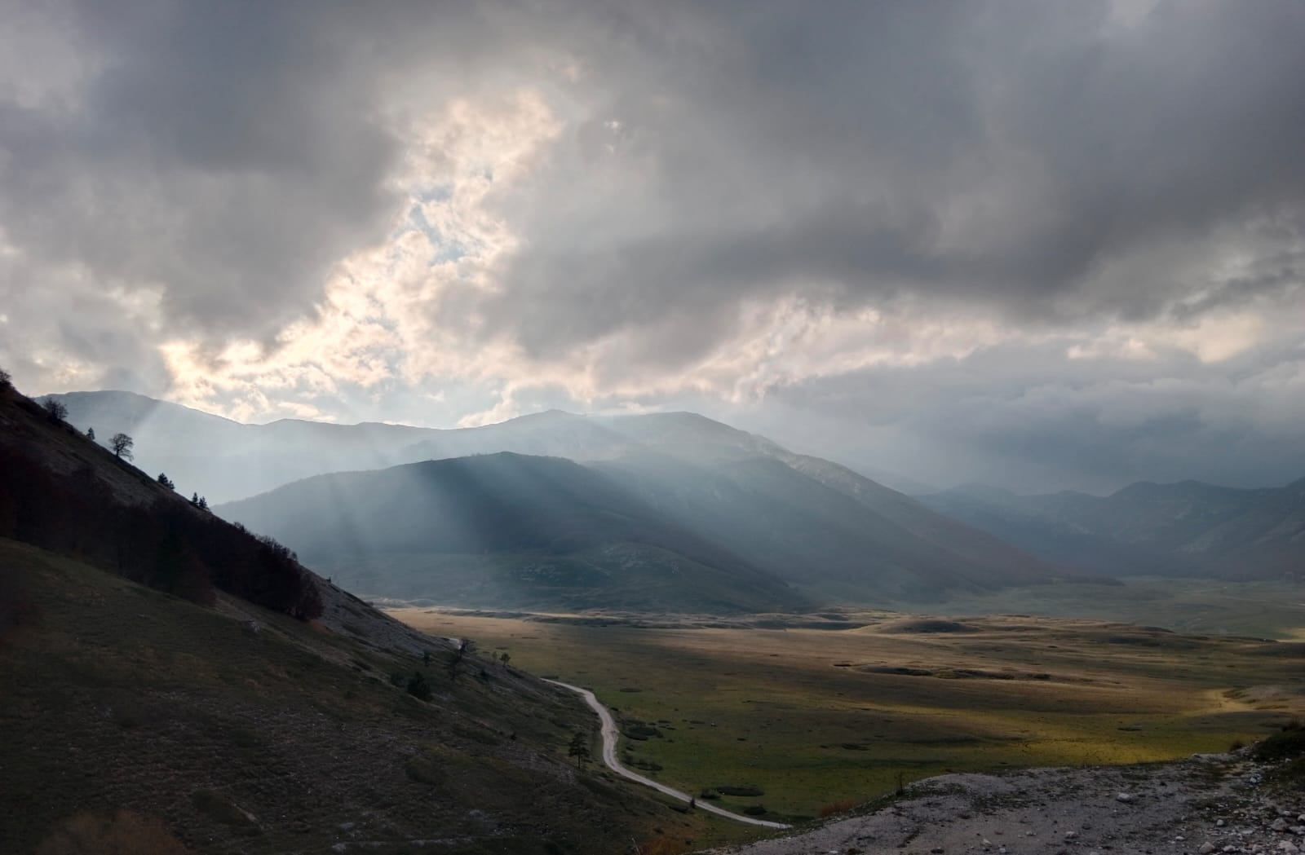

CNN Explainability on Seismic Models
Michele Magrini
Francesco Marrocco

Slide 2

Example Title
Example Text

