Slide 1
Deep Learning and Cognitive Therapy
CS598 Deep Learning for Healthcare
Michael Miller and Kurt Tuohy
5/6/2022
Franziska Burger, Mark A. Neerincx, and Willem-Paul Brinkman. 2021.
Natural language processing for cognitive therapy: Extracting schemas from thought records.
PLOS ONE, 16(10).

Slide 2
Overview
Background
Scope of reproduction
Results
Discussion

Slide 3
Background
NLP not yet utilized for psychological care
Difficult
High cost for mistakes
Potential high value
“Schemas” are categories for core beliefs
Currently, schemas manually predicted
Premise: use NLP and Deep Learning to predict schemas

Slide 4




Experimental Setup
Scenario
Automatic Thought
Schema
“You’ve been dieting for a week, but you gained a pound.”
Attachment
“I have no self-control.”
Power & Control
Competence
Meta-Cognition
Other People

Slide 5
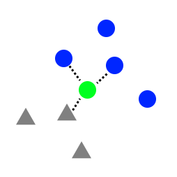



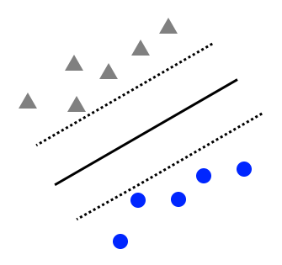


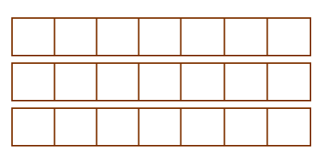

Preprocessing and Prediction
Utterances
Embedding
Embedding Levels
Models
Schemas
kNN
Classify by schema
Utterance-level
“I have no self-control.”
SVM
GLoVe
“I can’t accomplish my goals.”
Predict single schema rating
Word-level
LSTM

Slide 6
Scope of Reproducibility
Burger et all trained 4 types of model
Attempt to recreate these
Use different python packages
Use different design choices with judgement
Test two additional hypothesis
Lax preprocessing
Scenario level utterances
Notes:
KNN, SVM, Multi-label LSTM, per-schema LSTM

Slide 7



Results
At high level, results support hypothesis
Simpler models (KNN, SVM) close matches
More complicated models (RNNs) match less closely
Differences are a result of model changes, design changes. For example:
Tokenization, padding
Learning rate
Loss calculation
As a result, individual claims not verified
Notes:
K-Nearest Neighbor
Support Vector Machine
Recurrent Neural Networks

Slide 8
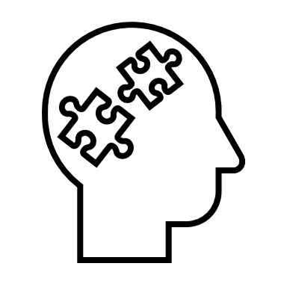

Discussion
Easy:
Straightforward access to code, data
Excellent documentation
Difficult:
Code community tend to rely on standard packages
Difficult to perfectly recreate results
Results point to potential confounding variables
Results suggest future research in psychology is worthwhile
Notes:
Example: utterance-level embeddings with Term Frequency Inverse Document Frequency
Deep Learning evolving rapid rate,

