Slide 1
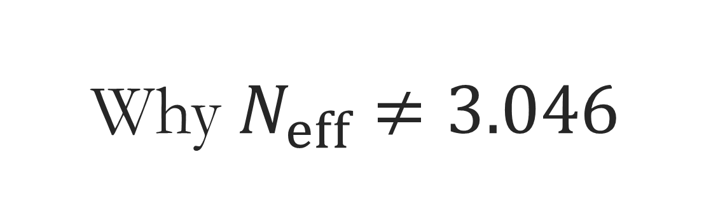
Why $N_{eff}≠3.046$
Jack Bennett. UNSW
Supervisor: Yvonne Wong

Slide 2
Outline
Motivations
Theory;
Active Transport
Finite Temperature QED
Our work:
Solve ODE
Add next order

Slide 3
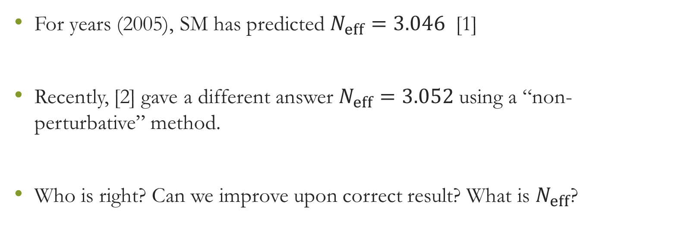
Motivations
For years (2005), SM has predicted $N_{eff}=3.046$ [1]
Recently, [2] gave a different answer $N_{eff}=3.052$ using a “non-perturbative” method.
Who is right? Can we improve upon correct result? What is $N_{eff}$?

Slide 4
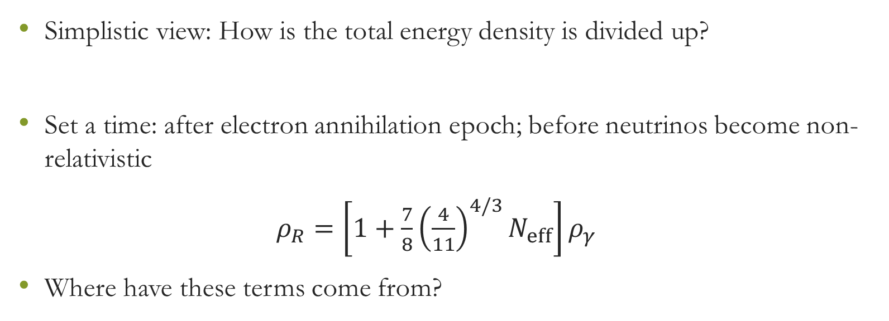
Effective number of neutrinos
Simplistic view: How is the total energy density is divided up?
Set a time: after electron annihilation epoch; before neutrinos become non-relativistic
$ρ_{R}=\left[1+\frac{7}{8}{\left(\frac{4}{11}\right)}^{4/3}N_{eff}\right]ρ_{γ}$
Where have these terms come from?

Slide 5
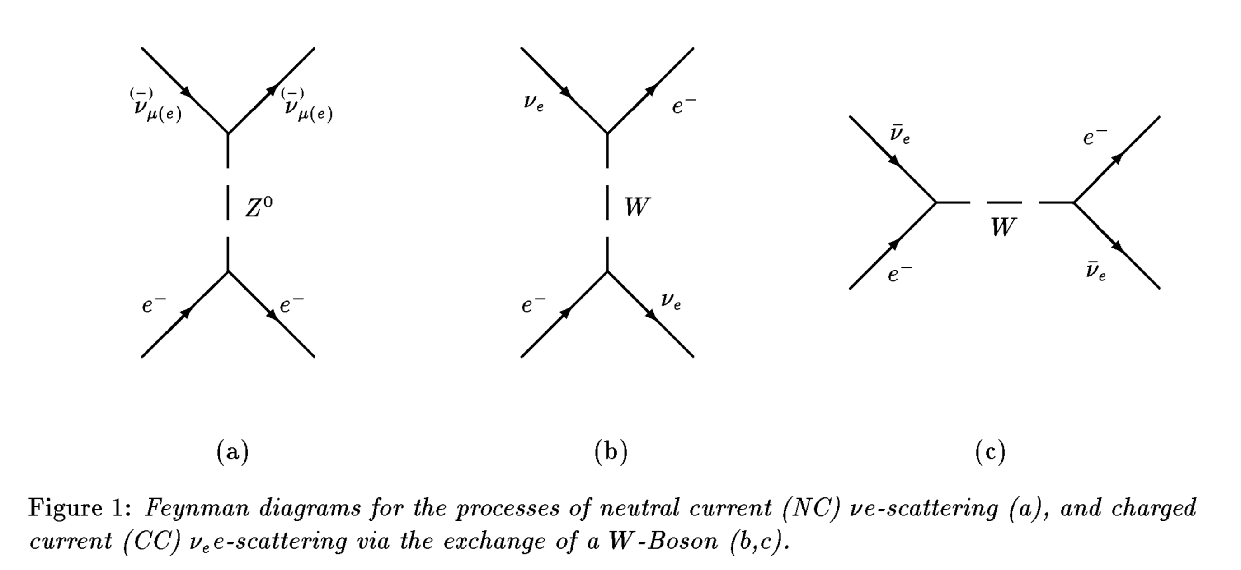
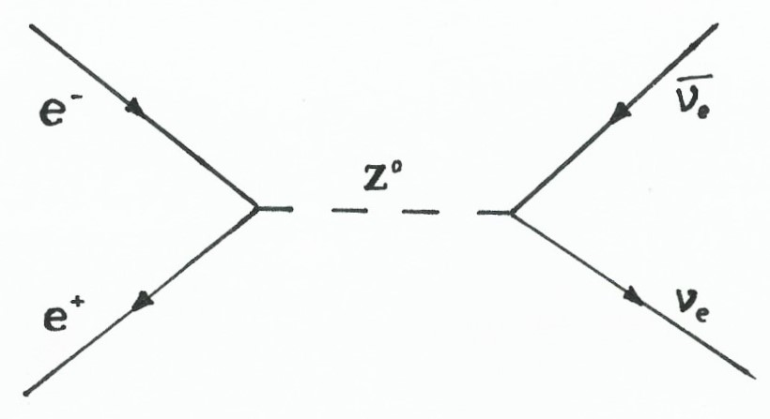


Deviation from $N_{eff}=3$
$ρ_{R}=\left[1+\frac{7}{8}{\left(\frac{4}{11}\right)}^{4/3}N_{eff}\right]ρ_{γ}$
Exchange energy with photons?
Not coupled directly.
Indirect – four diagrams at tree level
T=MeV Neutrinos decouple
T=0.5 MeV e+- decouple.
http://www.mushtukov.com/
https://cds.cern.ch/record/248487/

Slide 6
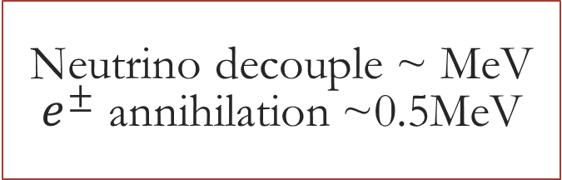
Active transport
Neutrino decouple ~ MeV
$e^{±}$ annihilation ~0.5MeV
Do all electrons annihilate instantaneously?
Fermi-Dirac distributions
Are all neutrinos decoupled when electrons annihilate?
Some energy transferred to neutrino sector
Use continuity equation
http://www.mushtukov.com/

Slide 7
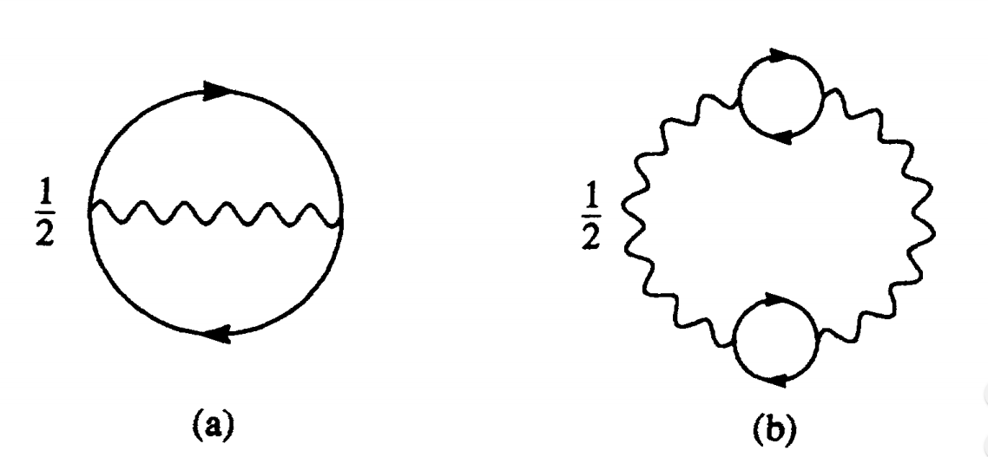
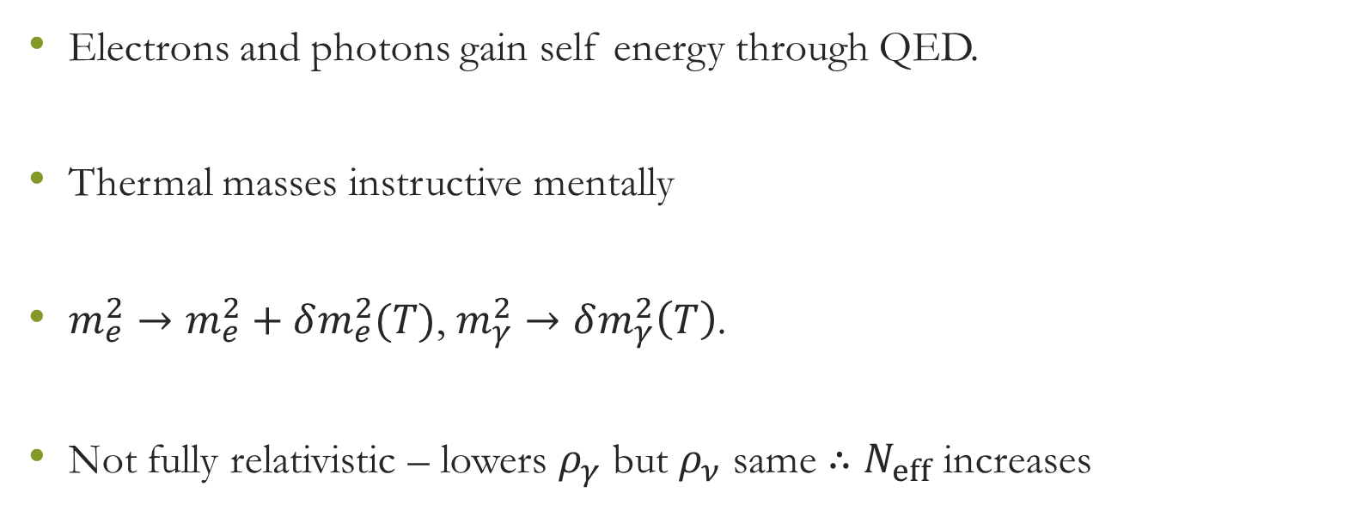
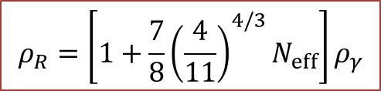
Finite-temperature QED
$$ρ_{R}=\left[1+\frac{7}{8}{\left(\frac{4}{11}\right)}^{4/3}N_{eff}\right]ρ_{γ}$$
Electrons and photons gain self energy through QED.
Thermal masses instructive mentally
$m_{e}^{2}→m_{e}^{2}+δm_{e}^{2}(T)$, $m_{γ}^{2}→δm_{γ}^{2}\left(T\right)$.
Not fully relativistic – lowers $ρ_{γ}$ but $ρ_{ν}$ same ∴ $N_{eff}$ increases
journals.aps.org/prd/pdf/10.1103/PhysRevD.49.611

Slide 8
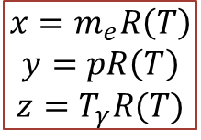
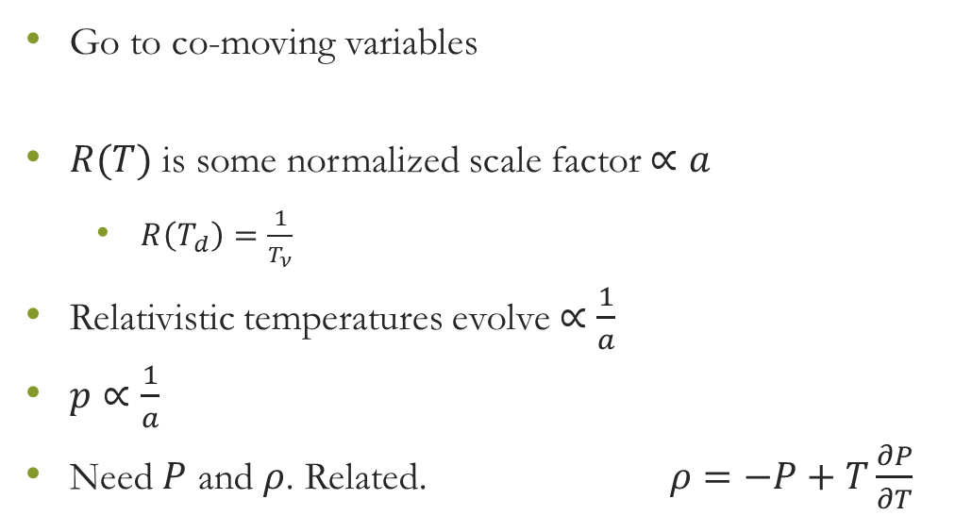
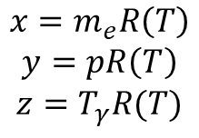
New Variables
$$x=m_{e}R\left(T\right)$$
$$y=pR\left(T\right)$$
$$z=T_{γ}R(T)$$
$$x=m_{e}R\left(T\right)$$
$$y=pR\left(T\right)$$
$$z=T_{γ}R(T)$$
Go to co-moving variables
$R(T)$ is some normalized scale factor $∝a$
$R\left(T_{d}\right)=\frac{1}{T_{ν}}$
Relativistic temperatures evolve $∝\frac{1}{a}$
$p∝\frac{1}{a}$
Need $P$ and $ρ$. Related. $ρ=−P+T\frac{∂P}{∂T}$

Slide 9

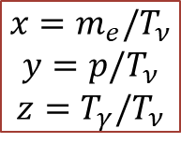


Continuity Equation
$$x=m_{e}/T_{ν}$$
$$y=p/T_{ν}$$
$$z=T_{γ}/T_{ν}$$
Normally $\frac{d}{dt}ρ=−3H(ρ+P)$.
Need to track $H$. Tough.
Co-moving continuity equation $\frac{d}{dx}\overline{ρ}=\frac{1}{x}\left(\overline{ρ}−3\overline{P}\right)$
When does this approach work?
$$\overline{P}=P{\left(\frac{x}{m_{e}}\right)}^{4}$$
$$\overline{ρ}=ρ{\left(\frac{x}{m_{e}}\right)}^{4}$$

Slide 10
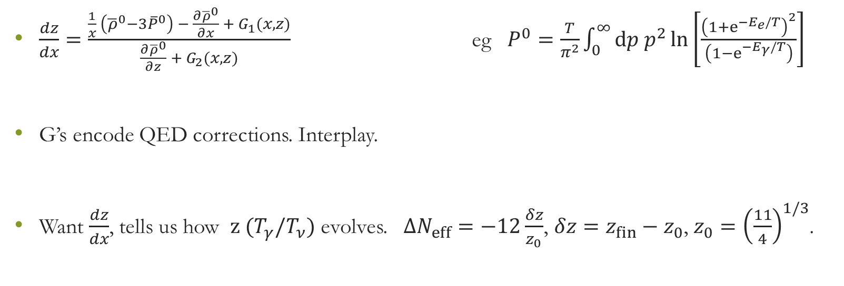
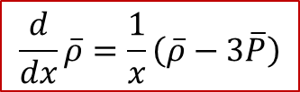
ODE
$$\frac{d}{dx}\overline{ρ}=\frac{1}{x}\left(\overline{ρ}−3\overline{P}\right)$$
$$x=m_{e}/T_{ν}$$
$$y=p/T_{ν}$$
$$z=T_{γ}/T_{ν}$$
$\frac{dz}{dx}=\frac{\frac{1}{x} \left({\overline{ρ}}^{0}−3{\overline{P}}^{0}\right) − \frac{∂{\overline{ρ}}^{0}}{∂x} + G_{1}(x,z)}{\frac{∂{\overline{ρ}}^{0}}{∂z} + G_{2}(x,z)}$ eg $P^{0}=\frac{T}{π^{2}}\int_{0}^{∞}{dp p^{2}\ln\left[\frac{{\left(1+e^{−E_{e}/T}\right)}^{2}}{\left(1−e^{−E_{γ}/T}\right)}\right] }$
G’s encode QED corrections. Interplay.
Want $\frac{dz}{dx}$, tells us how $z (T_{γ}/T_{ν})$ evolves. $ΔN_{eff}=−12\frac{δz}{z_{0}}$, $δz=z_{fin}−z_{0}$, $z_{0}={\left(\frac{11}{4}\right)}^{1/3}$.

Slide 11
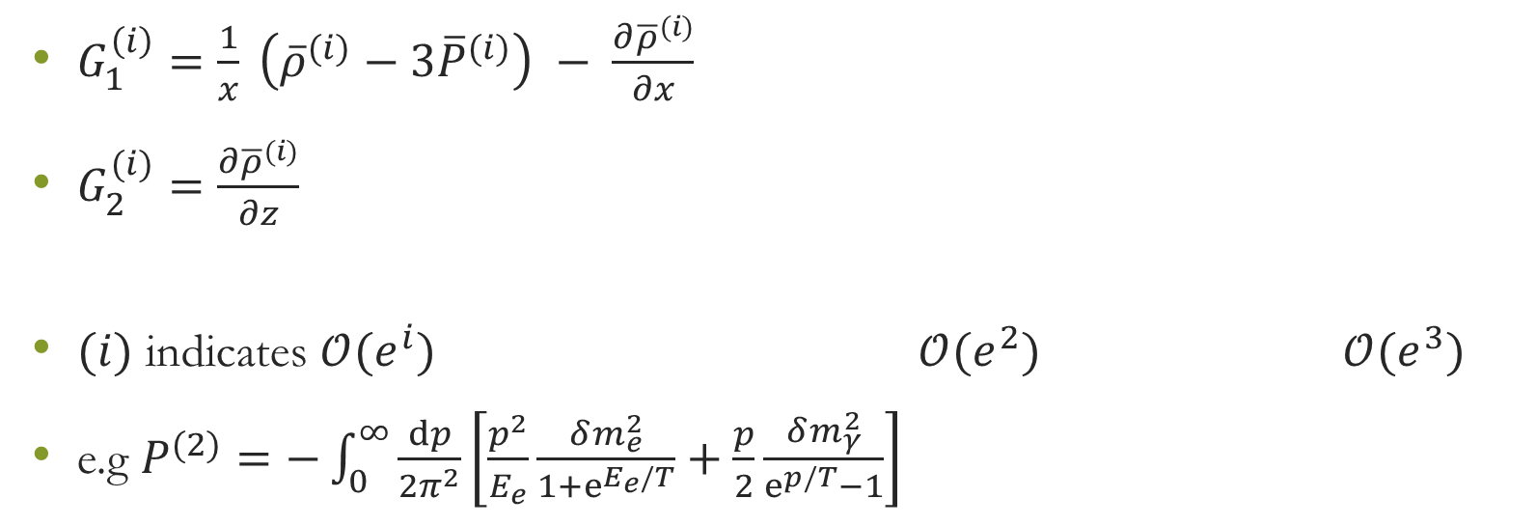
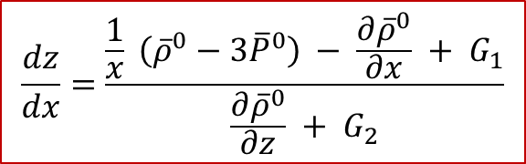
Higher order
$$\frac{dz}{dx}=\frac{\frac{1}{x} \left({\overline{ρ}}^{0}−3{\overline{P}}^{0}\right) − \frac{∂{\overline{ρ}}^{0}}{∂x} + G_{1}}{\frac{∂{\overline{ρ}}^{0}}{∂z} + G_{2}}$$
$$x=m_{e}/T_{ν}$$
$$y=p/T_{ν}$$
$$z=T_{γ}/T_{ν}$$
journals.aps.org/prd/pdf/10.1103/PhysRevD.49.611
$G_{1}^{\left(i\right)}=\frac{1}{x} \left({\overline{ρ}}^{(i)}−3{\overline{P}}^{(i)}\right) − \frac{∂{\overline{ρ}}^{(i)}}{∂x}$
$G_{2}^{(i)}=\frac{∂{\overline{ρ}}^{(i)}}{∂z}$
$(i)$ indicates $𝒪(e^{i})$ $𝒪(e^{2})$ $𝒪(e^{3})$
e.g $P^{(2)}=−\int_{0}^{∞}{\frac{dp}{2π^{2}}\left[\frac{p^{2}}{E_{e}}\frac{δm_{e}^{2}}{1+e^{E_{e}/T}}+\frac{p}{2}\frac{δm_{γ}^{2}}{e^{p/T}−1}\right]}$

Slide 12
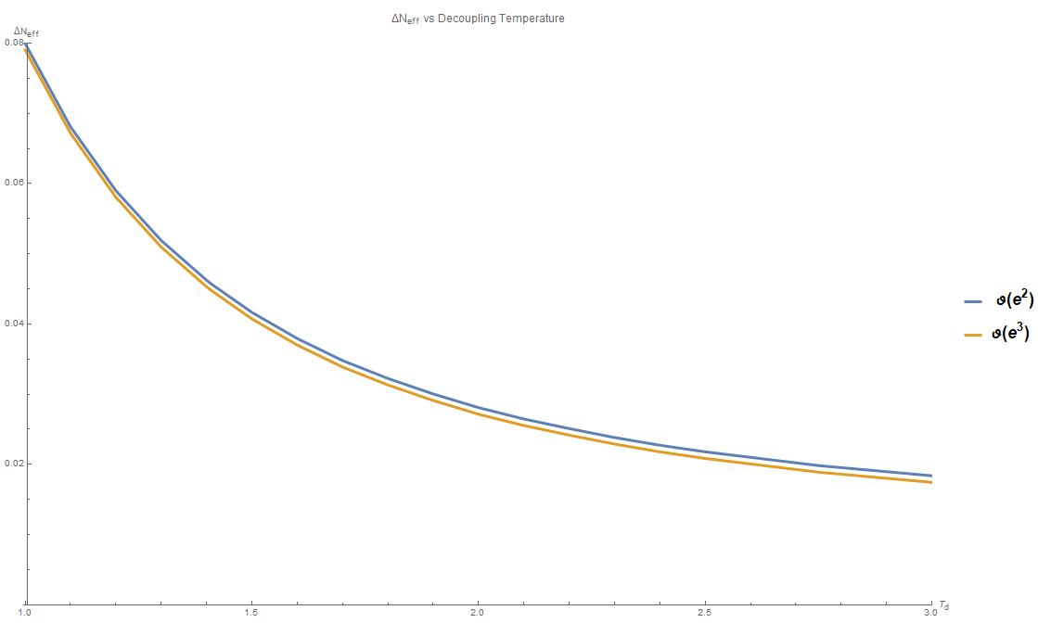

Solutions
Wrote C++ code
to solve
Sensitive to $T_{D}$.
$T_{D}=1.41 MeV$[3],
$N_{eff}^{(2)}=3.046$;
$N_{eff}^{(3)}=3.04$5
Similar to inc. $ν$ osc.

Slide 13
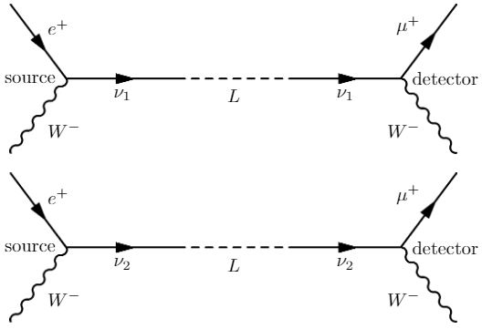
Future
$$\frac{dz}{dx}=\frac{\frac{1}{x} \left({\overline{ρ}}^{0}−3{\overline{P}}^{0}\right) − \frac{∂{\overline{ρ}}^{0}}{∂x} + G_{1}}{\frac{∂{\overline{ρ}}^{0}}{∂z} + G_{2}}$$
$$x=m_{e}/T_{ν}$$
$$y=p/T_{ν}$$
$$z=T_{γ}/T_{ν}$$
Even higher order pointless?
Include non-instantaneous neutrino decoupling
Neutrino oscillations
physino.xyz/learning/2015/05/15/illusion-of-neutrino-oscillation/

Slide 14
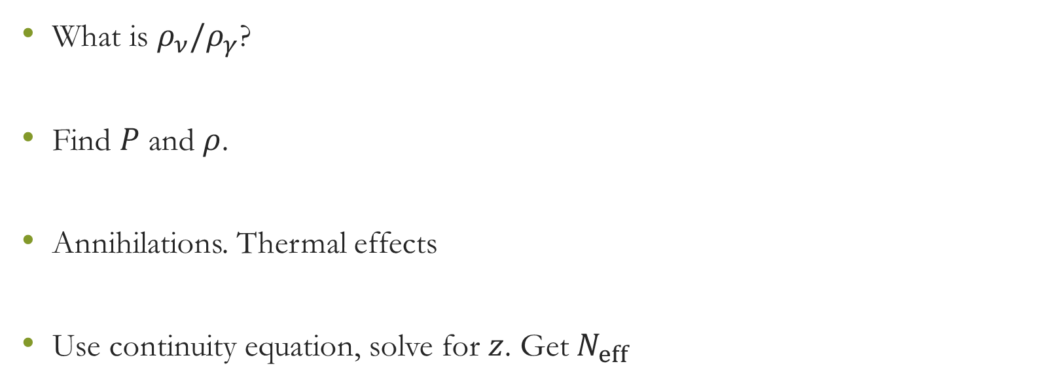
Conclusion
$$\frac{dz}{dx}=\frac{\frac{1}{x} \left({\overline{ρ}}^{0}−3{\overline{P}}^{0}\right) − \frac{∂{\overline{ρ}}^{0}}{∂x} + G_{1}}{\frac{∂{\overline{ρ}}^{0}}{∂z} + G_{2}}$$
$$x=m_{e}/T_{ν}$$
$$y=p/T_{ν}$$
$$z=T_{γ}/T_{ν}$$
What is $ρ_{ν}/ρ_{γ}$?
Find $P$ and $ρ$.
Annihilations. Thermal effects
Use continuity equation, solve for $z$. Get $N_{eff}$

