Slide 1
Using Minkowski Functionals to analyse Weak Lensing maps
Speaker: Yuqi Kang Supervisor: Jan Hamann
UNSW
May 2019

Slide 2
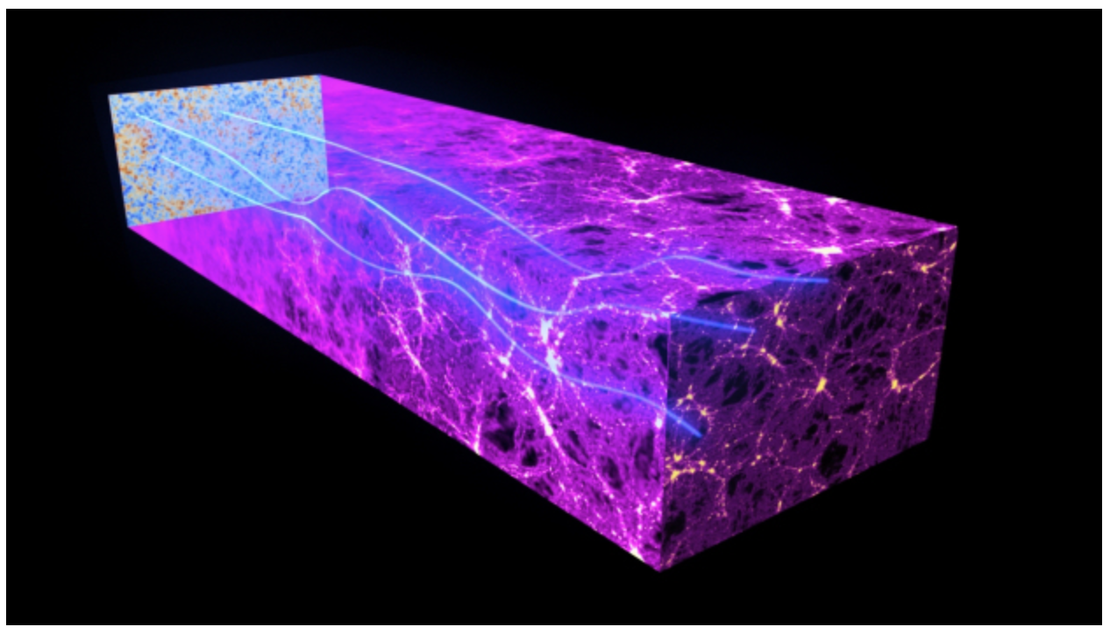
CMB Weak gravitational lensing
CMB photons emitted from the last scattering surface are deflected by gravitational potentials of the large-scale structures
[ESA and the Planck Collaboration]

Slide 3
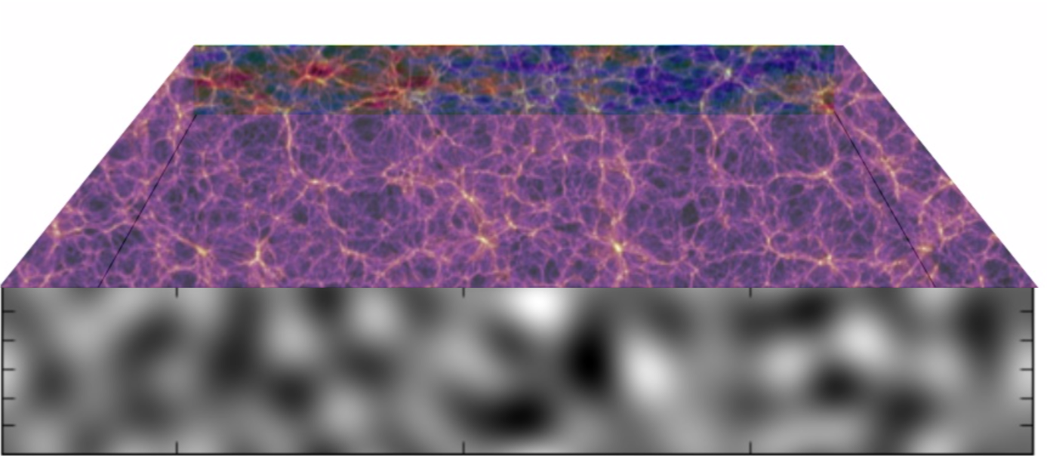

CMB Weak gravitational lensing
Matter density $φ$(x)
[Sherwin Das et al.]
Amount of lensing deflection depends on the projected matter density (Lensing potential) in that direction

Slide 4
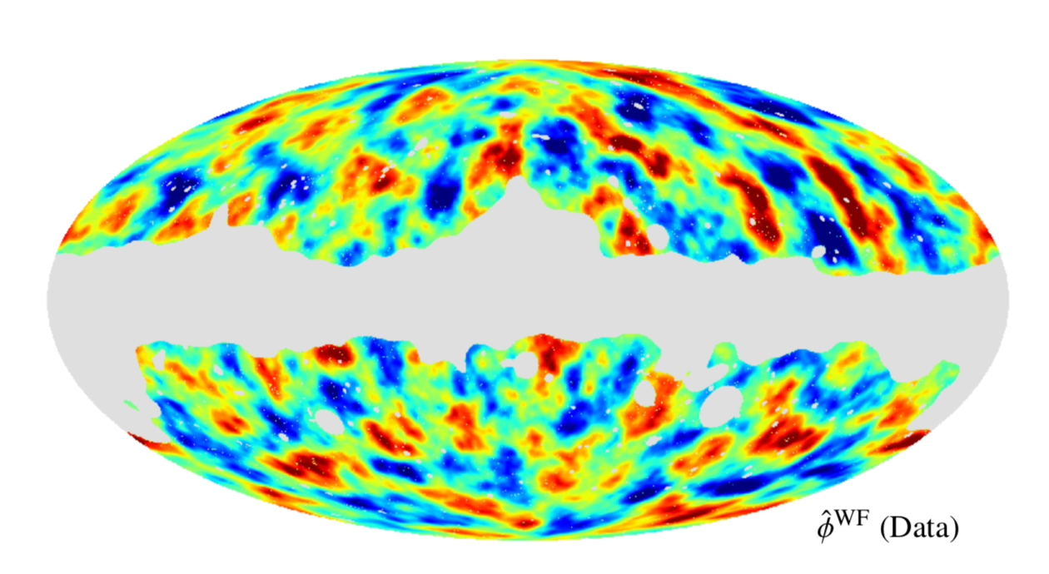
CMB Weak gravitational lensing
Lensing potential map reconstructed by Planck collaboration (2015)
Planck 2015 results.XV (Ade, P. A. R. and others)

Slide 5
Minkowski Functionals, include all higher orders information and easier to measured.
Constrain Cosmological parameters with weak lensing map
Usually use methods like Power spectrum and higher order spectrums
Only include Gaussian information
Include higher orders information, but hard to get

Slide 6
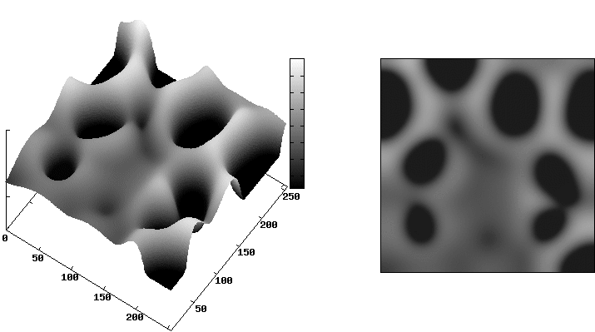
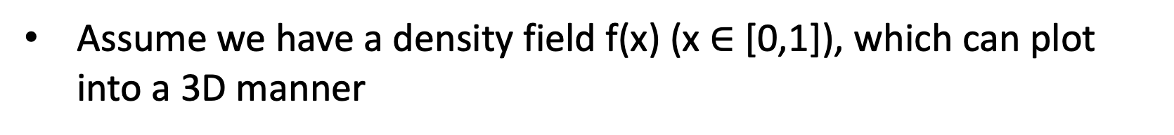
Brief introduction of Minkowski Functionals
Assume we have a density field f(x) (x $∈$ [0,1]), which can plot into a 3D manner
Hubert Mantz et al.

Slide 7
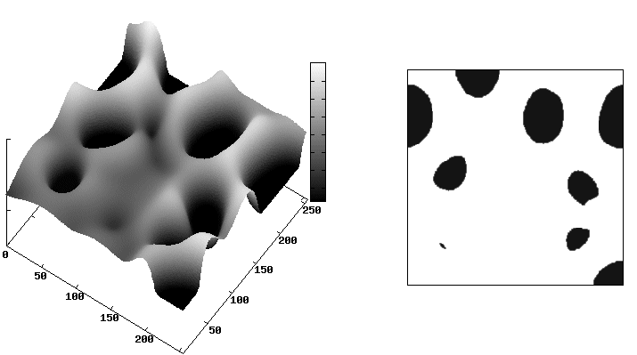
Brief introduction of Minkowski Functionals
Use a threshold plate “cut” the field from 0 to 1.
Hubert Mantz et al.

Slide 8
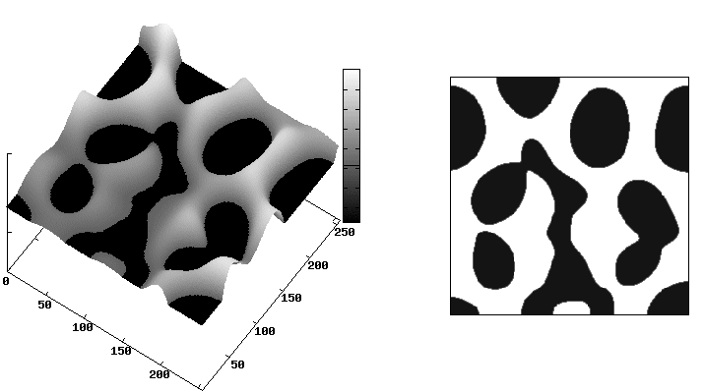
Brief introduction of Minkowski Functionals
Use a threshold plate “cut” the field from 0 to 1.
Hubert Mantz et al.

Slide 9
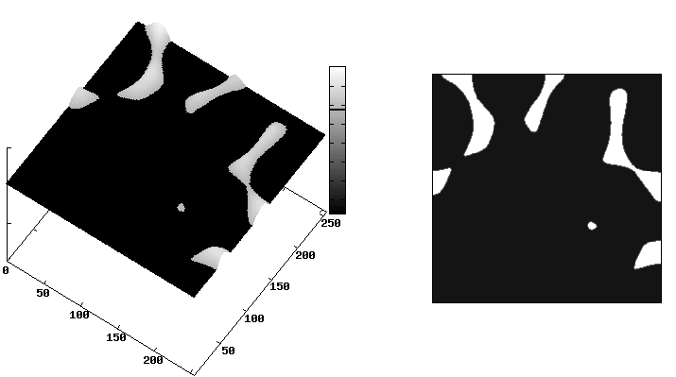
Brief introduction of Minkowski Functionals
Use a threshold plate “cut” the field from 0 to 1.
Hubert Mantz et al.

Slide 10
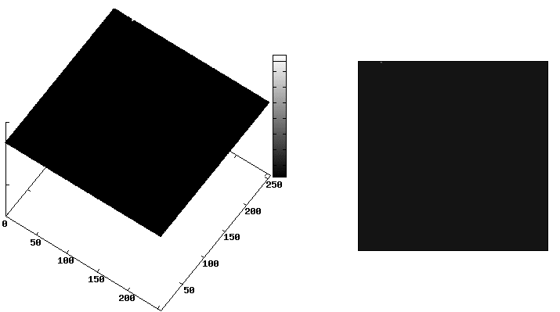
Brief introduction of Minkowski Functionals
Use a threshold plate “cut” the field from 0 to 1.
Hubert Mantz et al.

Slide 11
Brief introduction of Minkowski Functionals
The patches above the threshold are called an “excursion set”
The MFs describe the topological features of the excursion set
Hubert Mantz et al.

Slide 12
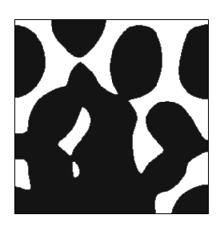

Brief introduction of Minkowski Functionals
The patches above the threshold are called as “excursion set”
The MFs describe the topological feature of excursion set
V₀: Area
V₁: Perimeter
V₂: Genus ($χ$)
$χ \text{=} \text{number} \text{of} \text{isolated} \text{regions}$- number of holes
Hubert Mantz et al.

Slide 13
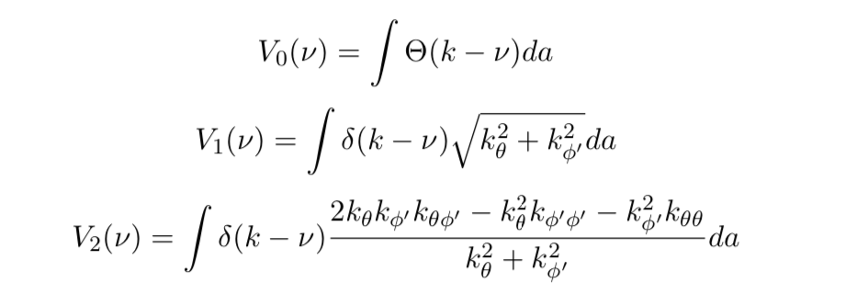
Get MFs from weak lensing result
Numerically
Area
Perimeter
Genus
$ν$: threshold $κ$: values of the map (the lensing map can express as a scalar field f($κ$))

Slide 14
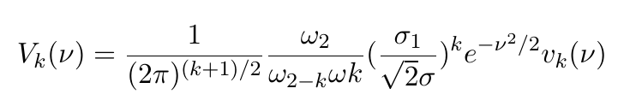
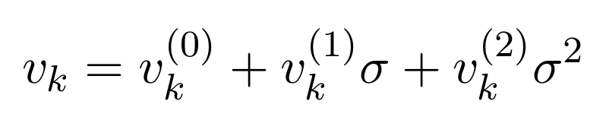
Get MFs from weak lensing result
constant
Analytically
+ ……
Gaussian part
Non-Gaussian part

Slide 15


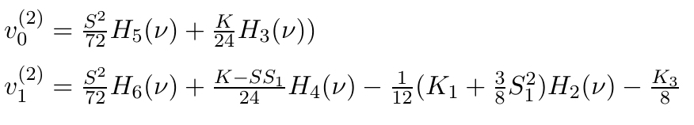
Get MFs from weak lensing result
Analytically
Zeroth order:
First order:
Second order:
H_{k} : Hermite Polynomial
S_{k} : Skewness parameters
K_{k} : Kurtosis parameters

Slide 16
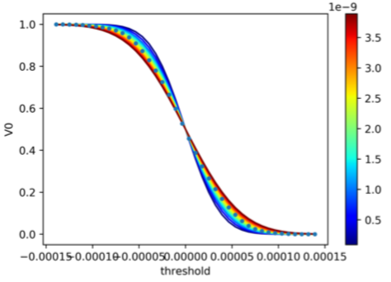
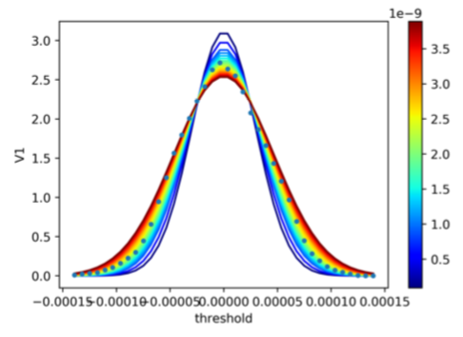
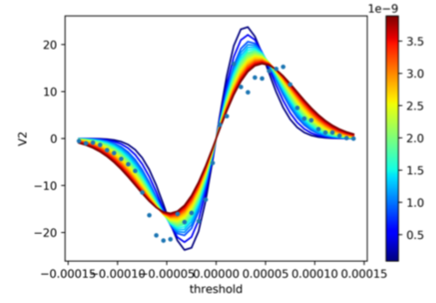

Previous work
Minkowski Functionals will be affected by the cosmological parameters
Example: $A_{s}$ (primordial fluctuation power spectrum amplitude)
V₀
_{(Area)}
V₁
_{(Perimeter)}
V₂
_{(Genus)}
Solid color line: Theoretical MFs Color bar: value of $A_{s}$,
Blue dot line: MFs measured from Planck's map

Slide 17
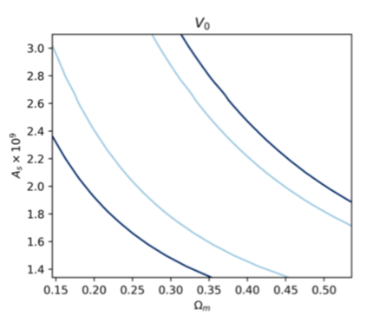
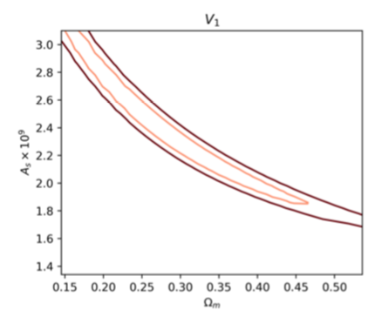
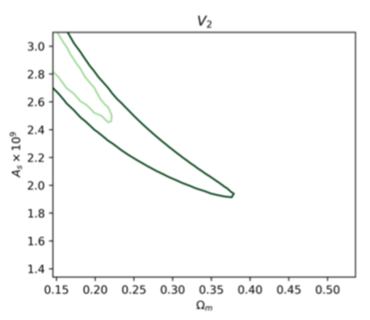







Previous work
Made a joint constrain of $Ω_{m} and A_{s}$
V₀
V₁
V₂
Inner contour : 68% confidence region
outer contour : 95% confidence region
$$A_{s}$$
$$A_{s}$$
$$A_{s}$$
$$Ω_{m}$$
$$Ω_{m}$$
$$Ω_{m}$$
($Ω_{m}$: matter density)
( $A_{s}$ : primordia fluctuation power spectrum amplitude)

Slide 18
Current & Future works
To analyze non-Gaussian information in weak lensing map, we add higher order correction of MFs in to account.
Use N-body simulation generate simulated weak lensing maps

