Slide 1
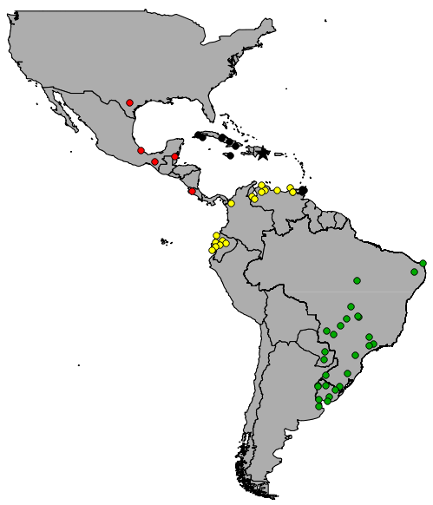
Summary of previous results
NC/CG - North/Central America
DRG - Dominican Republic
NAG - North of the Amazon
SAG - South of the Amazon
No shared haplotypes among groups
Fresia et al. 2011

Slide 2
Summary of previous results
Pairwise ΦST's
0.718*
0.359*
0.347*
0.623*
ABC hypothesis test
0.155*
0.597*
* P<0.001

Slide 3
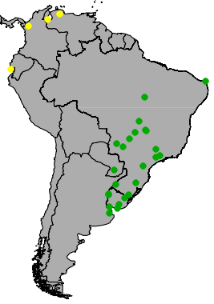
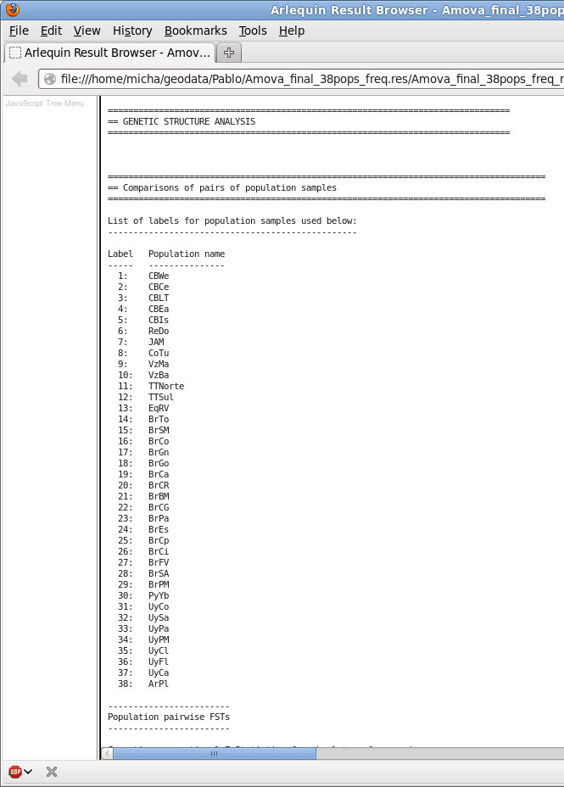

Population sampling sites
Arlequin Software
28 sampling sites
N ≥ 4

Slide 4
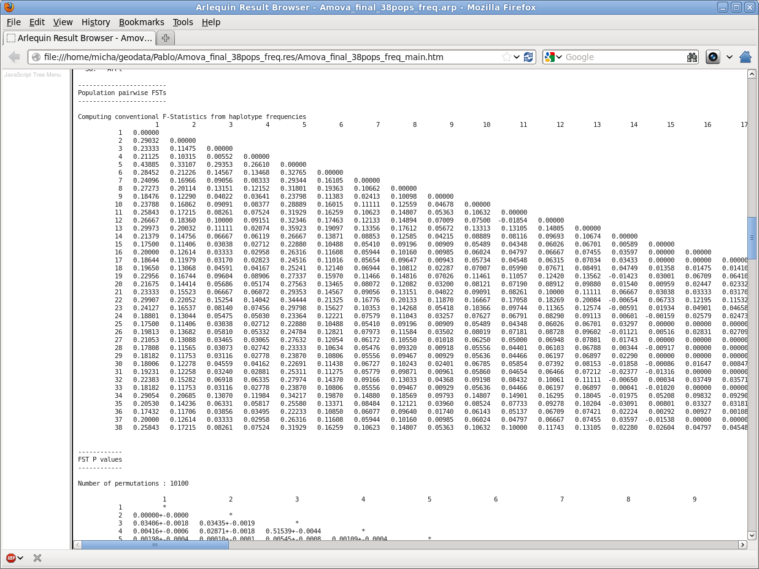
Pairwise ΦST's matrix

Slide 5
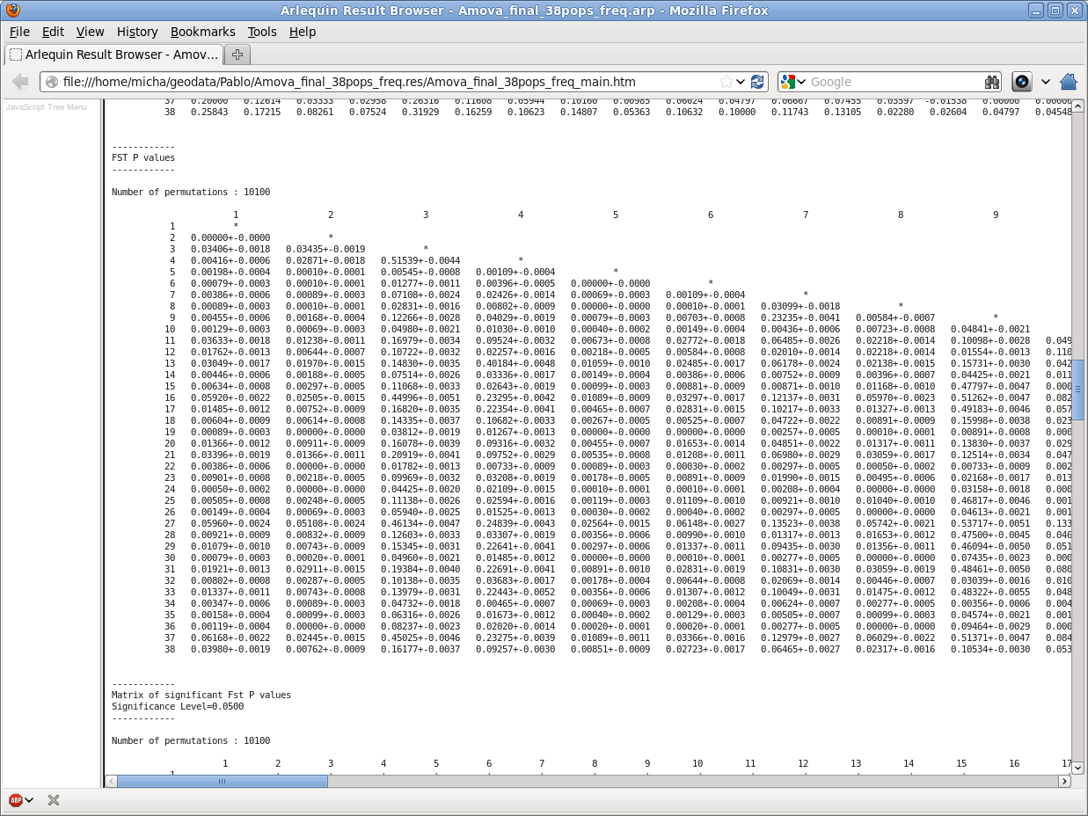
Statistical significance - P values

Slide 6
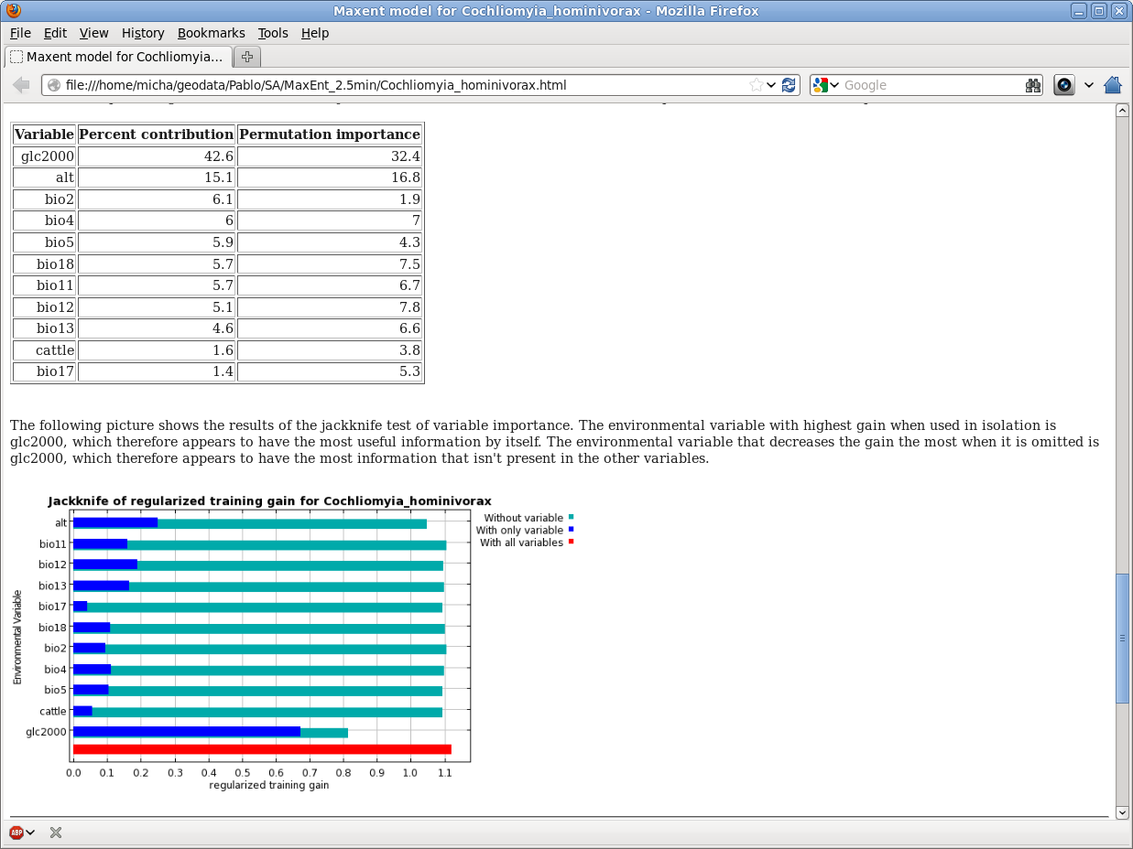
Using MaxEnt
Environmental Predictors
19 Bioclim Variables
Altitude
GLC2000 land cover
Livestock distribution

Slide 7
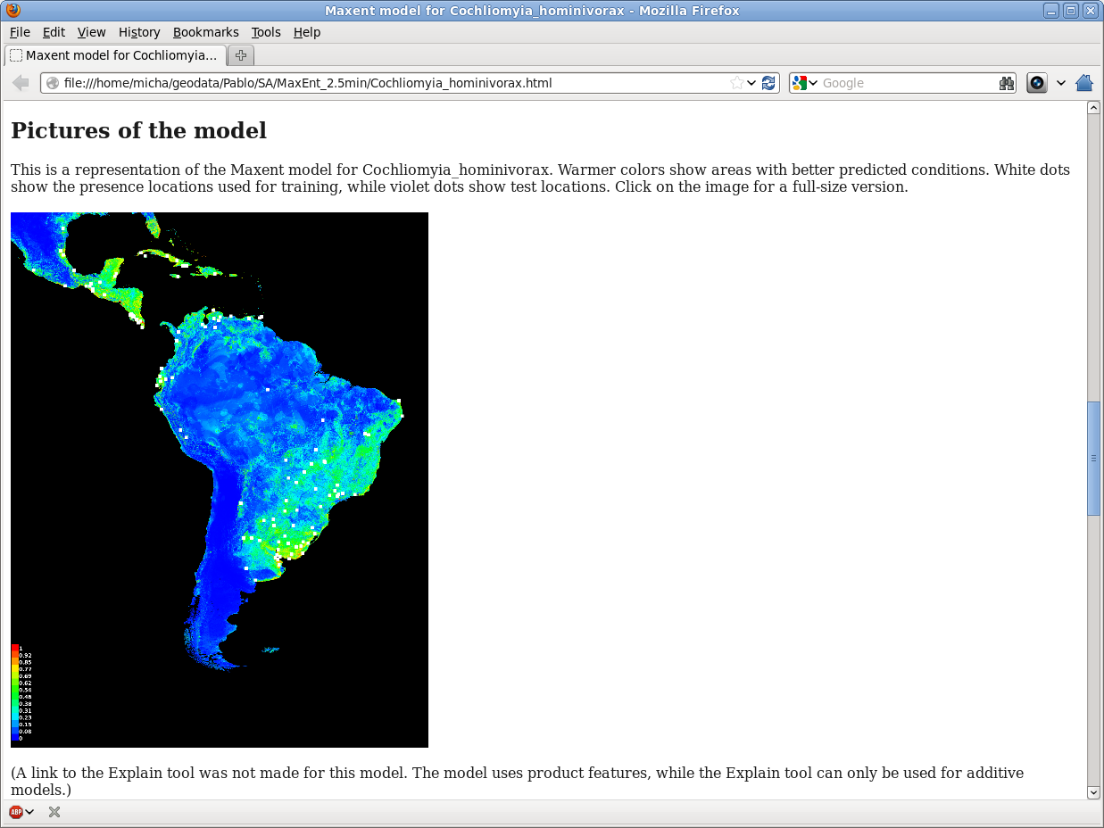
Using MaxEnt
Habitat Density

Slide 8
Procedure in GRASS GIS
Import
HSM raster
Merge all
corridors
Invert HSM –>
friction map
Reclass
Merged
Raster
Import
localities
Create LCP
for each locality
Import
Locality pairs
Create corridors
for each
Locality pair
Result ->
Predicted
migration
corridors

