Slide 1
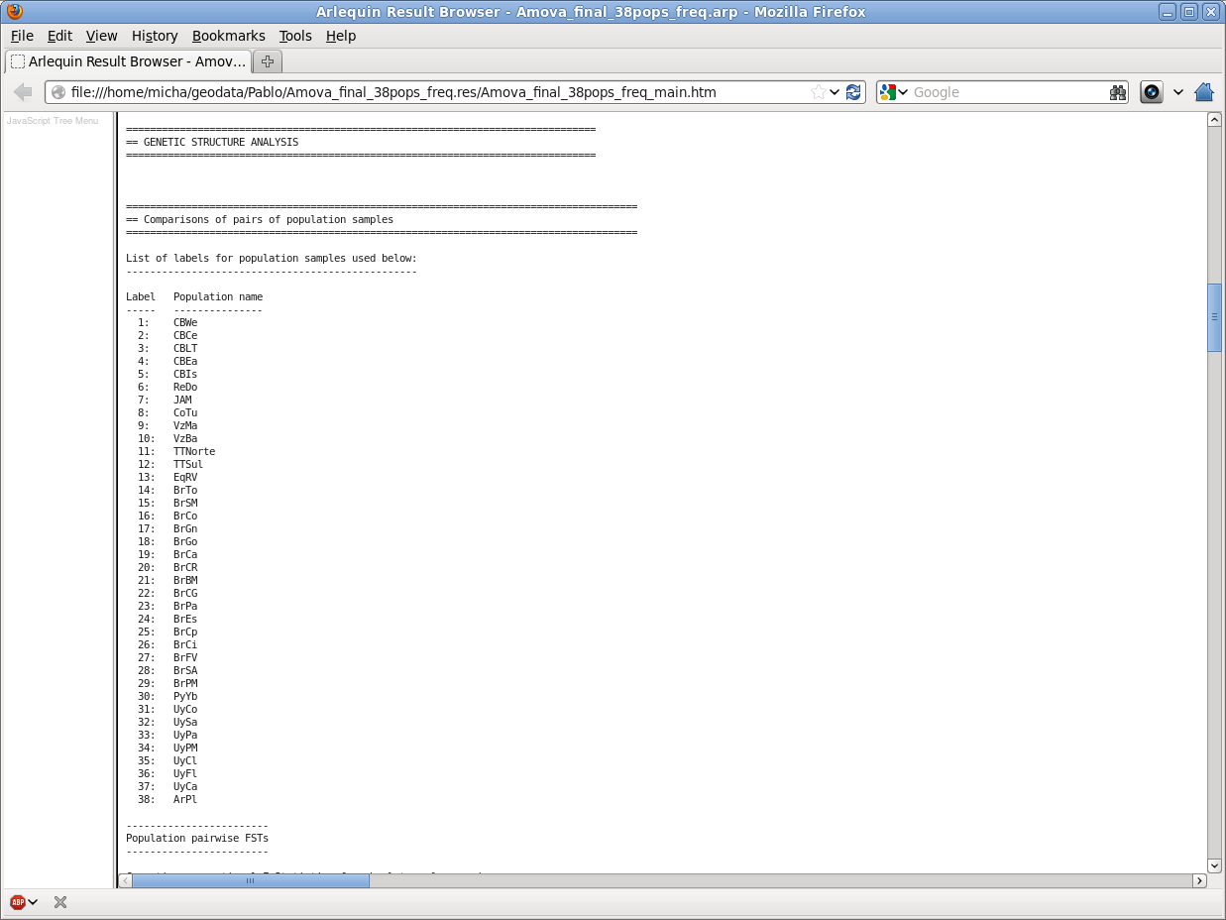
Genetic Analysis with Arlequin
Population sampling sites

Slide 2
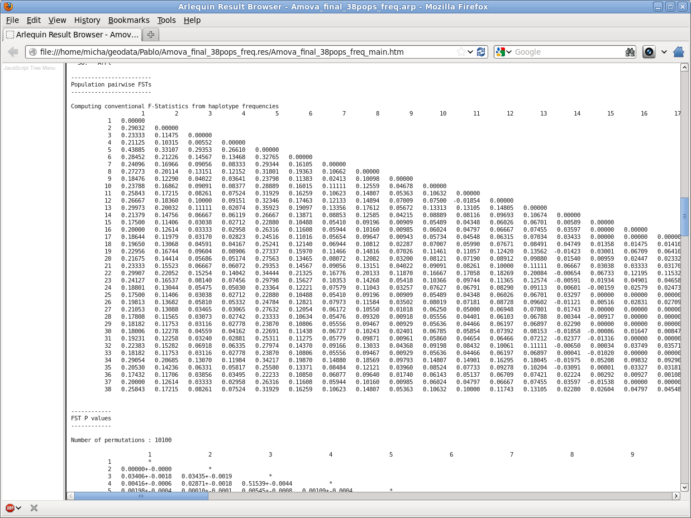
Genetic Analysis with Arlequin
Fst Result Matrix

Slide 3
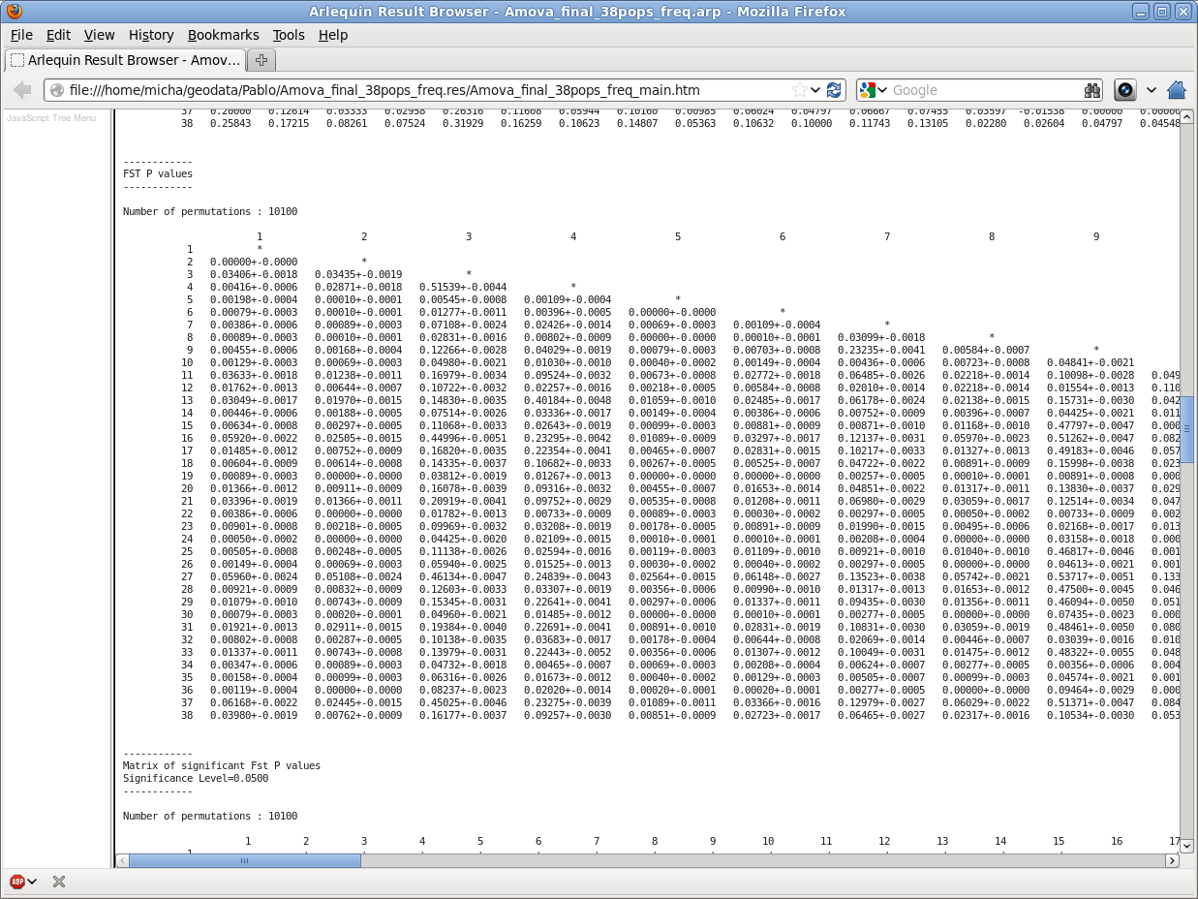
Genetic Analysis with Arlequin
Statistical significance - P values

Slide 4
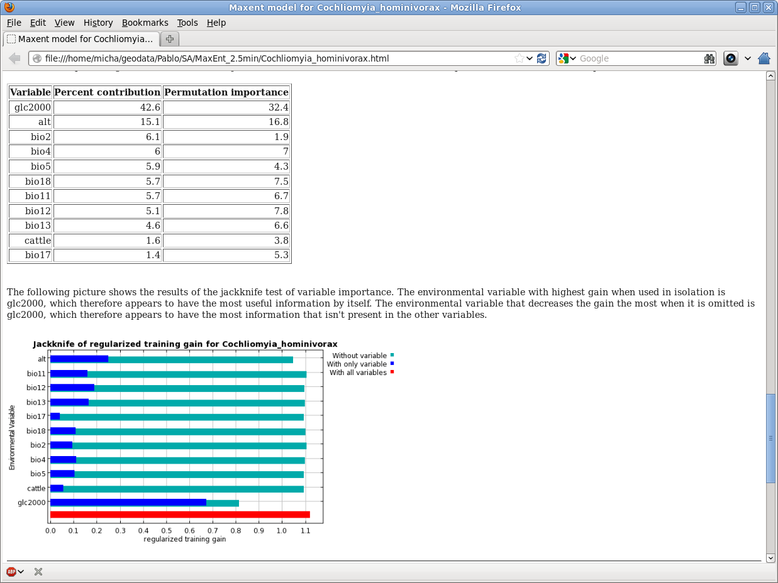
Using MaxEnt
Environmental Predictors

Slide 5
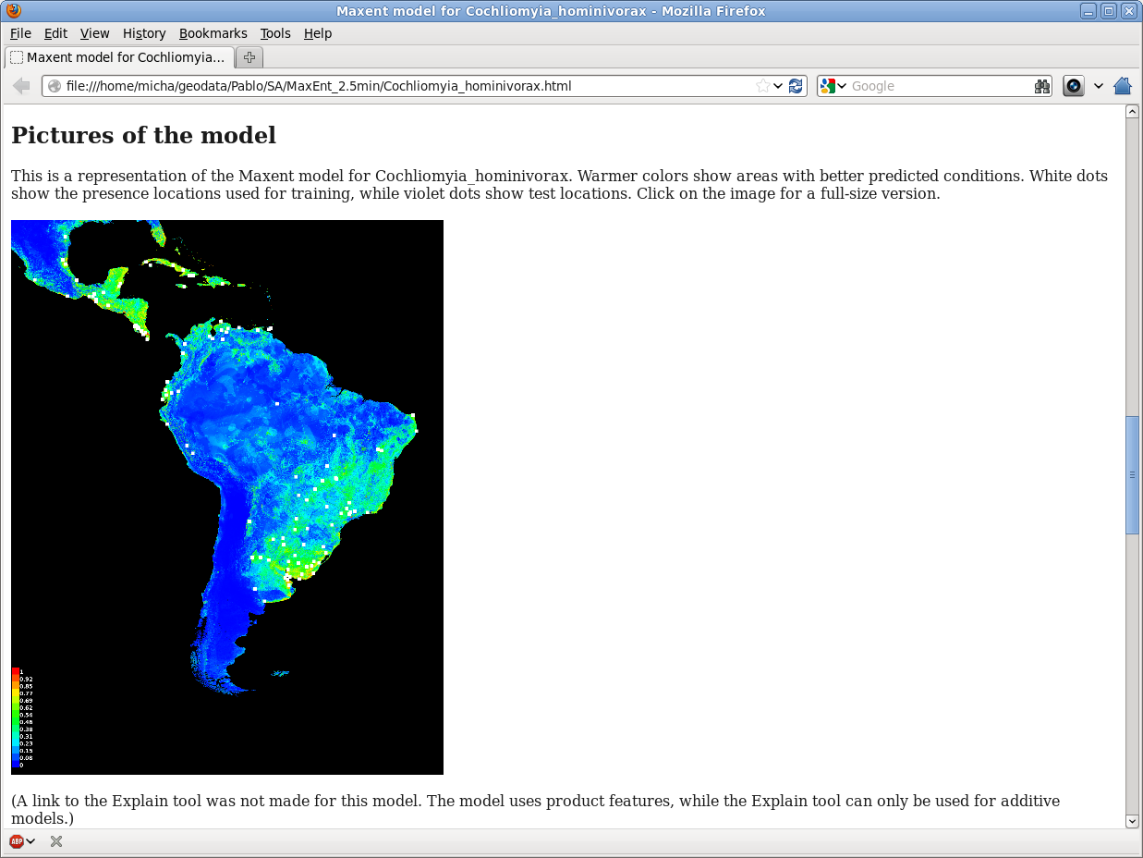
Using MaxEnt
Habitat Density

Slide 6
Procedure in GRASS GIS

