Slide 1
Exploring Underwater Acoustics Using Parallel Algorithms
Michael Haas

Slide 2
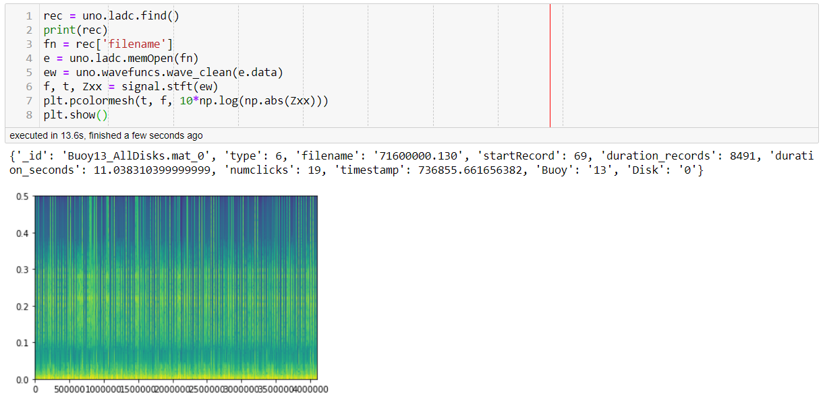
Problem
Want to operate (clean noise, extract frequency information, etc.) on large (hours +) amounts of 192kHz audio data.
Current solutions can handle on the order of minutes before crashing.
Specific operation targeted:
Load data -> Wavelet denoising -> stft (short time fast Fourier transform)
“normal” sequential code:

Slide 3
Challenges/Motivation
Current methods used numpy, numpy requires all data to be in memory and available to the process it is running in.
Can’t scale past single machine and limited by RAM.
Initially pursued MPI based solution, was difficult to manage details, but showed small promise.
Played with more traditional Python based parallelism.
Threading/multiprocessing has issues, threading can’t easily share and multiprocessing requires modules to be pickle serialized, causes much overhead
Dask seems to offer good solutions, uses threading/MPI/others under the hood, can scale easily to clusters from single machines with multi cores. Has some GPU accelerated features as well (did not get to try them yet)

Slide 4
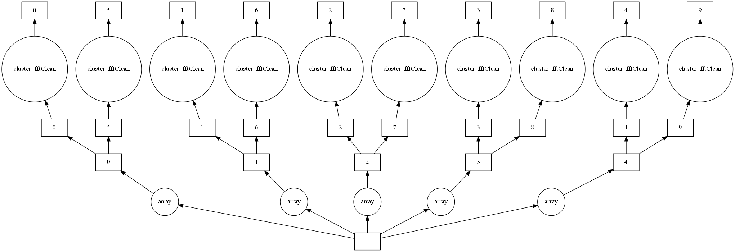
Implementation
Dask
System in Python to allow scalable numpy like operations
Dask Array
delayed
Lazy evaluation
Powerful debugging tooling
Live graph
DAG visualization

Slide 5
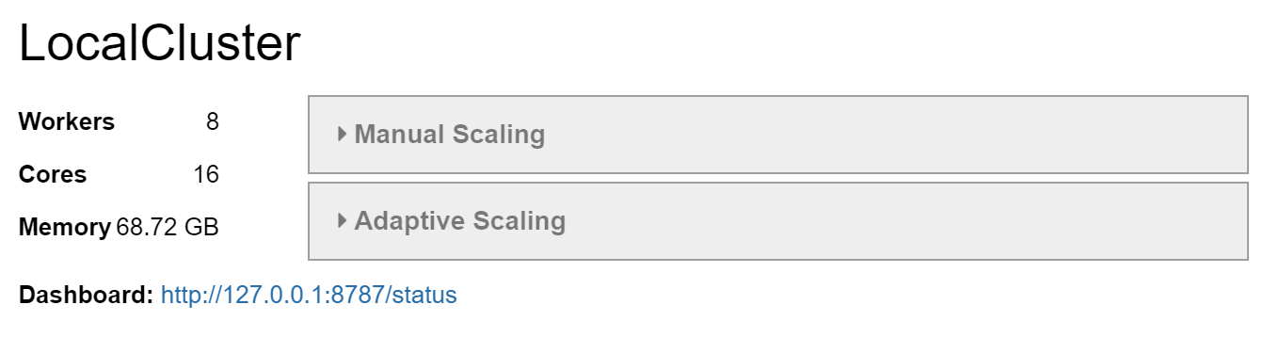
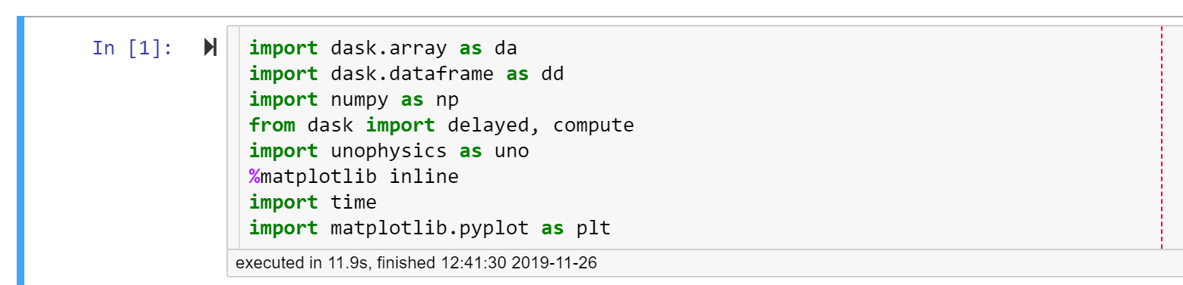
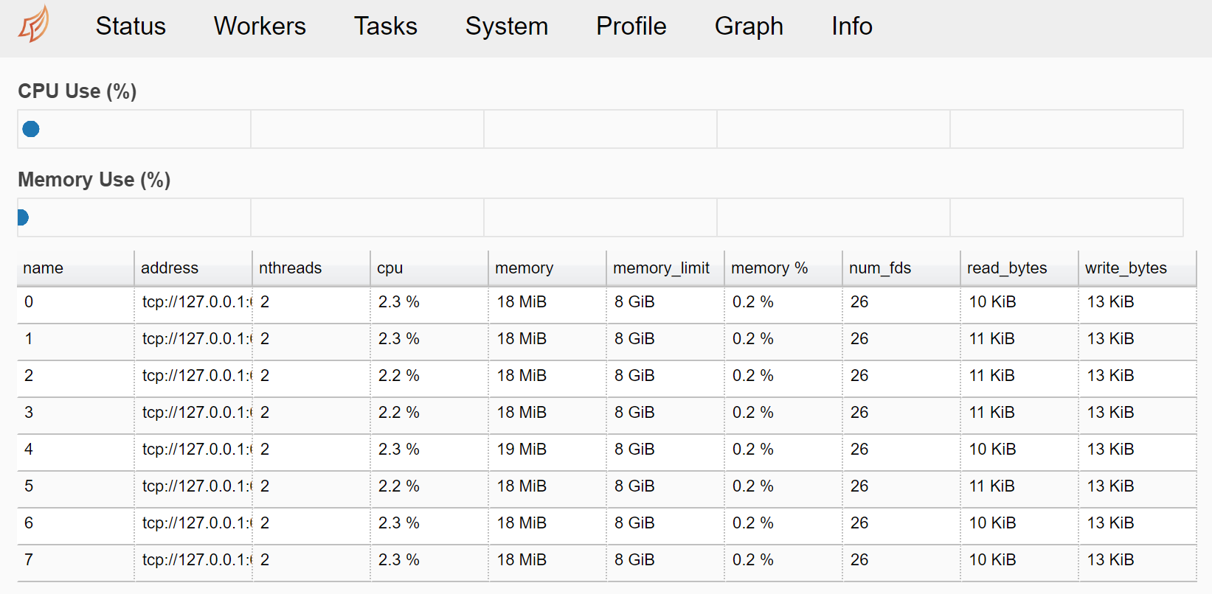
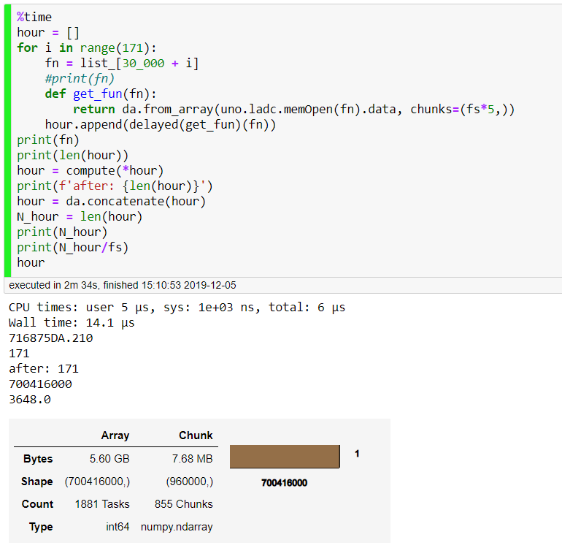
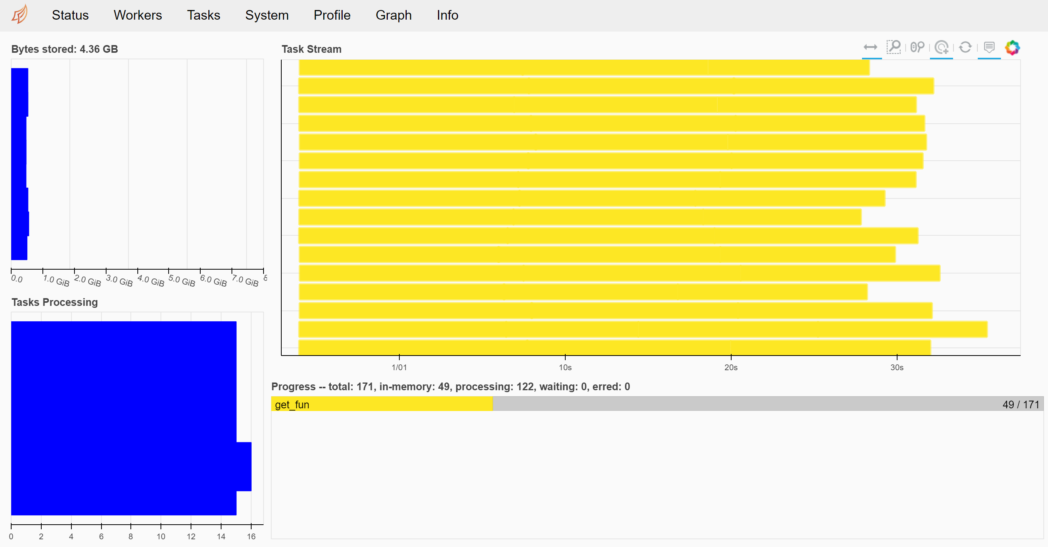

Slide 6
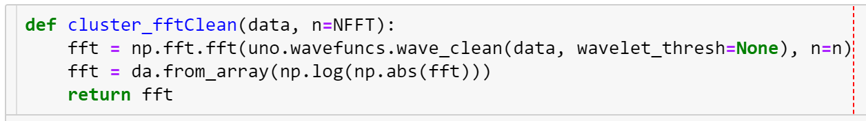
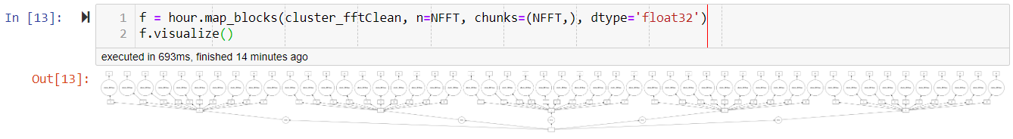
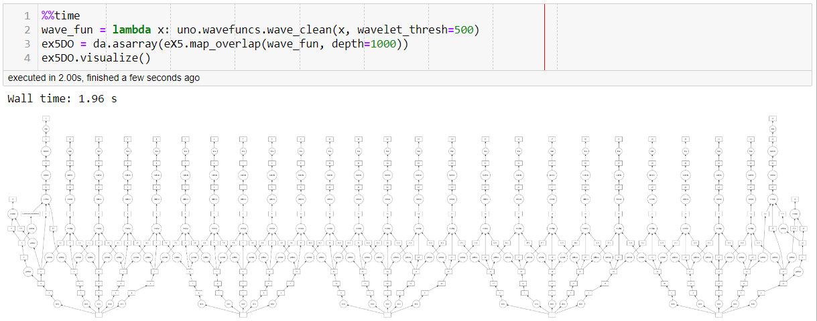
Strategy for Solutions
Load data into distributed Dask arrays
Can map to chunks (stft, peak detection, etc.)
Can map across with crossover (wavelet TF, standard fft, etc.)

Slide 7
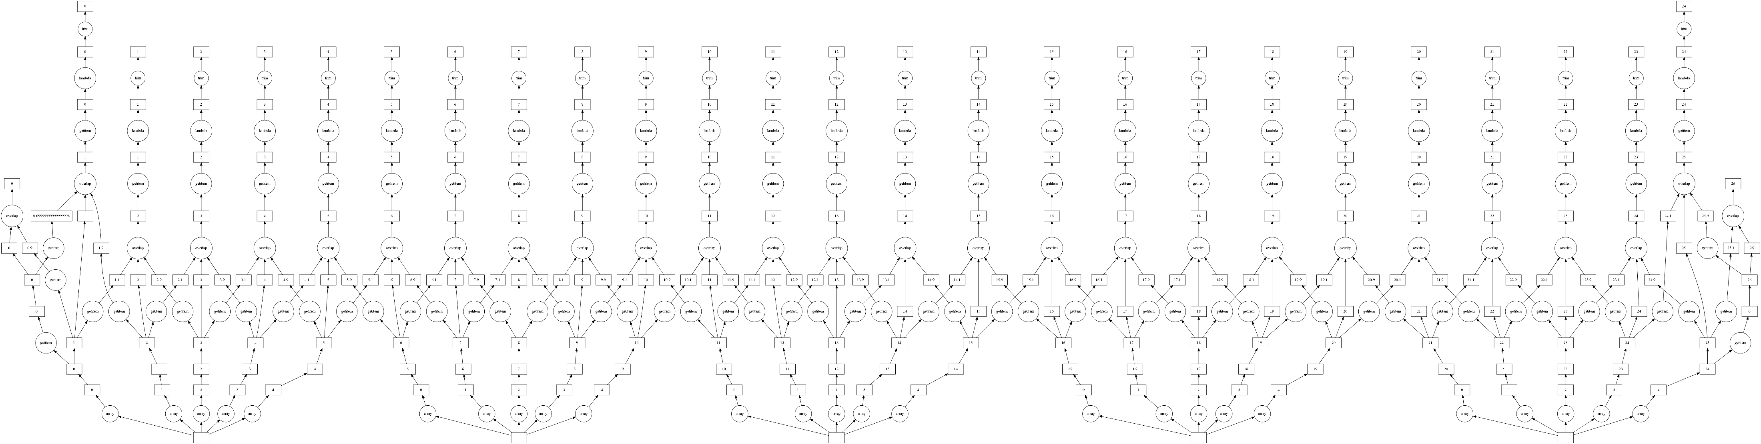
Direct mapping to chunks:
Mapping with overlap:

Slide 8
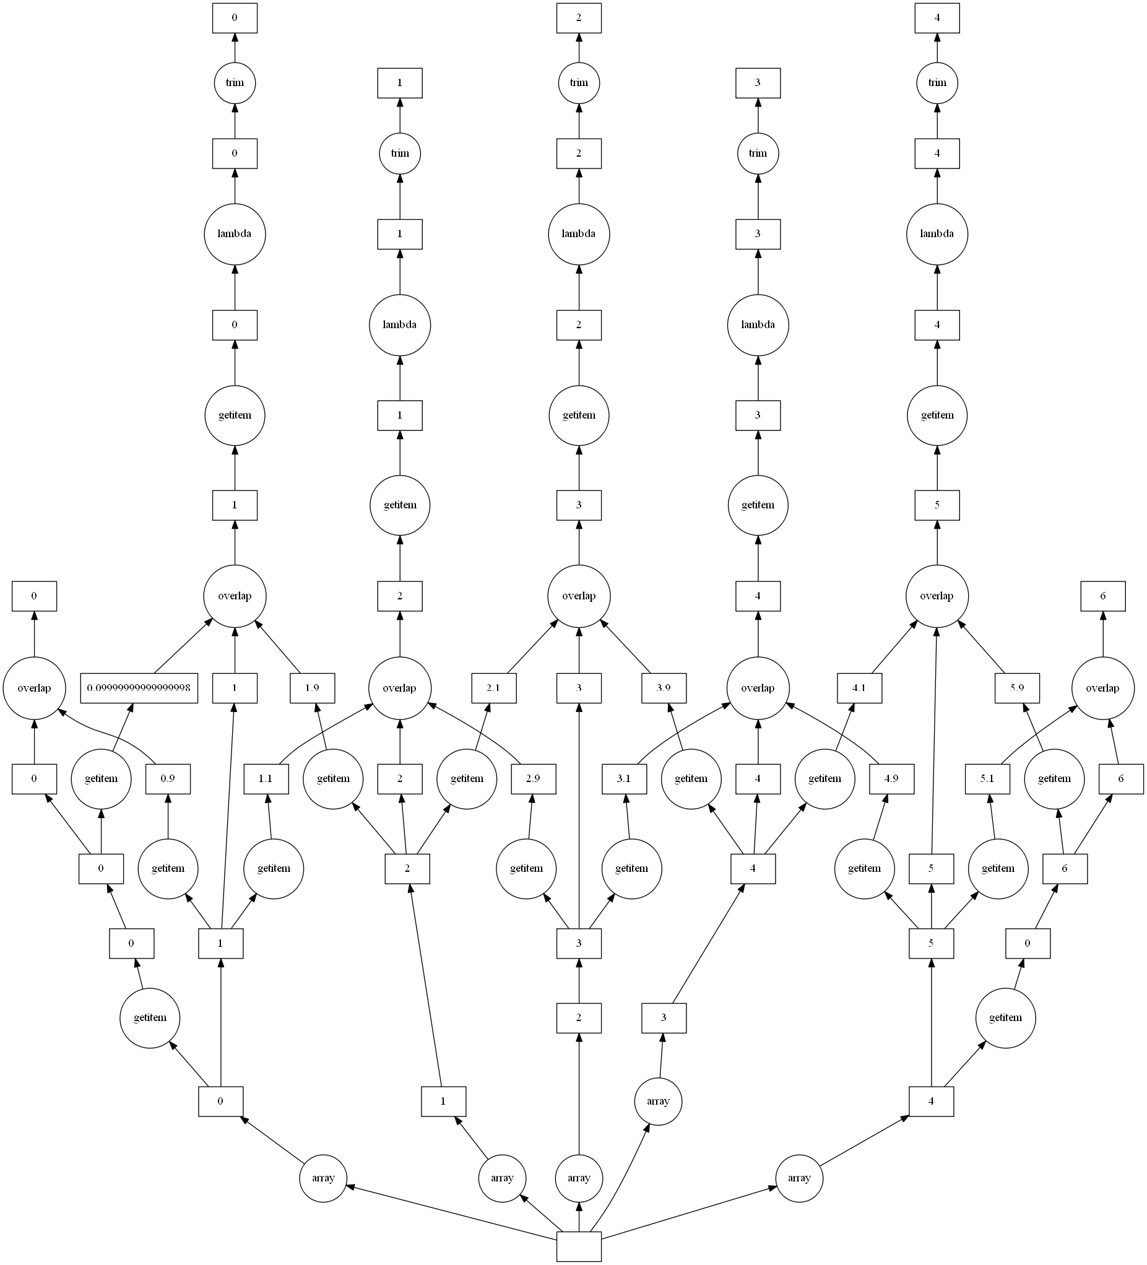
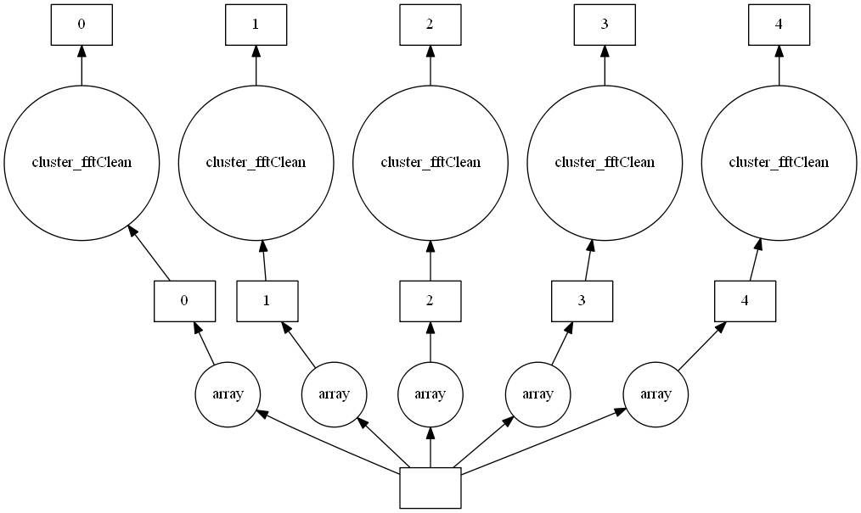

Slide 9
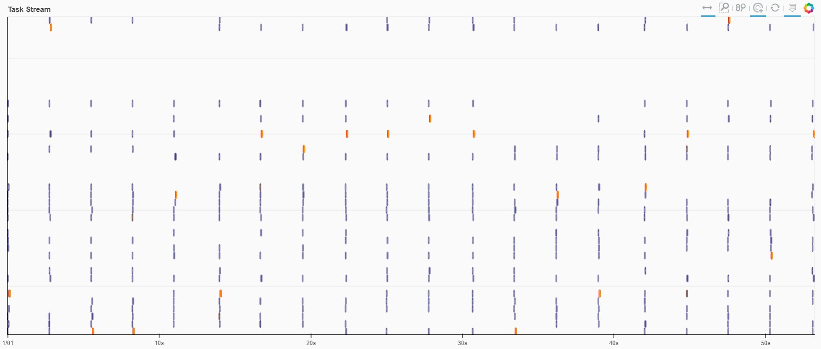
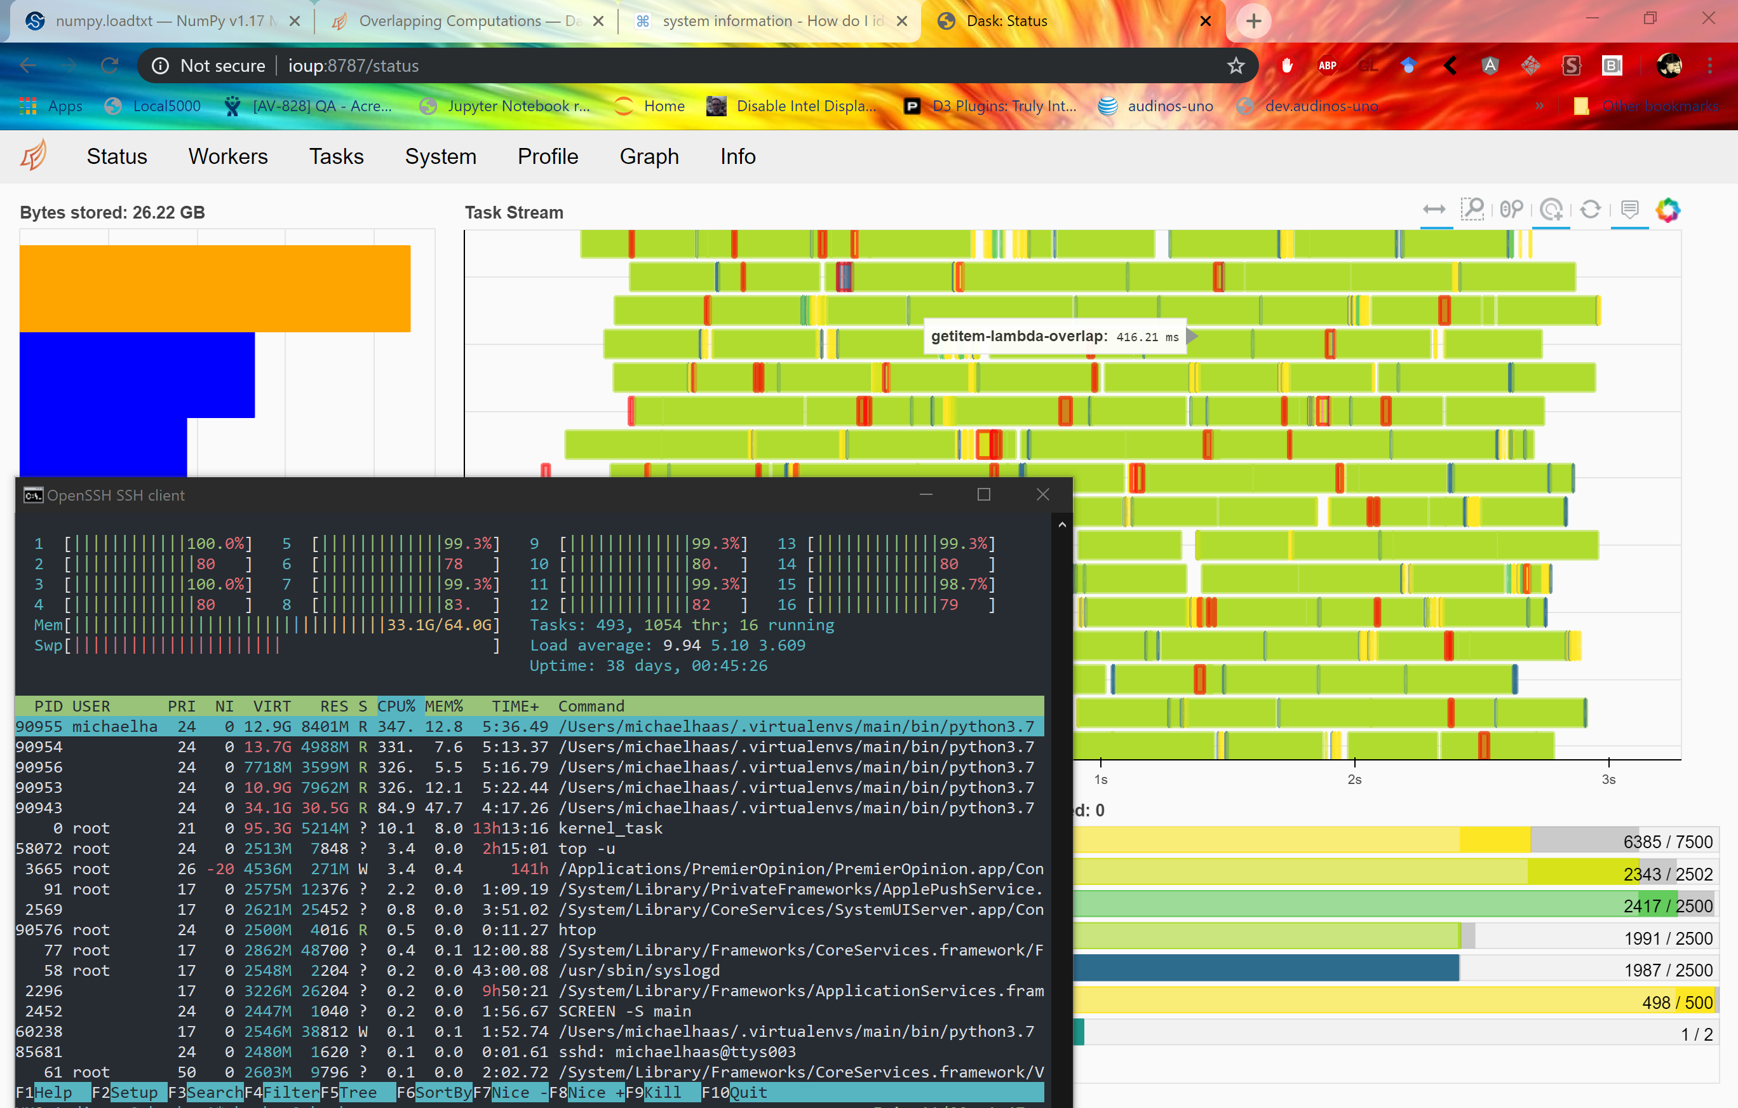
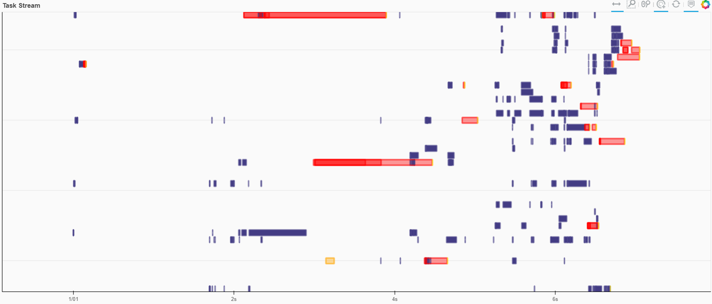
Results

Slide 10
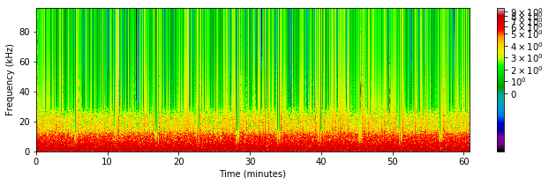
One full hour of data cleaned and STFT

Slide 11
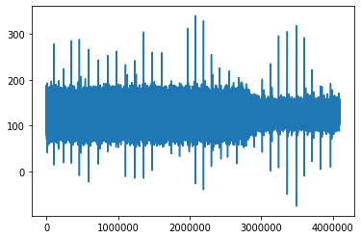
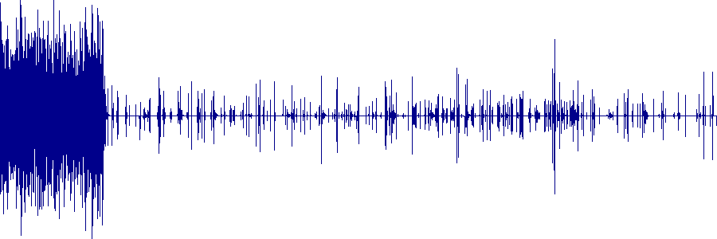
Example of wavelet thresholding on distributed array, overlapping. Threshold turned up high to show results better.

Slide 12
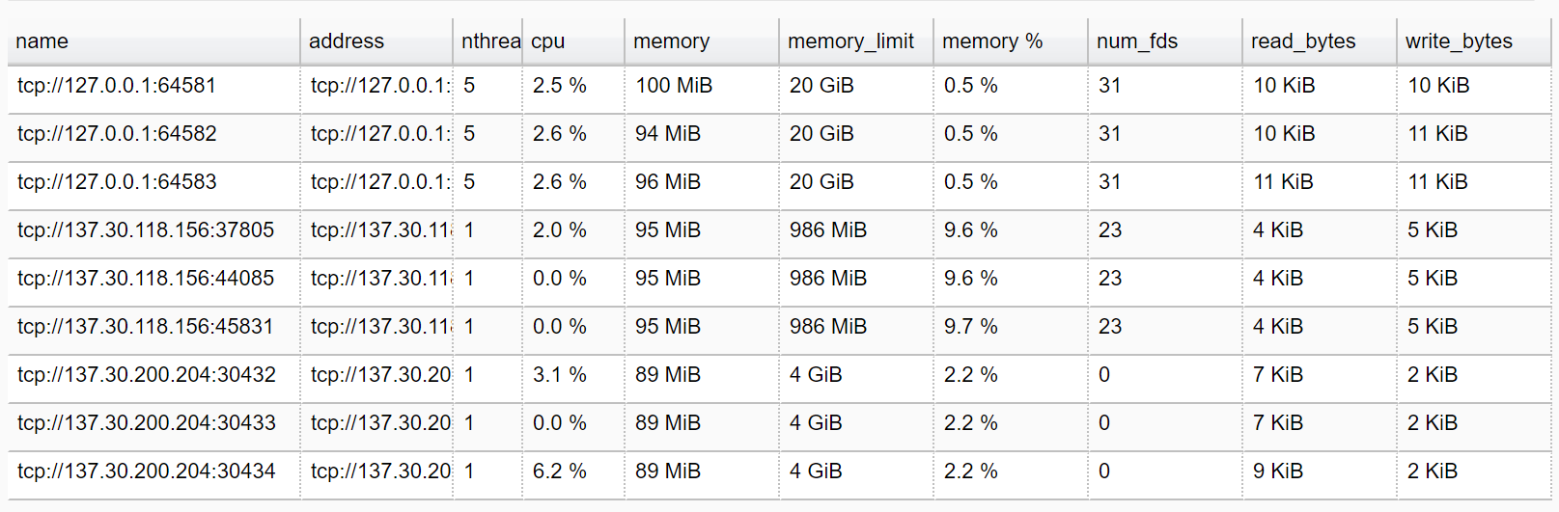
Can build heterogeneous clusters

Slide 13
Future work:
More accuracy verifications
More testing across numbers of cores/workers
Bring distributed functions into core library

