Slide 1




Identifying Crosslinks in MS2-MS3-based Workflows with MS Annika
Micha Johannes Birklbauer, University of Applied Sciences Upper Austria, Hagenberg
September 13th, 2022

Slide 2
Cross-linking
Protein A
Crosslinker: Small molecule that covalently links amino acids in or between proteins
Digestion
Smaller connected fragments → α Peptide and β Peptide
Analyzed with mass spectrometry
Used for structure determination and protein-interaction networks
Crosslinker
Protein B
Digestion
α Peptide
β Peptide
Fig. 1: Cross-linking basics.
Notes:
Very basic:
You have your sample with your proteins in it
You add your crosslinker
You digest it
You get theses smaller connected fragment called alpha and beta peptide
They are analyzed on the mass spectrometer

Slide 3
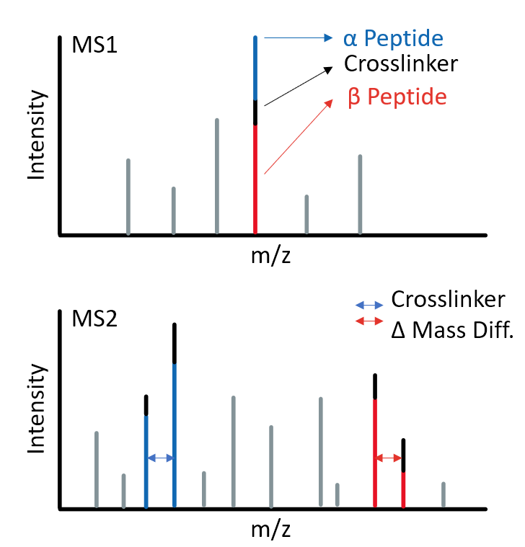
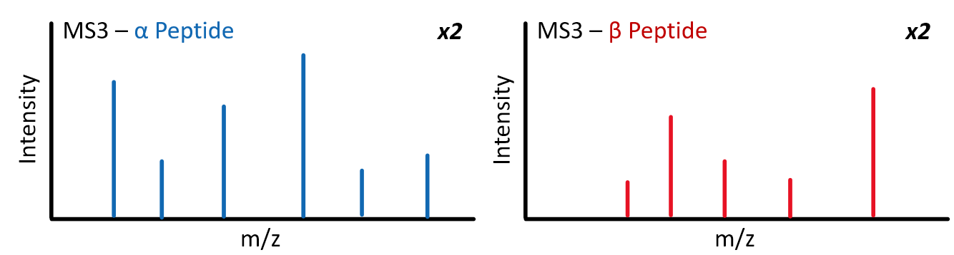
MS2 vs. MS3-based Cross-linking Workflows
In the context of MS-cleavable crosslinkers, identification of crosslinks can be done via:
MS2-based workflows
MS2-MS3-based workflows
Fig. 2: Cross-linked peptides at different MSn levels.
Notes:
On the right side you can see crosslinked peptides over different MS stages
At the MS1 level you have the two crosslinked peptides still linked together
At the MS2 level you have the crosslinker is cleaved and you can see these doublet peaks that are characteristic for cleavable crosslinkers
At the MS3 level you only have a single peptide per spectrum
Identification can either be done from the MS2 spectrum or from the MS3 spectrum

Slide 4

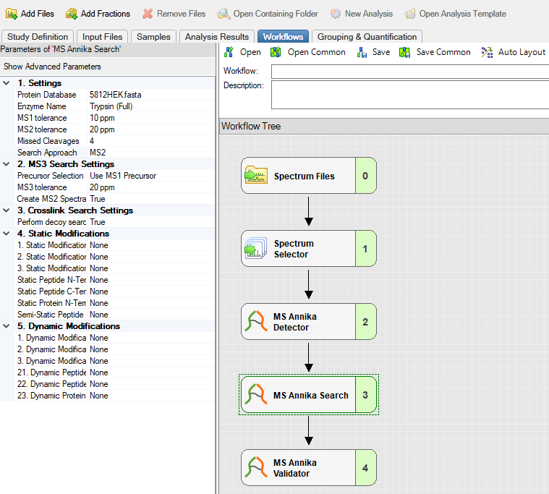
MS Annika
We previously developed MS Annika¹ – a cross-linking search engine for MS2-based workflows
MS Annika is implemented as nodes for Proteome Discoverer
The updated version of MS Annika now also supports data from MS3-based workflows
1) Pirklbauer G. J., et al. (2021) MS Annika: A New Cross-Linking Search Engine. Journal of Proteome Research (20)
Fig. 3: A basic cross-linking workflow with MS Annika in Proteome Discoverer.

Slide 5
Identification of Crosslinks from MS3 Spectra
Match MS3 spectra to MS2 crosslink peaks → modification, verification
De-isotoping → mono-isotopic mass
Calculating unmodified peptide masses
Search
MS2
Intensity
m/z
MS3 – α Peptide (long)
MS3 – β Peptide (short)
Intensity
Intensity
m/z
m/z
Fig. 4: MS3 spectra matched to precursor MS2.

Slide 6

Search
Identification of peptides with MS Amanda² – our in-house developed search engine. Example:
Input: Mass of α Peptide, MS3 Spectrum
Database search with MS Amanda
Output: Peptide Sequence, Score
Input: α Peptide Mass + MS3 Spectrum
MS3 – α Peptide (long)
Intensity
m/z
MS Amanda
KQQGHR, 456.35
2) Dorfer V., et al. (2014) MS Amanda, a Universal Identification Algorithm Optimized for High Accuracy Tandem Mass Spectra. Journal of Proteome Research (13)
Fig. 5: Peptide search with MS Amanda.

Slide 7
Boosting Cross-linking Identifications
We can often identify the same peptide in the MS2 spectrum and the MS3 spectra
Peptide hit should have higher confidence/score → boosting
MS2 – identified α Peptide KQQGHR
Intensity
m/z
MS3 – α Peptide (short, ident. KQQGHR)
MS3 – α Peptide (long, ident. KQQGHR)
Intensity
Intensity
m/z
m/z
Fig. 6: MSn spectra of the same peptide.

Slide 8
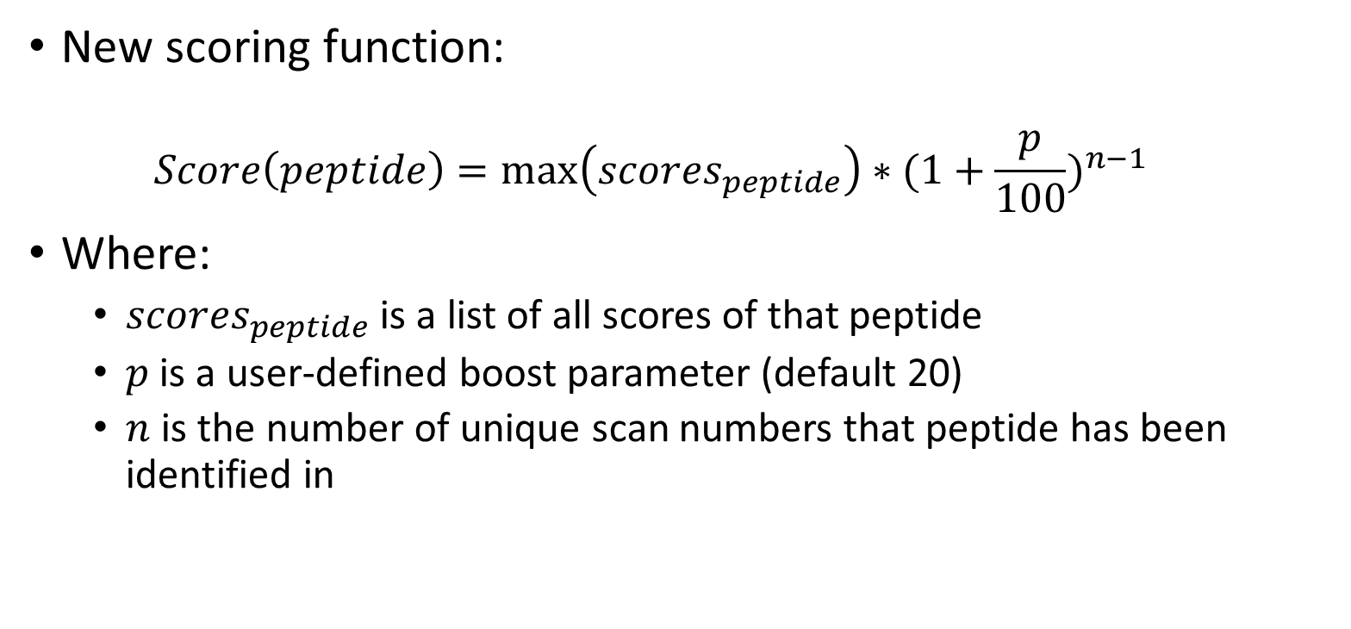
Boosting – Scoring Function
New scoring function:
$$Score\left(peptide\right)=\max\left({scores}_{peptide}\right)∗{(1+\frac{p}{100})}^{n−1}$$
Where:
${scores}_{peptide}$ is a list of all scores of that peptide
$p$ is a user-defined boost parameter (default 20)
$n$ is the number of unique scan numbers that peptide has been identified in

Slide 9
CSM and Crosslink Creation
Having identified both α Peptide and β Peptide, the two results are combined to one Crosslink-Spectrum-Match (CSM), e.g.:
KQQGHR – AMEKAR (Spectrum 1337)
The CSM score is the minimum score of the α Peptide and β Peptide
Multiple CSMs (with the same sequence) are combined to one crosslink
The crosslink score is the maximum score of all associated CSMs
MS Annika does 2 step validation – at CSM level and crosslink level

Slide 10
Results

Slide 11
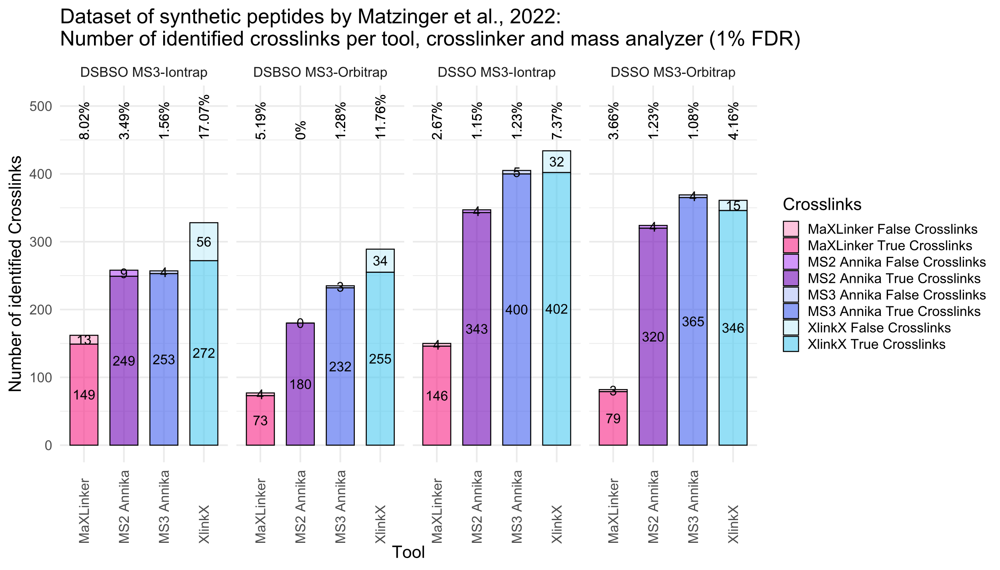
Notes:
We benchmarked MS Annika on datasets of synthetic peptides that allow us to assess the true FDR
The idea is that we have different peptide groups and peptides can only be crosslinked with peptides of their group, so any crosslink consisting of peptides from different groups is a false positive hit
Comparison to 2 other MS3-capable tools: MaXLinker and XlinkX
And to the MS2 version of MS Annika
First dataset by Matzinger and coworkers
Measurements:
Two different crosslinkers DSBSO and DSSO
Two different Mass Analyzer: MS3 recorded in the Iontrap or in the Orbitrap
We validated for 1% FDR
MS Annika yields better FDR estimates than MaXLinker and XlinkX
MS Annika reports a high number of unique crosslinks, outperforming MaXLinker and in some cases also XlinkX

Slide 12
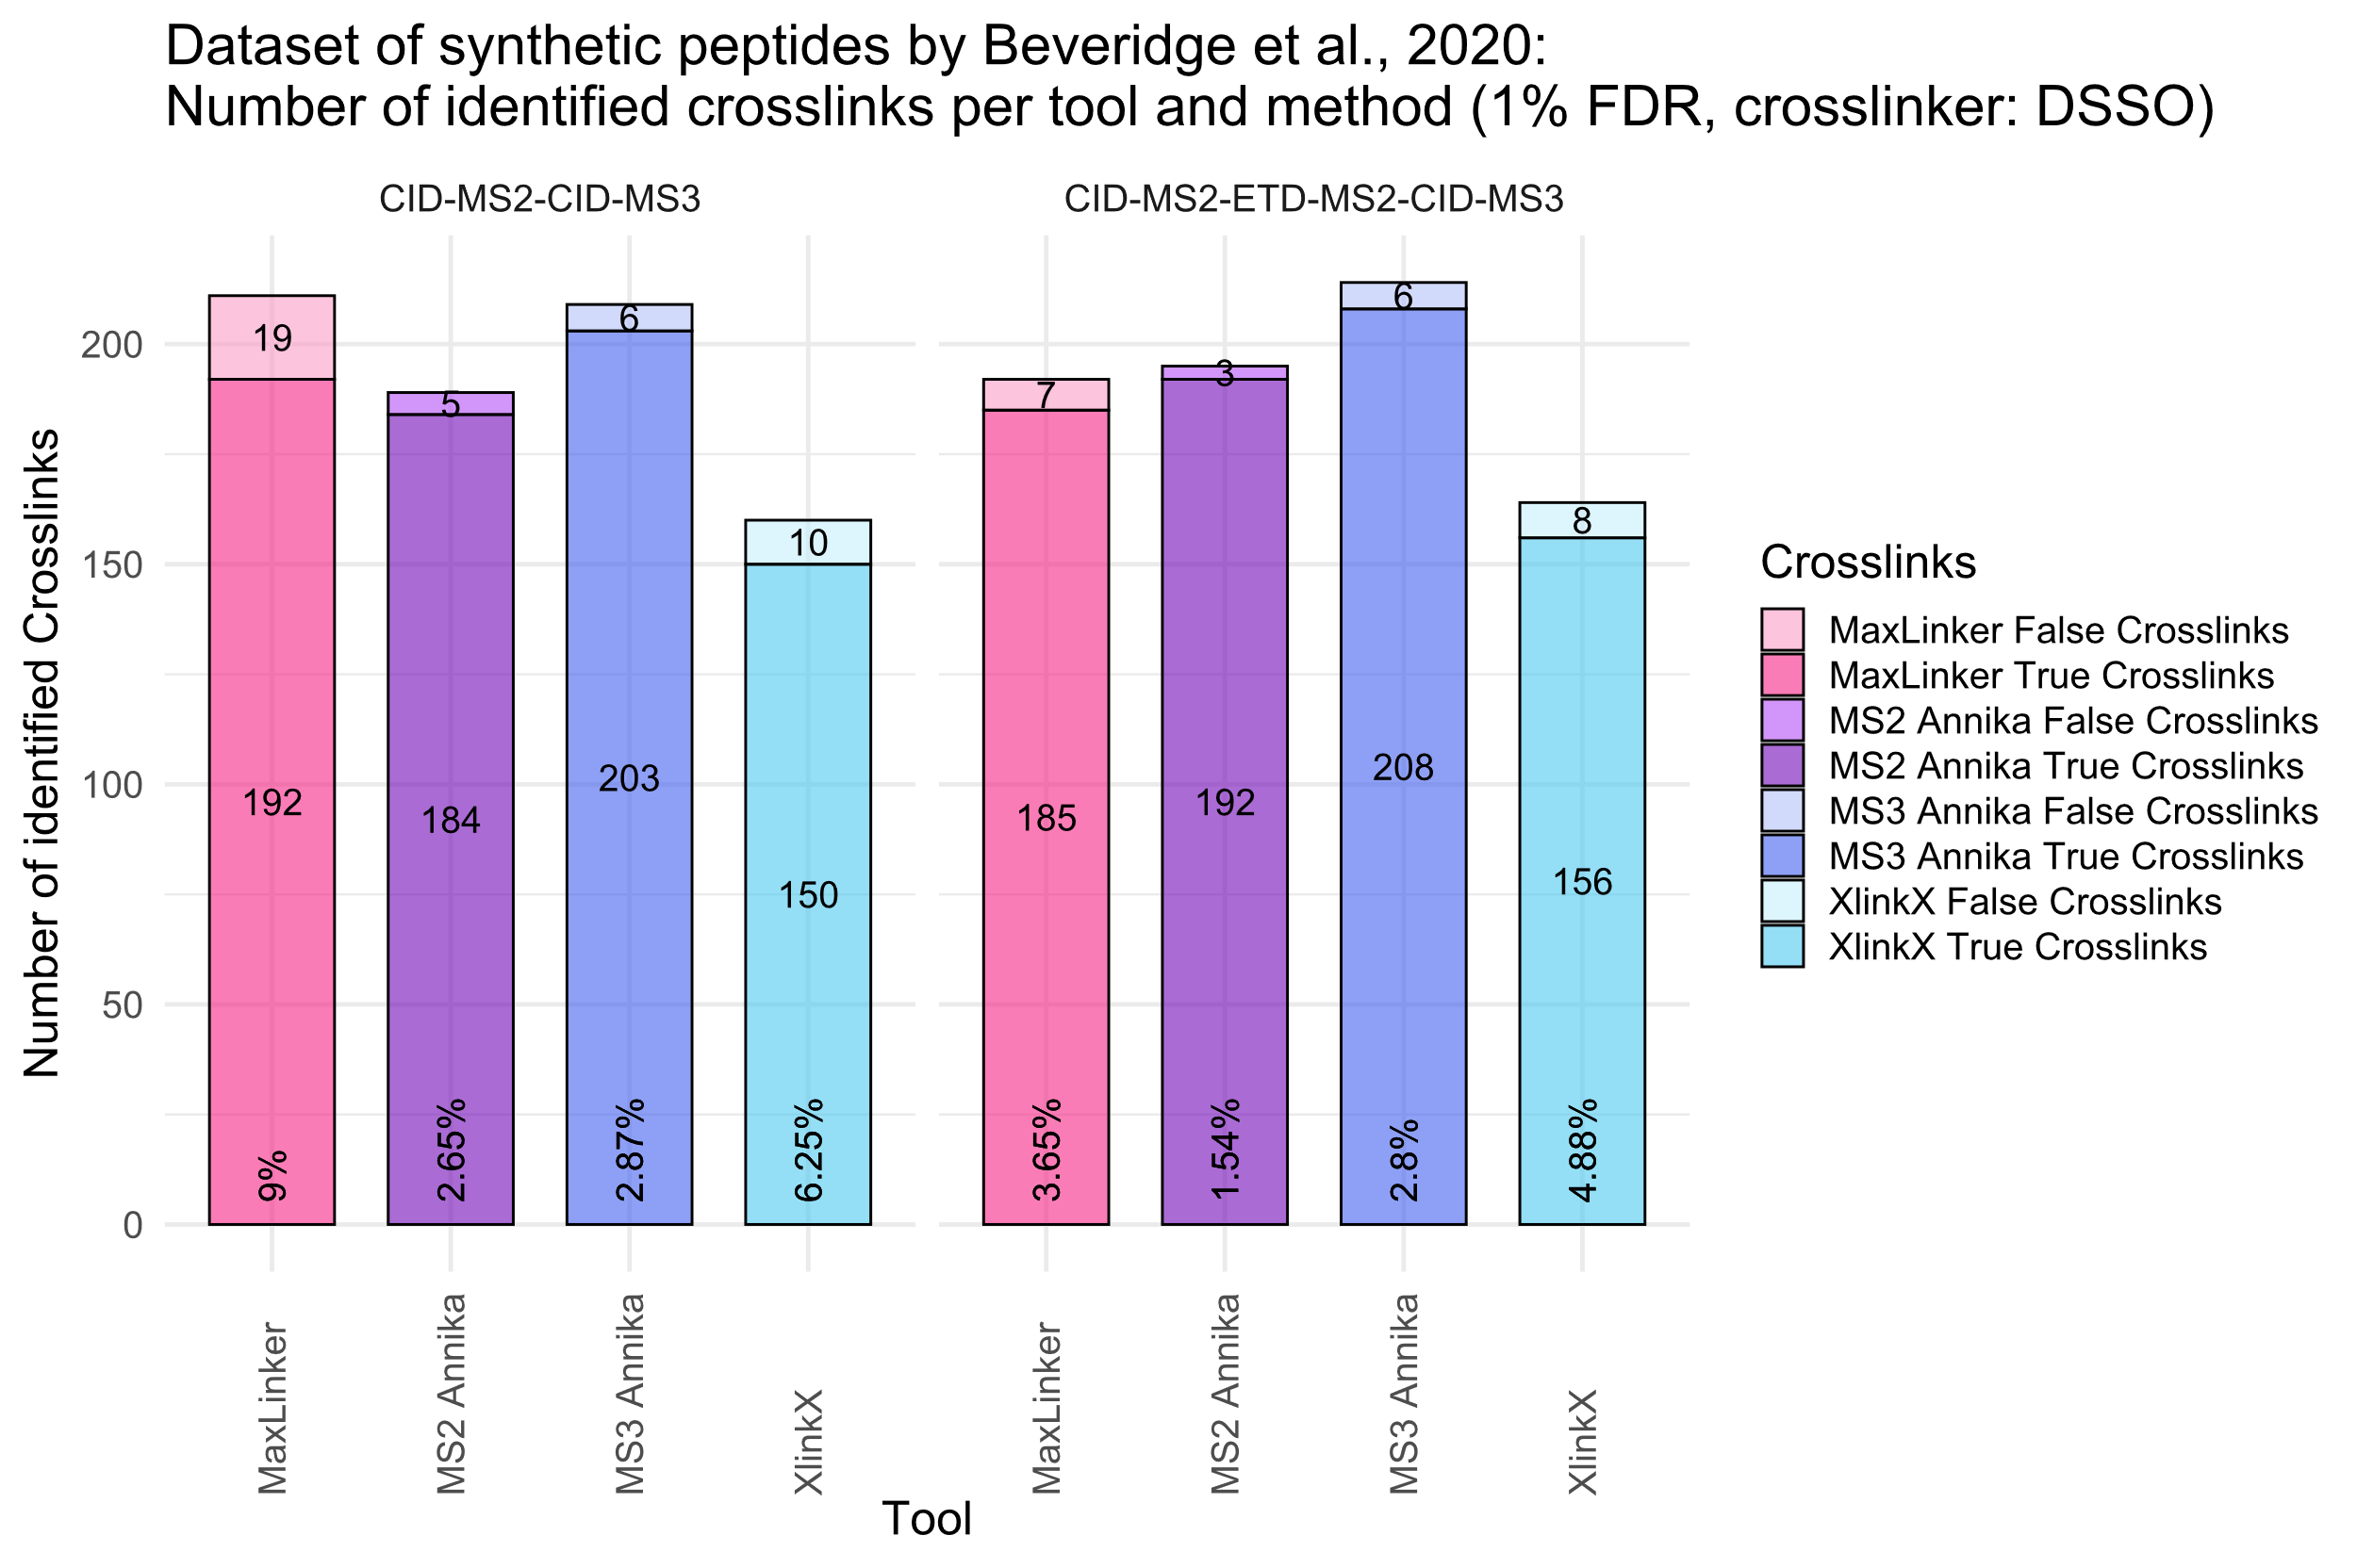
Notes:
Another dataset of synthetic peptides by Beveridge and coworkers
They employed two different methods for crosslink identification
CID-MS2-CID-MS3
CID-MS2-EThcD-MS2-CID-MS3
For these two datasets MS Annika yields better FDR estimated and more unique crosslinks than all other tools

Slide 13


Conclusion
We updated our cross-linking search engine MS Annika to support MS3-based workflows
MS Annika yields accurate FDR estimates while reporting high numbers of unique crosslinks
The MS2 version of MS Annika is available for free download at: https://ms.imp.ac.at/index.php?action=ms-annika
If you are interested in a beta version of the MS3 Annika, please drop me an email: micha.birklbauer@fh-hagenberg.at

Slide 14



Acknowledgements
Special thanks to my supervisor
Viktoria Dorfer
as well as our research partners from the IMP
Manuel Matzinger
Fränze Müller
Karl Mechtler
and the
Austrian Science Fund (FWF),
(grant number 35045) for funding this research!

Slide 15
Questions?

