Slide 1





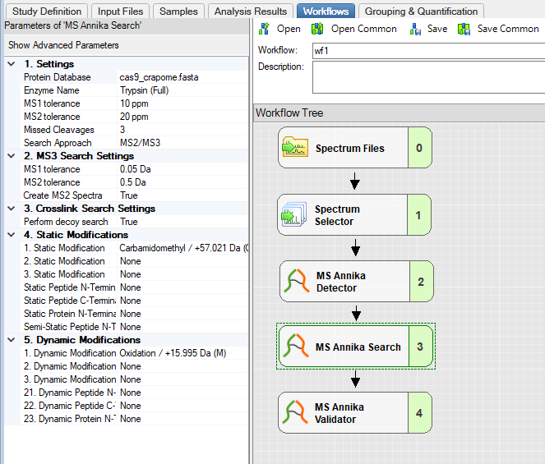
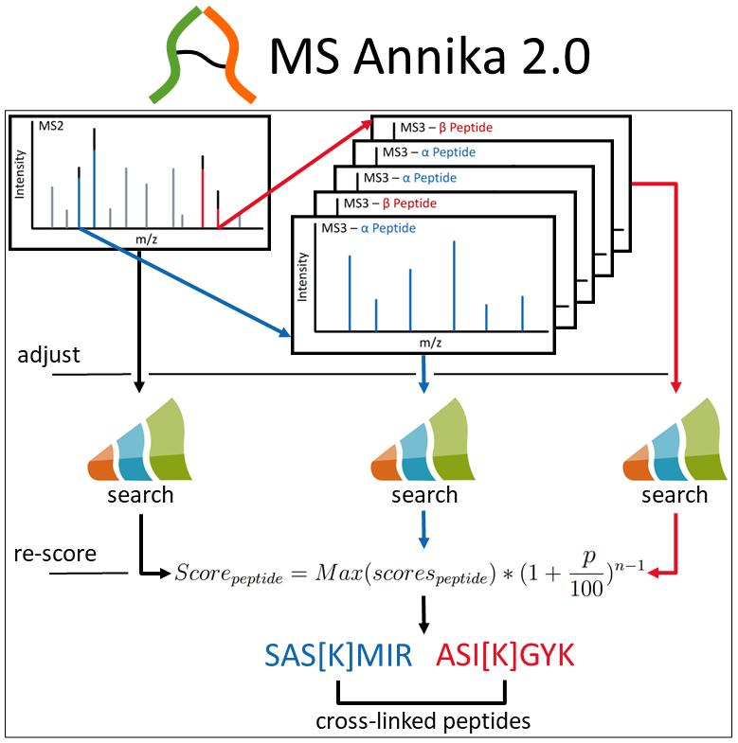
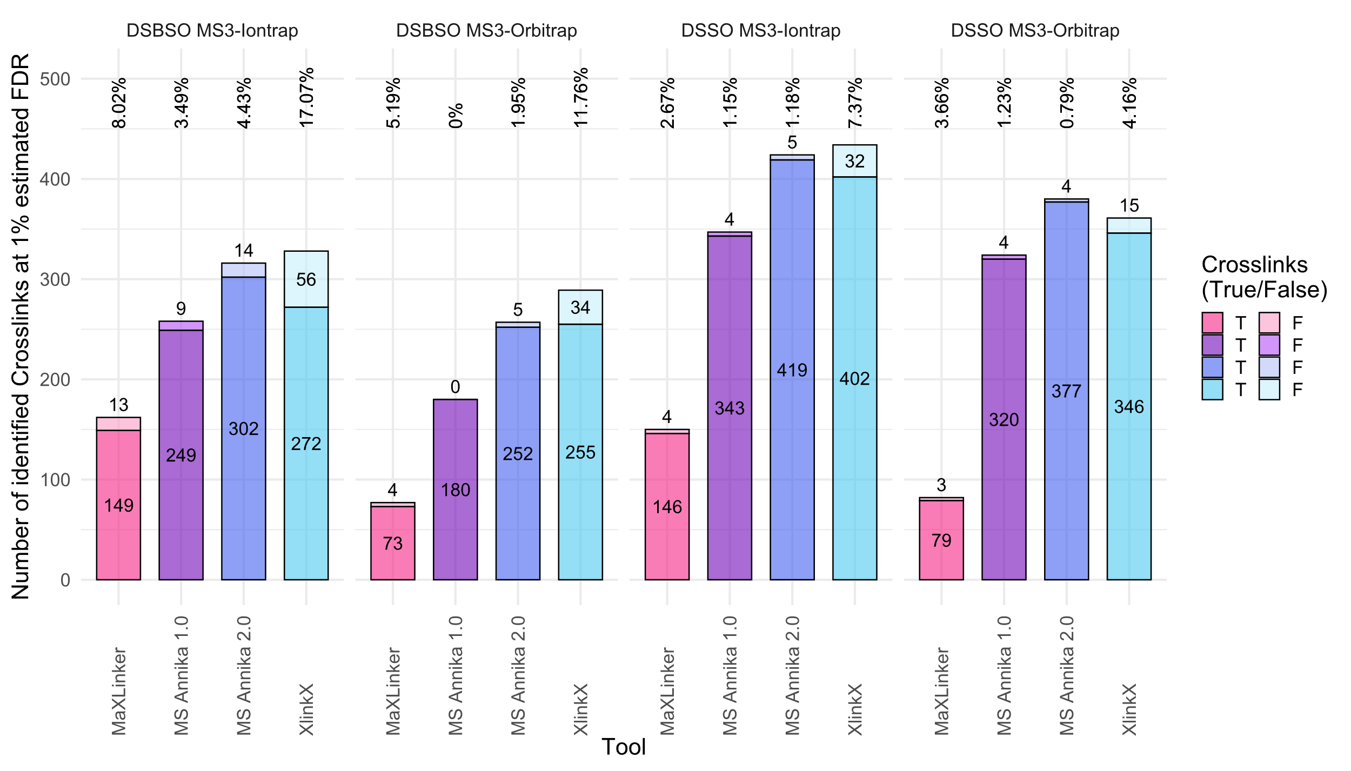
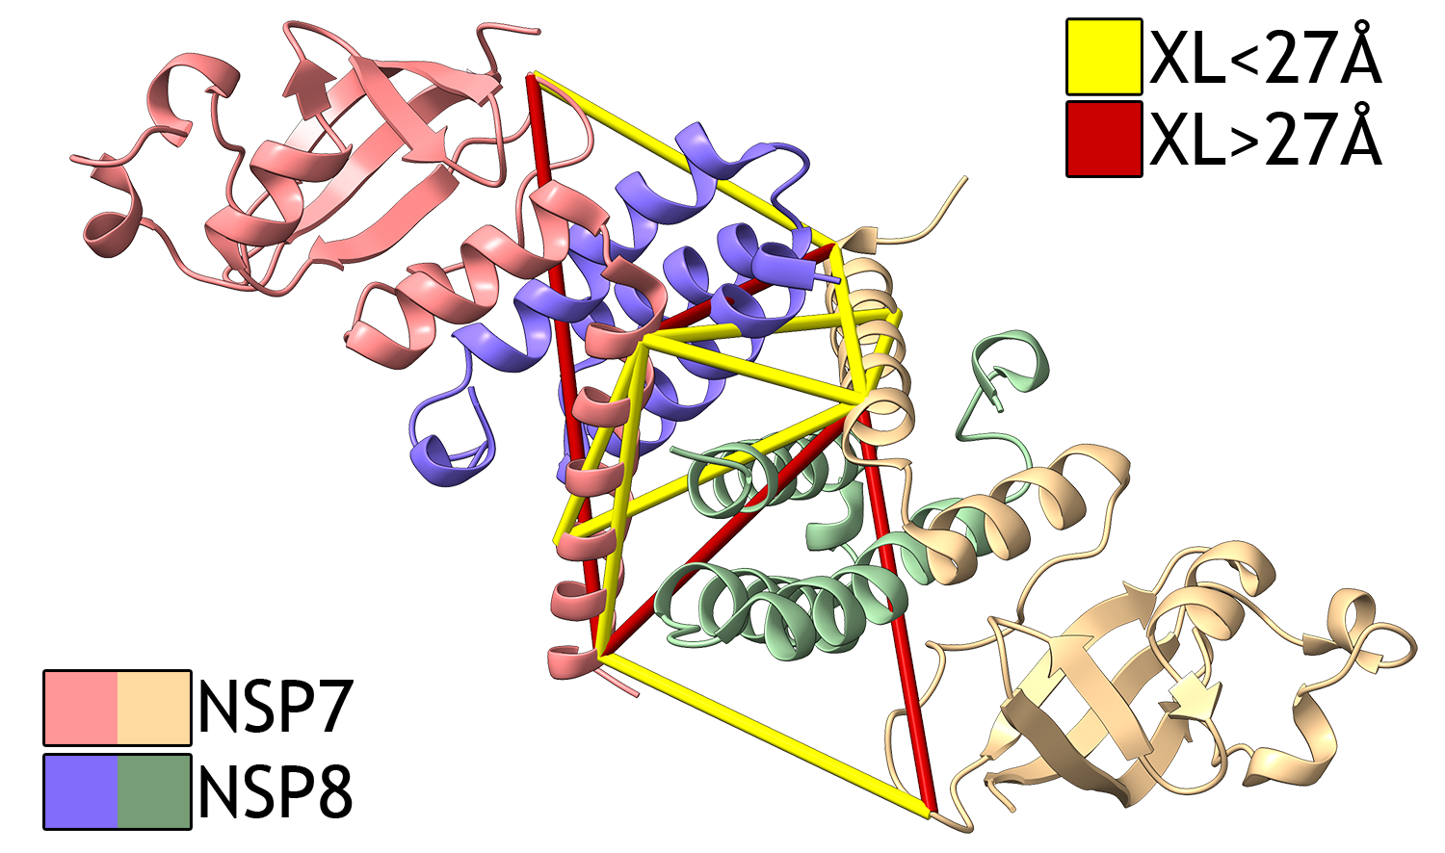
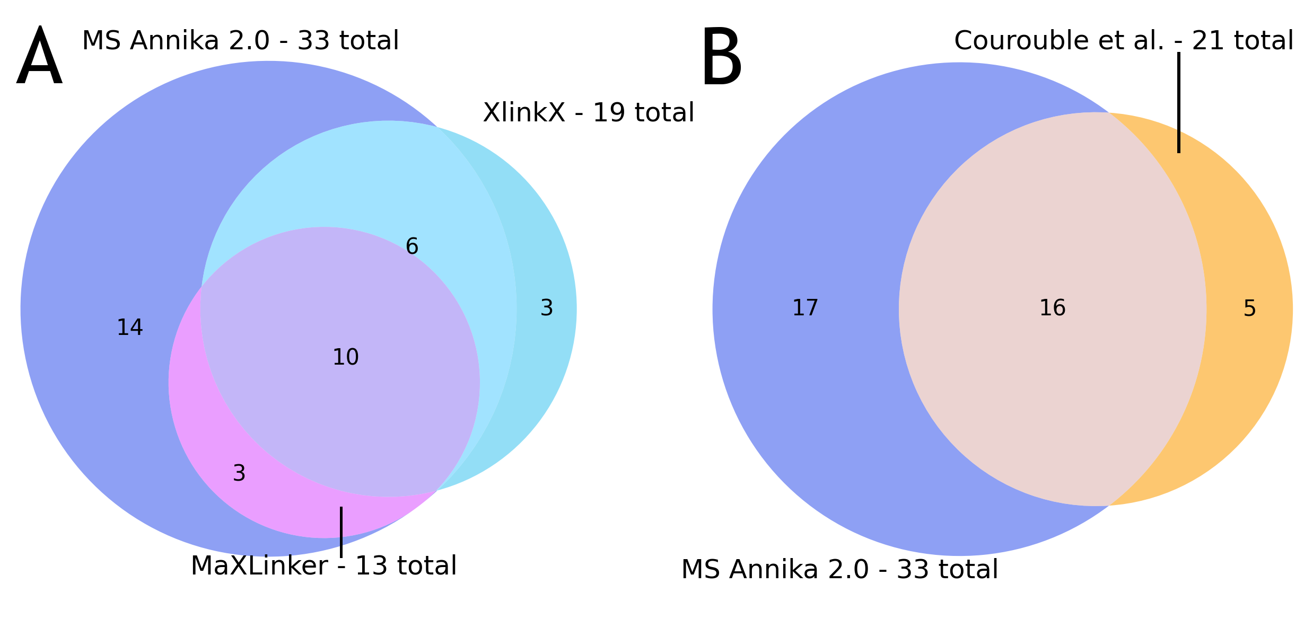

MS Annika 2.0: Identification of cross-linked peptides in
MS2 and MS3 spectra
Micha J. Birklbauer¹, Manuel Matzinger², Fränze Müller², Karl Mechtler^{2,3,4}, Viktoria Dorfer¹
1 Bioinformatics Research Group, University of Applied Sciences Upper Austria, Hagenberg
2 Institute of Molecular Pathology (IMP), Vienna BioCenter (VBC), Vienna
3 Institute of Molecular Biotechnology (IMBA), Austrian Academy of Sciences, Vienna BioCenter (VBC), Vienna
4 Gregor Mendel Institute (GMI), Austrian Academy of Sciences, Vienna BioCenter (VBC), Vienna
Protein A
Crosslinker
β Peptide
Cross-linking mass spectrometry
Protein B
α Peptide
has emerged as a prominent tool for identification of protein-protein interactions and for gaining insight into the structures of proteins. Over the last decade cross-linking mass spectrometry has seen continuous growth that led to the development of numerous new software tools specifically for the analysis and interpretation of cross-linking data. [1] We previously published MS Annika, a cross-linking search engine which can accurately identify cross-linked peptides in MS2 spectra from a variety of different MS-cleavable crosslinkers. [2]
α Peptide
Crosslinker Mass Diff.
MS1
MS2
Crosslinker
Intensity
β Peptide
Intensity
m/z
m/z
Intensity
MS3 – α Peptide
Intensity
MS3 – β Peptide
MS Annika 2.0
m/z
m/z
is an updated and improved version that additionally to MS2-only supports processing of data from MS2-MS3-based approaches and identification of peptides from MS3 spectra using the algorithm depicted in Figure 3. [3] MS Annika 2.0 is available free of charge for Proteome Discoverer 2.5, 3.0 and 3.1 at:
https://ms.imp.ac.at/?action=ms-annika
Figure 1: A schematic cross-linking mass spectrometry workflow with an MS-cleavable crosslinker – proteins are cross-linked and digested. In the mass spectrometer they are fragmented and yield spectra with crosslinker-specific doublet peaks.
Figure 2: MS Annika 2.0 workflow in Proteome Discoverer 2.5 – the new MS3-based search approach can be selected in the Search Node of MS Annika 2.0.
Results
We evaluated the MS3-search-capabilities of MS Annika 2.0 on five different datasets covering a variety of experimental approaches and compared it to XlinkX [4] and MaXLinker [5], two other cross-linking search engines that support MS3 crosslink identification. Three of the datasets were benchmark datasets of synthetic peptides that allow calculation of the true FDR, and we could show that MS Annika 2.0 detects more unique crosslinks while simultaneously yielding less false-positive hits than the other two search engines. The results for one of these datasets [6] are depicted in Figure 4. Additionally, for the two other datasets we could demonstrate that MS Annika 2.0 finds more crosslinks at 1% estimated FDR (Figure 5) and reveals protein-protein interactions that are not detected by either XlinkX or MaXLinker – as depicted in Figure 6 for the SARS-CoV-2 non-structural-protein 8 [7].
Figure 3: The MS Annika 2.0 workflow for identifying crosslinks from MS3 spectra – MS3 spectra are first mapped to the precursor peaks of the corresponding MS2 spectra, the accurate mass of the cross-linked peptides is determined and subsequently the peptides are identified using a peptide search engine and re-scored with a novel scoring function. Crosslinks are validated using a target-decoy approach.
Figure 4: Different cross-linking search engines in comparison for dataset [6]. Numbers at the top of the plot denote the true FDR. MS Annika 2.0 yields accurate FDR estimates while maintaining high numbers of true identifications.
Figure 5: A – Overlaps of the identified crosslinks by the different search engines. B – Overlap of the crosslinks identified by MS Annika 2.0 and the crosslinks reported in the NSP7-NSP8 dataset publication. [7]
Figure 6: Structure of the NSP7-NSP8 complex of SARS-CoV-2 (PDB: 6YHU) with crosslinks that are uniquely identified by MS Annika 2.0. Crosslinks shown in yellow satisfy the DSSO distance constraint of 27 Å while red ones exceed that threshold.
Acknowledgements
This research project has received funding from the Austrian Science Fund (FWF), project number 35045.
References
[1] Matzinger, M. & Mechtler, K. (2021) Cleavable Cross-Linkers and Mass Spectrometry for the Ultimate Task of Profiling Protein-Protein Interaction Networks in Vivo. J. Proteome Res., 20, 78 – 93. [2] Pirklbauer, G. J., Stieger, C. E., Matzinger, M., Winkler, S., Mechtler, K. & Dorfer, V. (2021) MS Annika: A New Cross-Linking Search Engine. J. Proteome Res., 20, 2560 – 2569. [3] Birklbauer, M. J., Matzinger, M., Müller, F., Mechtler, K. & Dorfer, V. (2023) MS Annika 2.0 Identifies Cross-linked Peptides in MS2-MS3-Based Workflows at High Sensitivity and Specificity, J. Proteome Res., 22, 3009 – 3021 [4] Liu, F., Lössl, P., Scheltema, R., Viner, R. & Heck, A. J. R. (2017) Optimized fragmentation schemes and data analysis strategies for proteome-wide cross-link identification. Nature Communications, 8, 15473. [5] Yugandhar, K., Wang, T.-Y., Leung, A. K.-Y., et al. (2020) MaXLinker: Proteome-wide Cross-link Identifications with High Specificity and Sensitivity. Molecular & Cellular Proteomics, 19, 554 – 568. [6] Matzinger, M., Vasiu, A., Madalinski, M., Müller, F., Stanek, F. & Mechtler, K. (2022) Mimicked synthetic ribosomal protein complex for benchmarking crosslinking mass spectrometry workflows. Natura Communications, 13, 3975. [7] Courouble, V., Dey, S. K., Yadav, R. et al. (2021) Revealing the Structural Plasticity of SARS-CoV‑2 nsp7 and nsp8 Using Structural Proteomics. Journal of the American Society for Mass Spectrometry, 32, 1618 – 1630.
http://bioinformatics.fh-hagenberg.at
Micha J. Birklbauer: micha.birklbauer@fh-hagenberg.at
University of Applied Sciences Upper Austria · Hagenberg

