Slide 1




New Bioinformatic algorithms for proteome-wide Cross-linking mass Spectrometry
PhD Pre-Defense – Micha J. Birklbauer
27th February 2025
Supervised by FH-Prof. PD DI Dr. Stephan Winkler
in close cooperation with

Slide 2
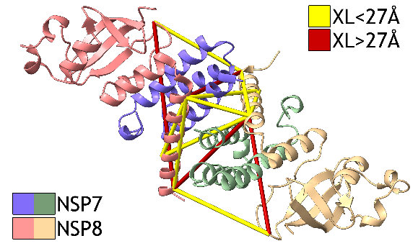
Proteomics
introduction
Proteins are the core components of life
They are integral to controlling cellular function and state
Ultimately they determine the characteristics of any organism
Proteomics is the study of all proteins
Motivation
Research of native protein structures and their interactions is crucial for understanding diseases and pathological processes (vital for drug development)
In this regard Cross-Linking Mass Spectrometry (XLMS) has become the tool of choice
Figure 1

Slide 3
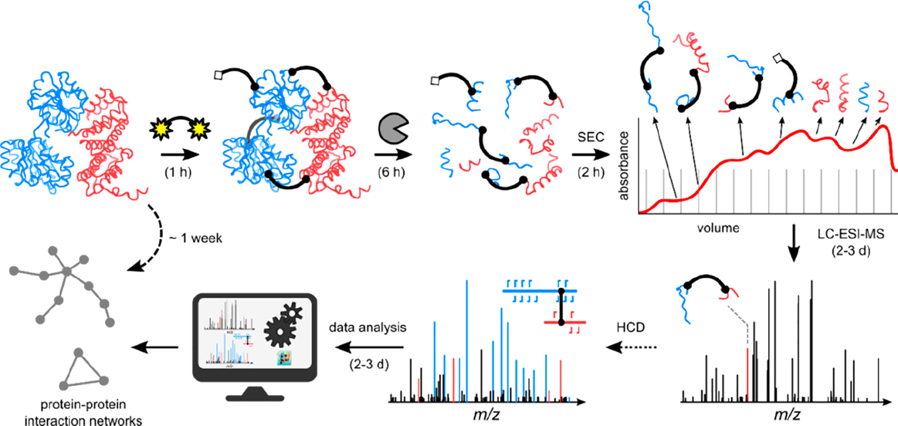
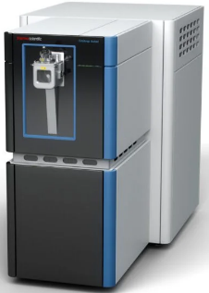
Cross-linking mass spectrometry
introduction
protein A
protein B
crosslinker
alpha
beta
+ validation
MS2 spectrum
MS1 spectrum
Figure 2*
MY RESEARCH:
Identification of crosslinks from MS2-MS3 acquisition workflows
Identification of crosslinks from non-cleavable reagents
*Figure adopted from Piersimoni et al., Chemical Reviews, 2021

Slide 4
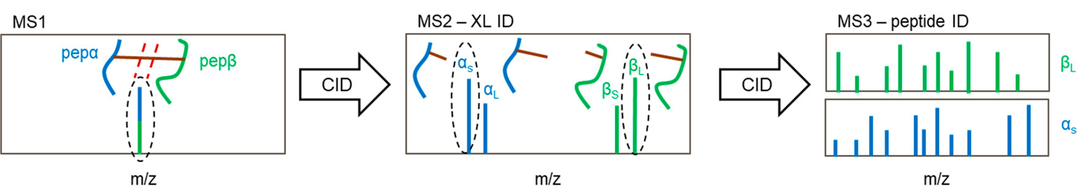
MS2-MS3-based CrossLink Identification
Research Project I: Problem Statement
Figure 3*
MOTIVATION
One of the most common workflows
Software exist, but limited in sensitivity and specificity (crucial for biological application)
PROBLEM
Algorithm of high sensitivity and specificity needed
CHALLENGES
Incorrect precursor isolation (1)
Incorrect C12 assignment from isotope distribution (2)
Matching and combining MS2 and MS3 information
(1)
m/z
Figure 4
(2)
m/z
Figure 5
*Figure adopted from Matzinger et al., Journal of Proteome Research, 2021

Slide 5
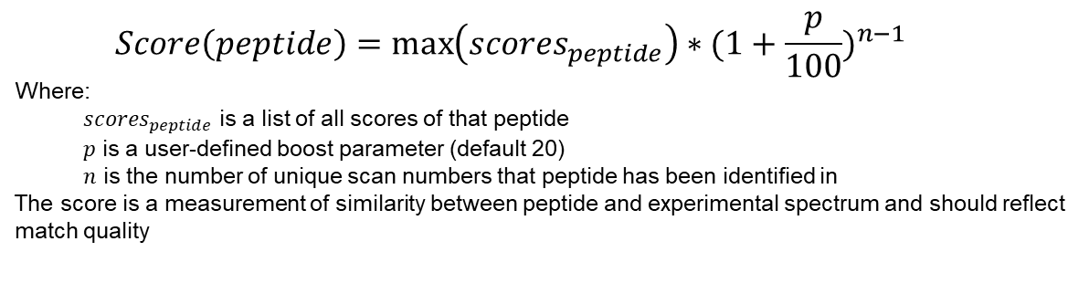
MS2-MS3-based CrossLink Identification
Research Project I: APPROACH
INCORRECT PRECURSOR ISOLATION
Verify precursor ion by comparison to MS2 spectrum
If MS3 spectrum originates from non-crosslinked precursor → discard spectrum
INCORRECT C12 ASSIGNMENT
Re-calculate C12 mass from MS2 spectrum based on known rules for isotope distributions
MATCHING AND COMBINING MS2 / MS3
Match via precursor and product ion mass considering mass tolerance and retention time frame
Combination via novel scoring function
(1)
discard
m/z
Figure 6
recalculate
(2)
m/z
Figure 7
$$Score\left(peptide\right)=\max\left({scores}_{peptide}\right)∗{(1+\frac{p}{100})}^{n−1}$$
Where:
${scores}_{peptide}$ is a list of all scores of that peptide
$p$ is a user-defined boost parameter (default 20)
$n$ is the number of unique scan numbers that peptide has been identified in
The score is a measurement of similarity between peptide and experimental spectrum and should reflect match quality

Slide 6
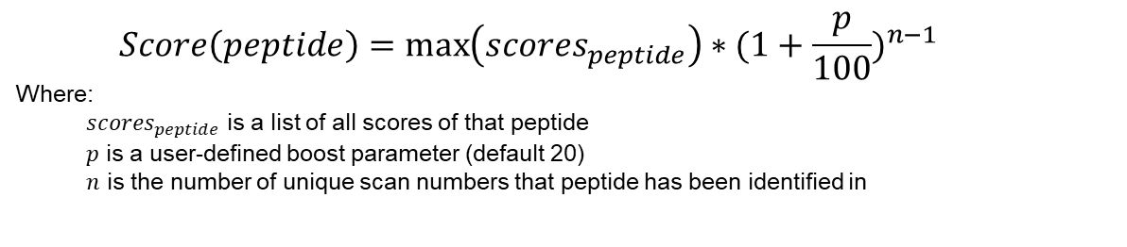
MS2-MS3-based CrossLink Identification
Research Project I: APPROACH
INCORRECT PRECURSOR ISOLATION
Verify precursor ion by comparison to MS2 spectrum
If MS3 spectrum originates from non-crosslinked precursor → discard spectrum
INCORRECT C12 ASSIGNMENT
Re-calculate C12 mass from MS2 spectrum based on known rules for isotope distributions
MATCHING AND COMBINING MS2 / MS3
Match via precursor and product ion mass considering mass tolerance and retention time frame
Combination via novel scoring function
(1)
discard
Annotation of precursor ion is needed
Match of MS2 and MS3 spectrum is prerequisite
m/z
Figure 6
recalculate
(2)
Pattern matching problem
Need to consider rules from chemistry and physics
Dependent on used mass spectrometry instrument
Isotopic envelopes often ambigous
Interference from noise
Whole subfield dedicated to identifying isotope patterns
Multi-hundred LOC algorithm
m/z
Figure 7
$$Score\left(peptide\right)=\max\left({scores}_{peptide}\right)∗{(1+\frac{p}{100})}^{n−1}$$
Where:
${scores}_{peptide}$ is a list of all scores of that peptide
$p$ is a user-defined boost parameter (default 20)
$n$ is the number of unique scan numbers that peptide has been identified in

Slide 7
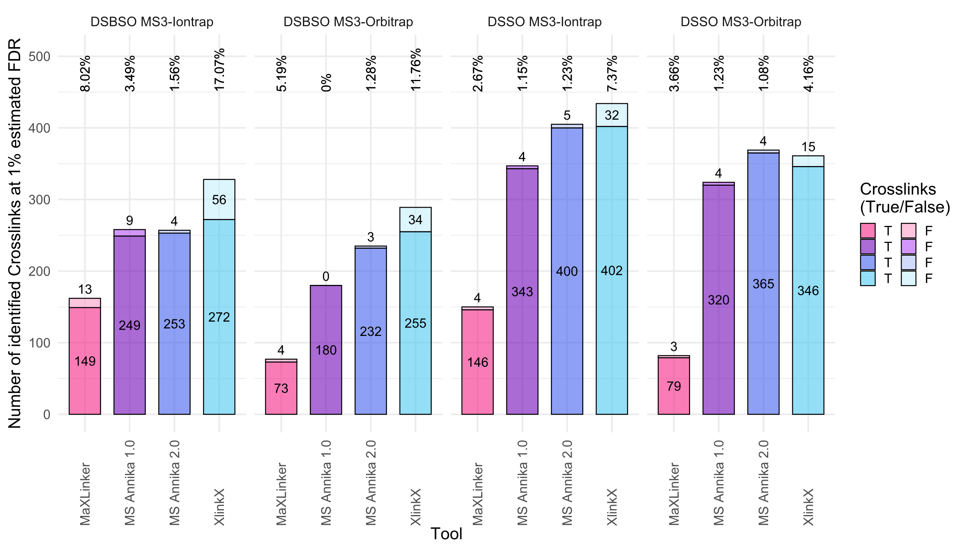
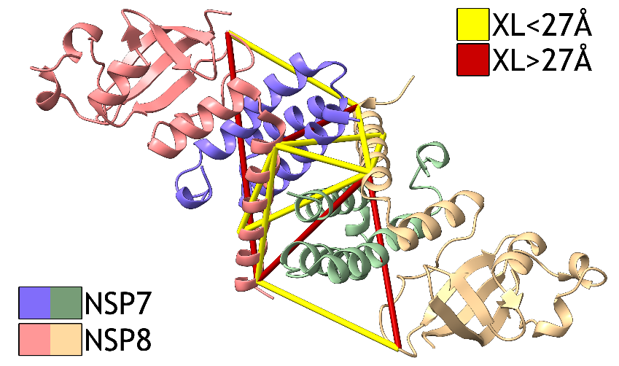
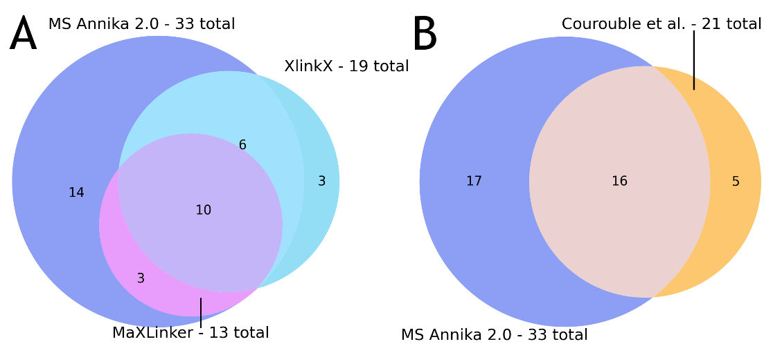
MS2-MS3-based CrossLink Identification
Research Project I: RESULTS
Algorithms implemented in MS Annika 2.0 [1]
Figure 8, 9, 10
[1] M. J. Birklbauer, M. Matzinger, F. Müller, K. Mechtler, and V. Dorfer, “MS Annika 2.0 Identifies Cross-Linked Peptides in MS2-MS3-Based Workflows at High Sensitivity and Specificity”, Journal of Proteome Research, vol. 22, no. 9, pp. 3009-3021, Aug. 2023

Slide 8
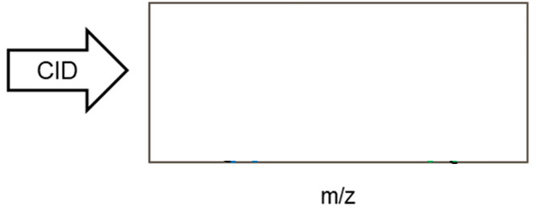



Non-cleavable Crosslink Identification
Research Project II: Problem Statement
Figure 11*
$$c=\left(\begin{matrix}n \\ 2\end{matrix}\right)+n=\left(n+1\right)∗ \frac{n}{2}$$
MOTIVATION
Non-cleavable crosslinkers are the most common crosslinker reagent
Limited software support for data analysis, especially for complex samples
PROBLEM
An efficient algorithm for proteome-wide searches is needed
CHALLENGES
Reduction of search space
Efficient search algorithm for considering potentially millions of peptide candidates and tackling the n-squared problem
*Figure adopted from Matzinger et al., Journal of Proteome Research, 2021

Slide 9
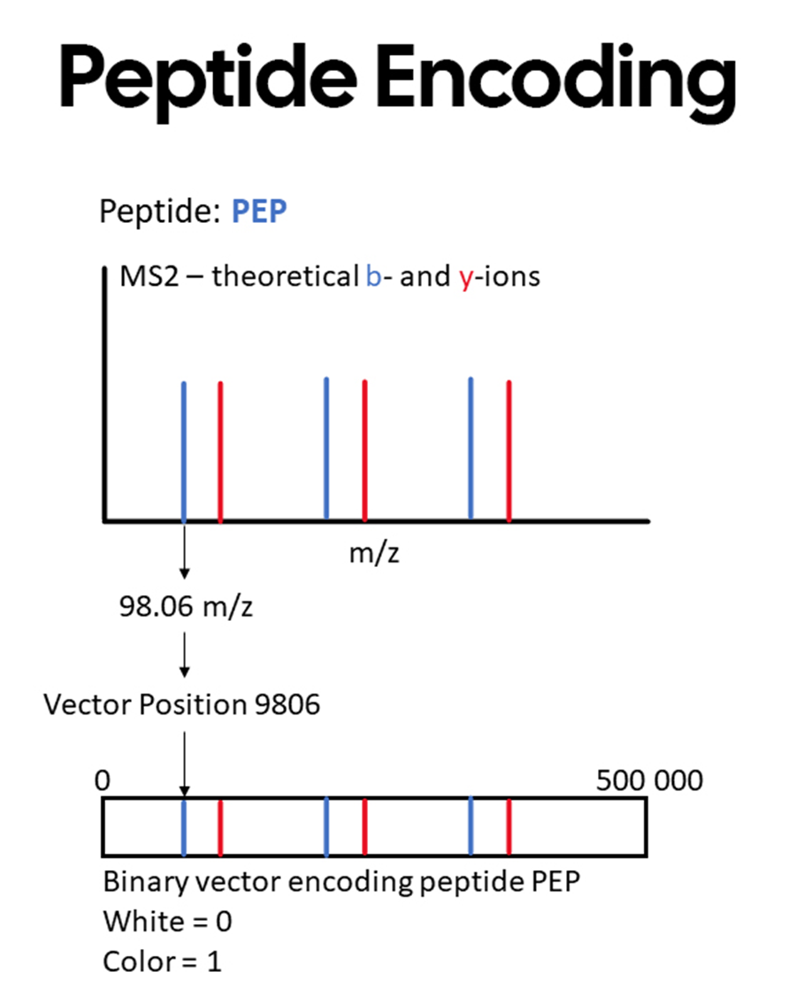
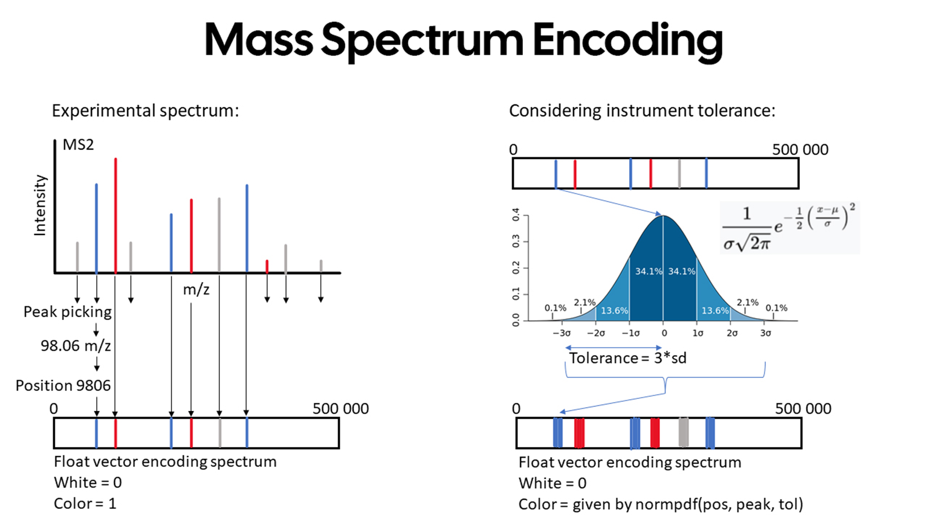
NON-cleavable Crosslink Identification
Research Project II: APPROACH
REDUCTION OF SEARCH SPACE
Divide and conquer approach: identify one of the two cross-linked peptides first, the second peptide can then be more easily inferred
EFFICIENT SEARCH ALGORITHM
Encode peptides and spectra as sparse vectors
Fast scoring by matrix multiplication
A
B
C
Figure 12

Slide 10
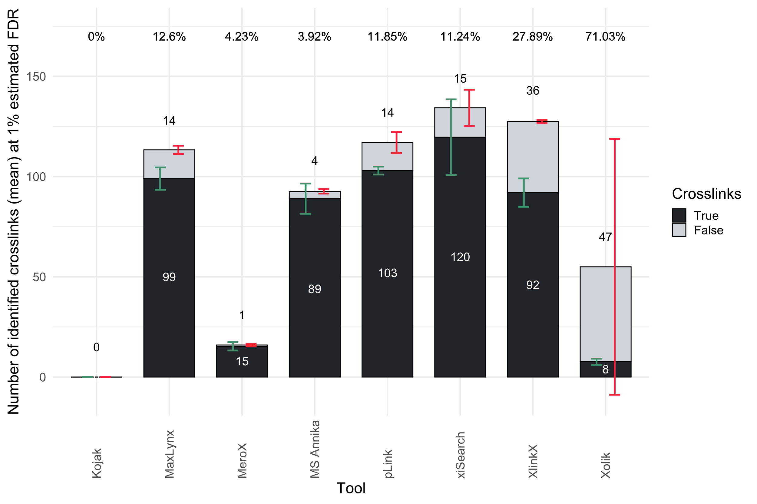
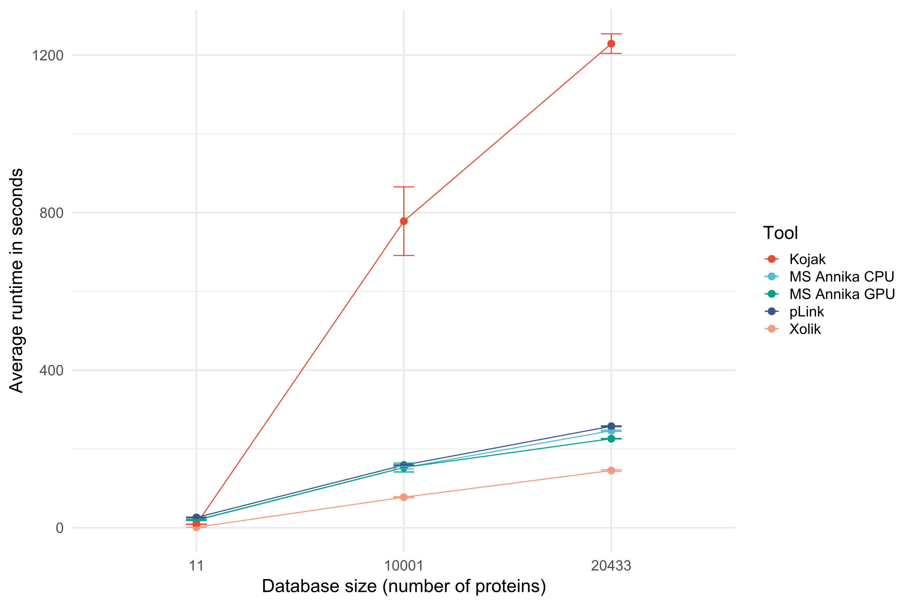
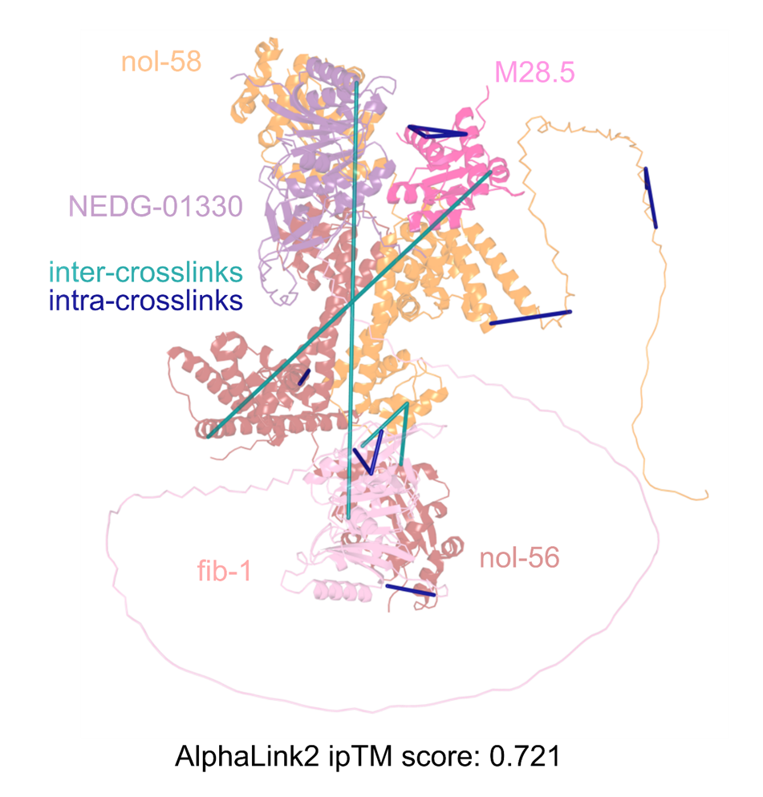
NON-cleavable Crosslink IDentification
Research Project II: RESULTS
Algorithms implemented in MS Annika 3.0 [2]
Figure 8, 9, 10
Figure 13, 14, 15
[2] M. J. Birklbauer, F. Müller, S. S. Geetha, M. Matzinger, K. Mechtler, and V. Dorfer, “Proteome-wide Non-Cleavable Crosslink Identification with MS Annika 3.0 Reveals the Structure of the C. elegans Box C/D Complex”, Communications Chemistry, vol. 7, no. 1, Dec. 2024
Improved structure of the C. elegans Box C/D RNP complex
Database size: ~26 000 proteins

Slide 11
research progress
Cross-linking Publications (Published or in Preparation)
M. J. Birklbauer, M. Matzinger, F. Müller, K. Mechtler, and V. Dorfer, “MS Annika 2.0 Identifies Cross-Linked Peptides in MS2-MS3-Based Workflows at High Sensitivity and Specificity”, Journal of Proteome Research, vol. 22, no. 9, pp. 3009-3021, Aug. 2023
M. J. Birklbauer, F. Müller, S. S. Geetha, M. Matzinger, K. Mechtler, and V. Dorfer, “Proteome-wide Non-Cleavable Crosslink Identification with MS Annika 3.0 Reveals the Structure of the C. elegans Box C/D Complex”, Communications Chemistry, vol. 7, no. 1, Dec. 2024
F. Müller, B. R. Brutiu, I. Saridakis, T. Leischner, M. J. Birklbauer, M. Matzinger, T. Lendl, S. Shaaban, V. Dorfer, N. Maulide, and K. Mechtler, “A Journey Towards Developing a New Cleavable Crosslinker Reagent for In-Cell Crosslinking”, in review at Communications Chemistry
M. J. Birklbauer, F. Müller, M. Matzinger, K. Mechtler, and V. Dorfer, “Unified Down-Stream Analysis of Crosslink Results with pyXLMS”, is a planned journal article to be submitted in 2025 to Bioinformatics
F. Müller, M. J. Birklbauer, D. Hollenstein, V. Dorfer, and K. Mechtler, “Optimized Crosslink Quantification using Data-Independent Acquisition”, is a planned journal article to be submitted in 2025 to Nature Communications
Other Publications (Published or in Preparation)
A. Grimaud, M. J. Birklbauer, L. Levitsky, L. Buur, V. Gorshkov, Z. Udvardy, C. Lennartsson, and V. Schwämmle, “Making Sense of Internal Ions” is a planned journal article to be submitted in 2025 to the Journal of Proteome Research
Software
MS Annika is a cross-linking search engine capable of identifying crosslinks from both cleavable and non-cleavable reagents, and with support for a variety of acquisition workflows including multi-stage tandem acquisition. MS Annika is available at https://github.com/hgb-bin-proteomics/MSAnnika
Conference Contributions
21/03/2022 Poster at the EuBIC-MS Winter School
13/09/2022 Talk at APRMS 2022
15/01/2023 Talk and poster at the EuBIC-MS Developers Meeting
27/09/2023 Poster at APRMS 2023
15/01/2024 Co-Organizer and poster at the EuBIC-MS Winter School
25/09/2024 Talk, chair, and „Best Presentation“ winner at APRMS 2024
Other Research Activities
Reviewer for Analytical Chemistry
Member of the APMA junior board since 2023
Timeline
May:
submit remaining publications
August:
submit dissertation
September:
PhD defense

