Slide 1

Natural Language Processing
Micha Birklbauer

Slide 2
Contents
Preprocessing
Feature representations
Popular NLP packages
spaCy
NLTK
Gensim
Clustering
Classification

Slide 3
Preprocessing
Tokenization:
Process of breaking a stream of text up into (key)words, symbols, or other meaningful elements called tokens
Tokens are small units of (meaningful) text, such that a comparison between a token in the query and a token in a document can take place
Usually tokenization based on whitespace, but we will see that that doesn’t always work very well
Removing punctuation may or may not be useful depending on further transformations, good for TF-IDF but may lose information for 2Vec models
The quick brown fox jumps over the lazy dog = the, quick, brown, fox, …

Slide 4
Preprocessing
Stopword removal:
Stopwords are words that are too frequent in a language or document collection and have very little semantic meaning
Removing them reduces the feature space
The quick brown fox jumps over the lazy dog = quick, brown, fox, …

Slide 5
Preprocessing
Stemming:
Different word forms may have similar meaning e.g. jumps, jumping
Therefore, create a “standard” representation for them by removing the endings
The quick brown fox jumps over the lazy dog = quick, brown, fox, jump, …

Slide 6
Feature Representations
TF-IDF:
Term Frequency tf = number of times term t occurs in document d
Document Frequency df = number of documents a term t occurs in
Inverse Document Frequency idf = log₂(total number of documents/df)
TF-IDF = tf * idf
Word2Vec, Sentence2Vec, Doc2Vec, …
Each word, sentence, document, etc is represented as an n-dimensional real vector that encapsules the semantic and syntactic properties of the object
These vectors can in turn be used for finding similar words, clustering or classification

Slide 7
Word2Vec
We can get these vectors by training an artificial neural network on a large corpus to predict the semantic and syntactic meaning of words
TensorFlow has a nice tutorial for that: https://www.tensorflow.org/tutorials/text/word2vec
But usually we use pre-trained models for that task since there are plenty good ones out there already e.g. fastText by Facebook AI Research
We will use the pre-trained models by spaCy

Slide 8



Popular NLP Packages
spaCy, NLTK, Gensim

Slide 9
spaCy
https://spacy.io/
spaCy is a natural language processing library that comes with many built-in features that solve core linguistic tasks like tokenization, lemmatization, POS-tagging and NER
Exercise 1: https://github.com/michabirklbauer/hgb_dse_text_mining/blob/master/spaCy.ipynb https://colab.research.google.com/github/michabirklbauer/hgb_dse_text_mining/blob/master/spaCy.ipynb

Slide 10
NLTK
https://www.nltk.org/
NLTK - short for Natural Language Toolkit - is a leading platform for building Python programs to work with human language data
It provides easy-to-use tokenization, stemming, and much more
I mostly use NLTK for preprocessing tasks because it is more light-weight and straightforward than spaCy in my opinion

Slide 11
Gensim
https://radimrehurek.com/gensim/
Gensim “Topic Modelling for Humans” is another NLP library in Python
Gensim offers easy-to-use implementations for TF-IDF and text/document queries
Exercise 2: https://github.com/michabirklbauer/hgb_dse_text_mining/blob/master/NLTK_Gensim.ipynb https://colab.research.google.com/github/michabirklbauer/hgb_dse_text_mining/blob/master/NLTK_Gensim.ipynb

Slide 12
Clustering
kMeans

Slide 13
kMeans Clustering
Initially select k random datapoints (documents) as cluster centroids
Assign each document in the corpus to the nearest centroid
Calculate new cluster centroids
Repeat 2. and 3. until convergence or maximum iteration (or other stopping criterion) is met
Exercise 3: https://github.com/michabirklbauer/hgb_dse_text_mining/blob/master/Features_Clustering.ipynb https://colab.research.google.com/github/michabirklbauer/hgb_dse_text_mining/blob/master/Features_Clustering.ipynb

Slide 14
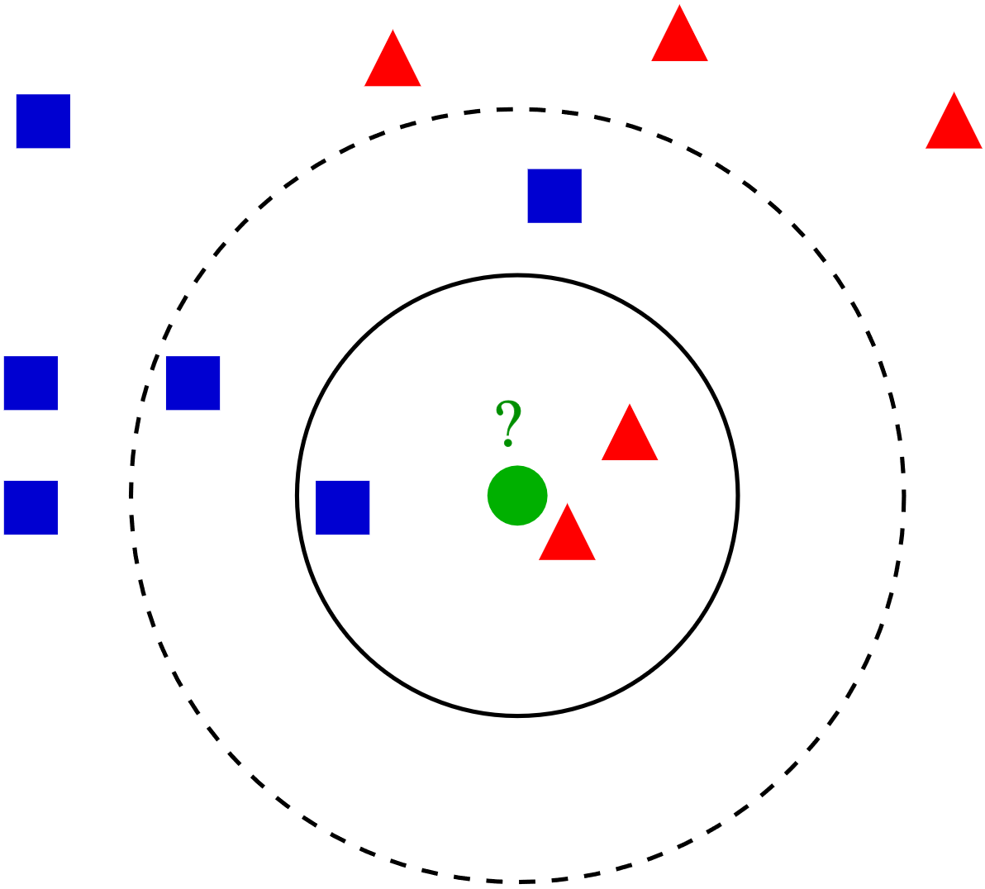
Classification
kNN, naiveBayes

Slide 15
kNN
Predict the class that is most frequent among the k closest datapoints (documents)
(That‘s it…)

Slide 16


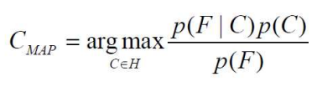
naiveBayes
The probability of class C given feature F is according to Bayes Theorem given as:
We want to predict the Class C_{MAP} that has the highest probability given F, we call that the class with the maximum a-posteriori probability

Slide 17


naiveBayes
For a finite set of features F₁, …, F_{n} we can write this down as:
The denominator is not dependent on C and therefore constant and we can eliminate it:
If we can assume that all features F₁, …, F_{n} are independent we can decompose the last part into:

Slide 18

naiveBayes
Our final classifier is therefore:
Exercise 4: https://github.com/michabirklbauer/hgb_dse_text_mining/blob/master/Classification.ipynb https://colab.research.google.com/github/michabirklbauer/hgb_dse_text_mining/blob/master/Classification.ipynb

Slide 19
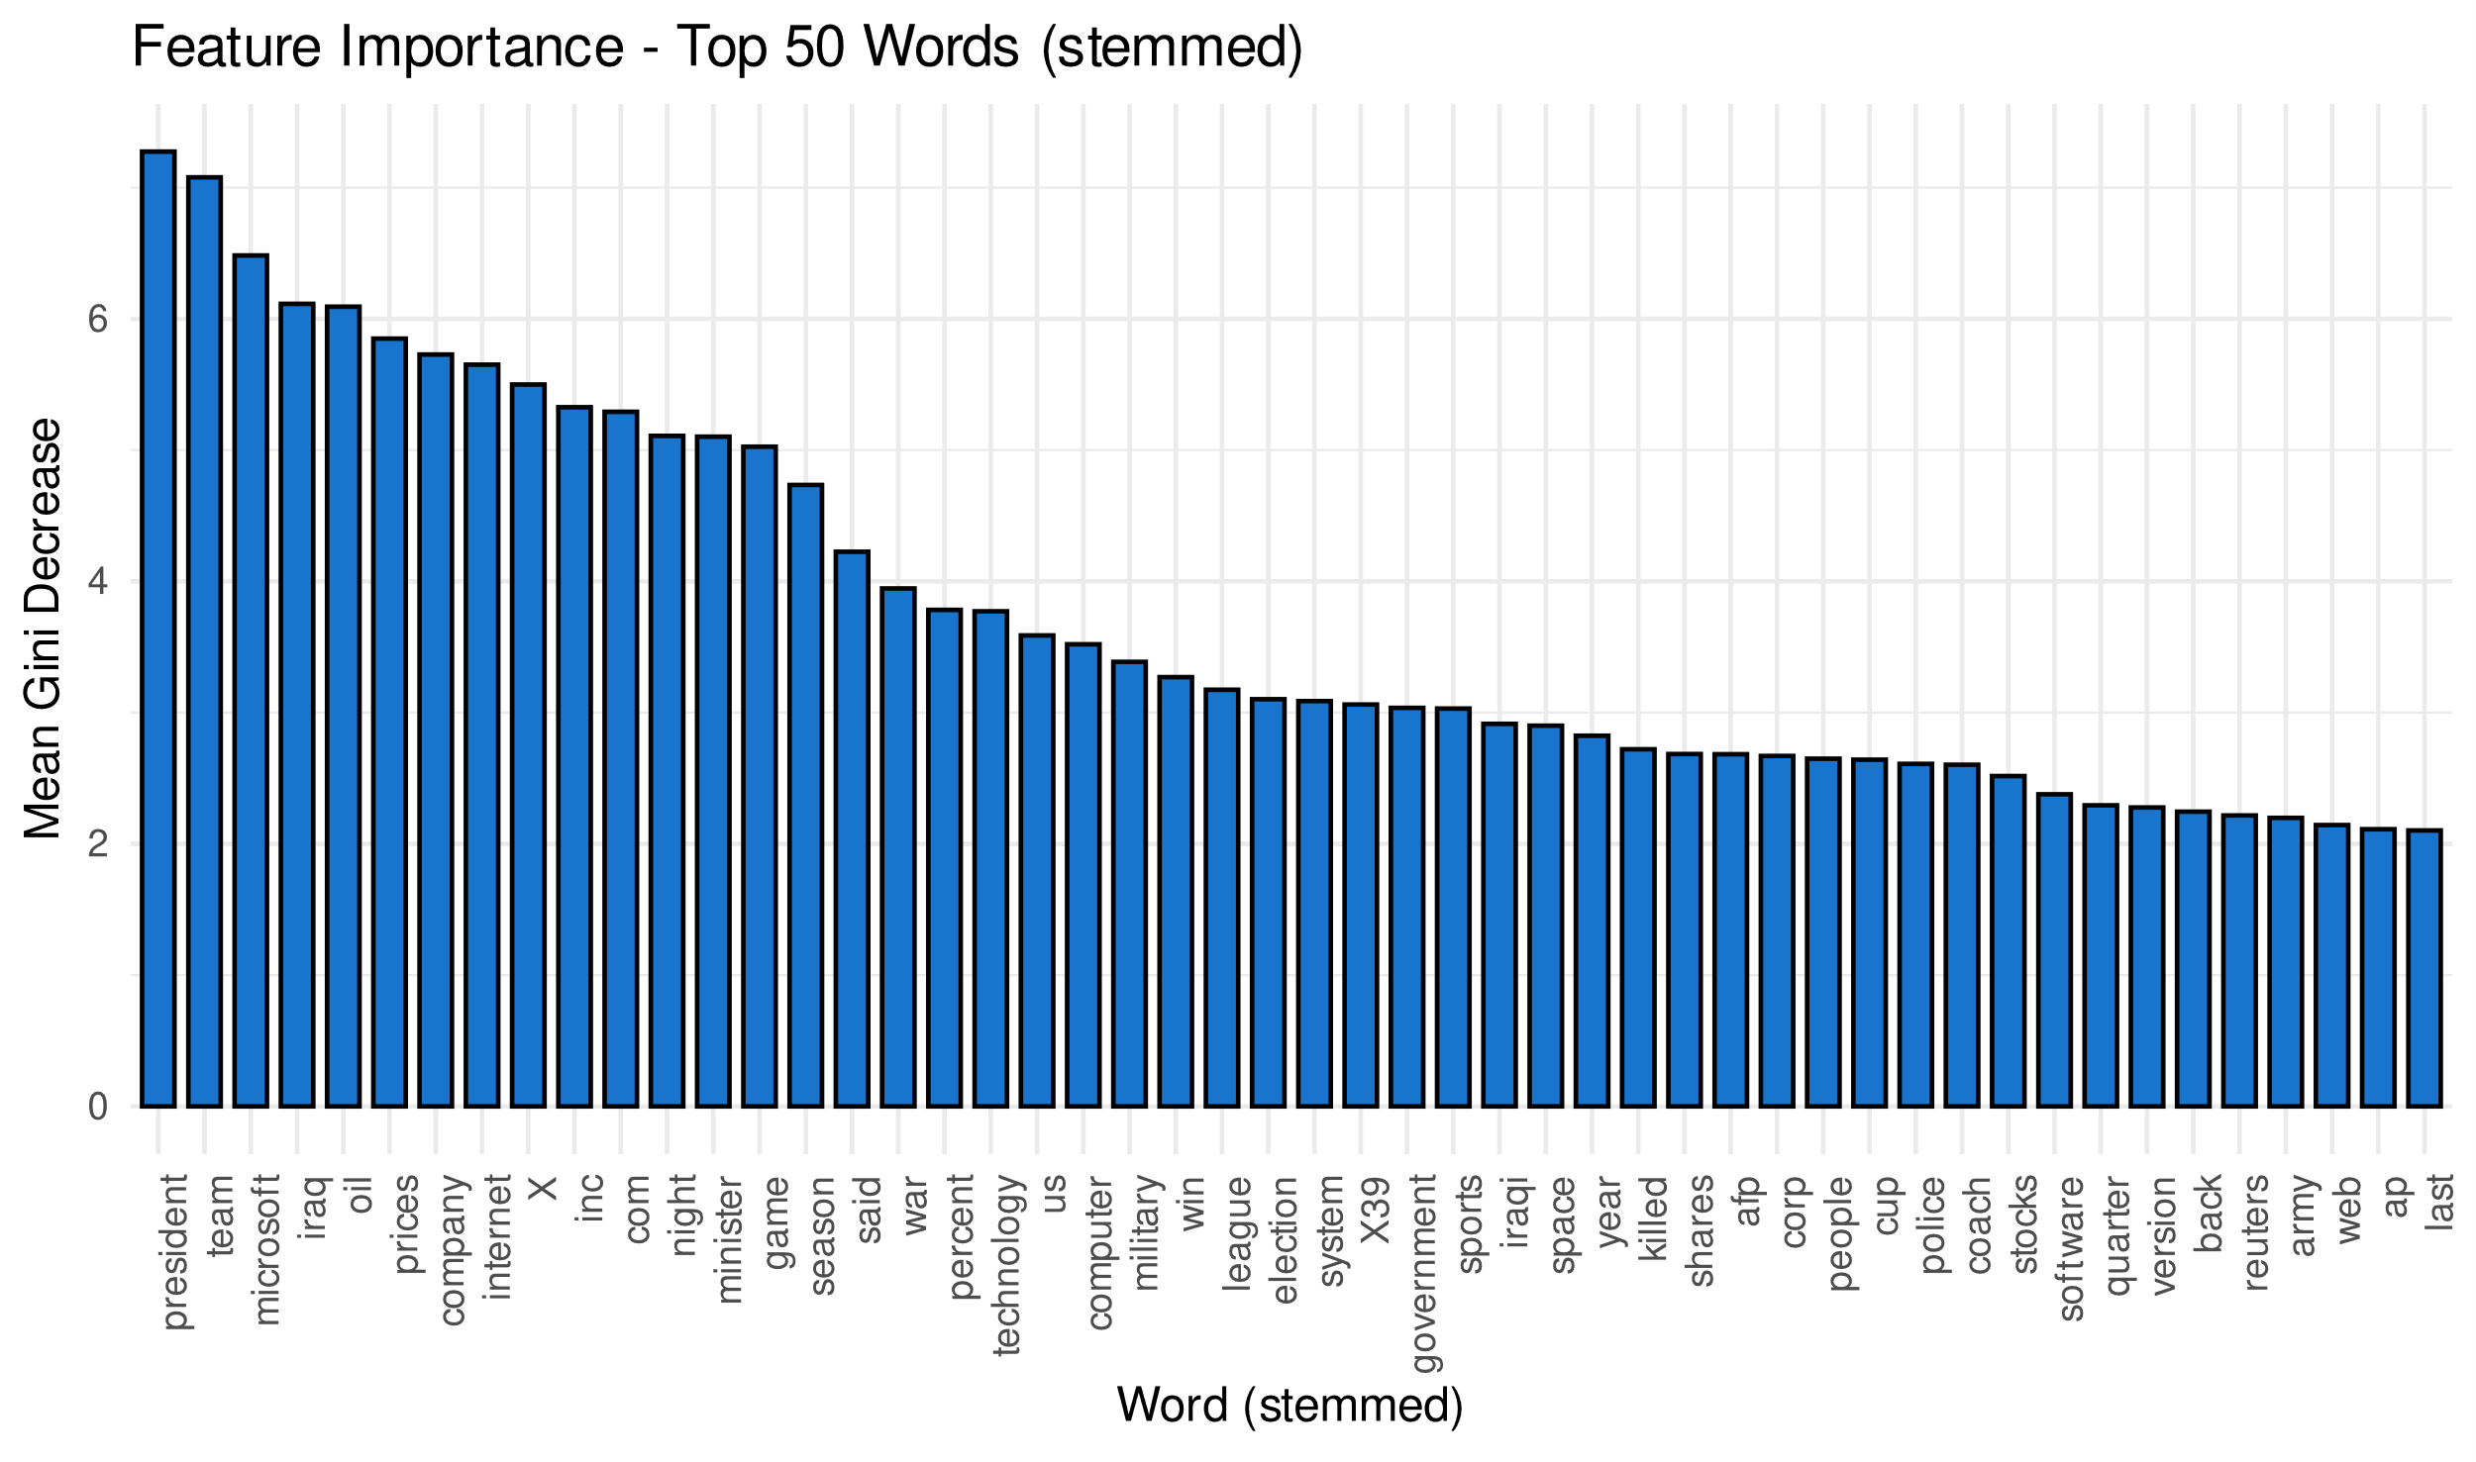
Feature Importance

Slide 20
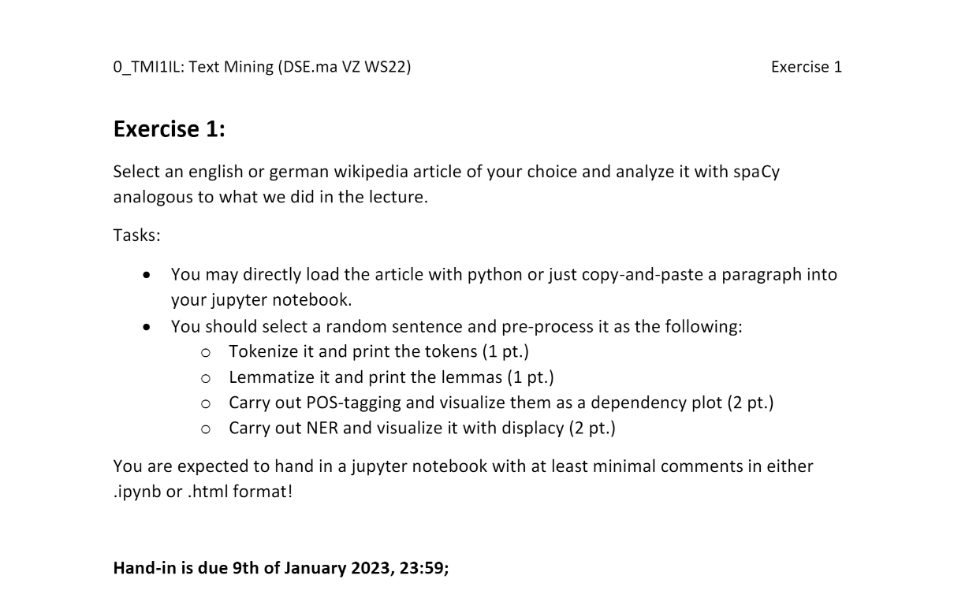
Homework

Slide 21
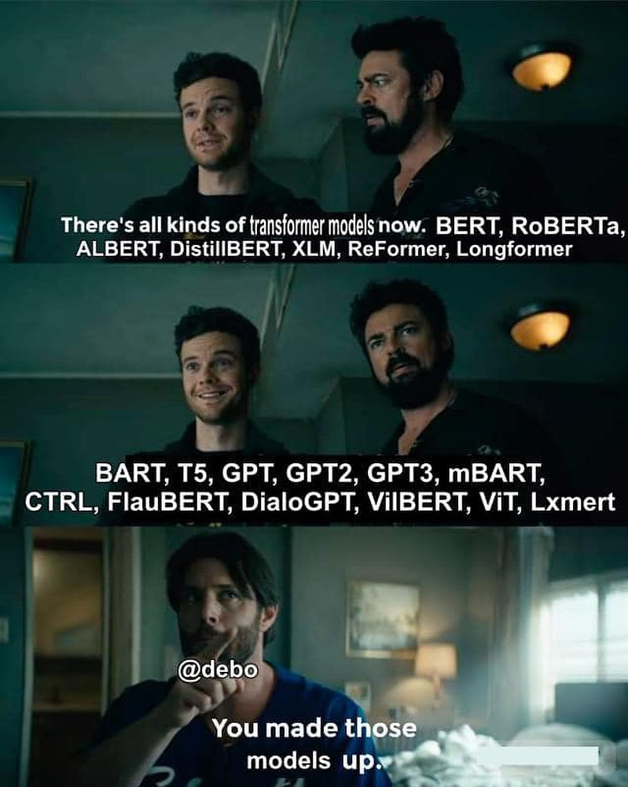
2. Block – Outlook:
Artificial Neural Networks
Generative Models
Hands-on: Sentiment Analysis
Hands-on: Show-and-Tell models
Feedback & Questions:
micha.birklbauer@fh-hagenberg.at

