Slide 1
Data Pre-processing
Data cleaning
  Fill in missing values, smooth noisy data, identify or remove outliers, and resolve inconsistencies
Data integration
  Integration of multiple databases, data cubes, or files
Data transformation
  Normalization and aggregation
Data reduction
  Obtains reduced representation in volume but produces the same or similar analytical results
Data discretization
  Part of data reduction but with particular importance, especially for numerical data

Slide 2
Why Data Preprocessing?
Data in the real world is dirty
  incomplete: lacking attribute values, lacking certain attributes of interest, or containing only aggregate data
  noisy: containing errors or outliers
  inconsistent: containing discrepancies in codes or names
No quality data, no quality mining results!
  Quality decisions must be based on quality data
  Data warehouse needs consistent integration of quality data

Slide 3

Forms of data preprocessing

Slide 4
Data Cleaning
Data cleaning tasks
  Fill in missing values
  Identify outliers and smooth out noisy data
  Correct inconsistent data

Slide 5
Missing Data
Data is not always available
  E.g., many tuples have no recorded value for several attributes, such as customer income in sales data
Missing data may be due to
  equipment malfunction
  inconsistent with other recorded data and thus deleted
  data not entered due to misunderstanding
  certain data may not be considered important at the time of entry
  not register history or changes of the data
Missing data may need to be inferred.

Slide 6
How to Handle Missing Data?
Fill in the missing value manually: tedious + infeasible?
Use a global constant to fill in the missing value: e.g., “unknown”, a new class?!
Use the attribute mean to fill in the missing value
Use the attribute mean for all samples belonging to the same class to fill in the missing value: smarter
Use the most probable value to fill in the missing value: inference-based such as Bayesian formula or decision tree

Slide 7
Noisy Data
Noise: random error or variance in a measured variable
Incorrect attribute values may due to
  faulty data collection instruments
  data entry problems
  data transmission problems
  technology limitation
  inconsistency in naming convention
Other data problems which requires data cleaning
  duplicate records
  incomplete data
  inconsistent data

Slide 8
How to Handle Noisy Data?
Binning method:
  first sort data and partition into (equi-depth) bins
  then one can smooth by bin means, smooth by bin median, smooth by bin boundaries, etc.
Clustering
  detect and remove outliers
Combined computer and human inspection
  detect suspicious values and check by human
Regression
  smooth by fitting the data into regression functions

Slide 9
Simple Discretization Methods: Binning
Equal-width (distance) partitioning:
  It divides the range into N intervals of equal size: uniform grid
  if A and B are the lowest and highest values of the attribute, the width of intervals will be: W = (B-A)/N.
  The most straightforward
  But outliers may dominate presentation
  Skewed data is not handled well.
Equal-depth (frequency) partitioning:
  It divides the range into N intervals, each containing approximately same number of samples
  Good data scaling
  Managing categorical attributes can be tricky.

Slide 10
Binning Methods for Data Smoothing
* Sorted data for price (in dollars): 4, 8, 9, 15, 21, 21, 24, 25, 26, 28, 29, 34
* Partition into (equi-depth) bins:
- Bin 1: 4, 8, 9, 15
- Bin 2: 21, 21, 24, 25
- Bin 3: 26, 28, 29, 34
* Smoothing by bin means:
- Bin 1: 9, 9, 9, 9
- Bin 2: 23, 23, 23, 23
- Bin 3: 29, 29, 29, 29
* Smoothing by bin boundaries:
- Bin 1: 4, 4, 4, 15
- Bin 2: 21, 21, 25, 25
- Bin 3: 26, 26, 26, 34

Slide 11
Cluster Analysis

Slide 12
Regression
y
Y1
Y1’
y = x + 1
X1
x

Slide 13
Data Integration
Data integration:
  combines data from multiple sources into a coherent store
Schema integration
  integrate metadata from different sources
  Entity identification problem: identify real world entities from multiple data sources, e.g., A.cust-id ≡ B.cust-#
Detecting and resolving data value conflicts
  for the same real world entity, attribute values from different sources are different
  possible reasons: different representations, different scales, e.g., metric vs. British units

Slide 14
Handling Redundant Data
Redundant data occur often when integration of multiple databases
  The same attribute may have different names in different databases
  One attribute may be a “derived” attribute in another table, e.g., annual revenue
Redundant data may be able to be detected by correlational analysis
Careful integration of the data from multiple sources may help reduce/avoid redundancies and inconsistencies and improve mining speed and quality

Slide 15
Data Transformation
Smoothing: remove noise from data
Aggregation: summarization, data cube construction
Generalization: concept hierarchy climbing
Normalization: scaled to fall within a small, specified range
  min-max normalization
  z-score normalization
  normalization by decimal scaling
Attribute/feature construction
  New attributes constructed from the given ones

Slide 16




Data Transformation: Normalization
min-max normalization
z-score normalization
normalization by decimal scaling
Where j is the smallest integer such that Max(| |)<1

Slide 17
Data Reduction Strategies
Warehouse may store terabytes of data: Complex data analysis/mining may take a very long time to run on the complete data set
Data reduction
  Obtains a reduced representation of the data set that is much smaller in volume but yet produces the same (or almost the same) analytical results
Data reduction strategies
  Data cube aggregation
  Dimensionality reduction
  Numerosity reduction
  Discretization and concept hierarchy generation

Slide 18
Dimensionality Reduction
Feature selection (i.e., attribute subset selection):
  Select a minimum set of features such that the probability distribution of different classes given the values for those features is as close as possible to the original distribution given the values of all features
  reduce # of patterns in the patterns, easier to understand
Heuristic methods (due to exponential # of choices):
  step-wise forward selection
  step-wise backward elimination
  combining forward selection and backward elimination
  decision-tree induction

Slide 19
Example of Decision Tree Induction
Initial attribute set:
{A1, A2, A3, A4, A5, A6}
A4 ?
A1?
A6?
Class 1
Class 2
Class 1
Class 2
>
Reduced attribute set: {A1, A4, A6}

Slide 20
Heuristic Feature Selection Methods
There are 2^{d} possible sub-features of d features
Several heuristic feature selection methods:
  Best single features under the feature independence assumption: choose by significance tests.
  Best step-wise feature selection:
    The best single-feature is picked first
    Then next best feature condition to the first, ...
  Step-wise feature elimination:
    Repeatedly eliminate the worst feature
  Best combined feature selection and elimination:
  Optimal branch and bound:
    Use feature elimination and backtracking

Slide 21
Data Compression
String compression
  There are extensive theories and well-tuned algorithms
  Typically lossless
  But only limited manipulation is possible without expansion
Audio/video compression
  Typically lossy compression, with progressive refinement
  Sometimes small fragments of signal can be reconstructed without reconstructing the whole
Time sequence is not audio
  Typically short and vary slowly with time

Slide 22
Data Compression
Original Data
Compressed
Data
lossless
Original Data
Approximated
lossy

Slide 23
Numerosity Reduction
Parametric methods
  Assume the data fits some model, estimate model parameters, store only the parameters, and discard the data (except possible outliers)
  Log-linear models: obtain value at a point in m-D space as the product on appropriate marginal subspaces
Non-parametric methods
  Do not assume models
  Major families: histograms, clustering, sampling

Slide 24
Regression and Log-Linear Models
Linear regression: Data are modeled to fit a straight line
  Often uses the least-square method to fit the line
Multiple regression: allows a response variable Y to be modeled as a linear function of multidimensional feature vector
Log-linear model: approximates discrete multidimensional probability distributions

Slide 25
Regress Analysis and Log-Linear Models
Linear regression: Y = α + β X
  Two parameters , α and β specify the line and are to be estimated by using the data at hand.
  using the least squares criterion to the known values of Y1, Y2, …, X1, X2, ….
Multiple regression: Y = b0 + b1 X1 + b2 X2.
  Many nonlinear functions can be transformed into the above.
Log-linear models:
  The multi-way table of joint probabilities is approximated by a product of lower-order tables.
  Probability: p(a, b, c, d) = αab βacχad δbcd

Slide 26
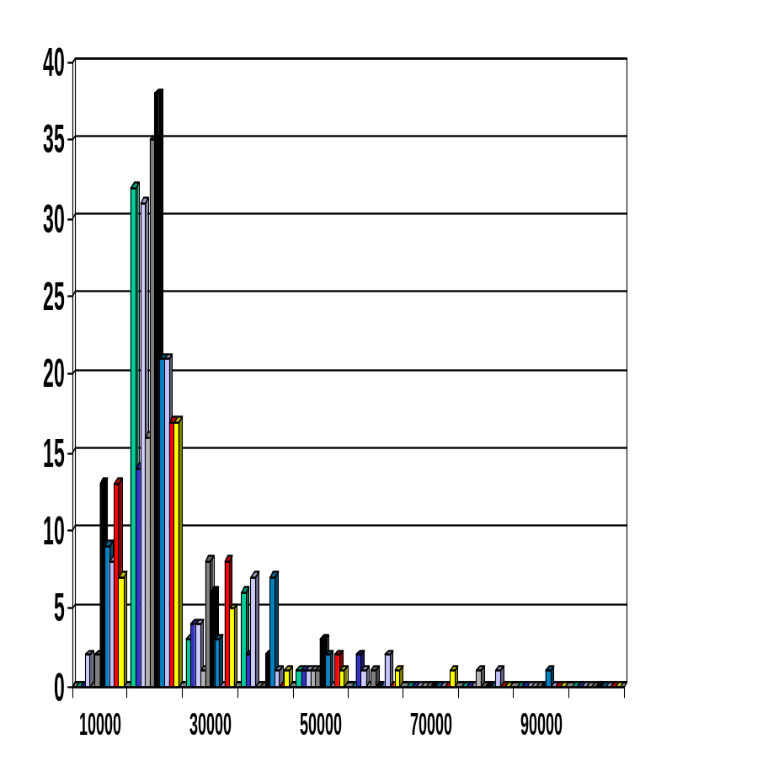
Histograms
A popular data reduction technique
Divide data into buckets and store average (sum) for each bucket
Can be constructed optimally in one dimension using dynamic programming
Related to quantization problems.

Slide 27
Clustering
Partition data set into clusters, and one can store cluster representation only
Can be very effective if data is clustered but not if data is “smeared”
Can have hierarchical clustering and be stored in multi-dimensional index tree structures

Slide 28
Sampling
Allow a mining algorithm to run in complexity that is potentially sub-linear to the size of the data
Choose a representative subset of the data
  Simple random sampling may have very poor performance in the presence of skew
Develop adaptive sampling methods
  Stratified sampling:
    Approximate the percentage of each class (or subpopulation of interest) in the overall database
    Used in conjunction with skewed data
Sampling may not reduce database I/Os (page at a time).

Slide 29
Sampling
SRSWOR
(simple random
sample without
replacement)
SRSWR
Raw Data

Slide 30
Sampling
Raw Data
Cluster/Stratified Sample

Slide 31
Hierarchical Reduction
Use multi-resolution structure with different degrees of reduction
Hierarchical clustering is often performed but tends to define partitions of data sets rather than “clusters”
Parametric methods are usually not amenable to hierarchical representation
Hierarchical aggregation
  An index tree hierarchically divides a data set into partitions by value range of some attributes
  Each partition can be considered as a bucket
  Thus an index tree with aggregates stored at each node is a hierarchical histogram

Slide 32
Discretization
Three types of attributes:
  Nominal — values from an unordered set
  Ordinal — values from an ordered set
  Continuous — real numbers
Discretization:
  divide the range of a continuous attribute into intervals
  Some classification algorithms only accept categorical attributes.
  Reduce data size by discretization
  Prepare for further analysis

Slide 33
Discretization and Concept hierarchy
Discretization
  reduce the number of values for a given continuous attribute by dividing the range of the attribute into intervals. Interval labels can then be used to replace actual data values.
Concept hierarchies
  reduce the data by collecting and replacing low level concepts (such as numeric values for the attribute age) by higher level concepts (such as young, middle-aged, or senior).

Slide 34
Discretization and concept hierarchy generation for numeric data
Binning (see sections before)
Histogram analysis (see sections before)
Clustering analysis (see sections before)
Entropy-based discretization
Segmentation by natural partitioning

Slide 35
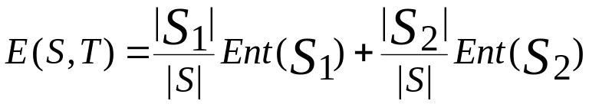

Entropy-Based Discretization
Given a set of samples S, if S is partitioned into two intervals S1 and S2 using boundary T, the entropy after partitioning is
The boundary that minimizes the entropy function over all possible boundaries is selected as a binary discretization.
The process is recursively applied to partitions obtained until some stopping criterion is met, e.g.,
Experiments show that it may reduce data size and improve classification accuracy

Slide 36
Segmentation by natural partitioning
3-4-5 rule can be used to segment numeric data into
relatively uniform, “natural” intervals.
* If an interval covers 3, 6, 7 or 9 distinct values at the most significant digit, partition the range into 3 equi-width intervals
* If it covers 2, 4, or 8 distinct values at the most significant digit, partition the range into 4 intervals
* If it covers 1, 5, or 10 distinct values at the most significant digit, partition the range into 5 intervals

Slide 37
Example of 3-4-5 rule
count
Step 1:
-$351 -$159 profit $1,838 $4,700
Min Low (i.e, 5%-tile) High(i.e, 95%-0 tile) Max
Step 2:
msd=1,000 Low=-$1,000 High=$2,000
Step 3:
(-$1,000 - $2,000)
(-$1,000 - 0)
(0 -$ 1,000)
($1,000 - $2,000)
Step 4:
(-$4000 -$5,000)
(-$400 - 0)
(0 - $1,000)
($1,000 - $2, 000)
($2,000 - $5, 000)
(0 -
$200)
($1,000 -
$1,200)
(-$400 -
-$300)
($2,000 -
$3,000)
($200 -
$400)
($1,200 -
$1,400)
(-$300 -
-$200)
($3,000 -
$4,000)
($400 -
$600)
($1,400 -
$1,600)
(-$200 -
-$100)
($4,000 -
$5,000)
($600 -
$800)
($1,600 -
$1,800)
($1,800 -
$2,000)
($800 -
$1,000)
(-$100 -
0)

Slide 38
Concept hierarchy generation for categorical data
Specification of a partial ordering of attributes explicitly at the schema level by users or experts
Specification of a portion of a hierarchy by explicit data grouping
Specification of a set of attributes, but not of their partial ordering
Specification of only a partial set of attributes

Slide 39
Specification of a set of attributes
Concept hierarchy can be automatically generated based on the number of distinct values per attribute in the given attribute set. The attribute with the most distinct values is placed at the lowest level of the hierarchy.
country
15 distinct values
province_or_ state
65 distinct values
city
3567 distinct values
street
674,339 distinct values

Slide 40
Data Mining Operations and Techniques:
Predictive Modelling :
  Based on the features present in the class_labeled training data, develop a description or model for each class. It is used for
    better understanding of each class, and
    prediction of certain properties of unseen data
  If the field being predicted is a numeric (continuous ) variables then the prediction problem is a regression problem
  If the field being predicted is a categorical then the prediction problem is a classification problem
  Predictive Modelling is based on inductive learning (supervised learning)

Slide 41
Predictive Modelling (Classification):
debt
*
*
*
o
o
o
*
*
o
o
*
*
*
o
*
o
*
*
o
o
o
income
Linear Classifier:
Non Linear Classifier:
debt
debt
*
*
*
*
o
o
*
*
o
o
*
o
*
o
*
*
*
o
o
o
*
*
*
o
o
o
*
*
*
o
*
o
*
*
o
o
*
*
o
o
o
o
income
a*income + b*debt < t => No loan !
income

Slide 42
Clustering (Segmentation)
  Clustering does not specify fields to be predicted but targets separating the data items into subsets that are similar to each other.
  Clustering algorithms employ a two-stage search:
    An outer loop over possible cluster numbers and an inner loop to fit the best possible clustering for a given number of clusters
  Combined use of Clustering and classification provides real discovery power.

Slide 43
Supervised vs Unsupervised Learning:
debt
debt
*
*
+
*
o
o
o
+
+
+
+
*
o
o
+
+
*
*
*
o
+
+
+
+
*
+
+
+
*
o
+
*
*
o
o
+
+
+
+
o
+
+
income
Supervised
Learning
Unsupervised
Learning
debt
debt
*
*
+
+
*
o
o
o
+
+
+
+
*
*
o
o
+
+
+
+
*
*
*
o
+
+
+
+
*
o
+
+
*
*
o
o
+
+
+
+
o
+
income
income

Slide 44
Associations
  relationship between attributes (recurring patterns)
Dependency Modelling
  Deriving causal structure within the data
Change and Deviation Detection
  These methods accounts for sequence information (time-series in financial applications pr protein sequencing in genome mapping)
  Finding frequent sequences in database is feasible given sparseness in real-world transactional database

Slide 45
Basic Components of Data Mining Algorithms
Model Representation (Knowledge Representation) :
  the language for describing discoverable patterns / knowledge
    (e.g. decision tree, rules, neural network)
Model Evaluation:
  estimating the predictive accuracy of the derived patterns
Search Methods:
  Parameter Search : when the structure of a model is fixed, search for the parameters which optimise the model evaluation criteria (e.g. backpropagation in NN)
  Model Search: when the structure of the model(s) is unknown, find the model(s) from a model class
Learning Bias
  Feature selection
  Pruning algorithm

Slide 46
Predictive Modelling (Classification)
Task: determine which of a fixed set of classes an example belongs to
Input: training set of examples annotated with class values.
Output:induced hypotheses (model/concept description/classifiers)
Learning : Induce classifiers from training data
Inductive
Learning
System
Training
Data:
Classifiers
(Derived Hypotheses)
Predication : Using Hypothesis for Prediction: classifying any example described in the same manner
Data to be classified
Classifier
Decision on class
assignment

Slide 47
Classification Algorithms
Basic Principle (Inductive Learning Hypothesis): Any hypothesis found to approximate the target function well over a sufficiently large set of training examples will also approximate the target function well over other unobserved examples.
Typical Algorithms:
Decision trees
Rule-based induction
Neural networks
Memory(Case) based reasoning
Genetic algorithms
Bayesian networks

Slide 48
Decision Tree Learning
General idea: Recursively partition data into sub-groups
• Select an attribute and formulate a logical test on attribute
• Branch on each outcome of test, move subset of examples (training data) satisfying that outcome to the corresponding child node.
• Run recursively on each child node.
Termination rule specifies when to declare a leaf node.
Decision tree learning is a heuristic, one-step lookahead (hill climbing), non-backtracking search through the space of all possible decision trees.

Slide 49
Decision Tree: Example
Day Outlook Temperature Humidity Wind Play Tennis
1 Sunny Hot High Weak No
2 Sunny Hot High Strong No
3 Overcast Hot High Weak Yes
4 Rain Mild High Weak Yes
5 Rain Cool Normal Weak Yes
6 Rain Cool Normal Strong No
7 Overcast Cool Normal Strong Yes
8 Sunny Mild High Weak No
9 Sunny Cool Normal Weak Yes
10 Rain Mild Normal Weak Yes
11 Sunny Mild Normal Strong Yes
12 Overcast Mild High Strong Yes
13 Overcast Hot Normal Weak Yes
14 Rain Mild High Strong No
Outlook
Sunny
Overcast
Rain
Humidity
Yes
Wind
High
Normal
Strong
Weak
No
Yes
No
Yes

Slide 50
Decision Tree : Training
DecisionTree(examples) =
Prune (Tree_Generation(examples))
Tree_Generation (examples) =
IF termination_condition (examples)
THEN leaf ( majority_class (examples) )
ELSE
LET
Best_test = selection_function (examples)
IN
FOR EACH value v OF Best_test
Let subtree_v = Tree_Generation ({ e  example| e.Best_test = v )
IN Node (Best_test, subtree_v )
Definition :
selection: used to partition training data
termination condition: determines when to stop partitioning
pruning algorithm: attempts to prevent overfitting

Slide 51
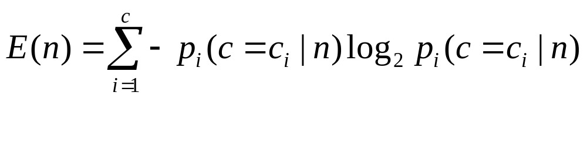
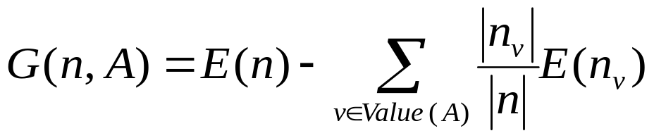
Selection Measure : the Critical Step
The basic approach to select a attribute is to examine each attribute and evaluate its likelihood for improving the overall decision performance of the tree.
The most widely used node-splitting evaluation functions work by reducing the degree of randomness or ‘impurity” in the current node:
Entropy function (C4.5):
Information gain :
• ID3 and C4.5 branch on every value and use an entropy minimisation heuristic to select best attribute.
• CART branches on all values or one value only, uses entropy minimisation or gini function.
GIDDY formulates a test by branching on a subset of attribute values (selection by entropy minimisation)

Slide 52
Tree Induction:
The algorithm searches through the space of possible decision trees from simplest to increasingly complex, guided by the information gain heuristic.
Outlook
Sunny
Overcast
Rain
{1, 2,8,9,11 }
{4,5,6,10,14}
Yes
?
?
Δ (Sunny, Humidity) = 0.97 - 3/5*0 - 2/5*0 = 0.97
Δ (Sunny,Temperature) = 0.97-2/5*0 - 2/5*1 - 1/5*0.0 = 0.57
Δ (Sunny,Wind)= 0.97 -= 2/5*1.0 - 3/5*0.918 = 0.019

Slide 53
Overfitting
Consider eror of hypothesis H over
  training data : error_training (h)
  entire distribution D of data : error_D (h)
  Hypothesis h overfits training data if there is an alternative hypothesis h’ such that
  error_training (h) < error_training (h’)
  error_D (h) > error (h’)

Slide 54
Preventing Overfitting
Problem: We don’t want to these algorithms to fit to ``noise’’
Reduced-error pruning :
  breaks the samples into a training set and a test set. The tree is induced completely on the training set.
  Working backwards from the bottom of the tree, the subtree starting at each nonterminal node is examined.
    If the error rate on the test cases improves by pruning it, the subtree is removed. The process continues until no improvement can be made by pruning a subtree,
    The error rate of the final tree on the test cases is used as an estimate of the true error rate.

Slide 55
Decision Tree Pruning:
physician fee freeze = n:
| adoption of the budget resolution = y: democrat (151.0)
| adoption of the budget resolution = u: democrat (1.0)
| adoption of the budget resolution = n:
| | education spending = n: democrat (6.0)
| | education spending = y: democrat (9.0)
| | education spending = u: republican (1.0)
physician fee freeze = y:
| synfuels corporation cutback = n: republican (97.0/3.0)
| synfuels corporation cutback = u: republican (4.0)
| synfuels corporation cutback = y:
| | duty free exports = y: democrat (2.0)
| | duty free exports = u: republican (1.0)
| | duty free exports = n:
| | | education spending = n: democrat (5.0/2.0)
| | | education spending = y: republican (13.0/2.0)
| | | education spending = u: democrat (1.0)
physician fee freeze = u:
| water project cost sharing = n: democrat (0.0)
| water project cost sharing = y: democrat (4.0)
| water project cost sharing = u:
| | mx missile = n: republican (0.0)
| | mx missile = y: democrat (3.0/1.0)
| | mx missile = u: republican (2.0)
Simplified Decision Tree:
physician fee freeze = n: democrat (168.0/2.6)
physician fee freeze = y: republican (123.0/13.9)
physician fee freeze = u:
| mx missile = n: democrat (3.0/1.1)
| mx missile = y: democrat (4.0/2.2)
| mx missile = u: republican (2.0/1.0)
Evaluation on training data (300 items):
Before Pruning After Pruning
---------------- ---------------------------
Size Errors Size Errors Estimate
25 8( 2.7%) 7 13( 4.3%) ( 6.9%) <

Slide 56
Evaluation of Classification Systems
Predicted
Training Set: examples with class values for learning.
Test Set: examples with class values for evaluating.
Evaluation: Hypotheses are used to infer classification of examples in the test set; inferred classification is compared to known classification.
Accuracy: percentage of examples in the test set that are classified correctly.
False Positives
True Positives
False Negatives
Actual

