Slide 1
DATABASES MOD. 2 — PROJECT A.Y. 2025/2026
Overseas Mobility
Management Platform
Flask · SQLAlchemy · PostgreSQL · Angular
Daren Akpinar · Umar Akhmaev · Mihail Skorenko

Slide 2
THE BRIEF
What the platform manages
One record, three phases
A mobility application carries the whole process: before departure, during the mobility, after the return.
Three kinds of user, different reach
The student prepares it, the academic coordinator decides on its academic content, the Overseas office opens and closes it.
Documents drive the workflow
The Learning Agreement and the Transcript of Records are uploaded files; each decision on them moves the application forward.
Recognition is the outcome
Exams passed abroad are mapped to Ca' Foscari courses, graded, and then approved or rejected one by one.

Slide 3
AUTHORISATION
Roles and what each one reaches
Role | Sees | Does
Student | Only their own applications | Creates and revises applications, proposes the exam mapping, uploads Learning Agreements and the transcript, enters grades
Academic coordinator | Only applications assigned to them | Reads the documents, approves or rejects each Learning Agreement version and each exam recognition, with date and motivation
Overseas office | Every application | Maintains the partner institutions, completes the pre-departure check, closes the application
Role is checked by the endpoint; ownership is a filter inside the query — someone else's application is “not found”, never “forbidden”.

Slide 4
WORKFLOW
The application lifecycle
upload LA
office
arrival
created
waiting_la_
approval
pre_departure_
completed
mobility_in_
progress
office closes
Transcript uploaded → recognition opens
Learning Agreement rejected → back to created
Modification approved mid-mobility → back to mobility_in_progress
closed
under_exam_
recognition
One module owns every status change: it refuses moves outside the workflow and writes the history row in the same operation.

Slide 5
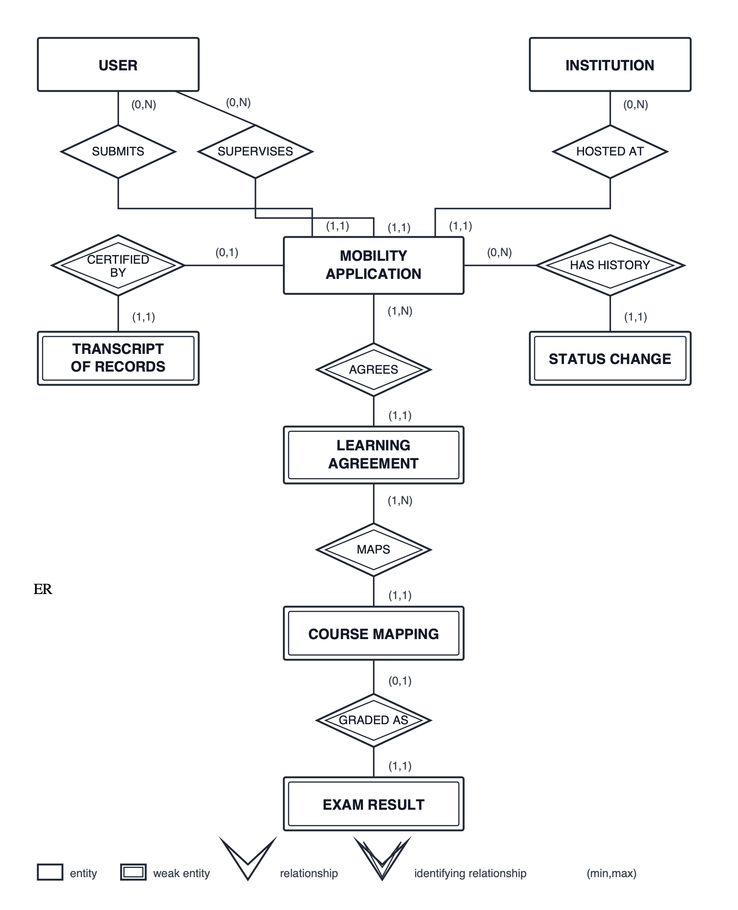
DESIGN
Conceptual schema
8 entities
5 of them weak: the agreement versions, their mappings, the exam results, the transcript and the status history exist only as part of an application.
One USER entity
The three roles share every attribute and an application must point at exactly one student and one coordinator.
No “modification” entity
A proposed change is simply the next Learning Agreement version, with its own mappings.

Slide 6
DESIGN
Logical schema
USER_ACCOUNT(user_id, email, password_hash, first_name, last_name, user_role)
INSTITUTION(institution_id, name, country, city, contact_email, is_active)
MOBILITY_APPLICATION(application_id, academic_year, optional_note,
expected_mobility_period, status,
actual_arrival_date, actual_departure_date,
student_id, coordinator_id, host_institution_id)
APPLICATION_STATUS_HISTORY(history_id, application_id, old_status,
new_status, changed_at)
LEARNING_AGREEMENT(application_id, version_number, file_path, uploaded_at,
approval_status, decision_date, rejection_reason)
COURSE_MAPPING(mapping_id, application_id, version_number,
foreign_course_*, home_course_*)
TRANSCRIPT_OF_RECORDS(transcript_id, application_id, file_path, uploaded_at)
EXAM_RESULT(result_id, mapping_id, foreign_grade, exam_date,
recognition_status, decision_date, rejection_reason)
Composite key (application_id, version_number) makes version numbers unique by construction · unique application_id and mapping_id give the two 1:1 relationships · owned rows CASCADE, referenced rows RESTRICT.

Slide 7
DATA INTEGRITY
Where each rule is enforced
In the schema
• Enumerated types for every status
• Academic-year format, positive credits, date ordering
• Unique course pair per plan version, unique partner location
• Decision consistency: pending has no date or reason, approved has a date, rejected has a date and a reason
• CASCADE for owned rows, RESTRICT for users and institutions
In the service layer
• Ownership scoping of every student and coordinator query
• Second academic year is the first plus one
• Mapping frozen while a version awaits a decision
• Pre-departure needs an approved agreement; closure needs every result decided
• Exam date inside the mobility period
• Status changes follow the permitted workflow
One transaction per request: services flush, the request commits once — any response of 400 or worse rolls the whole request back.

Slide 8
MAIN QUERIES
The query behind the recognition screen
SELECT cm.mapping_id,
cm.foreign_course_code, cm.foreign_course_name, cm.foreign_course_credits,
cm.home_course_code, cm.home_course_name, cm.home_course_credits,
er.foreign_grade, er.exam_date, er.recognition_status
FROM course_mapping cm
LEFT JOIN exam_result er ON er.mapping_id = cm.mapping_id
WHERE cm.application_id = :application_id
AND cm.version_number = (
SELECT MAX(version_number)
FROM learning_agreement
WHERE application_id = :application_id
AND approval_status = 'approved');
The mapping in force is the one belonging to the highest approved version — which is exactly why an approved modification replaces the plan and a rejected one leaves it standing.
Written with the SQLAlchemy Expression Language: no SQL string is hard-coded, so no dialect is either.

Slide 9
DESIGN CHOICES
Security and personal data
Argon2id password hashing
Only the encoded hash is stored; it carries its own salt and parameters, so there is no salt column, and verification never touches SQL.
Session cookie, HttpOnly
Signed cookie, not readable by page scripts; SameSite and Secure are configurable for deployment behind HTTPS.
Authorisation inside the queries
A student's lookup filters on their own id, a coordinator's on theirs — so another student's application is not found rather than forbidden, and its existence stays private.
Documents follow the same path
Each role has its own download endpoint, which fetches the application through that role's scoped query before locating the file. A path never comes from the request.

Slide 10
DESIGN CHOICES
Documents: versions, not overwrites
v1 rejected
“credits do not match”
v2 approved
plan in force
v3 modification
pending
rejected →
v2 still in force
• Every version is kept, with its upload time, decision, decision date and motivation.
• Only the file path is stored in the database; the binary stays on disk under a generated, collision-resistant name.
• Mappings are validated before the file is written, so a refused upload leaves no orphan file.
• Downloads are renamed to something meaningful: learning-agreement-v2.pdf.

Slide 11
IMPLEMENTATION
Architecture
Angular 22
single-page app
/api, cookie
Flask 3
routes · services
repositories
SQLAlchemy 2
PostgreSQL 16
constraints · enums
uploads
on disk
Routes translate HTTP and nothing else · services own the domain rules · repositories own the queries and the ownership scoping · models own the schema.
Services raise domain errors with a stable code and know nothing about HTTP; one module maps each code to a status and a message.
Alembic migrations version the schema with the code. Docker Compose brings up database, API and front end together.

Slide 12
VERIFICATION
Tests and demonstration
Automated tests
• The three role services, end to end
• Routes and their authorisation
• Database constraints, against a real PostgreSQL
• Seed script, document downloads, app wiring
• Each test runs in a transaction that is rolled back
Live demonstration
• Student creates an application and uploads a Learning Agreement
• Coordinator rejects it with a motivation, student revises it
• Office completes the pre-departure check
• Student records arrival, proposes a modification
• Transcript, grades, recognition, closure
Five seeded accounts (two students, two coordinators, the office) and eight partner institutions, all sharing one development password.

Slide 13
APPENDIX
Contribution of each member
Member | Contribution
Daren Akpinar | Database service structure, SQLAlchemy models, first migration, requirements and business rules, first drafts of the schema documents
Umar Akhmaev | Alembic setup and schema revision, integrity constraints, exam-result and status-history models, session authentication and role decorators, the API blueprints for all three roles, constraint tests
Mihail Skorenko | Repository and Docker setup, Angular front end, domain services and repositories, status workflow, document storage, transaction boundary, seed and test suite
Thank you — questions welcome.

