Slide 1

Automatically Detecting Financial Fraud In Mobile A Mobile Payment System
A System for Mobile Payment Service Providers

Slide 2
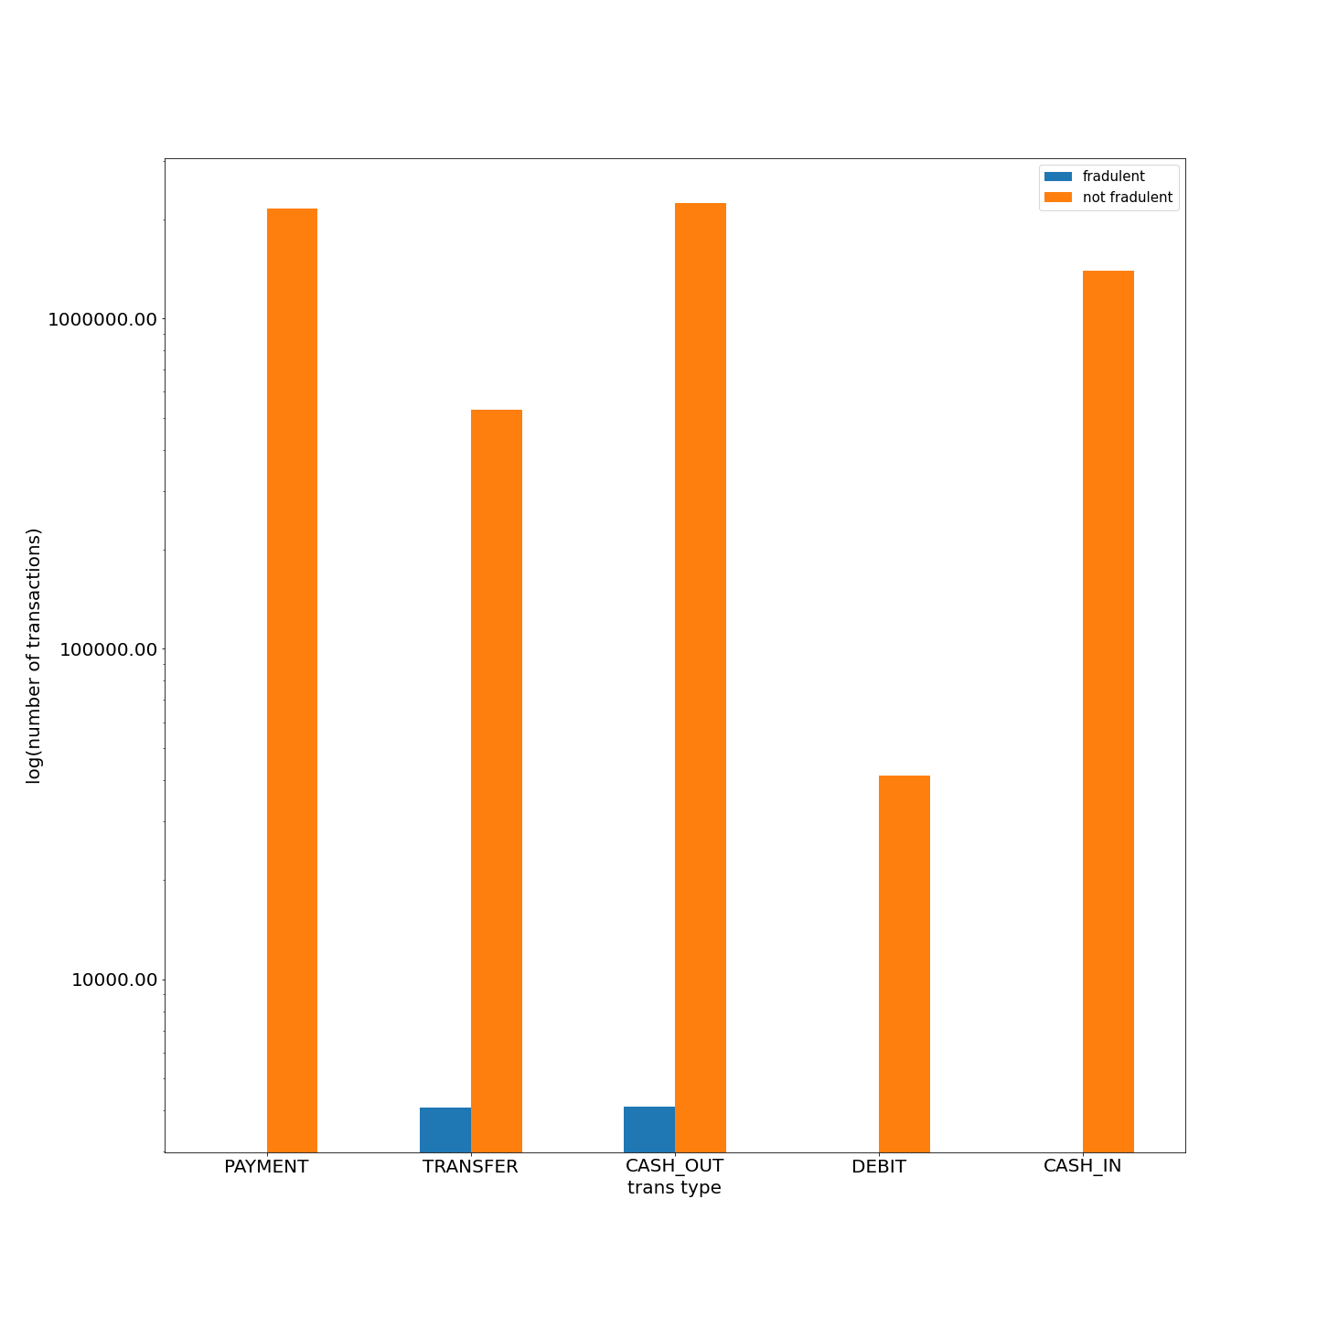

Slide 3
Evaluation Metric
 | Precision | Recall | F1-score | Support
NotFraud | 1.0 | 1.00 | 1.00 | 6535450
Fraud | 0.0 | 0.00 | 0.00 | 812
Accuracy |  |  | 1.00 | 636262
Macro avg | 0.5 | 0.5 | 0.5 | 636262
Weighted avg | 1.00 | 1.00 | 1.00 | 636362

Slide 4
Improvement
Formulated engineered features that will facilitate separation of isFraud==1 class of data points from isFraud==0 class of data points.

