Slide 1

Automatically Detecting Financial Fraud In A Mobile Payment System
A System for Mobile Payment Service Providers

Slide 2
Topics (Remove this before publishing)
Problem Statement
Approach
Results
Appendix
Model Chosen and Why
Precision, Recall, F1, ROC Curve, Confusion Matrix

Slide 3
An Average of 23% of users of SIM-Based Mobile Payment Systems in African and parts of the Middle East Have Experienced Loss Due to Fraud¹
This not only affects the consumer but is a cost to the Mobile Payment Operator That Attempts to Take Action to Resolve Cases of Fraud

Slide 4
This Presentation Describes A Computer-Based System That Can Automatically Detect Fraudulent Transactions In Real Time

Slide 5
Fraud Scenario Covered
Fraudster obtains access to another person’s account
(steals phone, or phishes PIN and swaps SIM card)
Fraudster transfers money from victim's account to one or more target accounts under control
Fraudster cashes these accounts accounts
May or may not use a merchant as an facilitator

Slide 6
Approach
Mobile Payment Simulation Results From Kaggle:
SKLearn
XGBoost
RAPIDS
Pandas
Numpy
Jupyter
MariaDB (mySQL)
Flask (Mobile Transaction Fraud Detection Web Application)

Slide 7
Takeaway from EDA

Slide 8
Data Clean
EDA
Model Selection
Final Model Evaulation
Fraud Detection Web Appliction

Slide 9
Results (XGBoosted Model)
 | Precision | Recall | F1-Score | Support
NotFraud | 1.00 | 1.00 | 1.00 | 635439
Fraud | 0.99 | 0.95 | 0.97 | 824
 |  |  | F1-Score | Support
Accuracy |  |  | 1.00 | 636263
Macro Avg | 1.00 | 0.98 | 0.99 | 636263
Weighted Avg | 1.00 | 1.00 | 1.00 | 636263

Slide 10
Results (RandomForest Model)
 | Precision | Recall | F1-Score | Support
NotFraud | 1.00 | 1.00 | 1.00 | 635439
Fraud | 0.99 | 0.89 | 0.94 | 824
 |  |  | F1-Score | Support
Accuracy |  |  | 1.00 | 636263
Macro Avg | 1.00 | 0.95 | 0.97 | 636263
Weighted Avg | 1.00 | 1.00 | 1.00 | 636263

Slide 11
Conclusions
What model should we use?
Depends
If you don’t want any Fraudulent transactions mislabeled as Not Fraudulent use XGBoost
But if your service does not want to inconvenience customers with false alarms go with RandomForest

Slide 13
Approach
The largest challenges:
Large data set: 6M+ transactions
Greatly Imbalanced Data Set: 8,213 Fraudulent Transactions in 6,362,321 Total Transaction
Mixture of Feature types: 1 temporal, 3 Categorical (5 class, ~1000s of classes, ~1000 of classes), 4 numeric
Dirty Data: Accounting of several transactions did not add up due to unknown underlying assumptions of the
Dataset not documented by the dataset author

Slide 14
Appendix

Slide 17
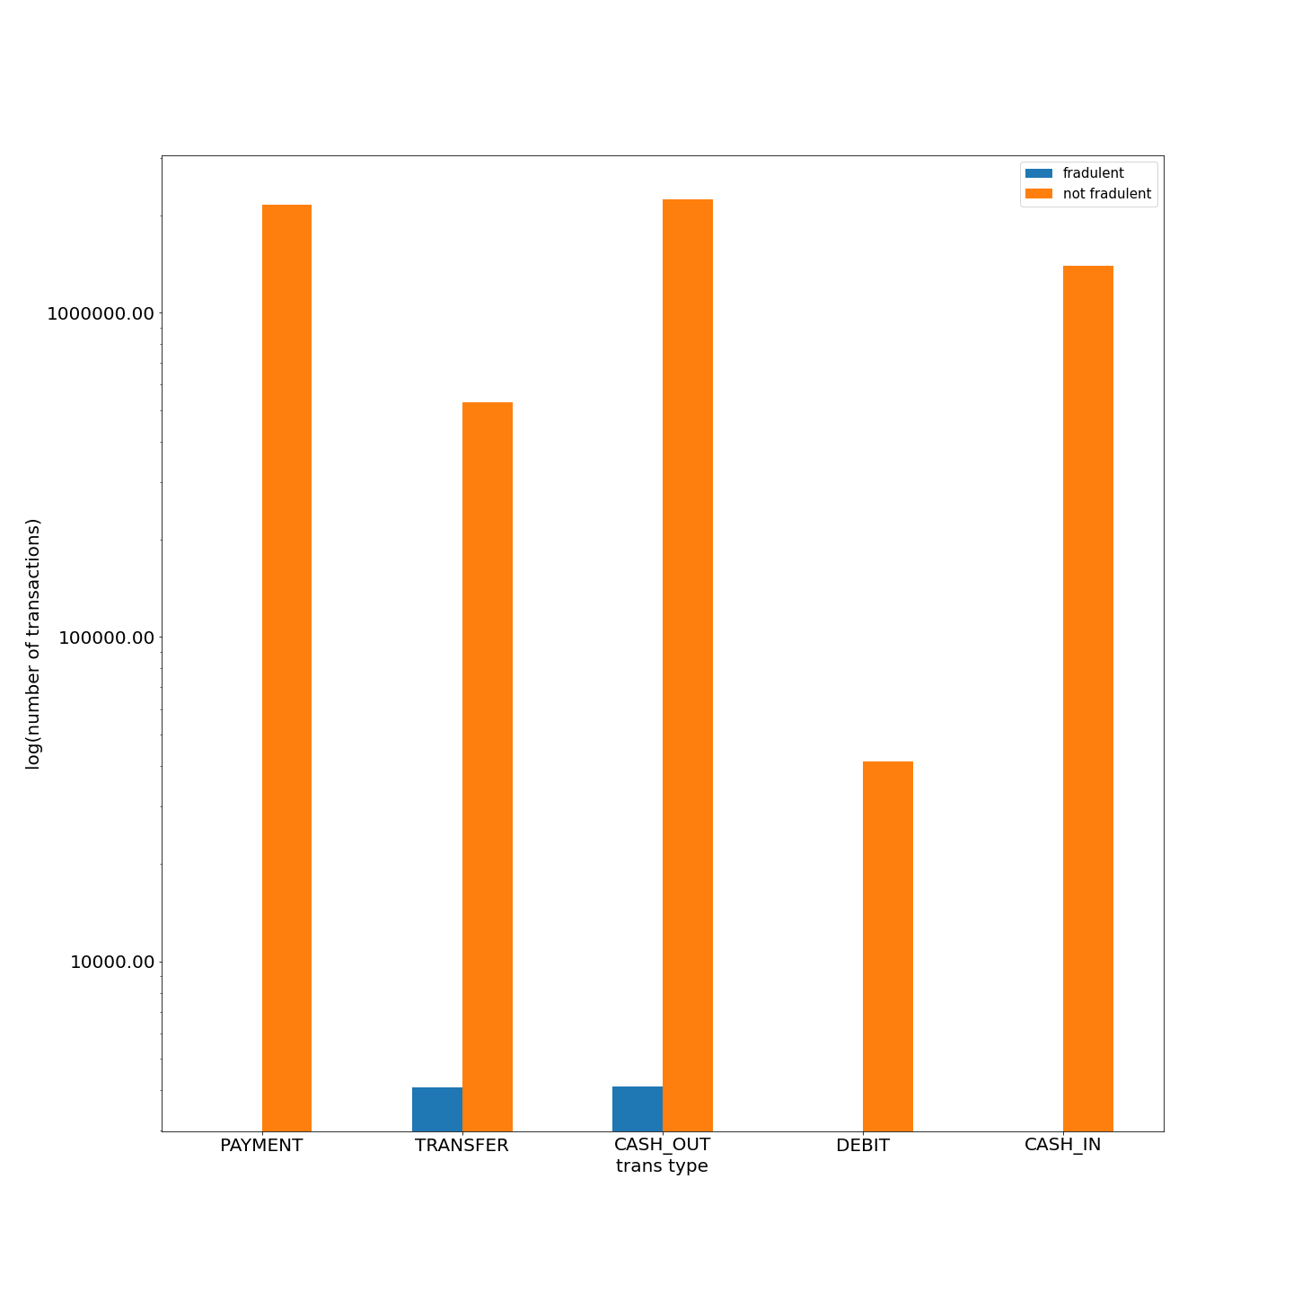

Slide 18
Evaluation Metric
 | Precision | Recall | F1-score | Support
NotFraud | 1.0 | 1.00 | 1.00 | 6535450
Fraud | 0.0 | 0.00 | 0.00 | 812
Accuracy |  |  | 1.00 | 636262
Macro avg | 0.5 | 0.5 | 0.5 | 636262
Weighted avg | 1.00 | 1.00 | 1.00 | 636362

Slide 19
Improvement
Formulated engineered features that will facilitate separation of isFraud==1 class of data points from isFraud==0 class of data points.

