Slide 1
Investition und Finanzierung
Tutorium Nr. 1
Bei Fragen, Anmerkungen oder Kritik:
Hergen.Schlueter@Uni-Oldenburg.de

Slide 2
Aufgabe I
What are the three main types of decision a financial manager can make? For each decision, give a relevant example. (1-A2)

Slide 3
Aufgabe II
Evaluate the following statement: “Managers should not focus on the current share price, because doing so will lead to an overemphasis on short-term profits at the expense of long-term profits.” (1-A3)

Slide 4
Aufgabe III
Many companies view a stock market listing as an important objective. Why do you think this is the case? Why do you think Google listed on a stock exchange? (1-A6)

Slide 5
Aufgabe IV
The 2007 annual report for Anglo American plc, the world´s leading global mining company, shows that the firm had $34.042 billion in non-current assets and $9.962 billion in current assets. It reported $11.480 billion in current liabilities and $ 8.665 billion in non-current liabilities. How much has the equity of Anglo American plc worth? (1-A7)

Slide 6
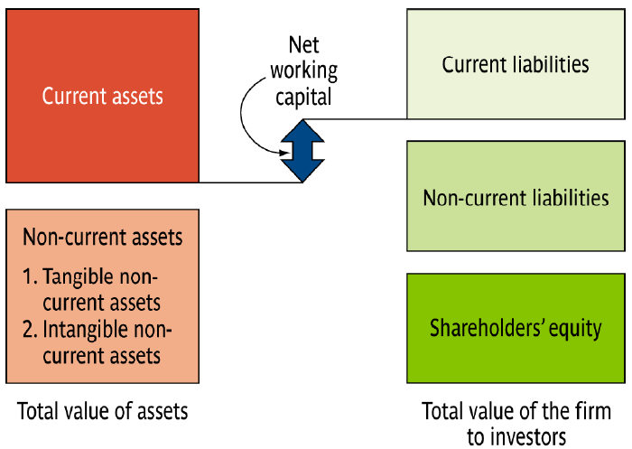
Bilanzübersicht

Slide 7
Lösung Aufgabe IV
Equity = Total Assets – Total Liabilities = (9.962 + 34.042) – (11.480 + 8.665)
= $23.859 billion

Slide 8
Aufgabe V
Anglo American plc announces that it plans to increase its non-current assets by $10 billion. If the company wishes to maintain its ratio of total liabilities to equity, how much long-term debt should it use? (1-A8)

Slide 9
Lösung Aufgabe V
Step 1: Determine liability/equity ratio:
= Liability/equity = 20.145/23.856 = 0,844
Step II: To find the current weightings of debt and equity in the new funding, you must actually calculate a new ratio, liability/assets:
= liability/total assets = 20.145/44.004 = 0,457799

Slide 10
Lösung Aufgabe V
Step 3: The debt that is raised is thus $4.5779 billion and equity is $5.4220 billion = 10 billion
Step 4: Check the new liability/equity ratio.
new level of liabilities = $24.7229 billion
new level of equity = $29.2810 billion
The new ratio is: $24.7229 billion/ $29.2810 billion
= 0,844 – the same as before

Slide 11
Aufgabe VI
Your company has just purchased a forklift truck, and has two payment options. The first option is to pay 100,000 Swedish kroner every month for 12 months. The second option is to pay 1,200,000 Swedish kroner at end of the year. Which option should you choose? Why? (1-A10)

Slide 12
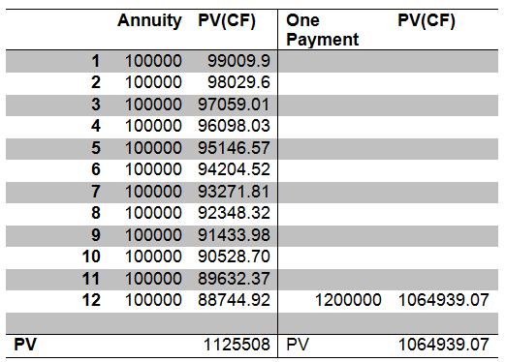
Lösung Aufgabe VI
The payment of SEK1,200,000 in twelve months is less because the cash flow is after the majority of SEK100,000 monthly payments (Assume the monthly interest rate is 1 percent)

Slide 13
Aufgabe VII
You are assessing the viability of two projects.
Project A has a 25 per cent chance of losing €1,000,000, a 50 per cent chance of break even, and a 25 per cent chance of making €1,000,000 profit.
Project B has a 25 per cent chance of losing €2,000,000, a 50 per cent chance of breaking even, and a 25 per cent chance of making €2,000,000 profit.
Which project should you choose? Why? (1-A11)

Slide 14
Aufgabe VIII
You have read the first chapter of this textbook and have taken over a company that you now discover is losing € 100,000 a week. At the rate things are going, the company won´t have any cash left in six months to pay it creditors.
What are your goals as a financial manager? Is this consistent with what you have read in this chapter? Explain. (1-A14)

Slide 15
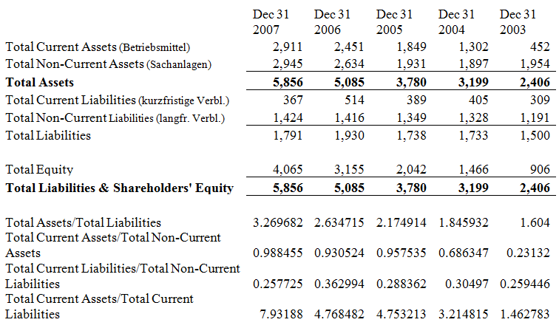
Aufgabe IX

Slide 16
Aufgabe X
Explain why the corporate governance of a firm sole proprietorship should be different from that for a partnership, which in turn should be different from a limited corporation. (2-A5)

Slide 17
Aufgabe XI
What are the differences between a general partnership and a limited partnership? Why do firms choose to be partnerships instead of limited liability corporations? (2-A6)

Slide 18
Lösung Aufgabe XI
In a general partnership all partners agree to provide some fraction of the work and cash and to share the profits and losses.
Each partner is liable for all of the debts of the partnership.
Limited partnerships permit some of the partners to have limited liability (liable only to the amount of cash one has contributed to the partnership).
Limited partnerships usually require that (1) at least one partner be a general partner and (2) the limited partners do not participate in managing the business.

Slide 19
Aufgabe XII
Why would we expect managers of a corporation to pursue the objectives of shareholders? What about bondholders? (2-A19)

Slide 20
Lösung Aufgabe XII
In agency theory, the underlying contract between the principal (shareholders) and agent (management) is based on maximising the principal’s wealth.
We would expect managers to pursue the objectives of shareholders only if their interests are the same as that of the shareholders.
This can be done through appropriate executive compensation contracts. In most situations, the shareholder and bondholder objectives will be the same.
However, when a firm is in financial distress, these may differ and then shareholder objectives will naturally take precedence. This is why we have bond indentures.

