Slide 1
Investition und Finanzierung
Tutorium Nr. 3
Bei Fragen, Anmerkungen oder Kritik:
Hergen.Schlueter@Uni-Oldenburg.de

Slide 2
Aufgabe I (4A18)
i. What is the annualized interest rate, compounded daily, that is equivalent to 12 per cent interest compounded semi-annually?
ii. What is the daily compounded rate that is equivalent to 12 per cent compounded continuously?

Slide 3
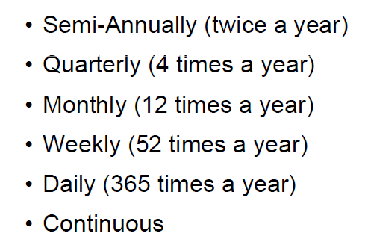
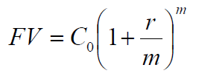
Zu Aufgabe I (4A18)

Slide 4
Aufgabe II (4A19)
Growing Perpetuities:
Marcus Boruc has been working on a new hands-free telephone that clips into your ear. The new gadget has now been cleared for manufacture and development. Marcus anticipates his first annual cash flow from the phone to be €200,000, received two years from today. Subsequent annual cash flows will grow at 5 per cent in perpetuity.
What is the present value of the phone if the discount rate is 10 per cent?

Slide 5

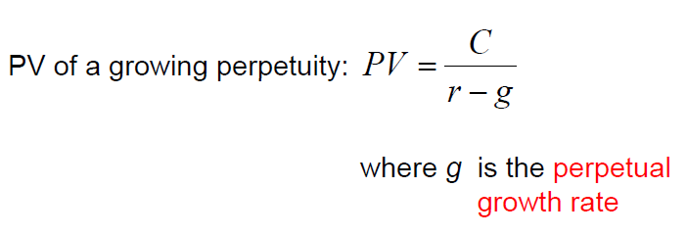
Zu Aufgabe II (4A19)

Slide 6
Aufgabe III (4A21)
Calculating Interest Expense:
You receive a credit card application from Shady Banks plc offering an introductory rate of 1.90 per cent per year, compounded monthly for the first six months, increasing thereafter to 16 per cent per year compounded monthly.
Assuming you transfer the £4,000 balance from your existing credit card and make no subsequent payments, how much interest will you owe at the end of the first year?

Slide 7
Aufgabe IV (4A20)
Balloon Payments:
Mario Guiglini has just sold his hotel and purchased a restaurant with the proceeds. The cost of the restaurant to Mario is €500,000, and the seller requires a 25 per cent up-front payment. Mario is able to pay the up-front payment from the proceeds of the hotel sale. He needs to take out a mortgage, and has been able to arrange one with Unicredit Bank that charges a 9 per cent APR. Mario will make equal monthly payments over the next 30 years. His first payment will be due one month from now. However, the mortgage has an eight-year-balloon payment option, meaning that the balance of the loan could be paid off at the end of year 8. There were no other transaction costs or finance charges.
How much will Mario´s balloon payment be in eight years?

Slide 8

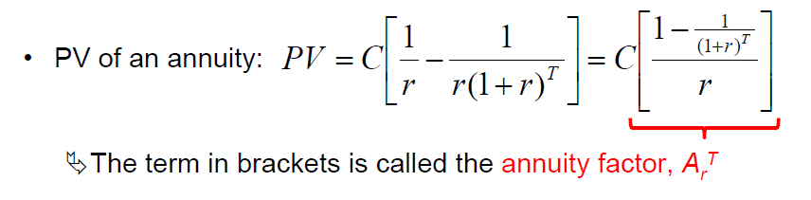
Zu Aufgabe IV (4A20)

Slide 9
Aufgabe V (4A26)
Annuities:
Today, you have become a new mother, and the British government has given you £250 for your child´s trust fund. You think it would be a great idea to use this as the basis for saving for your child´s future. You believe in private schooling, and so you want to put aside a certain amount each year to pay for your child´s primary schooling (ages 5-11), secondary schooling (ages 12-17), and university tuition (ages 18-22). Private primary schooling costs £7,000 per year and private secondary schooling costs £8,000 per year. If your child gets into university, the fees and maintenance will be in the region of £15,000 per year. Your child will start school five years from now, and you plan to deposit money every year in the trust fund, starting one year from now. The annual percentage rate you´ve been quoted by the government is 6.5 per cent.
How much money must your deposit in an account each year to fund your child´s education? You will make your last deposit when your child enters university.

