Slide 1
Investition und Finanzierung
Tutorium Nr. 4
Bei Fragen, Anmerkungen oder Kritik:
Hergen.Schlueter@Uni-Oldenburg.de

Slide 2
Aufgabe 27 (5A1)
Definition of a Bond:
What are the main characteristics of a bond? Provide examples of different types of bond in terms of coupons, maturity and face value.

Slide 3
Aufgabe 29 (5A10)
Valuing Bond:
In March 2009 the German freight company Deutsche Bahn issued a 10-year bond with face value of €1,000 and paying an annual coupon of 4.875 per cent. What is the price of the bond if the yield to maturity (YTM) is
a) 4 per cent?
b) 5 per cent?
c) 10 per cent?
Yield to maturity = Rückzahlungsrendite

Slide 4
Zu Aufgabe 29 (5A10)
If the yield to maturity for a bond is less than the bond's coupon rate, then the (clean) market value of the bond is greater than the par value (and vice versa).
If a bond's coupon rate is less than its YTM, then the bond is selling at a discount.
If a bond's coupon rate is more than its YTM, then the bond is selling at a premium.
If a bond's coupon rate is equal to its YTM, then the bond is selling at par.

Slide 5
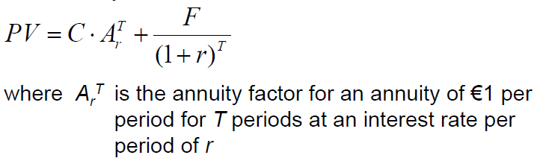
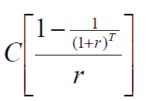

Zu Aufgabe 29 (5A10)
=

Slide 6
Aufgabe 30 (5A12)
Share Values:
In 2009 DaimlerChrysler had just paid a dividend of €2 per share on its equity. The dividends are expected to grow at a constant rate of 5 per cent per year indefinitely.
If investors require a 11 per cent return on DaimlerChrysler´s equity, what is the current price?
What will the price be in three years? In 15 years?

Slide 7
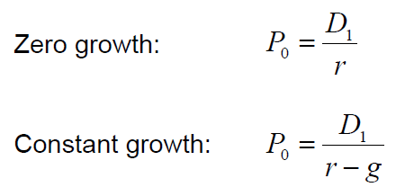
Zu Aufgabe 30 (5A12)

Slide 8
Aufgabe 31 (5A13)
Share Values:
The next dividend payment from French health food firm Danone will be €1.12 per share. The dividends are anticipated to maintain a 5 per cent growth rate for ever. If Danone shares currently sell for €35.00, what is the required return?

Slide 9
Zu Aufgabe 31 (5A13)

Slide 10
Aufgabe 33 (5A18)
Bond return: A six-year government bond makes annual coupon payments of 5 per cent and offers a yield of 3 per cent annually compounded. Suppose that one year later the bond still yields 3 per cent.
What return has the bondholder earned over the 12-month period?
Now suppose that the bond yields 2 per cent at the end of the year. What return would the bondholder earn in this case?

Slide 11
Zu Aufgabe 33 (5A18)
=

Slide 12
Lösung zu Aufgabe 33 (5A18)
The return on the bond is
[(P₁ + C)/P₀] – 1

Slide 13
Aufgabe 34 (5A19)
Non-Constant Growth:
Dylan Bearings is a young start-up company. No dividends will be paid on the shares over the next nine years because the firm needs to plough back its earnings to fuel growth. The company will pay an £8 per share dividend in 10 years and will increase the dividend by 6 per cent per year thereafter.
If the required return is 13 per cent, what is the current share price?

