Slide 1
Zero Knowledge Proofs
Privacy Without Compromise

Slide 2
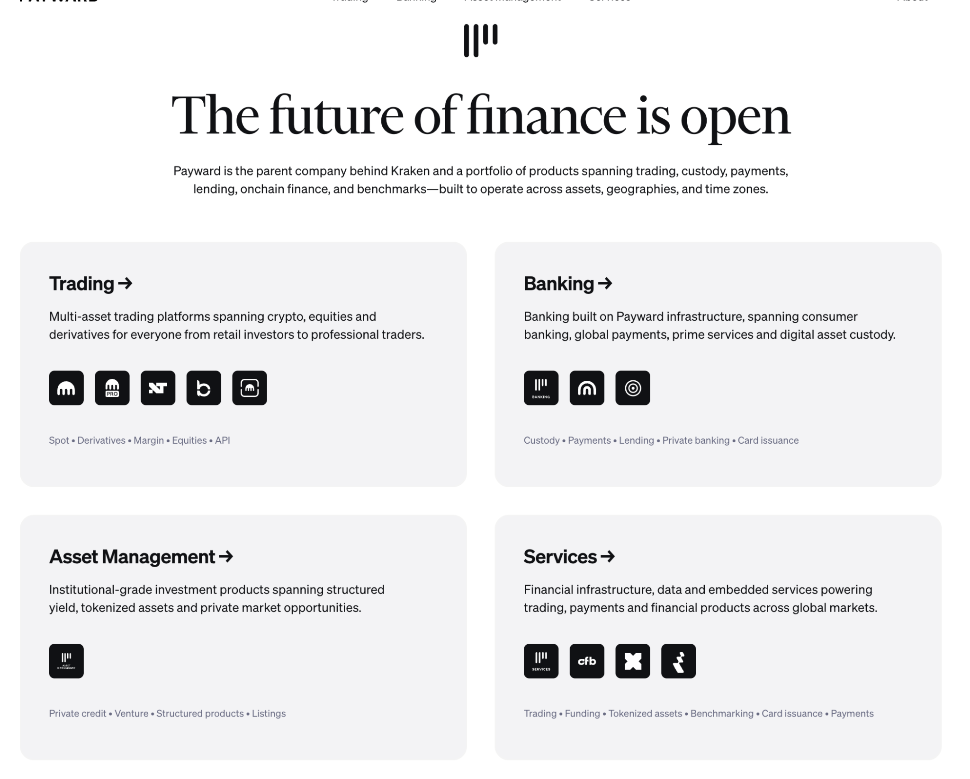

Slide 3

November 14th
78th Street Studios
burningrivercybercon.com

Slide 4
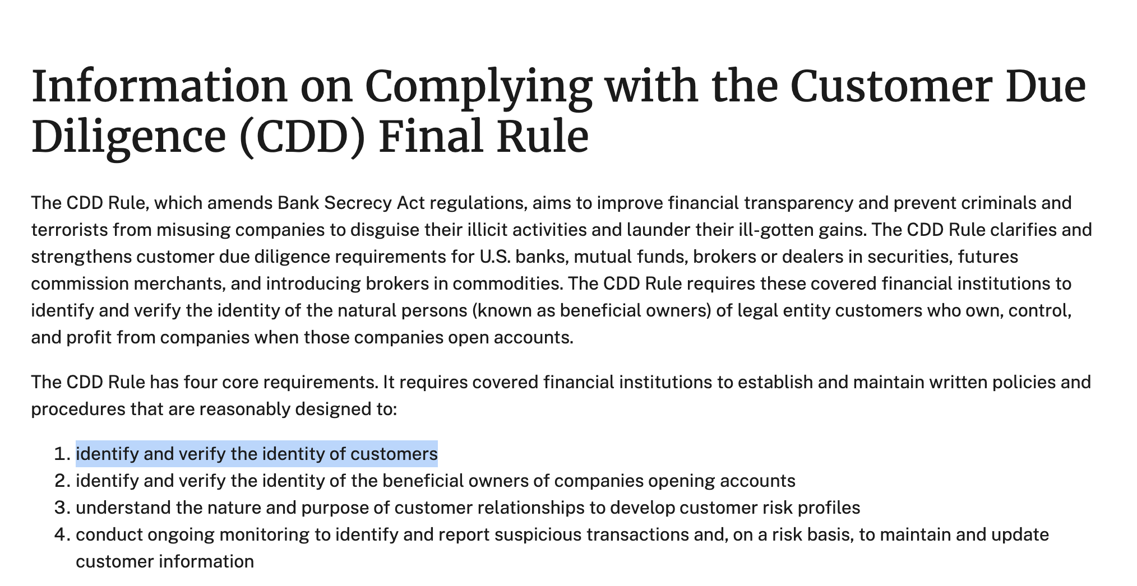

Slide 5
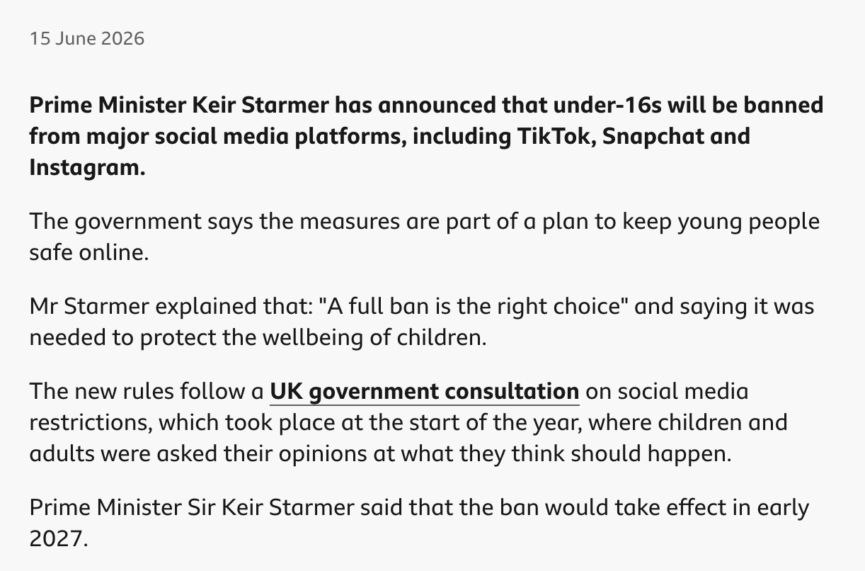

Slide 6
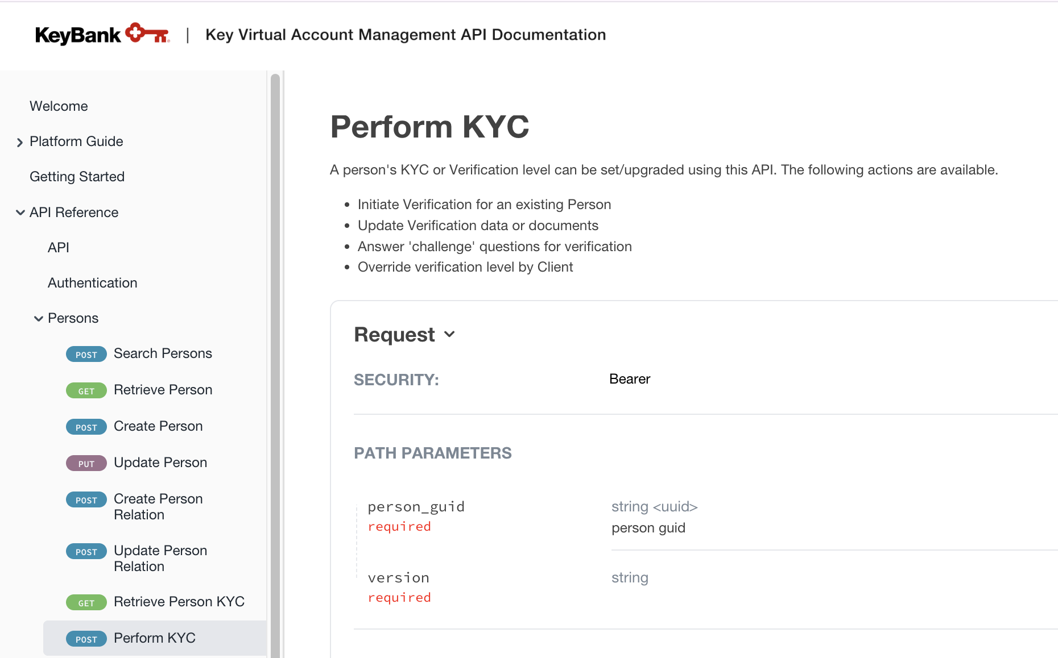
KYC Verification

Slide 7
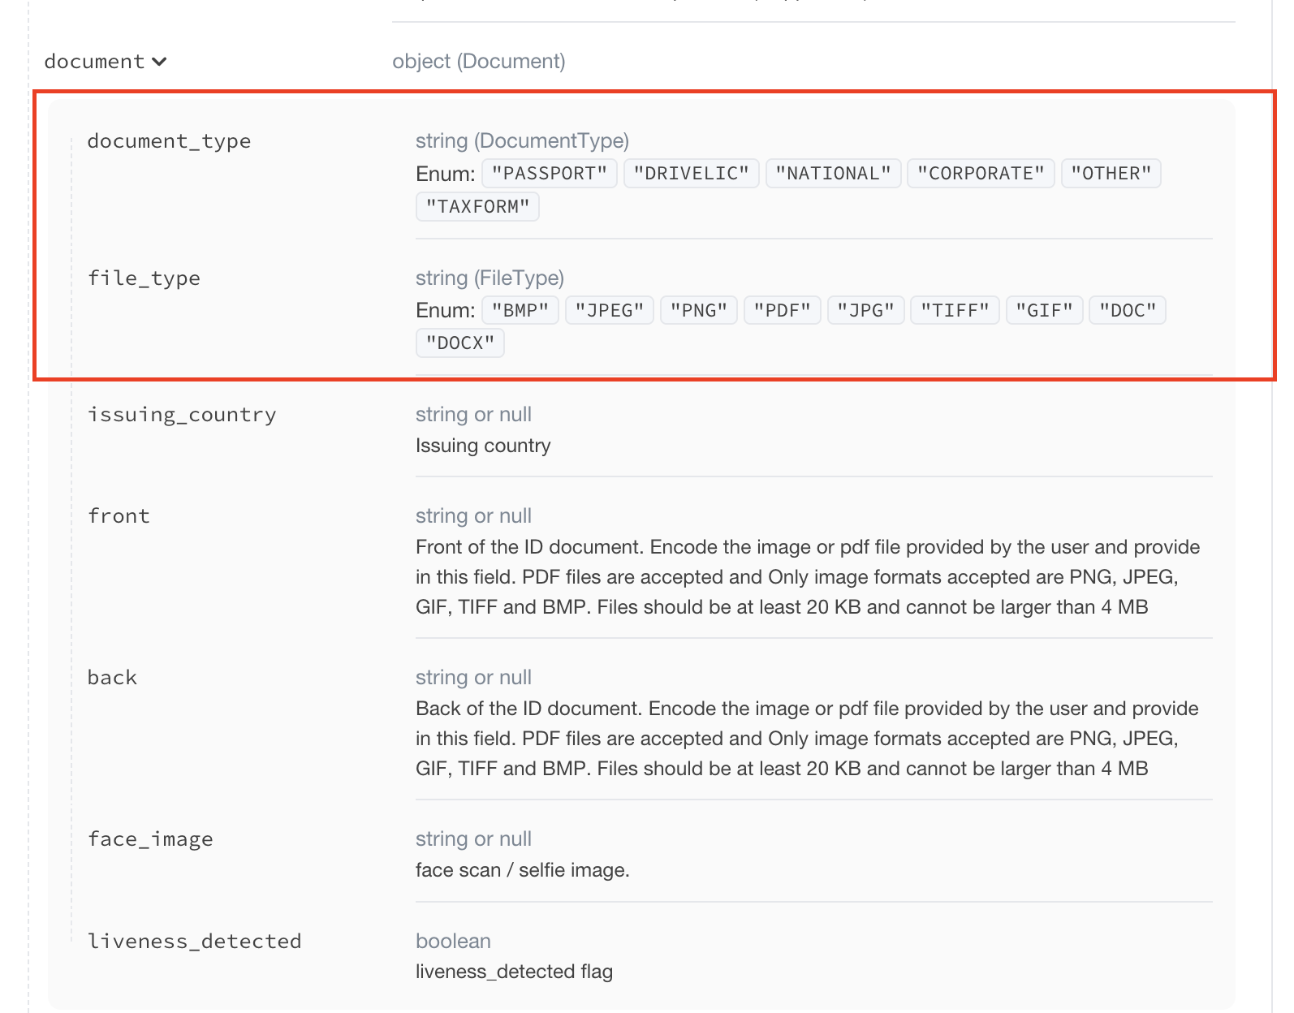
KYC Verification
A typical KYC API: front and back of your ID, plus a selfie

Slide 8
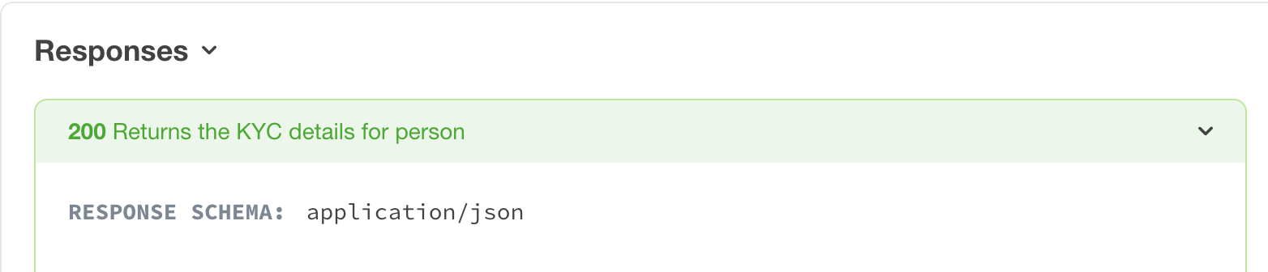
KYC Verification

Slide 9


Issues
Security Risk
Sensitive data needs to be collected, processed, and stored.
This is a high value target to hackers.

Slide 10
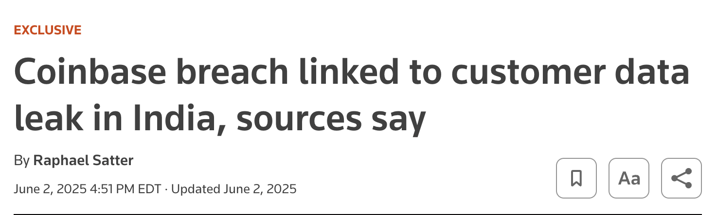
Coinbase breach, June 2025 (Reuters)

Slide 11
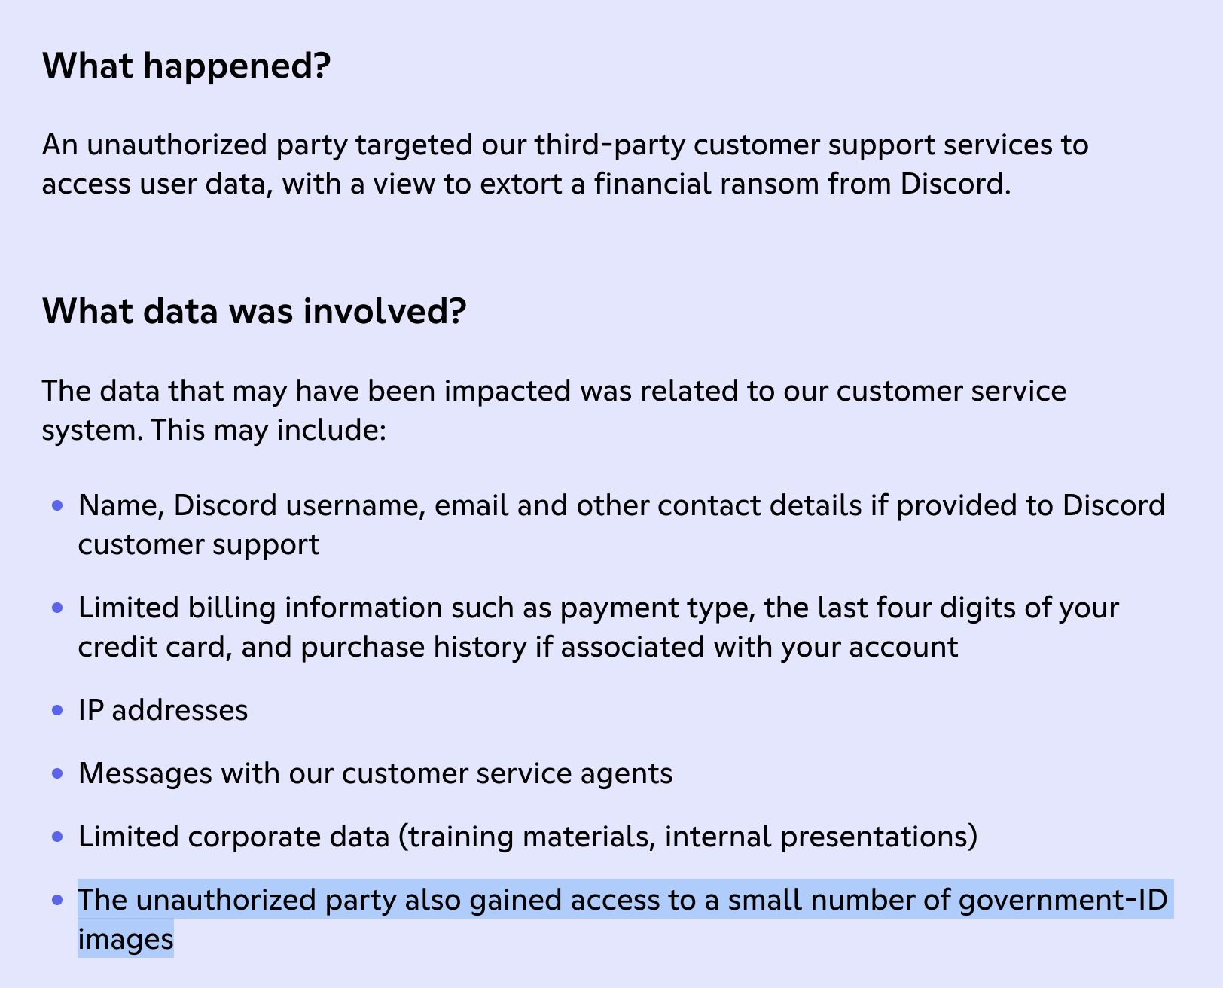
Discord: attackers reached government ID images through a support vendor

Slide 12
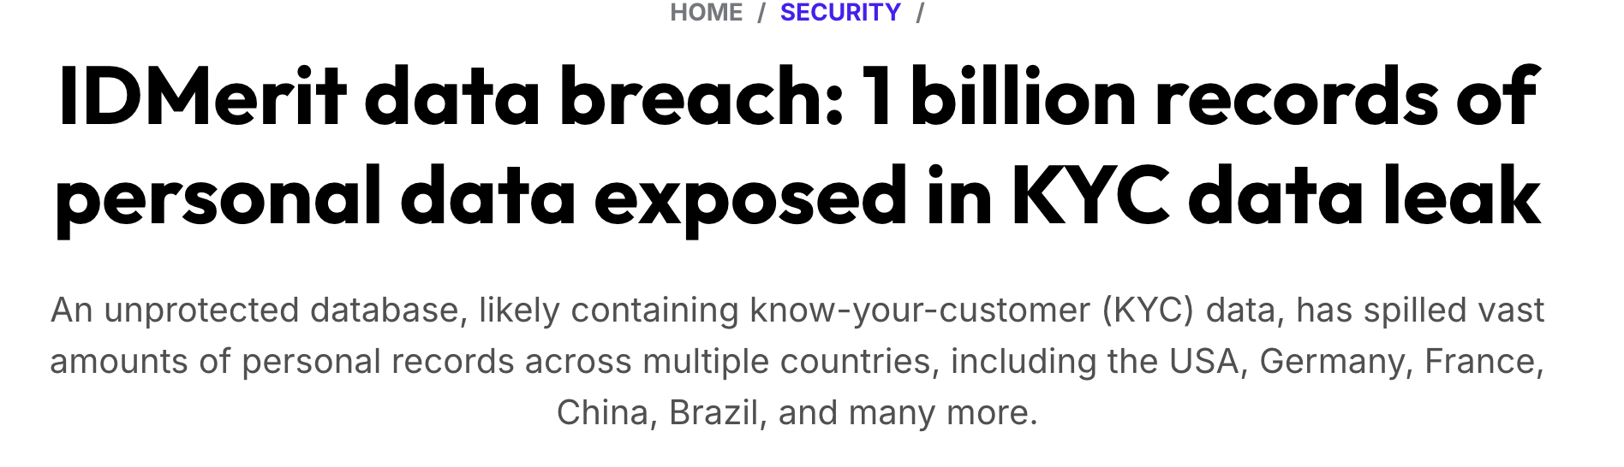

Slide 13
Issues
Security Risk
Sensitive data needs to be collected, processed, and stored.
This is a high value target to hackers.
AI Risk
Synthetic IDs, deepfakes, and other AI tools make a picture of a passport easier to fake.

Slide 14
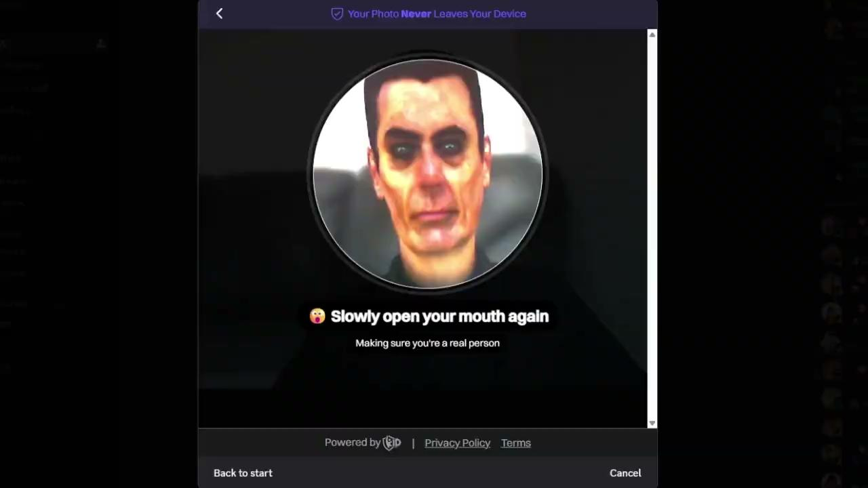

Slide 15
Issues
Security Risk
Sensitive data needs to be collected, processed, and stored.
This is a high value target to hackers.
AI Risk
Synthetic IDs, deepfakes, and other AI tools make a picture of a passport easier to fake.
Bad UX
KYC experience causes massive onboarding issues.
According to one study, 68% of fintech app users abandon the app before onboarding is done.

Slide 16
Zero Knowledge Proofs
Cryptography tool that lets you:
Prove that a statement is true (“the user is over 18”)
Without revealing the secret data behind it (“January 1, 2008”)
In a way that is extremely difficult to fake (“soundness”)

Slide 17

Background
Original content and illustrations
from MatterLabs and Marcin Michalski
Adapted for Educational Purposes
by @michaelbe

Slide 18
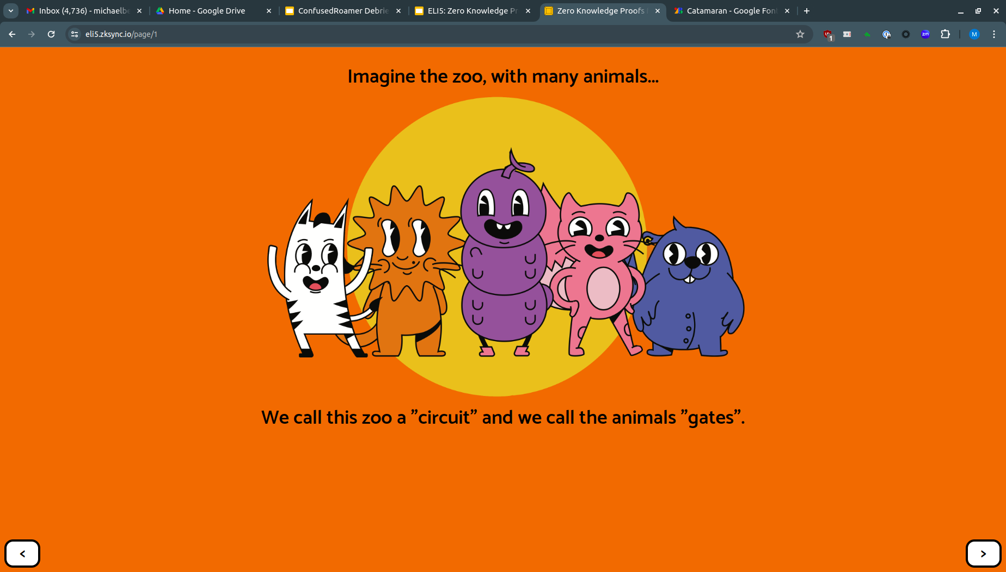
Background

Slide 19
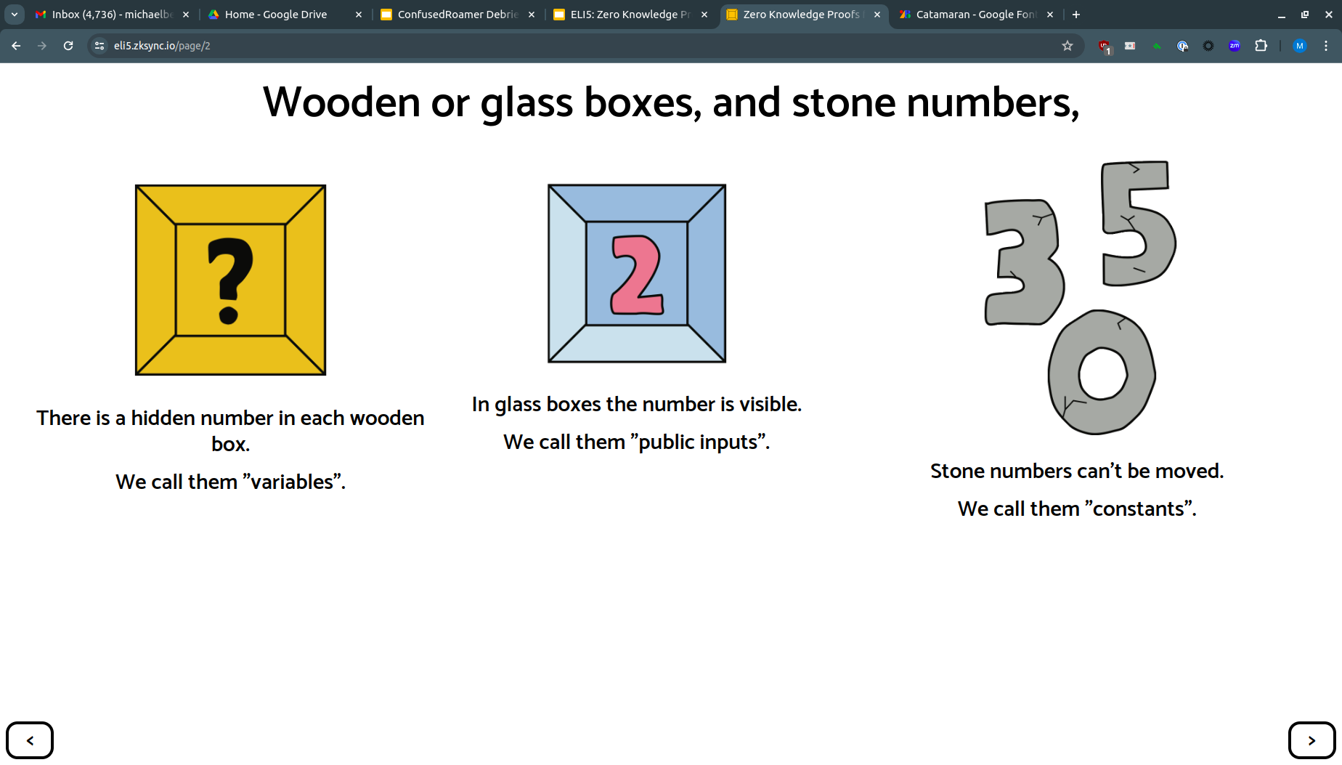
Background

Slide 20
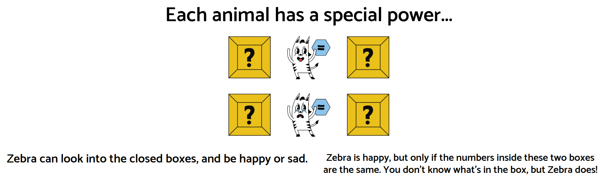
Background

Slide 21
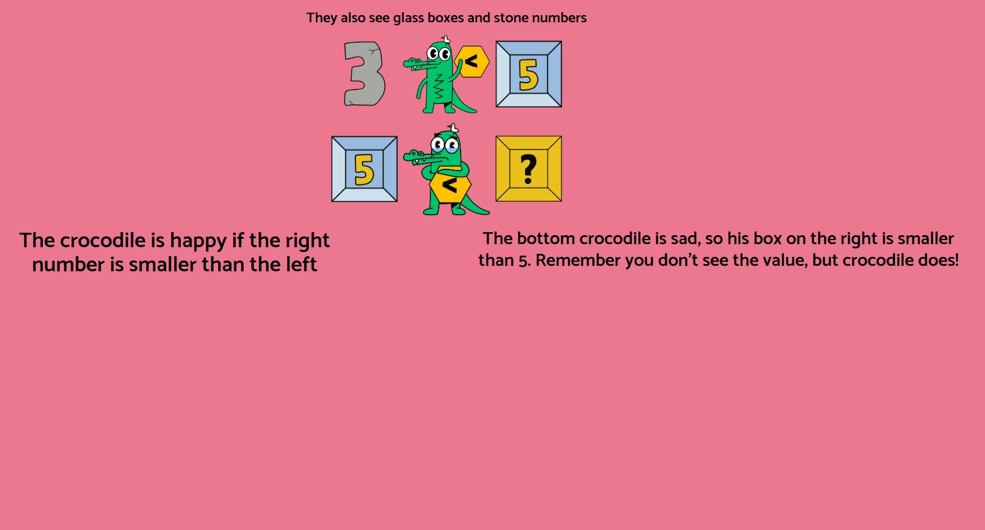
Background

Slide 22
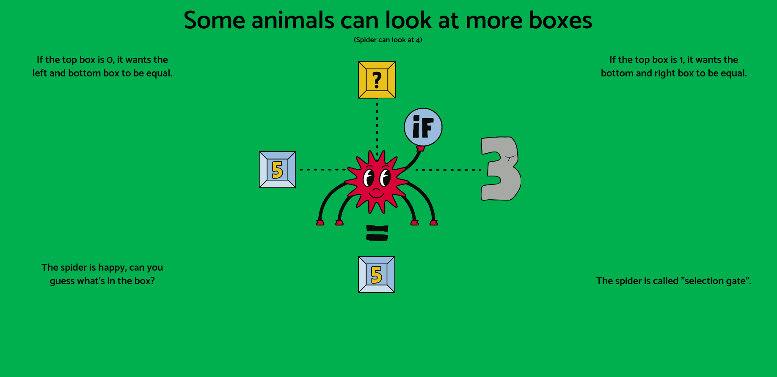
Background

Slide 23
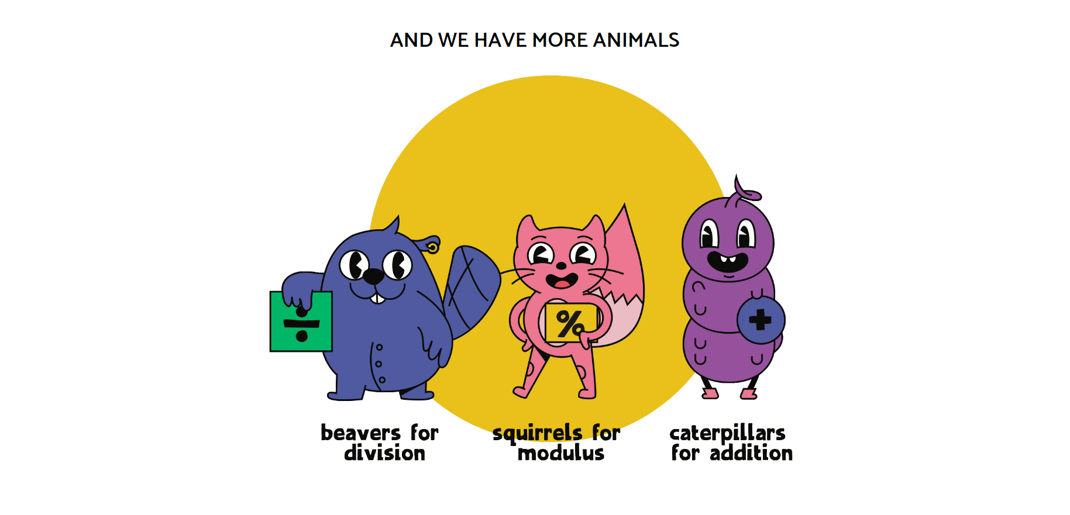
Background

Slide 24
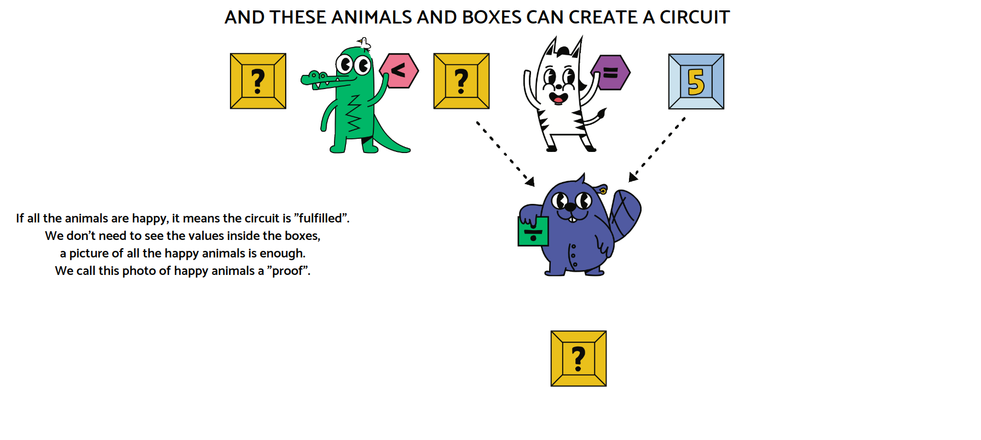
Background

Slide 25
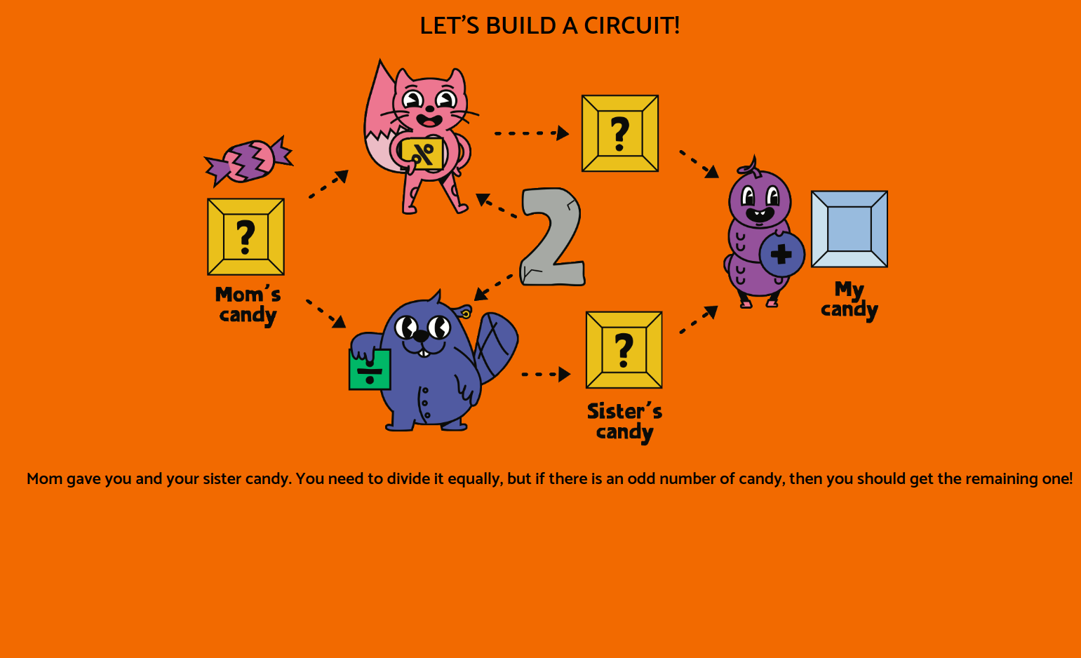
Background

Slide 26

Practical Examples

Slide 27

ZKPassport
Idea: Passports already have NFC chips …
Read the data from the chip (signed by government)
Generate a ZK Proof on device, verifying the relevant info
Present the proof(s) to the server

Slide 28


Slide 29

QuarkID
Idea: Digital credentials
Government issues a digital document -i.e. vaccination certificate
Generate a ZK Proof on device, verifying the relevant info
The government can verify the information came from a trusted source without needing to see the exact data

Slide 30
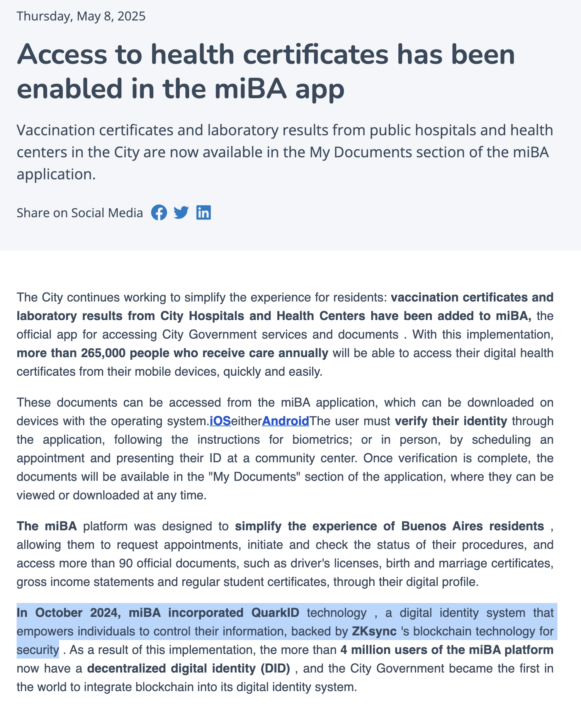

Slide 31

Semaphore
Idea: Prove you’re a group member without revealing WHO
Private voting
Anonymous feedback
Anonymous chats / social media

Slide 32
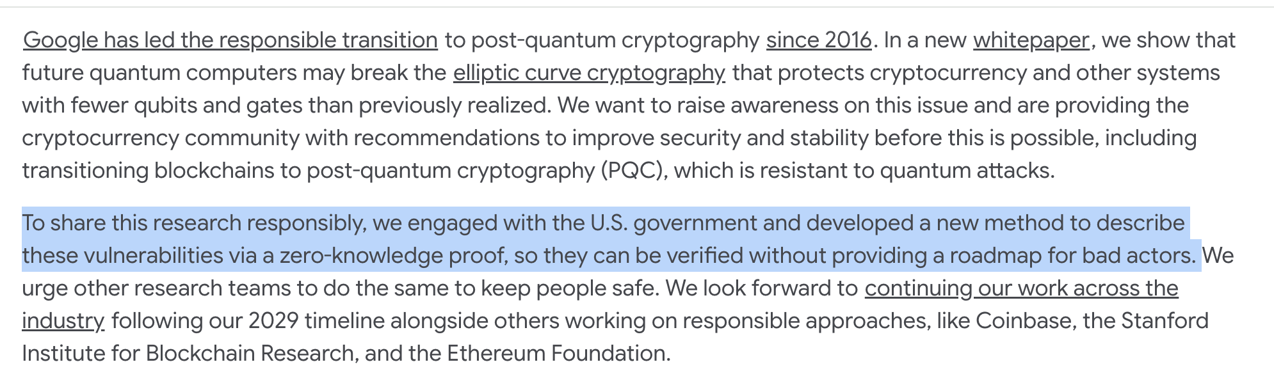
Other Uses

Slide 33
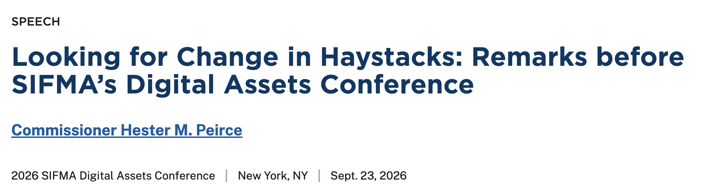
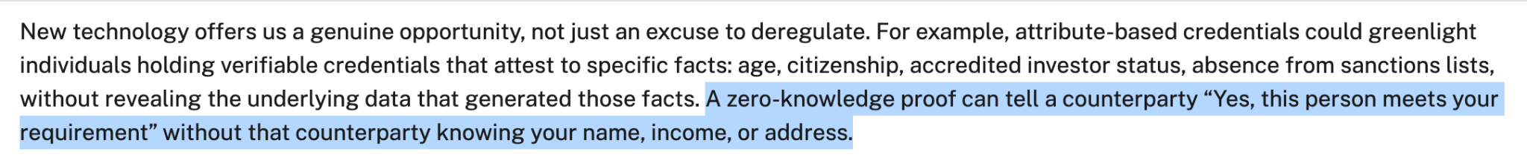

Slide 34








Thank you!
eli5.zksync.io
zkpassport.id
Discord demo: https://github.com/michael-bey/zkcord
Michael Benich
linkedin.com/in/michaelbenich

