Slide 1
AI in the Curriculum: Challenges & Opportunities
Michael Borck, Curtin University

Slide 2
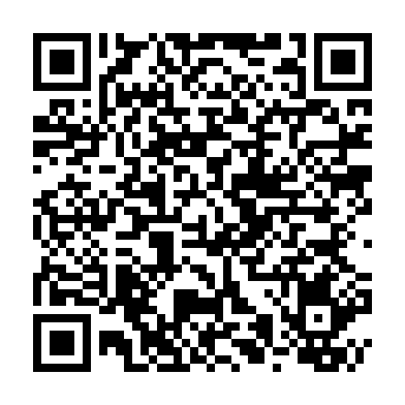
Companion Website
AI in the Curriculum

Slide 3
AI Acknowledgment: AI tools were used in the initial drafting and development of this document. All content has been reviewed, refined, and validated through human expertise and professional judgment.

Slide 4
Today: 15 Minutes
We’ll explore: - Four challenges we’re all facing - One hidden barrier we don’t discuss - Three pathways forward - Your questions and experiences
Not covering: - How AI works - Which tools to use - Detection strategies - Policy development
“Not about answers — just questions worth asking”
Notes:
I’m sharing observations from my own teaching and conversations with colleagues - you’ll likely recognize these patterns. * Reality Check: AI already in workflows; disciplines differ; no one-size-fits-all * Today’s Goal: Share challenges & spark reflection * “Not about answers — just questions worth asking”
AI is already here - students using ChatGPT for assignments, staff for admin tasks
Engineering will use it differently than Creative Writing - acknowledge this
We’re exploring together, not prescribing solutions
Set expectation: discussion starter, not definitive guide
Elephant in the room: We need to talk about AI shame - tease what’s coming
Some of you might be thinking ‘not another AI talk’ - but we need to talk about what’s actually happening in our classrooms
Let me share four challenges I’m seeing…

Slide 5
Over-Trust: The “Fountain of Knowledge” Problem
Challenge: Students over-trust AI
Impact: Weakens critical thinking
Response: Error-spotting, critique, reward questioning
Notes:
I watched a student refuse to question an obviously wrong AI answer because ‘the AI said so’
Students treat AI like authoritative source
Hesitant to disagree even when they know better
“But ChatGPT said…” becoming common refrain
Give students an AI explanation with 2 deliberate errors
Works across disciplines: wrong physics formula, incorrect historical date, buggy code, flawed diagnosis
Students initially struggle to spot errors they’d normally catch
Response strategies: - Make error-hunting a regular exercise - Compare multiple AI responses to same prompt - Reward students who challenge AI answers - “Find three ways to improve this AI response”
Key message: Critical thinking matters MORE with AI, not less
But over-trust isn’t the only problem…

Slide 6
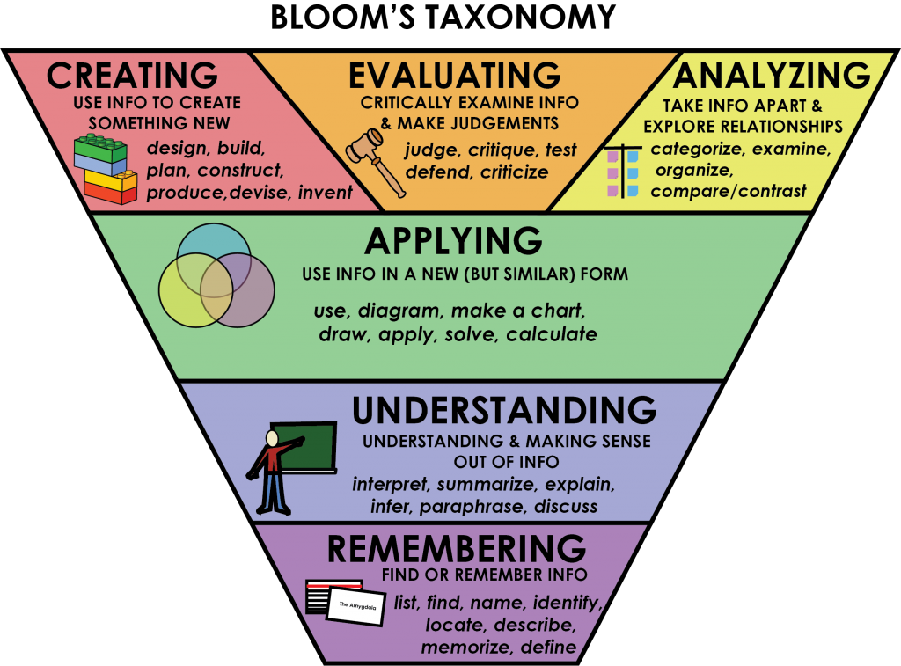
Over-Use: Shortcuts vs. Scaffolds
Challenge: AI as bypass, not support
Risks: Shallow learning, plagiarism fears, lost skills
Response: Frame AI as scaffold within pedagogy
© Rawia Inaim. “Bloom’s Taxonomy.” Retrieved September 4, 2025, from https://opentextbc.ca/studentsuccess/chapter/effective-questions/. Licensed under a CC BY-SA (Attribution ShareAlike) license.
Notes:
The distinction: “There’s a difference between using AI to skip learning and using it to enhance learning”
Students jump straight to “give me the answer”
Miss the learning that comes from struggle
Can’t explain their “own” work
Panic when asked to work without AI
Bloom’s Flip explanation: - Traditional: Start at Remember/Understand, work up to Create - AI Era: Start with Create/Evaluate WITH AI support - Then work backwards to build foundational understanding - Example: Create a marketing campaign (with AI) THEN learn marketing principles
Practical example: - Don’t use AI to write essay from scratch - DO use AI to generate counter-arguments to strengthen your thesis - Use it as sophisticated sparring partner, not ghostwriter
“This isn’t lowering standards - it’s changing the journey”
“Now, some staff see this as AI breaking education…”

Slide 7
Misplaced Blame: It’s Not the Tool
Challenge: Staff blame AI for integrity issues
Response: Adapt assessment, don’t ban
Authentic, Personalised, Reflective
Past tools changed assessment, AI will too
Notes:
Historical context: - Calculators “ruined” mathematics → we adapted assessments - Wikipedia “destroyed” research → we taught evaluation - Google “killed” memorisation → we focused on application - Spell-check “weakened” writing → we emphasised ideas over mechanics
“AI doesn’t break assessments, it reveals what was already breakable”
Assessment evolution examples: - Authentic tasks: Real-world problems with no single answer - Personalised: Connect to student’s own experience/context - Reflective: “Explain your process” “What would you do differently?” - In-class components: Presentations, demonstrations, peer review
For the skeptics: - Banning won’t work - they’ll use it anyway - Better to teach proper use than pretend it doesn’t exist - “We don’t ban calculators, we teach when to use them”
But there’s a hidden challenge we rarely discuss…

Slide 8
Fear of AI: The Root of Resistance
The Fear: “AI will replace me” | “I’ll become obsolete” | “My expertise won’t matter”
The Reality: Every new tool sparked fear
Printing press → scribes worried
Calculators → mathematicians concerned
Internet → everyone panicked
The Pattern: Those who adapted thrived
Notes:
Let’s name the real issue - fear. Not fear of technology, but fear of irrelevance. I feel it too. When I first saw ChatGPT write a decent lecture outline, my stomach dropped. ‘What’s my value now?’
But here’s what I learned: AI makes my expertise MORE valuable. It handles the routine so I can focus on what only humans do - connect, inspire, judge, create meaning. Students need us MORE to help them navigate this, not less.
The choice isn’t whether AI enters education - it’s already here. The choice is whether we guide its use or let students figure it out alone.
Anchor story: “When I first saw ChatGPT write a lecture outline, my stomach dropped.”
Reframe: “AI makes my expertise more valuable — because only I can judge, connect, inspire.”
Takeaway: “Students don’t need us less, they need us more — to guide them through this shift.”

Slide 9
AI Shame: The Hidden Barrier
Challenge: Students & staff feel guilt/cheating
Impact: Underground use, stress, lost learning
Response: Normalise, Teach process, Share examples
Notes:
When I first used AI for teaching prep, I felt like I was cheating. Anyone else?
Student experiences: - “I’m not really learning if I use AI” - Hide AI use from peers - worried about judgment - Imposter syndrome intensifies - Won’t ask for help with AI - too ashamed
Staff experiences: - “Real academics don’t need AI” - Secret experimentation - won’t share successes - Fear colleagues will think less of them - Worry about being “found out”
Why this matters: - Drives use underground → can’t develop best practices - Creates unnecessary stress for everyone - Prevents skill development in AI collaboration - Blocks innovation and sharing
The reframe: - Using AI well REQUIRES expertise - You need domain knowledge to evaluate outputs - Creativity to direct it effectively - We don’t say “spell-check wrote my paper”
Share your own AI use openly: “I used Claude to help structure this presentation”
Teach the process: prompting, evaluating, iterating
Make it part of academic integrity discussions, not separate
So how do we move forward constructively?

Slide 10
Here’s the slide content with presenter notes based on the UNESCO framework:

Slide 11
Moving Forward: AI as Learning Partner
Role | Description | Example of Implementation
Possibility engine | AI generates alternative ways of expressing an idea | Students write queries in ChatGPT and use the Regenerate response function to examine alternative responses.
Socratic opponent | AI acts as an opponent to develop and argument | Students enter prompts into ChatGPT following the structure of a conversation or debate. Teachers can ask students to use ChatGPT to prepare for discussions.
Collaboration coach | AI helps groups to research and solve problems together | Working in groups, students use ChatGPT to find out information to complete tasks and assignments.
Guide on the side | AI acts as a guide to navigate physical and conceptual spaces | Teachers use ChatGPT to generate content for classes/courses (e.g., discussion questions) and advice on how to support students in learning specific concepts.
Personal tutor | AI tutors each student and gives immediate feedback on progress | ChatGPT provides personalized feedback to students based on information provided by students or teachers (e.g., test scores).
Co-designer | AI assists throughout the design process | Teachers ask ChatGPT for ideas about designing or updating a curriculum (e.g., rubrics for assessment) and/or focus on specific goals (e.g., how to make the curriculum more accessible).
Exploratorium | AI provides tools to play with, explore and interpret data | Teachers provide basic information to students who write different queries in ChatGPT to find out more. ChatGPT can be used to support language learning.
Study buddy | AI helps the student reflect on learning material | Students explain their current level of understanding to ChatGPT and ask for ways to help them study the material. ChatGPT could also be used to help students prepare for other tasks (e.g., job interviews).
Motivator | AI offers games and challenges to extend learning | Teachers or students ask ChatGPT for ideas about how to extend students’ learning after providing a summary of the current level of students’ knowledge (e.g., quizzes, exercises).
Dynamic assessor | AI provides educators with a profile of each student’s current knowledge | Students interact with ChatGPT in a tutorial-type dialogue and then ask ChatGPT to produce a summary of their current state of knowledge. Students can also ask ChatGPT for dynamic assessments.
Adapted from UNESCO Report (2023)

Slide 12
This markdown table will render cleanly in your presentation materials and is easier to edit if needed.
Notes:
So how do we move to productive use? UNESCO’s research identifies multiple roles AI can play in education - not as replacement, but as partner.”
Walk through key roles (pick 3-4 based on time):
Possibility Engine example: “Students use ChatGPT to brainstorm essay topics. One student was stuck on a history assignment until AI helped generate 10 different angles - they chose one they’d never considered.”
Socratic Opponent: “In my business ethics class, students argue one position while ChatGPT argues the opposite. Forces them to strengthen their reasoning - can’t just say ‘because I think so.’”
Personal Tutor (relate to shame): “This addresses the shame issue directly - students can ask AI ‘dumb questions’ they’re embarrassed to ask in class. No judgment, infinite patience.”
Study Buddy: “Perfect for exam prep. Students explain concepts TO the AI - if they can’t explain it clearly, they don’t understand it yet.”
Key message: “Notice none of these replace YOU. They augment learning. AI handles repetitive tasks so you can focus on what only humans do - inspire, connect, judge quality, provide wisdom.”
Address elephant: “Some of you might be thinking ‘but students will cheat.’ Remember - it’s not about the tool, it’s about the task design. If AI can complete your assignment alone, the assignment needs redesigning.”
Practical takeaway: “Pick ONE role from this table. Try it next week. Start small.”
“Let me show you how one colleague did exactly that…”
“These aren’t replacements - they’re enhancements”
1. Learning Assistant examples: - Brainstorming: “Give me 10 unconventional approaches to this problem” - Counter-arguments: “What would critics say about my thesis?” - Debugging: “Help me understand why this code/formula/logic isn’t working” - Socratic dialogue: AI as questioning partner
2. Teaching Partner examples: - Generate practice problems based on individual student errors - Create first-draft feedback (you refine and personalise) - Build adaptive quizzes that adjust to student level - Develop case studies relevant to your cohort
3. Discipline-Specific examples: - Engineering: Design validation, optimisation scenarios, failure analysis - Business: Market analysis, strategy simulation, competitor research - Health: Diagnostic reasoning practice, patient interaction scenarios - Arts: Concept iteration, style exploration, critique generation - Law: Case analysis, argument construction, precedent research - Education: Lesson plan variations, differentiation strategies
Key message: Every discipline can benefit - question is how, not if
“Start small - pick ONE thing that takes too much time”
“Let me share a real example from last week…”

Slide 13
Quick Win: 30-Minute Experiment
What: Worksheet → HTML in 30 min
Result: Upload both verisons, more engagement
Key Insight: Options, not replacements
Notes:
Set the scene: - “After our last session, colleague went back to office…” - Not particularly tech-savvy - Had a PDF style worksheet they’d used for years
The process: 1. Took PDF of worksheet 2. Prompted AI: “Convert this to an interactive HTML exercise with instant feedback” 3. AI generated the code 4. Tested it quickly 5. Uploaded BOTH versions to Blackboard 6. Total time: Less than a coffee break
The results: - Students choose interactive version - Some will still preferred PDF - and that’s fine! - Interactive users engaged more, completed faster - PDF users had their familiar option
Breaking through AI shame: - They chose content, evaluated output, tested - AI was just the formatting tool
The lesson: - We’re adding options, not replacing what works - Students appreciate choice - No risk approach - can always revert
“There are tools to help with this…”

Slide 14
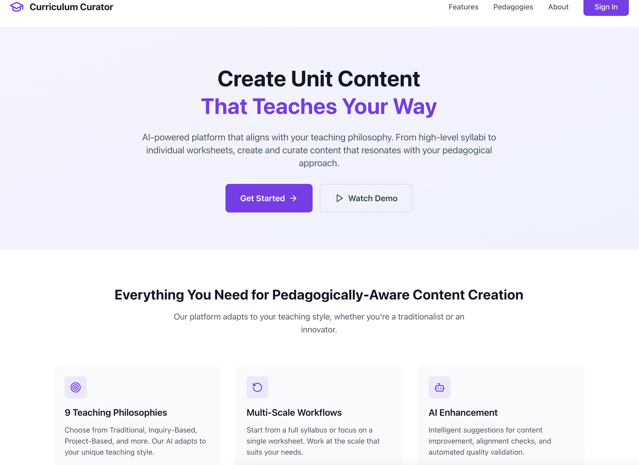
Showcase: Curriculum Curator (FLX)
Tool: Import → Restructure → Save 80% time
Value: Supports staff, not replaces
Takeaway: Efficiency
Notes:
Quick overview: - FLX tool specifically designed for curriculum - Import existing materials - PDFs, slides, documents - Restructure into different formats - Extend with additional examples/exercises
Specific example: - 10 hours creating new module content → 2 hours curating/refining - Import last year’s content → Update with current examples - Generate practice questions from lecture notes
Address the elephant: - No shame in being efficient - Using tools for busywork = more time for students - You’re still the expert - tool just handles formatting/structure
Key selling point: - It’s not about replacing your expertise - It’s about amplifying it - Like having a teaching assistant who never sleeps
Practical use cases: - Quick quiz generation from lecture content - Converting static content to interactive - Creating multiple versions for different cohorts - Accessibility improvements (alt formats)
“Even if you never use it for creation, it’s great for reformatting”
“But the real questions are…”

Slide 15
Questions to Guide Your Thinking
Where can AI save time?
How could students practice discipline-specific skills?
What risks/barriers must we prepare for?
How do we move past AI shame?
Notes:
“I’m not expecting answers today - just want you thinking”
Where can AI save time? - Routine tasks: Grading rubrics, email responses, meeting summaries - Content creation: Quiz questions, worked examples, case studies - Administrative: Report writing, grant applications, reviews - Ask yourself: “What do I dread doing because it’s repetitive?”
Discipline-specific skills practice: - What would junior professionals in your field use AI for? - What simulations could AI enable that weren’t possible before? - How could students practice client/patient interactions? - What expensive/dangerous scenarios could AI simulate?
Risks and barriers: - Over-reliance - students who can’t work without it - Accuracy issues - hallucinations, outdated information - Equity - not all students have equal access - Industry expectations - what will employers expect?
Moving past AI shame: - How do we model healthy AI use? - What would transparent use look like in your course? - How do we separate tool use from academic integrity?
Future consideration - What skills become MORE important when AI handles routine tasks? - Critical thinking, creativity, ethical reasoning, human connection

Slide 16
Let’s Discuss
What’s one small thing you could try next week?
What concerns need addressing?
How might your discipline benefit/challenge?
Have you felt AI shame?
Notes:
“These are conversation starters, not required answers”
“Who wants to share a thought, concern, or experience?”
Small experiment ideas: - Use AI to generate discussion questions for one topic - Create alternative explanations for difficult concepts - Draft marking rubric with AI, then refine - Generate practice problems for next tutorial
Common concerns: - “This enables cheating” → Redirect to assessment design discussion - “My discipline doesn’t need AI” → Any repetitive tasks they hate - “This is moving too fast” → Acknowledge, suggest tiny experiments - “Students won’t learn properly” → Discuss scaffolding vs replacement
“These conversations are just beginning…”

Slide 17
Thank You
“Not about answers — just questions worth asking… together, without shame”
Next Step: Try one small experiment, share results
“The best way to predict the future is to help create it”
Notes:
Reinforce key messages: - We’re all figuring this out together - Small experiments, not wholesale change - Share successes AND failures - both valuable - No shame in using tools to work smarter
Resources available - Example prompts for worksheet conversion - Access to Curriculum Curator for interested parties - Discipline-specific AI use cases document - “Moving Past AI Shame” discussion guide
Call to action emphasis: - “One small experiment” - lower the bar - “Share results” - build community of practice - “Be open” - break the shame cycle
Final thought: - “Remember - using AI well is a skill that requires your expertise” - “You’re not being replaced - you’re being amplified”

Slide 18
Resources & References
(Heaven, W. (2023, April 6). ChatGPT is going to change education, not destroy it. MIT Technology Review. Retrieved September 4 2025, from https://www.technologyreview.com/2023/04/06/1070216/chatgpt-is-going-to-change-education-not-destroy-it)[https://www.technologyreview.com/2023/04/06/1071059/chatgpt-change-not-destroy-education-openai/]
(McNealis, R. Shame in the machine: affective accountability and the ethics of AI. AI & Soc (2025). https://doi.org/10.1007/s00146-025-02472-x)[https://link.springer.com/article/10.1007/s00146-025-02472-x]
(Giray L. (2024). AI Shaming: The Silent Stigma among Academic Writers and Researchers. Annals of biomedical engineering, 52(9), 2319–2324. https://doi.org/10.1007/s10439-024-03582-1)[https://pubmed.ncbi.nlm.nih.gov/38977530/]
(Sabzalieva, E., & Valentini, A. (2023). ChatGPT and artificial intelligence in higher education: Quick start guide. UNESCO International Institute for Higher Education in Latin America and the Caribbean (IESALC). https://unesdoc.unesco.org/ark:/48223/pf0000385146)[https://unesdoc.unesco.org/ark:/48223/pf0000385146]
(WalkMe. (2025, August 27). Employees left behind in workplace AI boom, new WalkMe survey finds - WalkMe - Digital adoption Platform. WalkMe - Digital Adoption Platform. https://www.walkme.com/news-releases/employees-left-behind-in-workplace-ai-boom-new-walkme-survey-finds/?tabId=company-news)[https://www.walkme.com/news-releases/employees-left-behind-in-workplace-ai-boom-new-walkme-survey-finds/?tabId=company-news]
(Russell Group. (2023). Russell Group principles on the use of generative AI tools in education. Russell Group. Retrieved September 4 2025, from https://www.russellgroup.ac.uk/policy/policy-briefings/principles-use-generative-ai-tools-education)[https://www.russellgroup.ac.uk/policy/policy-briefings/principles-use-generative-ai-tools-education]
(Lichtenberg, N. (2025, August 29). “AI shame” is running rampant in the corporate sector—and C-suite leaders are most worried about getting caught, survey says. Fortune. https://fortune.com/2025/08/29/what-is-ai-shame-readiness-gap-training-artificial-intelligence/)[https://fortune.com/2025/08/29/what-is-ai-shame-readiness-gap-training-artificial-intelligence/]
Canva Workplace Study on AI Adoption (2025)
TEQSA on Generative AI

