Slide 1

Computational Thinking
ISYS2001, School of Marketing and Management

Slide 2


Slide 3
I acknowledge the traditional custodians of the land on which I work and live, and recognise their continuing connection to land, water and community. I pay respect to elders past, present and emerging.

Slide 4
Today
Welcome
Computers
Programming
Data

Slide 5
90%
of students have never taken a programming course
Notes:
Welcome!
And so if you're feeling a little uncomfortable with the idea of taking a class like Introduction to Programming, know that almost every semester, 90% of the students who take ISYS5002 have never taken a programming course before. So if you look up, down, left, right, right now, odds are more than many of the classmates joining you here today are in a very similar position. What's ultimately matters in this course is not so much where you end up relative to your classmates, but where you end up relative to yourself when you began. Indeed, taking into account where you currently are, perhaps with no prior background, and considering where you will be in just three or so months is ultimately meant to be the measure of your own success.

Slide 6
LIFE IS A JOURNEY,
NOT A DESTINATION.
— RALPH WALDO EMERSON
This applies to learning, as well. The process of learning is more important than the often intangible result or “end goal.”

Slide 7

You Don’t Just watch Lectures!

Slide 8
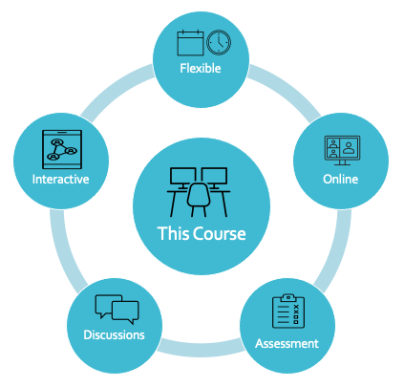

Slide 9
Email
Live Chat
Phone
Face to Face

Slide 10
Laptop or Desktop
Modern Browser
Google/Github

Slide 11
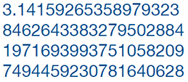
Problem with Computer!
One thing at a time
Basic Steps (fast)
Limited Space
Limited Language
Notes:
The challenges faced in communicating with a computer are not due to your limitations as a human, but rather to the limitations of the computer as a machine.
A computer might seem smart, but it is only because it is fast. It can execute simple steps very quickly. So your job is to break down tasks into simple steps. Another limitation is that a computer has a finite amount of storage space. This becomes obvious when you run out of space to store music on your phone or computer.
What is less obvious is what happens when you store a number like pi, which has an infinite number of digits after the decimal point. Only a finite number of digits can be stored as an approximation of the original number, called a floating point number.

Slide 12
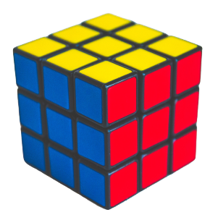
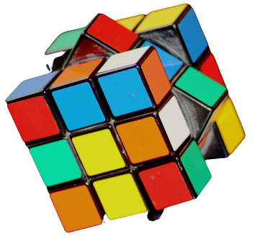
Notes:
Programming is like solving a puzzle.
Learning from your mistakes is part of the learning process.
Practice is the key. The more you do, the better you get at it.

Slide 13
Welcome!
Assume no programming experiences
Series of short lectures
Weekly lab sessions
Discuss the unit outline in first lab
If confused ask questions
Practice, practice, practice!

Slide 14
Hardware and Software
Hardware
  CPU
  Main Memory
  Secondary Storage
  Input and Output devices
Software
  Operating systems
  Utility programs
  Software development tools
  Applications
Notes:
Hardware refers to all physical devices
A computer consists of many pieces of hardware that all work together
Each piece of hardware does its own work
A typical computer system contains:
The CPU
Main memory
Secondary storage devices
Input devices
Output devices

Slide 15
How Computers Store Data
One Bit
0
1
0
0
0
0
0
1
One Byte
A 65 10000001
Notes:
“Digital” refers to anything that can only have two possible values
Digital data is the data that is stored in binary.
Digital devices are devices that work with binary data
Computers are digital devices
All data stored in a computer is converted to sequence of 0s and 1s; each sequence is called a bit
A computer’s memory is divided into tiny storage locations called bytes
Eight bits make a byte
Combinations of bits, 0s and 1s, are used to represent characters. For example,
The character ‘A’ is 65 in ASCII code, which is converted to binary format 1000001
When you press ‘A’, 1000001 will be stored in computer’s memory

Slide 16
How a Program Works
CPU uses the “fetch-decode-execute” cycle for processing
  Fetch: Reads instructions from memory
  Decode: Decodes the instructions that were just read to determine how to perform operations
  Execute: Actually performs the operations
Notes:
CPU reads instructions written in machine language called instruction set
A program will be copied into memory for CPU to execute
CPU uses the “fetch-decode-execute” cycle for processing
Fetch: Reads instructions from memory
Decode: Decodes the instructions that were just read to determine how to perform operations
Execute: Actually performs the operations

Slide 17
Programming Languages
  Machine Language
  10101010
  11001100
  11100011
  10001000
  Assembly
  MOV R1, 0x1000
  MOV R2, 0x1004
  ADD R1,R2
  STA 0x1008
  High Level Language
  C = A + B
Notes:
These code segments do the same thing!
Notice same number of line for Machine Code and Assembly.
Notice the high-level language one line, easier to read.
Machine languages: sequences of 0s and 1s
Assembly languages: use short words known as “mnemonics” to write program. Understand the CPU! Use assembler to convert into Machine code
High-level languages: more human readable languages that allow programmers to create programs without knowing how CPU works. Modern languages are high-level

Slide 18
Compilers vs Interpreters
High Level Language Text
High Level Language Text
1
1
4
Compiler
Interpreter
2
2
Machine Code (exe)
Machine Code (1 line)
3
3
CPU
CPU
Notes:
A compiler translates a high-level language program to a separate machine program for CPU to read and execute
An interpreter translates one lne of a high-level language program to machine code for CPU to read and execute and then repeats the process for the next line
Source code: the statements a programmer writes in a high-level language
Compilation: translates a text-based source code to binary codes. Examples include C, C++, C Sharp
Interpreter reads, translates, and executes the instructions of a high-level language program
Examples are PHP, Perl, Python, etc

Slide 19
Computers
Hardware
Software
Digital
Fetch-Decode-Execute
Compiler vs Interpreter

Slide 20
input
output
Notes:
What we thought we would do the very first week of the class, is consider exactly what it means to solve problems. And let me propose that this is programming.
This is problem solving. You have some input, which is the problem you care about that you want to solve, and you care about the solution to that problem, which is the so-called output.
And in between that input and output is this black box of sorts, inside of which is the magic that happens, the magic that you'll eventually be able to harness and compel computers to solve problems for you. Inside of that black box, ultimately, is going to be the code that you write.

Slide 21
sales values
average sales
months
plot of sales and
month values
Notes:
What we thought we would do the very first week of the class, is consider exactly what it means to solve problems. And let me propose that this is programming.
This is problem solving. You have some input, which is the problem you care about that you want to solve, and you care about the solution to that problem, which is the so-called output.
And in between that input and output is this black box of sorts, inside of which is the magic that happens, the magic that you'll eventually be able to harness and compel computers to solve problems for you. Inside of that black box, ultimately, is going to be the code that you write.

Slide 22
algorithms
Notes:
And so inside of this black box is what we would typically describe as algorithms. Algorithms are step by step instructions for solving problems. They don't even have to involve computers. We humans can execute algorithms just by following someone else's instructions. If you've ever prepared something from a cookbook, following a recipe, you are executing an algorithm step by step.
But unlike a lot of recipes or unlike a lot of instructions that we humans give to each other, there's no room for ambiguity in computers. Computers' algorithms, when implemented by machines, they really have to be not only correct so that you get the right outputs that you care about, but they also need to be precise. You need to be ever so precise, because unlike we humans who can kind of like read between the lines and, yeah, I get what you mean, computers are going to take you literally.
And so when programming a computer, that is, translating an algorithm, step by step instructions, into some language the computer understands, the onus is on you to make sure that the computer cannot misinterpret what you want.

Slide 23

Notes:
There's a whole bunch of words with definitions in a dictionary.
So suppose we want to solve a problem.
And the input to that problem is not only this phone book, but also the word to look up the definition of. So say I want find the definition of programming.
If I want to look the definition, you might open up this book and start looking for Virtual. I don't see “programming” on the first page, so I move on to the second. I don't see “programming” there, so I move on to the third. I don't see “programming” there so I move on to the fourth. And so forth, one page at a time, looking for the word virtual.

Slide 24
Is this algorithm, turning the pages, step by step, looking for the definition of “Programming” correct?
Notes:
All right. So it looks like the algorithm is indeed correct, but it's terribly, terribly slow.
How well designed is the algorithm? This is correct. It's just incredibly, incredibly tedious and slow. But I will find the definition. But, of course, we can do better.

Slide 25
Instead of looking for the definition one page at a time, lets do two, four, six, eight, pages at a time. It it is faster. Is this algorithm correct?
Notes:
I might skip my name on a page. And let me ask a follow up question. Can I fix this? Do I have to throw out the whole algorithm or can we at least fix this problem, do you think?
I don't think we have to completely sacrifice the idea of speeding up this algorithm by moving twice as fast. If I go too far-- maybe I get to the Q section, which is one letter too late-- I should at least double back one page.
But thanks to the alphabetization of the dictionary, I can be smarter. I'm looking for. But I can decide it's to the left or to the right. I know P comes after M. And so now I can go to the left. And you know what's interesting here, is that I can use that exact same algorithm. I don't have to think any differently. I can apply the same logic, open to the middle of this half of the phone, book and now I see I'm in the S section. So I'm still a little too far. But again, I can tear half the problem away.

Slide 26
Pseudocode
The following example is inspired from Harvard’s CS50x OpenCourseWare, see https://cs50.harvard.edu/x/2021/weeks/0/
Notes:
So when it comes to programming now, we need to translate these things called algorithms to code. Or, in this case, let's call it pseudocode. And in just a bit, we'll focus on an actual programming language, albeit a graphical one. But for now let's just consider some of the constructs or sort of fundamental ideas that are going to be useful to leverage here on out in this class.

Slide 27
Pseudocode
Pick up dictionary
Open to middle of dictionary
Look at page
If word is on page
Read definition
Else if word is earlier in book
Open to middle of left half of book
Go back to line 3
Else if word is later in book
Open to middle of right half of book
Go back to line 3
Else
Quit
Notes:
So when it comes to programming now, we need to translate these things called algorithms to code. Or, in this case, let's call it pseudocode. And in just a bit, we'll focus on an actual programming language, albeit a graphical one. But for now let's just consider some of the constructs or sort of fundamental ideas that are going to be useful to leverage here on out in this class. So let me propose that what I really just did verbally can be translated into pseudocode, which is like an algorithm implemented in English, or whatever your spoken or written language is. But the key is that it's got to be correct, and ideally it had better be precise so that there's no ambiguity. Step one was, indeed, what I did. Pick up phone book. Step two, open to middle of phone book. Step three, look at page. And indeed I did that. And now things got interesting. Step four, if person-- David, in my case-- is on the page, what do I want to do? Well, I should probably call that person. The problem is solved. I've gotten my output, the person's number. But there's another possibility, not if the person's on the page but, rather if the person is earlier in the book-- and that is what happened a moment ago. If I ended up on M, but I'm looking for David, that's to the left, I should then do what? Open to the middle of the left half of the book. And that's indeed what I did. And I sort of gratuitously tore the problem in half. But algorithmically, I just looked at the left half of the book next. What do I do next? Well, really, that's the point at which I proposed that the algorithm is now just repeatable, again and again, and so we'll say go back to line three. Why? Well, starting at line three, I have an algorithm for looking up someone in a phone book. It just so happens the phone book now is half as large. But there's another case. What if the person is later in the book? I wasn't searching for David, which starts with D, but someone else's name that's toward the end of the alphabet. Well, then if that person is later in the book, same idea. Open to the middle of the right half of the book, and then again, go back to step three. But lastly, there's a fourth possibility. There's a fourth possibility. Either the person's in the phone book, or they're to the left or they're to the right, or, frankly, they are just not there at all. And this last point, though somewhat subtle, is so important. Odds are all of us on our Macs, PCs. Maybe even phones, have had that very frustrating experience where your computer hangs, you get the stupid spinning beachball or hourglass, the thing freezes or just reboots, you know, something goes wrong and it's sort of inexplicable.

Slide 28
Functions
Pick up dictionary
Open to middle of dictionary
Look at page
If word is on page
Read definition
Else if word is earlier in book
Open to middle of left half of book
Go back to line 3
Else if word is later in book
Open to middle of right half of book
Go back to line 3
Else
Quit
Notes:
So what are the fundamental constructs we've seen here that we're going to continue seeing in class? Well, highlighted in yellow now are really some verbs or actions that we exercised with that phone book. These are, in general, in programming called functions. A function is an action or a verb. It's a statement that gets the computer to do something.

Slide 29
Selection
Pick up dictionary
Open to middle of dictionary
Look at page
If word is on page
read definition
Else if word is earlier in book
Open to middle of left half of book
Go back to line 3
Else if word is later in book
Open to middle of right half of book
Go back to line 3
Else
Quit
Notes:
Next highlighted here are what we'll call conditions or branches. These are sort of the proverbial forks in the road. You could either do this or this or maybe this other thing. And you can have one decision to make or two or three or four, however many conditions make sense logically. We'll call those conditions. But how do you decide which fork in the road to take? Whether to do this or that or this other thing? For that we need something called Boolean expressions.

Slide 30
Boolean Expressions
Pick up dictionary
Open to middle of dictionary
Look at page
If word is on page
read definition
Else if word is earlier in book
Open to middle of left half of book
Go back to line 3
Else if word is later in book
Open to middle of right half of book
Go back to line 3
Else
Quit
Notes:
A Boolean expression it's just a question whose answer is yes or no, or true or false, or, frankly, one or zero. All of those would be equivalent for our purposes. So person on page. That's a yes or no question. Person earlier in book? That too is a question. Person later in book is a third question as well. So if you can imagine a yes-no answer, a true-false answer, a one-zero answer, that is what gives us these things called Boolean expressions.

Slide 31
Loops
Pick up dictionary
Open to middle of dictionary
Look at page
If word is on page
read definition
Else if word is earlier in book
Open to middle of left half of book
Go back to line 3
Else if word is later in book
Open to middle of right half of book
Go back to line 3
Else
Quit
Notes:
And then lastly, in yellow here are these things. Go back to line three. This will induce what we'll call a loop or a cycle, which is just a programming construct or principle of an algorithm that gets you to do something again and again so you don't have to write 100-line algorithm. You can write a 13-line algorithm and reuse parts of it again and again.

Slide 32
Programming
Input/Output
Algorithms
Pseudocode
Functions
Conditions
Boolean expressions
Loops

Slide 33
input
output
Notes:
But for us to begin doing that, we all kind of need to agree on how we're going to represent these inputs and outputs. We all kind of have to speak a common language, so to speak. And so we need to agree how these inputs are going to be represented. So how might we typically represent information?

Slide 34
Decimal (base-10) Digits
0 1 2 3 4 5 6 7 8 9
Notes:
the decimal digits that you and I know. So the numbers that are otherwise more technically called base 10-- and that's just a fancy way of describing the fact that there's 10 digits that you and I as humans really tend to use typically. Those digits, of course, are zero through nine, and using these several digits, we can pose numbers like zero through nine, but also 10 and 11 and 12, and as high up as we want to go by using multiple digits still.

Slide 35
Binary (base-2) Digits
0 1
Notes:
the decimal digits that you and I know. So the numbers that are otherwise more technically called base 10-- and that's just a fancy way of describing the fact that there's 10 digits that you and I as humans really tend to use typically. Those digits, of course, are zero through nine, and using these several digits, we can pose numbers like zero through nine, but also 10 and 11 and 12, and as high up as we want to go by using multiple digits still.

Slide 36
Decimal (base-10)
1 2 3
Notes:
the decimal digits that you and I know. So the numbers that are otherwise more technically called base 10-- and that's just a fancy way of describing the fact that there's 10 digits that you and I as humans really tend to use typically. Those digits, of course, are zero through nine, and using these several digits, we can pose numbers like zero through nine, but also 10 and 11 and 12, and as high up as we want to go by using multiple digits still.

Slide 37
Decimal (base-10)
100 10 1
1 2 3
Notes:
the decimal digits that you and I know. So the numbers that are otherwise more technically called base 10-- and that's just a fancy way of describing the fact that there's 10 digits that you and I as humans really tend to use typically. Those digits, of course, are zero through nine, and using these several digits, we can pose numbers like zero through nine, but also 10 and 11 and 12, and as high up as we want to go by using multiple digits still.

Slide 38
Decimal (base-10)
100 10 1
1 2 3
100 x 1
Notes:
the decimal digits that you and I know. So the numbers that are otherwise more technically called base 10-- and that's just a fancy way of describing the fact that there's 10 digits that you and I as humans really tend to use typically. Those digits, of course, are zero through nine, and using these several digits, we can pose numbers like zero through nine, but also 10 and 11 and 12, and as high up as we want to go by using multiple digits still.

Slide 39
Decimal (base-10)
100 10 1
1 2 3
100 x 1 + 10 x 2
Notes:
the decimal digits that you and I know. So the numbers that are otherwise more technically called base 10-- and that's just a fancy way of describing the fact that there's 10 digits that you and I as humans really tend to use typically. Those digits, of course, are zero through nine, and using these several digits, we can pose numbers like zero through nine, but also 10 and 11 and 12, and as high up as we want to go by using multiple digits still.

Slide 40
Decimal (base-10)
100 10 1
1 2 3
100 x 1 + 10 x 2 + 3 x 1
Notes:
the decimal digits that you and I know. So the numbers that are otherwise more technically called base 10-- and that's just a fancy way of describing the fact that there's 10 digits that you and I as humans really tend to use typically. Those digits, of course, are zero through nine, and using these several digits, we can pose numbers like zero through nine, but also 10 and 11 and 12, and as high up as we want to go by using multiple digits still.

Slide 41
Decimal (base-10)
100 10 1
1 2 3
100 + 20 + 3
Notes:
the decimal digits that you and I know. So the numbers that are otherwise more technically called base 10-- and that's just a fancy way of describing the fact that there's 10 digits that you and I as humans really tend to use typically. Those digits, of course, are zero through nine, and using these several digits, we can pose numbers like zero through nine, but also 10 and 11 and 12, and as high up as we want to go by using multiple digits still.

Slide 42
Decimal (base-10)
1 2 3
Notes:
the decimal digits that you and I know. So the numbers that are otherwise more technically called base 10-- and that's just a fancy way of describing the fact that there's 10 digits that you and I as humans really tend to use typically. Those digits, of course, are zero through nine, and using these several digits, we can pose numbers like zero through nine, but also 10 and 11 and 12, and as high up as we want to go by using multiple digits still.

Slide 43
Decimal (base-10)
100 10 1
# # #
Notes:
the decimal digits that you and I know. So the numbers that are otherwise more technically called base 10-- and that's just a fancy way of describing the fact that there's 10 digits that you and I as humans really tend to use typically. Those digits, of course, are zero through nine, and using these several digits, we can pose numbers like zero through nine, but also 10 and 11 and 12, and as high up as we want to go by using multiple digits still.

Slide 44
Decimal (base-10)
10² 10¹ 10⁰
# # #
Notes:
the decimal digits that you and I know. So the numbers that are otherwise more technically called base 10-- and that's just a fancy way of describing the fact that there's 10 digits that you and I as humans really tend to use typically. Those digits, of course, are zero through nine, and using these several digits, we can pose numbers like zero through nine, but also 10 and 11 and 12, and as high up as we want to go by using multiple digits still.

Slide 45
Binary (base-2)
2² 2¹ 2⁰
# # #
Notes:
the decimal digits that you and I know. So the numbers that are otherwise more technically called base 10-- and that's just a fancy way of describing the fact that there's 10 digits that you and I as humans really tend to use typically. Those digits, of course, are zero through nine, and using these several digits, we can pose numbers like zero through nine, but also 10 and 11 and 12, and as high up as we want to go by using multiple digits still.

Slide 46
Binary (base-2)
4 2 1
# # #
Notes:
the decimal digits that you and I know. So the numbers that are otherwise more technically called base 10-- and that's just a fancy way of describing the fact that there's 10 digits that you and I as humans really tend to use typically. Those digits, of course, are zero through nine, and using these several digits, we can pose numbers like zero through nine, but also 10 and 11 and 12, and as high up as we want to go by using multiple digits still.

Slide 47
Binary (base-2)
4 2 1
0 0 0
Notes:
the decimal digits that you and I know. So the numbers that are otherwise more technically called base 10-- and that's just a fancy way of describing the fact that there's 10 digits that you and I as humans really tend to use typically. Those digits, of course, are zero through nine, and using these several digits, we can pose numbers like zero through nine, but also 10 and 11 and 12, and as high up as we want to go by using multiple digits still.

Slide 48
Binary (base-2)
4 2 1
0 0 0
4 x 0 + 2 x 0 + 1 x 0
Notes:
the decimal digits that you and I know. So the numbers that are otherwise more technically called base 10-- and that's just a fancy way of describing the fact that there's 10 digits that you and I as humans really tend to use typically. Those digits, of course, are zero through nine, and using these several digits, we can pose numbers like zero through nine, but also 10 and 11 and 12, and as high up as we want to go by using multiple digits still.

Slide 49
Binary (base-2)
4 2 1
0 0 1
4 x 0 + 2 x 0 + 1 x 1
Notes:
the decimal digits that you and I know. So the numbers that are otherwise more technically called base 10-- and that's just a fancy way of describing the fact that there's 10 digits that you and I as humans really tend to use typically. Those digits, of course, are zero through nine, and using these several digits, we can pose numbers like zero through nine, but also 10 and 11 and 12, and as high up as we want to go by using multiple digits still.

Slide 50
Binary (base-2)
4 2 1
0 1 0
4 x 0 + 2 x 1 + 1 x 0
Notes:
the decimal digits that you and I know. So the numbers that are otherwise more technically called base 10-- and that's just a fancy way of describing the fact that there's 10 digits that you and I as humans really tend to use typically. Those digits, of course, are zero through nine, and using these several digits, we can pose numbers like zero through nine, but also 10 and 11 and 12, and as high up as we want to go by using multiple digits still.

Slide 51
Binary (base-2)
4 2 1
0 1 1
4 x 0 + 2 x 1 + 1 x 1
Notes:
the decimal digits that you and I know. So the numbers that are otherwise more technically called base 10-- and that's just a fancy way of describing the fact that there's 10 digits that you and I as humans really tend to use typically. Those digits, of course, are zero through nine, and using these several digits, we can pose numbers like zero through nine, but also 10 and 11 and 12, and as high up as we want to go by using multiple digits still.

Slide 52
Binary (base-2)
4 2 1
1 1 1
Notes:
the decimal digits that you and I know. So the numbers that are otherwise more technically called base 10-- and that's just a fancy way of describing the fact that there's 10 digits that you and I as humans really tend to use typically. Those digits, of course, are zero through nine, and using these several digits, we can pose numbers like zero through nine, but also 10 and 11 and 12, and as high up as we want to go by using multiple digits still.

Slide 53
65
Notes:
the decimal digits that you and I know. So the numbers that are otherwise more technically called base 10-- and that's just a fancy way of describing the fact that there's 10 digits that you and I as humans really tend to use typically. Those digits, of course, are zero through nine, and using these several digits, we can pose numbers like zero through nine, but also 10 and 11 and 12, and as high up as we want to go by using multiple digits still.

Slide 54
... A B C D E F G H...
... 65 66 67 68 69 70 71 72...
Notes:
the decimal digits that you and I know. So the numbers that are otherwise more technically called base 10-- and that's just a fancy way of describing the fact that there's 10 digits that you and I as humans really tend to use typically. Those digits, of course, are zero through nine, and using these several digits, we can pose numbers like zero through nine, but also 10 and 11 and 12, and as high up as we want to go by using multiple digits still.

Slide 55
Text
72 73 33
Notes:
the decimal digits that you and I know. So the numbers that are otherwise more technically called base 10-- and that's just a fancy way of describing the fact that there's 10 digits that you and I as humans really tend to use typically. Those digits, of course, are zero through nine, and using these several digits, we can pose numbers like zero through nine, but also 10 and 11 and 12, and as high up as we want to go by using multiple digits still.

Slide 56
H I
72 73 33
Notes:
the decimal digits that you and I know. So the numbers that are otherwise more technically called base 10-- and that's just a fancy way of describing the fact that there's 10 digits that you and I as humans really tend to use typically. Those digits, of course, are zero through nine, and using these several digits, we can pose numbers like zero through nine, but also 10 and 11 and 12, and as high up as we want to go by using multiple digits still.

Slide 57
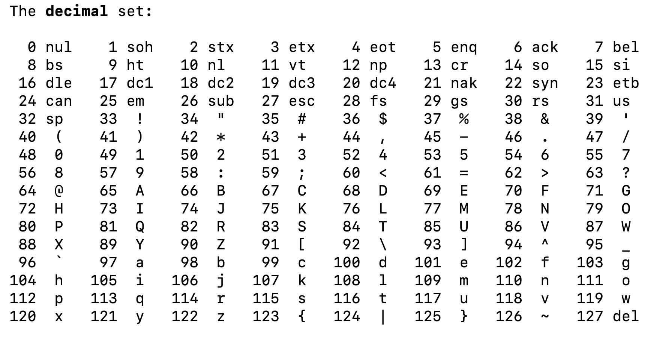

Slide 58
H I !
72 73 33
Notes:
the decimal digits that you and I know. So the numbers that are otherwise more technically called base 10-- and that's just a fancy way of describing the fact that there's 10 digits that you and I as humans really tend to use typically. Those digits, of course, are zero through nine, and using these several digits, we can pose numbers like zero through nine, but also 10 and 11 and 12, and as high up as we want to go by using multiple digits still.

Slide 59
H I !
01001000 01001001 00100001
Notes:
the decimal digits that you and I know. So the numbers that are otherwise more technically called base 10-- and that's just a fancy way of describing the fact that there's 10 digits that you and I as humans really tend to use typically. Those digits, of course, are zero through nine, and using these several digits, we can pose numbers like zero through nine, but also 10 and 11 and 12, and as high up as we want to go by using multiple digits still.

Slide 60
H I !
01001000 01001001 00100001
bytes
Notes:
the decimal digits that you and I know. So the numbers that are otherwise more technically called base 10-- and that's just a fancy way of describing the fact that there's 10 digits that you and I as humans really tend to use typically. Those digits, of course, are zero through nine, and using these several digits, we can pose numbers like zero through nine, but also 10 and 11 and 12, and as high up as we want to go by using multiple digits still.

Slide 61
Images
72 73 33
Notes:
the decimal digits that you and I know. So the numbers that are otherwise more technically called base 10-- and that's just a fancy way of describing the fact that there's 10 digits that you and I as humans really tend to use typically. Those digits, of course, are zero through nine, and using these several digits, we can pose numbers like zero through nine, but also 10 and 11 and 12, and as high up as we want to go by using multiple digits still.

Slide 62

Images
72 73 33
Notes:
the decimal digits that you and I know. So the numbers that are otherwise more technically called base 10-- and that's just a fancy way of describing the fact that there's 10 digits that you and I as humans really tend to use typically. Those digits, of course, are zero through nine, and using these several digits, we can pose numbers like zero through nine, but also 10 and 11 and 12, and as high up as we want to go by using multiple digits still.

Slide 63

Images
Notes:
the decimal digits that you and I know. So the numbers that are otherwise more technically called base 10-- and that's just a fancy way of describing the fact that there's 10 digits that you and I as humans really tend to use typically. Those digits, of course, are zero through nine, and using these several digits, we can pose numbers like zero through nine, but also 10 and 11 and 12, and as high up as we want to go by using multiple digits still.

Slide 64

Images
Notes:
the decimal digits that you and I know. So the numbers that are otherwise more technically called base 10-- and that's just a fancy way of describing the fact that there's 10 digits that you and I as humans really tend to use typically. Those digits, of course, are zero through nine, and using these several digits, we can pose numbers like zero through nine, but also 10 and 11 and 12, and as high up as we want to go by using multiple digits still.

Slide 65
Inputs
Binary
Agree on formats
  Text
  Images
  Audio
  Video

