Slide 1
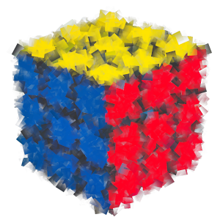
Welcome
ISYS2001, School of Marketing and Management

Slide 2


Slide 3
I acknowledge the traditional custodians of the land on which I work and live, and recognise their continuing connection to land, water and community. I pay respect to elders past, present and emerging.

Slide 4
90%
of students have never taken a programming course
Notes:
Welcome!
And so if you're feeling a little uncomfortable with the idea of taking a class like Introduction to Programming, know that almost every semester, 90% of the students who take ISYS5002 have never taken a programming course before. So if you look up, down, left, right, right now, odds are more than many of the classmates joining you here today are in a very similar position. What's ultimately matters in this course is not so much where you end up relative to your classmates, but where you end up relative to yourself when you began. Indeed, taking into account where you currently are, perhaps with no prior background, and considering where you will be in just three or so months is ultimately meant to be the measure of your own success.

Slide 5
LIFE IS A JOURNEY,
NOT A DESTINATION.
— RALPH WALDO EMERSON
This applies to learning, as well. The process of learning is more important than the often intangible result or “end goal.”

Slide 6

You Don’t Just watch Lectures!

Slide 7
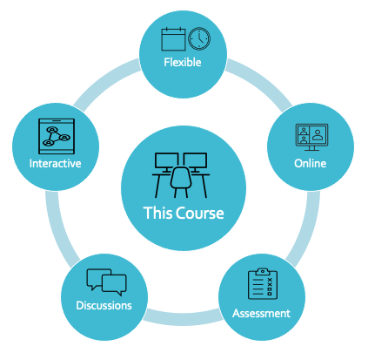

Slide 8
Email
Live Chat
Phone
Face to Face

Slide 9
Laptop or Desktop
Modern Browser
Google/Github

Slide 10
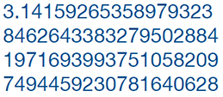
Problem with Computer!
One thing at a time
Basic Steps (fast)
Limited Space
Limited Language
Notes:
The challenges faced in communicating with a computer are not due to your limitations as a human, but rather to the limitations of the computer as a machine.
A computer might seem smart, but it is only because it is fast. It can execute simple steps very quickly. So your job is to break down tasks into simple steps. Another limitation is that a computer has a finite amount of storage space. This becomes obvious when you run out of space to store music on your phone or computer.
What is less obvious is what happens when you store a number like pi, which has an infinite number of digits after the decimal point. Only a finite number of digits can be stored as an approximation of the original number, called a floating point number.

Slide 11
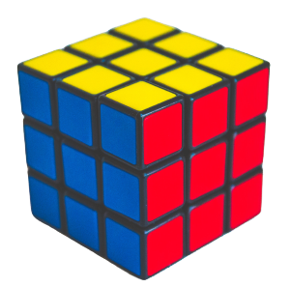
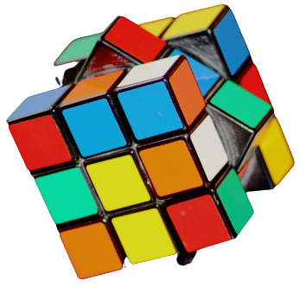
Notes:
Programming is like solving a puzzle.
Learning from your mistakes is part of the learning process.
Practice is the key. The more you do, the better you get at it.

Slide 12
Welcome!
Assume no programming experiences
Series of short lectures
Weekly lab sessions
Discuss the unit outline in first lab
If confused ask questions
Practice, practice, practice!

