Slide 1

Python Objects
ISYS2001, School of Marketing and Management

Slide 2


Slide 3
I acknowledge the traditional custodians of the land on which I work and live, and recognise their continuing connection to land, water and community. I pay respect to elders past, present and emerging.

Slide 4
Today
Break a problems down into simple actions
Actions carry out simple tasks
A set of actions is called an algorithm
Algorithms expressed as Pseudocode
Coding is translating an algorithm to a program
Six operations a computer can do

Slide 5
“The biggest mistake I see new programmers make is focusing on learning syntax instead of learning how to solve problems.”
— V. Anton Spraul, Think Like a Programmer: An Introduction to Creative Problem solving

Slide 6
Problem Solving Methodology
State the problem clearly
Describe the input and output
Work a simple example by hand
Develop and algorithm (and convert to Python)
Test solution with a variety of data

Slide 7
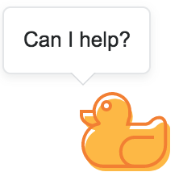
“If you can’t explain something in simple terms, you don’t understand it.”
— Richard Feynman

Slide 8
Rubber Duck
Notes:
Rubber ducking is a technique used in computer programming and problem-solving that involves explaining a problem or code issue to an inanimate object, such as a rubber duck, as if it were a human listener. The goal of rubber ducking is to help the programmer better understand the problem and find a solution by forcing them to break down the issue into small, understandable pieces.
The idea behind rubber ducking is that by describing the problem out loud to an external entity, such as a rubber duck, the programmer can better understand the problem and identify solutions. This technique is often used when a programmer is stuck on a problem and cannot figure out a solution, and it can be helpful in identifying errors or misunderstandings in the code.

Slide 9
Psuedocode
List the steps
Use short phrases (make it easier to convert)
No Syntax or rules
Not a language → (not compiled or executed)
Communication tool
Logic of the solution
Translate into a programming language
Notes:
Pseudocode is a type of informal language that programmers use to express the logic of an algorithm. It is a high-level description of the steps involved in solving a problem or completing a task, without using the syntax and specific details of any particular programming language.
Pseudocode uses simple and understandable English-like statements, and it allows developers to express their thoughts and ideas in a clear and concise manner. It is often used during the planning and design phase of software development, and it helps in communicating with stakeholders and other developers.
Pseudocode is not a formal programming language and cannot be compiled or executed directly by a computer. However, it serves as an essential tool for developers to understand and communicate the logic of a program before writing actual code. Once the pseudocode is created, developers can then use it as a guide to translate the algorithm into actual programming language code.

Slide 10
Recall
Pick up dictionary
Open to middle of dictionary
Look at page
If word is on page
Read definition
Else if word is earlier in book
Open to middle of left half of book
Go back to line 3
Else if word is later in book
Open to middle of right half of book
Go back to line 3
Else
Quit
Notes:
When programming, algorithms must be translated into code. This is typically done through pseudocode, which is like an algorithm implemented in English (or another spoken or written language). To ensure accuracy and precision, it is important to consider fundamental concepts that will be useful throughout the programming process.
For example, let's consider the process of looking up a word in a dictionary. The algorithm for this task involves several steps. First, pick up the dictionary. Next, open it to the middle page. Then, look at the page to see if the word is present.
If the word is on the page, the definition can be read and the task is complete. However, if the word is not on the page, the algorithm continues. If the word is earlier in the book, open the left half of the book and repeat the process from step three. Similarly, if the word is later in the book, open the right half and repeat the process.
It's important to note that this algorithm can be repeated as needed to find the desired word. However, there is also the possibility that the word is not in the dictionary at all. In this case, a different approach would be necessary.
In summary, understanding the fundamentals of programming concepts like algorithms and pseudocode is essential to effectively translating them into working code.

Slide 11
Problem Solving Methodology
State the problem clearly
Describe the input and output
Work a simple example by hand
Develop and algorithm (and convert to Python)
Test solution with a variety of data
Feedback Loop(s)
Notes:
Problem solving methodology is a structured approach to identifying and resolving issues and challenges in a systematic way. It involves a step-by-step process that can be applied to a wide range of problems in various fields, such as science, engineering, mathematics, and computer science.
A typical problem solving methodology includes the following steps:
Clearly identify and describe the problem or challenge that needs to be solved.
Collect relevant data and information about the problem and its context.
Generate possible solutions, Brainstorm potential solutions and alternatives.
Evaluate options: Assess the advantages and disadvantages of each option and choose the best one.
Develop and execute a plan to implement the chosen solution.
Test/Evaluate the effectiveness of the solution and make necessary adjustments.
Problem solving methodology can be used for a variety of problems, from simple to complex, and it can be applied to both personal and professional settings. It provides a structured and systematic way of approaching problems, helping individuals and organizations to make more informed and effective decisions.

Slide 12
Computer can…
Store Values
Perform Operations

Slide 13
What are values?
Single Value
  Integer
  Float
  Character
  Boolean
Data Structure
  Lists
  Strings
  Files

Slide 14
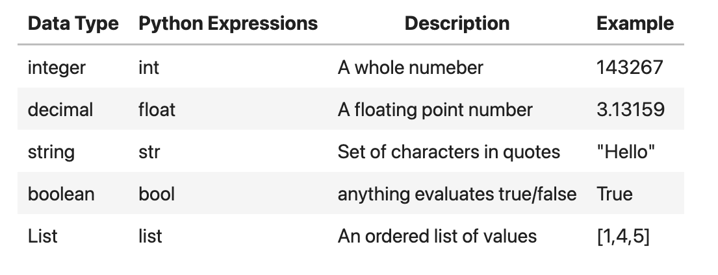

Slide 15
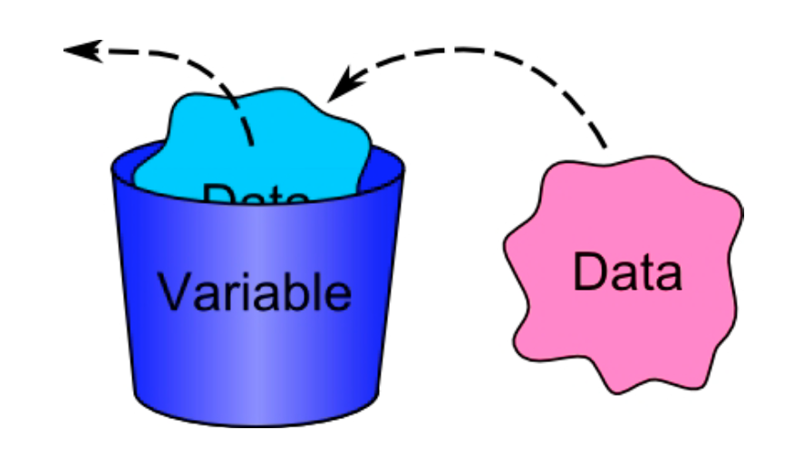
A variable is the name given to a part of the computers memory, designed to store a particular data item.

Slide 16
Variable Names
Rules
  Only letters, numbers, and the underscore character (_)
  No spaces
  No quotes
  Can’t start with a number
  Can't be a keyword import
Conventions
  variable names should be meaningful
  separate words with underscores (snake_case)

Slide 17
Only Six Operations
Receive Information
Output Information
Perform Arithmetic
Assign a value to a variable
Compare to variables
Repeat a group of actions.

Slide 18
input(“What is your name?”)

Slide 19
print(“Hello, world”)

Slide 20
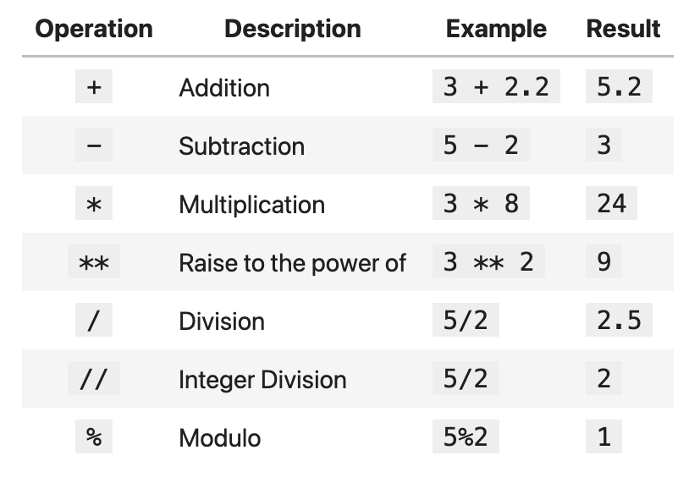

Slide 21
name = input(“What is your name?”)

Slide 22
if first_number > second_number:
print(first_number)
else:
print(second_number)

Slide 23
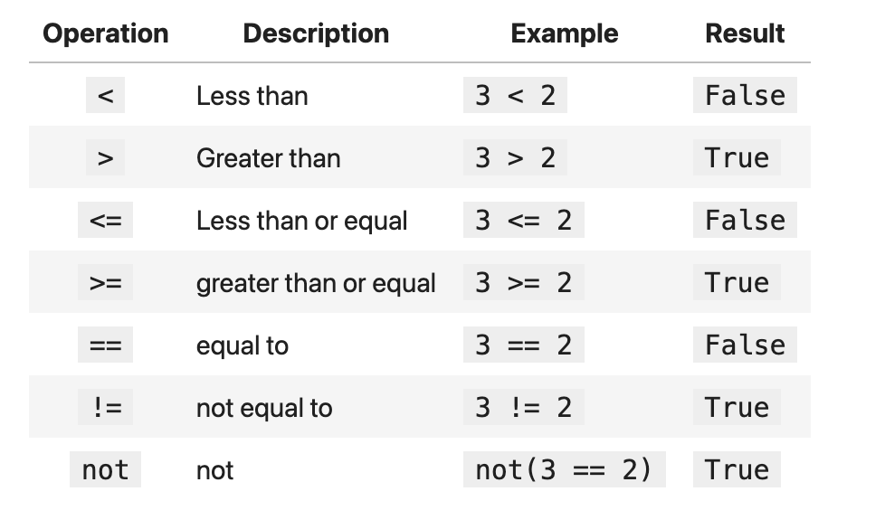

Slide 24
for number in [10,9,8,7,6,5,4,3,2,1]:
print(number)
print("Blast Off!")

Slide 25
Problem Solving Methodology
State the problem clearly
Describe the input and output
Work a simple example by hand
Develop and algorithm (and convert to Python)
Test solution with a variety of data
Feedback Loop(s)

Slide 26
Make the steps in your pseudocode to be one of the six operations, then translating from pseudocode to a programming language becomes simple.

Slide 27
Can you
Break a problems down into simple actions
Actions carry out simple tasks
A set of actions is called an algorithm
Algorithms expressed as Pseudocode
Coding is translating an algorithm to a program
Six operations a computer can do

