Slide 1

Data
ISYS2001, School of Marketing and Management

Slide 2


Slide 3
I acknowledge the traditional custodians of the land on which I work and live, and recognise their continuing connection to land, water and community. I pay respect to elders past, present and emerging.

Slide 4
input
output
Notes:
What we thought we would do the very first week of the class, is consider exactly what it means to solve problems. And let me propose that this is programming.
This is problem solving. You have some input, which is the problem you care about that you want to solve, and you care about the solution to that problem, which is the so-called output.
And in between that input and output is this black box of sorts, inside of which is the magic that happens, the magic that you'll eventually be able to harness and compel computers to solve problems for you. Inside of that black box, ultimately, is going to be the code that you write.

Slide 5
input
output
Notes:
But for us to begin doing that, we all kind of need to agree on how we're going to represent these inputs and outputs. We all kind of have to speak a common language, so to speak. And so we need to agree how these inputs are going to be represented. So how might we typically represent information?

Slide 6
Decimal (base-10) Digits
0 1 2 3 4 5 6 7 8 9
Notes:
the decimal digits that you and I know. So the numbers that are otherwise more technically called base 10-- and that's just a fancy way of describing the fact that there's 10 digits that you and I as humans really tend to use typically. Those digits, of course, are zero through nine, and using these several digits, we can pose numbers like zero through nine, but also 10 and 11 and 12, and as high up as we want to go by using multiple digits still.

Slide 7
Binary (base-2) Digits
0 1
Notes:
the decimal digits that you and I know. So the numbers that are otherwise more technically called base 10-- and that's just a fancy way of describing the fact that there's 10 digits that you and I as humans really tend to use typically. Those digits, of course, are zero through nine, and using these several digits, we can pose numbers like zero through nine, but also 10 and 11 and 12, and as high up as we want to go by using multiple digits still.

Slide 8
Decimal (base-10)
1 2 3
Notes:
the decimal digits that you and I know. So the numbers that are otherwise more technically called base 10-- and that's just a fancy way of describing the fact that there's 10 digits that you and I as humans really tend to use typically. Those digits, of course, are zero through nine, and using these several digits, we can pose numbers like zero through nine, but also 10 and 11 and 12, and as high up as we want to go by using multiple digits still.

Slide 9
Decimal (base-10)
100 10 1
1 2 3
Notes:
the decimal digits that you and I know. So the numbers that are otherwise more technically called base 10-- and that's just a fancy way of describing the fact that there's 10 digits that you and I as humans really tend to use typically. Those digits, of course, are zero through nine, and using these several digits, we can pose numbers like zero through nine, but also 10 and 11 and 12, and as high up as we want to go by using multiple digits still.

Slide 10
Decimal (base-10)
100 10 1
1 2 3
100 x 1
Notes:
the decimal digits that you and I know. So the numbers that are otherwise more technically called base 10-- and that's just a fancy way of describing the fact that there's 10 digits that you and I as humans really tend to use typically. Those digits, of course, are zero through nine, and using these several digits, we can pose numbers like zero through nine, but also 10 and 11 and 12, and as high up as we want to go by using multiple digits still.

Slide 11
Decimal (base-10)
100 10 1
1 2 3
100 x 1 + 10 x 2
Notes:
the decimal digits that you and I know. So the numbers that are otherwise more technically called base 10-- and that's just a fancy way of describing the fact that there's 10 digits that you and I as humans really tend to use typically. Those digits, of course, are zero through nine, and using these several digits, we can pose numbers like zero through nine, but also 10 and 11 and 12, and as high up as we want to go by using multiple digits still.

Slide 12
Decimal (base-10)
100 10 1
1 2 3
100 x 1 + 10 x 2 + 3 x 1
Notes:
the decimal digits that you and I know. So the numbers that are otherwise more technically called base 10-- and that's just a fancy way of describing the fact that there's 10 digits that you and I as humans really tend to use typically. Those digits, of course, are zero through nine, and using these several digits, we can pose numbers like zero through nine, but also 10 and 11 and 12, and as high up as we want to go by using multiple digits still.

Slide 13
Decimal (base-10)
100 10 1
1 2 3
100 + 20 + 3
Notes:
the decimal digits that you and I know. So the numbers that are otherwise more technically called base 10-- and that's just a fancy way of describing the fact that there's 10 digits that you and I as humans really tend to use typically. Those digits, of course, are zero through nine, and using these several digits, we can pose numbers like zero through nine, but also 10 and 11 and 12, and as high up as we want to go by using multiple digits still.

Slide 14
Decimal (base-10)
1 2 3
Notes:
the decimal digits that you and I know. So the numbers that are otherwise more technically called base 10-- and that's just a fancy way of describing the fact that there's 10 digits that you and I as humans really tend to use typically. Those digits, of course, are zero through nine, and using these several digits, we can pose numbers like zero through nine, but also 10 and 11 and 12, and as high up as we want to go by using multiple digits still.

Slide 15
Decimal (base-10)
100 10 1
# # #
Notes:
the decimal digits that you and I know. So the numbers that are otherwise more technically called base 10-- and that's just a fancy way of describing the fact that there's 10 digits that you and I as humans really tend to use typically. Those digits, of course, are zero through nine, and using these several digits, we can pose numbers like zero through nine, but also 10 and 11 and 12, and as high up as we want to go by using multiple digits still.

Slide 16
Decimal (base-10)
10² 10¹ 10⁰
# # #
Notes:
the decimal digits that you and I know. So the numbers that are otherwise more technically called base 10-- and that's just a fancy way of describing the fact that there's 10 digits that you and I as humans really tend to use typically. Those digits, of course, are zero through nine, and using these several digits, we can pose numbers like zero through nine, but also 10 and 11 and 12, and as high up as we want to go by using multiple digits still.

Slide 17
Binary (base-2)
2² 2¹ 2⁰
# # #
Notes:
the decimal digits that you and I know. So the numbers that are otherwise more technically called base 10-- and that's just a fancy way of describing the fact that there's 10 digits that you and I as humans really tend to use typically. Those digits, of course, are zero through nine, and using these several digits, we can pose numbers like zero through nine, but also 10 and 11 and 12, and as high up as we want to go by using multiple digits still.

Slide 18
Binary (base-2)
4 2 1
# # #
Notes:
the decimal digits that you and I know. So the numbers that are otherwise more technically called base 10-- and that's just a fancy way of describing the fact that there's 10 digits that you and I as humans really tend to use typically. Those digits, of course, are zero through nine, and using these several digits, we can pose numbers like zero through nine, but also 10 and 11 and 12, and as high up as we want to go by using multiple digits still.

Slide 19
Binary (base-2)
4 2 1
0 0 0
Notes:
the decimal digits that you and I know. So the numbers that are otherwise more technically called base 10-- and that's just a fancy way of describing the fact that there's 10 digits that you and I as humans really tend to use typically. Those digits, of course, are zero through nine, and using these several digits, we can pose numbers like zero through nine, but also 10 and 11 and 12, and as high up as we want to go by using multiple digits still.

Slide 20
Binary (base-2)
4 2 1
0 0 0
4 x 0 + 2 x 0 + 1 x 0
Notes:
the decimal digits that you and I know. So the numbers that are otherwise more technically called base 10-- and that's just a fancy way of describing the fact that there's 10 digits that you and I as humans really tend to use typically. Those digits, of course, are zero through nine, and using these several digits, we can pose numbers like zero through nine, but also 10 and 11 and 12, and as high up as we want to go by using multiple digits still.

Slide 21
Binary (base-2)
4 2 1
0 0 1
4 x 0 + 2 x 0 + 1 x 1
Notes:
the decimal digits that you and I know. So the numbers that are otherwise more technically called base 10-- and that's just a fancy way of describing the fact that there's 10 digits that you and I as humans really tend to use typically. Those digits, of course, are zero through nine, and using these several digits, we can pose numbers like zero through nine, but also 10 and 11 and 12, and as high up as we want to go by using multiple digits still.

Slide 22
Binary (base-2)
4 2 1
0 1 0
4 x 0 + 2 x 1 + 1 x 0
Notes:
the decimal digits that you and I know. So the numbers that are otherwise more technically called base 10-- and that's just a fancy way of describing the fact that there's 10 digits that you and I as humans really tend to use typically. Those digits, of course, are zero through nine, and using these several digits, we can pose numbers like zero through nine, but also 10 and 11 and 12, and as high up as we want to go by using multiple digits still.

Slide 23
Binary (base-2)
4 2 1
0 1 1
4 x 0 + 2 x 1 + 1 x 1
Notes:
the decimal digits that you and I know. So the numbers that are otherwise more technically called base 10-- and that's just a fancy way of describing the fact that there's 10 digits that you and I as humans really tend to use typically. Those digits, of course, are zero through nine, and using these several digits, we can pose numbers like zero through nine, but also 10 and 11 and 12, and as high up as we want to go by using multiple digits still.

Slide 24
Binary (base-2)
4 2 1
1 1 1
Notes:
the decimal digits that you and I know. So the numbers that are otherwise more technically called base 10-- and that's just a fancy way of describing the fact that there's 10 digits that you and I as humans really tend to use typically. Those digits, of course, are zero through nine, and using these several digits, we can pose numbers like zero through nine, but also 10 and 11 and 12, and as high up as we want to go by using multiple digits still.

Slide 25
65
Notes:
the decimal digits that you and I know. So the numbers that are otherwise more technically called base 10-- and that's just a fancy way of describing the fact that there's 10 digits that you and I as humans really tend to use typically. Those digits, of course, are zero through nine, and using these several digits, we can pose numbers like zero through nine, but also 10 and 11 and 12, and as high up as we want to go by using multiple digits still.

Slide 26
... A B C D E F G H...
... 65 66 67 68 69 70 71 72...
Notes:
the decimal digits that you and I know. So the numbers that are otherwise more technically called base 10-- and that's just a fancy way of describing the fact that there's 10 digits that you and I as humans really tend to use typically. Those digits, of course, are zero through nine, and using these several digits, we can pose numbers like zero through nine, but also 10 and 11 and 12, and as high up as we want to go by using multiple digits still.

Slide 27
Text
72 73 33
Notes:
the decimal digits that you and I know. So the numbers that are otherwise more technically called base 10-- and that's just a fancy way of describing the fact that there's 10 digits that you and I as humans really tend to use typically. Those digits, of course, are zero through nine, and using these several digits, we can pose numbers like zero through nine, but also 10 and 11 and 12, and as high up as we want to go by using multiple digits still.

Slide 28
H I
72 73 33
Notes:
the decimal digits that you and I know. So the numbers that are otherwise more technically called base 10-- and that's just a fancy way of describing the fact that there's 10 digits that you and I as humans really tend to use typically. Those digits, of course, are zero through nine, and using these several digits, we can pose numbers like zero through nine, but also 10 and 11 and 12, and as high up as we want to go by using multiple digits still.

Slide 29
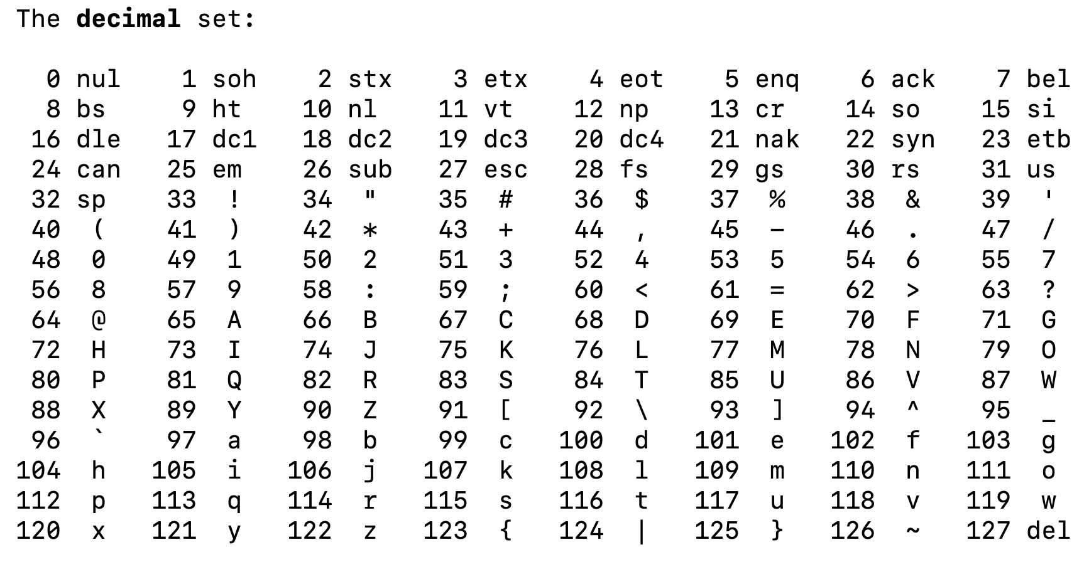

Slide 30
H I !
72 73 33
Notes:
the decimal digits that you and I know. So the numbers that are otherwise more technically called base 10-- and that's just a fancy way of describing the fact that there's 10 digits that you and I as humans really tend to use typically. Those digits, of course, are zero through nine, and using these several digits, we can pose numbers like zero through nine, but also 10 and 11 and 12, and as high up as we want to go by using multiple digits still.

Slide 31
H I !
01001000 01001001 00100001
Notes:
the decimal digits that you and I know. So the numbers that are otherwise more technically called base 10-- and that's just a fancy way of describing the fact that there's 10 digits that you and I as humans really tend to use typically. Those digits, of course, are zero through nine, and using these several digits, we can pose numbers like zero through nine, but also 10 and 11 and 12, and as high up as we want to go by using multiple digits still.

Slide 32
H I !
01001000 01001001 00100001
bytes
Notes:
the decimal digits that you and I know. So the numbers that are otherwise more technically called base 10-- and that's just a fancy way of describing the fact that there's 10 digits that you and I as humans really tend to use typically. Those digits, of course, are zero through nine, and using these several digits, we can pose numbers like zero through nine, but also 10 and 11 and 12, and as high up as we want to go by using multiple digits still.

Slide 33
Images
72 73 33
Notes:
the decimal digits that you and I know. So the numbers that are otherwise more technically called base 10-- and that's just a fancy way of describing the fact that there's 10 digits that you and I as humans really tend to use typically. Those digits, of course, are zero through nine, and using these several digits, we can pose numbers like zero through nine, but also 10 and 11 and 12, and as high up as we want to go by using multiple digits still.

Slide 34

Images
72 73 33
Notes:
the decimal digits that you and I know. So the numbers that are otherwise more technically called base 10-- and that's just a fancy way of describing the fact that there's 10 digits that you and I as humans really tend to use typically. Those digits, of course, are zero through nine, and using these several digits, we can pose numbers like zero through nine, but also 10 and 11 and 12, and as high up as we want to go by using multiple digits still.

Slide 35

Images
Notes:
the decimal digits that you and I know. So the numbers that are otherwise more technically called base 10-- and that's just a fancy way of describing the fact that there's 10 digits that you and I as humans really tend to use typically. Those digits, of course, are zero through nine, and using these several digits, we can pose numbers like zero through nine, but also 10 and 11 and 12, and as high up as we want to go by using multiple digits still.

Slide 36
Images
Notes:
the decimal digits that you and I know. So the numbers that are otherwise more technically called base 10-- and that's just a fancy way of describing the fact that there's 10 digits that you and I as humans really tend to use typically. Those digits, of course, are zero through nine, and using these several digits, we can pose numbers like zero through nine, but also 10 and 11 and 12, and as high up as we want to go by using multiple digits still.

Slide 37
Data
Binary (Digital)
Agree on formats
  Text
  Images
  Audio
  Video

