Slide 1
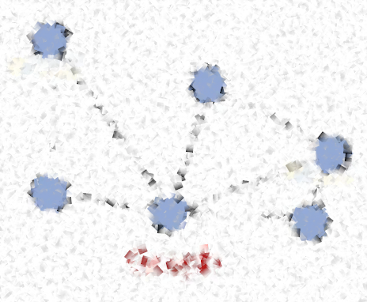
Data Structures & Algorithms
ISYS2001 Introduction to Business Programming

Slide 2


Slide 3
I acknowledge the traditional custodians of the land on which I work and live, and recognise their continuing connection to land, water and community. I pay respect to elders past, present and emerging.

Slide 4
Today
What are Data Structures?
Basic Data Structures in Python
What are Algorithms?
Important Algorithms in Python
Algorithmn Examples
Notes:
"Let's begin by understanding the core concepts that form the foundation of computer science and programming. First up, we have data structures."
"Data structures are essentially the building blocks of programming. They are specific means of organizing and storing data in a computer in such a way that we can perform operations on this data in an effective manner. Different data structures allow us to handle the data in different ways."
"In Python, we have several built-in data structures like lists, tuples, sets, and dictionaries. Lists are ordered collections of items, tuples are ordered and immutable collections, sets are unordered collections of unique items, and dictionaries are unordered collections of key-value pairs. Each of these structures has its own strengths and use-cases."
"Moving on to algorithms, an algorithm is a step-by-step procedure to solve a particular problem. In programming, we use algorithms to manipulate, process, and eventually solve problems with the data that we have stored using data structures."
"There are many important algorithms in Python, and in programming in general. Some of these include sorting algorithms like bubble sort, selection sort, and quick sort, search algorithms like linear search and binary search, and other algorithms for tasks like finding the greatest common divisor, checking for primality, and so on."

Slide 5
What are data Structures?
Notes:
Data structures are the fundamental constructs around which you build your programs. Each data structure provides a particular way of organizing data so it can be accessed efficiently, depending on your use case. Python ships with an extensive set of data structures in its standard library.

Slide 6
Python Data Structures
Built-in
  Lists
  Tuples and Named Tuples
  Sets
  Dictionaries
User Defined (using built-in)
  Stacks
  Queues
  Linked Lists
  Hash Maps
  Trees
  Graphs
Notes:
In the examples we've encountered thus far, we have already explored numerous built-in Python data structures. These are likely familiar to you from introductory resources or tutorials. In this section, we will delve deeper into the object-oriented aspects of these data structures, examining when they are more appropriate than regular classes and when they should be avoided. Specifically, we will cover:
1. Tuples
2. Dictionaries
3. Lists and sets
4. Explore other structures
By gaining a deeper understanding of these topics, you will be better equipped to choose the most suitable data structure for a given problem and harness the full potential of Python's built-in functionality.

Slide 7
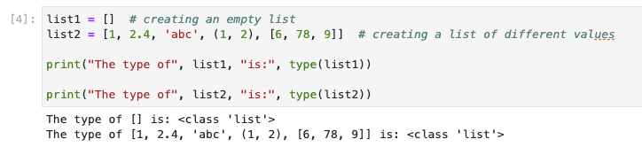
Lists
Notes:
Python lists are versatile containers that can hold values of various data types. They store data in a contiguous manner in memory, which facilitates efficient access to elements. Lists are particularly useful in situations where frequent data access is required, as elements can be easily retrieved using indexing.

Slide 8
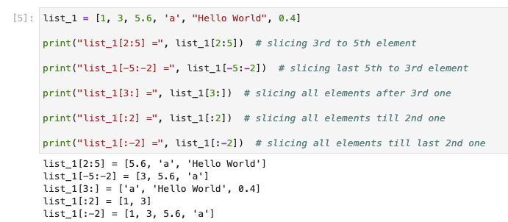
Lists
Notes:
Slicing is a technique in Python that allows you to extract a portion of a sequence, such as a string, list, or tuple, by specifying a start index, an end index, and an optional step. This results in a new sequence containing the selected elements, without modifying the original sequence.
The syntax for slicing is to use square brackets and a colon (:) to separate the start, end, and step indices. The start index is inclusive, while the end index is exclusive. If the start index is omitted, it defaults to the beginning of the sequence (index 0). If the end index is omitted, it defaults to the end of the sequence. The step is optional and defaults to 1.

Slide 9
Lists
my_list.append(x)
my_list.extend(L)
my_list.insert(i, x)
my_list.remove(x)
my_list.pop([i])
my_list.clear()
my_list.index(x)
my_list.count(x)
my_list.sort()
my_list.reverse()
my_list.copy
Notes:
Python provides several built-in methods for working with lists. Some of the most common list methods include:
1. `append`: Adds an element to the end of the list.
2. `extend`: Appends the elements of an iterable (e.g., list, tuple) to the end of the list.
3. `insert`: Inserts an element at a specified index.
4. `remove`: Removes the first occurrence of a specified value from the list.
5. `pop`: Removes and returns the element at a specified index, or the last element if no index is provided.
6. `index`: Returns the index of the first occurrence of a specified value in the list.
7. `count`: Counts the occurrences of a specified value in the list.
8. `sort`: Sorts the list in ascending order by default, or according to a specified key function.
9. `reverse`: Reverses the order of the elements in the list.
10. `clear`: Removes all elements from the list.
These methods offer various ways to modify, search, and manipulate lists in Python. Keep in mind that most of these methods modify the list in-place, meaning they alter the original list rather than returning a new one.

Slide 10
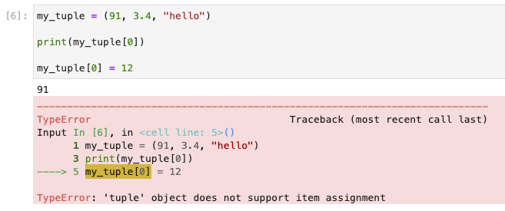
Tuples
Notes:
Tuples are ordered collections that can store a fixed number of objects. They are immutable, which means that their elements cannot be added, removed, or replaced once defined. While this might seem like a limitation, it is essential to remember that if you need a mutable collection, a list would be more appropriate. One of the main advantages of tuple immutability is that they can be used as keys in dictionaries and other data structures that require hashable objects.
Tuples are designed for storing data, not behavior. If you need to manipulate a tuple, you must pass it to a function or a method on another object that performs the desired action. This design choice ensures that tuples remain simple and efficient for their intended purpose.

Slide 11
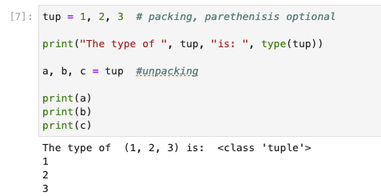
Tuples - unpacking
Notes:
Tuple unpacking, also known as multiple assignment or iterable unpacking, is a convenient feature in Python that allows you to assign the elements of a tuple (or any iterable) to multiple variables in a single statement. This enables you to extract the individual elements from a tuple and assign them to separate variables easily and concisely.
Tuple unpacking can also be used with other iterables, such as lists or strings. Keep in mind that the number of variables on the left side of the assignment must match the number of elements in the iterable on the right side, or you will encounter an error.

Slide 12
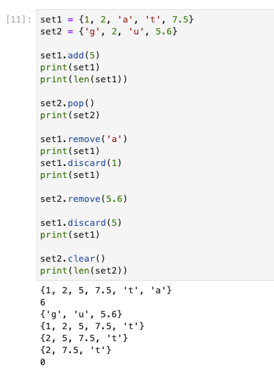
Sets
Notes:
Sets are a unique type of collection in Python, distinct from lists and tuples. They store non-duplicate elements without maintaining a specific order, which means that indexing is not applicable. When elements are added to a set, they are automatically arranged in ascending order, although this order is not preserved upon retrieval.
To create a set in Python, enclose its elements within curly braces and separate them with commas. While sets can contain tuples as elements, they cannot include lists. This is because sets are immutable, meaning their elements cannot be changed once added, while lists are mutable and can be modified.
Common operations od sets include:
1. add(): To add an element to a set.
2. pop():To remove the last element if index is not specified and if specified removes elements at that index.
3. clear(): To delete all the elements of a set.
4. len(): To find the length of a set, etc.
5. remove(): This removes the specified element from the set. This function gives an error if the element is not present in the set.
6. discard(): This removes the specified element from the set. But this function does not give an error if the element is not present in the set.

Slide 13
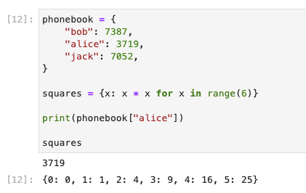
Dictionaries – key:value pairs
Notes:
Dictionaries are data structures in Python that store key-value pairs, similar to real-life dictionaries where unique words are mapped to their meanings. Keys must be unique and immutable, which means that modifiable or unhashable data types, such as lists, cannot be used as keys.
To define a dictionary, use curly braces to enclose the key-value pairs, with each pair separated by a colon, and pairs separated by commas.
This convenient and efficient data structure allows you to access, modify, and store values based on their associated keys.

Slide 14
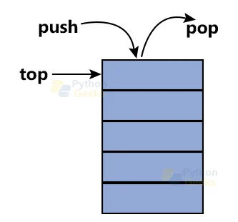
Stacks
Notes:
A stack is a linear data structure that follows the Last In, First Out (LIFO) principle, meaning that the most recently added element is the first one to be removed. Stacks can be thought of as a collection of items with two primary operations: `push`, which adds an element to the top of the stack, and `pop`, which removes the top element.
Some common use cases for stacks in programming include:
1. **Balancing symbols**: Stacks can be used to check for balanced parentheses, brackets, or braces in an expression. By pushing opening symbols onto the stack and popping them off when matching closing symbols are encountered, you can ensure that the expression is balanced.
2. **Undo/Redo functionality**: In text editors or other applications, a stack can keep track of actions performed by the user. The `push` operation can store each action, while the `pop` operation allows for undoing the most recent action. A second stack can be used to implement the redo functionality.
3. **Function call management**: Programming languages use stacks to manage function calls and maintain the execution order. When a function is called, its activation record (containing local variables, return address, and other relevant information) is pushed onto the call stack. When the function returns, its activation record is popped, and the execution continues from the return address.
4. **Backtracking algorithms**: Stacks can be employed in backtracking algorithms, such as solving mazes, searching for paths in graphs, or implementing depth-first search. By storing visited nodes or states on the stack, the algorithm can easily backtrack to the previous state when encountering a dead-end.
5. **Expression evaluation**: Stacks can be used to evaluate arithmetic expressions in postfix (Reverse Polish) notation or to convert infix expressions to postfix notation.
These examples illustrate the versatility of the stack data structure in various programming contexts. In Python, you can implement a stack using a list, with the `append` method for the `push` operation and the `pop` method for the `pop` operation.

Slide 15
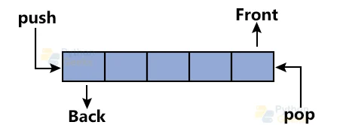
Queues
Notes:
A queue is a linear data structure that follows the First In, First Out (FIFO) principle, meaning that the element added earliest is the first one to be removed. Queues maintain the order in which elements are added and removed. The two primary operations associated with queues are `enqueue`, which adds an element to the rear of the queue, and `dequeue`, which removes the front element.
Some common use cases for queues in programming include:
1. **Task scheduling**: Queues can be used to manage tasks in operating systems, web servers, or other systems that require task prioritization and execution in the order they were received.
2. **Buffering**: Queues can serve as buffers in situations where data is produced and consumed at different rates. For example, they can be used to store keystrokes in a keyboard buffer or manage data packets in network communication.
3. **Breadth-First Search**: In graph traversal algorithms like Breadth-First Search (BFS), queues are used to visit nodes in layers, ensuring that all nodes at a given depth are visited before moving on to the next depth level.
4. **Cache management**: Some cache replacement algorithms, such as the First-In-First-Out (FIFO) cache replacement policy, utilize queues to manage the order in which items are removed from the cache when it becomes full.
5. **Print spooling**: Queues can be employed to manage print jobs in a print spooler, ensuring that documents are printed in the order they were added to the queue.
These examples showcase the versatility and applicability of the queue data structure in various programming contexts. In Python, you can implement a basic queue using a list, though it is not very efficient for large datasets due to the time complexity of inserting and removing elements. Instead, you can use the `deque` class from the `collections` module, which is designed for fast and efficient queue operations.

Slide 16
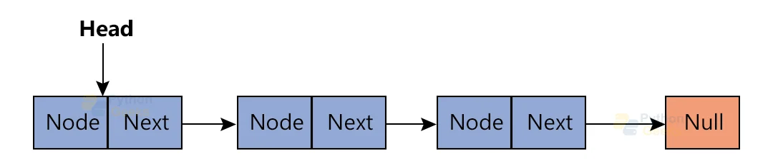
Linked Lists
Notes:
A linked list is a linear data structure in which elements are stored in nodes, and each node points to the next node in the sequence. Unlike arrays or lists, linked lists do not store elements in contiguous memory locations. There are several types of linked lists, including singly-linked lists, doubly-linked lists, and circular linked lists.
A singly-linked list consists of nodes that have two components: a data field containing the element and a reference (or pointer) to the next node in the sequence. The last node in the list points to a null reference, indicating the end of the list. A doubly-linked list, on the other hand, has nodes that contain a reference to both the next and previous nodes, allowing for bidirectional traversal.
Linked lists are useful in various programming scenarios, such as:
1. **Dynamic memory allocation**: When the size of the data structure needs to be adjusted during runtime, linked lists can be a suitable choice, as they can be resized easily by updating node references.
2. **Insertion and deletion**: Linked lists provide efficient insertion and deletion operations, especially at the beginning or end of the list. These operations can be performed in constant time, as opposed to arrays or Python lists, where elements may need to be shifted to maintain continuity.
3. **Stack and queue implementation**: Linked lists can be used to implement stacks and queues, as they allow for constant-time `push`, `pop`, `enqueue`, and `dequeue` operations.
4. **When indexing is not required**: If your use case does not require frequent random access to elements using an index, linked lists can be a suitable choice, as they prioritize efficient insertion and deletion operations.
5. **Complex data structures**: Linked lists can be used as building blocks for more complex data structures, such as trees and graphs, where elements need to be connected in non-linear ways.
In Python, linked lists can be implemented using custom classes for the nodes and the linked list itself. However, Python's built-in data structures (like lists or the `deque` class from the `collections` module) are often more suitable and efficient for most use cases.

Slide 17
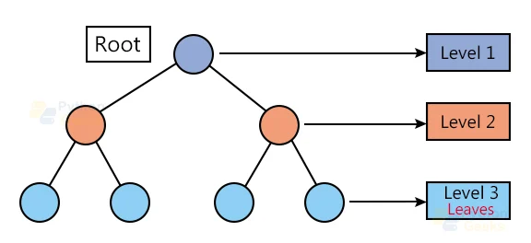
Tree
Notes:
A tree is a hierarchical data structure that consists of nodes connected by edges, with one node designated as the root. Each node in the tree can have zero or more child nodes, and a node without any children is called a leaf node. Trees are non-linear and can represent hierarchical relationships between elements. One of the most common types of trees is the binary tree, where each node has at most two children, typically referred to as the left and right child.
Trees are useful in various programming scenarios, such as:
1. **Searching and sorting**: Binary Search Trees (BST) provide efficient searching, insertion, and deletion operations. Balanced trees like AVL trees and Red-Black trees maintain optimal height to ensure that these operations have a time complexity of O(log n).
2. **File systems**: Trees are used to represent file systems, where directories and subdirectories form a hierarchical structure. Each node can represent a file or a directory, and its children represent files or subdirectories contained within it.
3. **Decision-making**: Decision Trees are used in machine learning and artificial intelligence for decision-making processes, where each node represents a decision or a test, and the branches represent the possible outcomes.
4. **Abstract Syntax Trees (AST)**: In programming languages and compilers, trees are used to represent the syntactic structure of the source code, enabling semantic analysis and optimization during the compilation process.
5. **Priority Queues**: Trees like Binary Heaps are utilized to implement priority queues, which are used in various applications, including scheduling processes in operating systems, pathfinding algorithms, and network traffic management.
6. **Trie (Prefix Tree)**: Tries are a tree-like data structure used for efficient storage and retrieval of strings, particularly when searching for strings with common prefixes, such as implementing auto-complete features or storing dictionaries for spell-checking.
These examples showcase the versatility and applicability of tree data structures in various programming contexts. In Python, trees can be implemented using custom classes for the nodes and the tree itself. There are also specialized libraries available for working with different types of trees, such as the `bintrees` library for binary search trees.

Slide 18
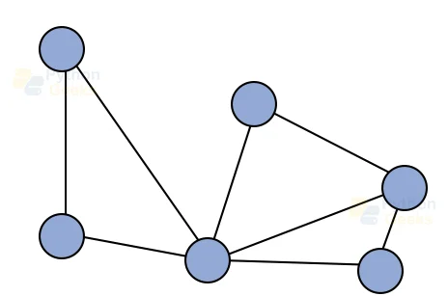
Graph
Notes:
A graph is a non-linear data structure that consists of a set of vertices (also called nodes) and a set of edges connecting these vertices. Graphs are used to represent relationships or connections between objects, where vertices represent the objects and edges represent the connections between them. There are two main types of graphs: directed graphs (digraphs), where edges have a direction, and undirected graphs, where edges do not have a direction.
Graphs are useful in various programming scenarios, such as:
1. **Social networks**: Graphs can be used to represent social networks, where users are represented as vertices, and connections or relationships between users are represented as edges.
2. **Transportation networks**: Graphs can model transportation networks like road maps, flight routes, or public transit systems, with vertices representing locations and edges representing roads or connections between them.
3. **Web crawling**: The structure of the World Wide Web can be represented as a directed graph, where vertices represent web pages and directed edges represent hyperlinks between pages. Web crawlers and search engines can traverse this graph to index and rank pages.
4. **Dependency management**: Graphs can be used to represent dependencies between modules or packages in software systems, where vertices represent modules, and edges represent dependency relationships.
5. **Pathfinding**: Graphs are employed in pathfinding and navigation algorithms, such as Dijkstra's or A* algorithms, to find the shortest path or the most cost-effective route between two nodes.
6. **Flow networks**: In operations research and optimization problems, graphs can be used to represent flow networks, where vertices represent sources, sinks, or intermediate nodes, and edges represent capacities or costs associated with the flow of goods or resources.
These examples illustrate the versatility and applicability of graph data structures in various programming contexts. In Python, graphs can be implemented using dictionaries, lists, or custom classes for vertices and edges. There are also specialized libraries available for working with graphs, such as NetworkX, which provides data structures and algorithms for complex network analysis.

Slide 19
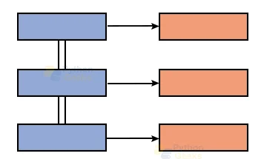
Hash Maps
Notes:
A hash map, also known as a hash table or dictionary, is a data structure that stores key-value pairs, providing fast access, insertion, and deletion operations. Hash maps use a hash function to compute an index from the key, mapping it to a particular slot (or bucket) in an underlying array. Since the hash function can compute the index in constant time, hash maps can offer average-case time complexity of O(1) for the primary operations.
Hash maps are useful in various programming scenarios, such as:
1. **Lookup tables**: Hash maps can be employed as lookup tables to store and retrieve data based on unique keys, such as phone directories, word-frequency counters, or symbol tables in compilers.
2. **Caching**: You can use hash maps to implement caching mechanisms, where the key represents the input data or query, and the value represents the precomputed result, allowing for faster retrieval in subsequent requests.
3. **Counting unique elements**: Hash maps can be used to count unique elements in a collection by using the elements as keys and their frequencies as values.
4. **Associative arrays**: In programming languages that support associative arrays, hash maps are commonly used as the underlying data structure.
5. **Implementing other data structures**: Hash maps can serve as building blocks for implementing other data structures, such as LRU caches, disjoint-set data structures, or trie nodes with dynamic child allocation.
In Python, hash maps are implemented as built-in dictionaries, providing a convenient and efficient way to store and manipulate key-value pairs:
```python
my_hash_map = {"key1": "value1", "key2": "value2", "key3": "value3"}
```
Python dictionaries use a highly optimized hash map implementation, making them suitable for most use cases requiring fast key-value storage and retrieval.

Slide 20
What are Algoritms?
Notes:
A step-by-step procedure for performing calculations or solving problems, often referred to as an algorithm, is a fundamental concept in computer science and programming. Algorithms provide systematic methods for tackling computational tasks by breaking them down into a sequence of simple instructions that a computer can execute. Designing and implementing efficient algorithms is essential to optimize the performance of programs and minimize the use of computational resources, such as memory and processing time.
The study of algorithms involves analyzing and optimizing their efficiency and speed, as well as minimizing resource usage. This process often entails evaluating the time and space complexity of various solutions to identify the most suitable approach for a given problem. Programmers can employ various techniques to enhance performance, including code optimization, algorithmic optimization, and parallelization.

Slide 21
Fundamental Algorithms
Searching
Sorting
Graph
Artificial Intelligence
Dynamic Programming
Greedy Algorithms
Divide and Conquer
Backtracking
Numerical Algorithms
Notes:
Programming encompasses a variety of fundamental algorithms and categories, addressing a wide range of problems and applications. Key categories include Search Algorithms for finding items in collections, Sorting Algorithms for organizing data, Graph Algorithms for processing graph structures, and Artificial Intelligence (AI) Algorithms for creating intelligent systems. AI algorithms include Machine Learning methods (Supervised, Unsupervised, and Reinforcement Learning) and Deep Learning techniques (Artificial Neural Networks, Convolutional Neural Networks, Recurrent Neural Networks, Autoencoders, Generative Adversarial Networks, and Transformer models) Dynamic Programming, Greedy Algorithms, Divide and Conquer, Backtracking, Probabilistic and Randomized Algorithms, Approximation Algorithms, and Numerical Algorithms.
Programming involves various fundamental algorithms and categories that address diverse problems and applications. Essential categories include:
1. **Search Algorithms**: Used for finding items in collections.
2. **Sorting Algorithms**: Applied for organizing data.
3. **Graph Algorithms**: Designed for processing graph structures.
4. **Artificial Intelligence (AI) Algorithms**: Developed for creating intelligent systems, which include Machine Learning methods such as Supervised, Unsupervised, and Reinforcement Learning, as well as Deep Learning techniques like Artificial Neural Networks, Convolutional Neural Networks, Recurrent Neural Networks, Autoencoders, Generative Adversarial Networks, and Transformer models.
5. **Dynamic Programming**: Solves complex problems by breaking them into simpler, overlapping subproblems.
6. **Greedy Algorithms**: Makes locally optimal choices to find globally optimal solutions.
7. **Divide and Conquer**: Breaks a problem into smaller subproblems, solves them independently, and combines the solutions for the final result.
8. **Backtracking**: Incrementally builds solution candidates and backtracks when a candidate is deemed invalid.
9. **Probabilistic and Randomized Algorithms**: Uses randomization to achieve practical solutions for difficult or impossible deterministic problems.
10. **Approximation Algorithms**: Aims to find solutions close to the optimal solution when finding an exact solution is computationally expensive or intractable.
11. **Numerical Algorithms**: Focuses on solving mathematical problems related to numerical analysis.
These algorithms and categories form the foundation of programming, enabling efficient solutions to a wide array of problems across various domains.

Slide 22
How Compare
Measure Space (memory, disk space)
Measure Time (number of operations)
Use Big-O notation
O(1) – constant
O(log n) – logarithmic
O(n) – linear
O(n^2) – Quadratic
O(2^n) - Exponential
Notes:
Big O notation is a mathematical notation used to describe the performance of an algorithm, specifically its time and space complexity. It expresses the upper bound of an algorithm's growth rate as a function of the input size. In other words, Big O notation gives an approximate measure of how the algorithm's execution time or memory usage increases as the input size grows.
Big O notation is crucial for comparing different algorithms and determining their efficiency, as it helps to identify how well an algorithm scales with increasing input size. By analyzing an algorithm using Big O notation, developers can make informed decisions about which algorithm is best suited for a specific problem or scenario, considering factors such as available resources and required performance.
The notation uses the letter 'O' followed by a function that represents the growth rate. Commonly used functions include:
- O(1): Constant time complexity, meaning the algorithm's performance does not depend on the input size.
- O(log n): Logarithmic time complexity, where the algorithm's performance grows logarithmically with the input size.
- O(n): Linear time complexity, indicating that the algorithm's performance grows linearly with the input size.
- O(n log n): Quasilinear time complexity, which is commonly seen in efficient sorting algorithms like Merge Sort and Quick Sort.
- O(n^2): Quadratic time complexity, typical in algorithms with nested loops, such as Bubble Sort and Insertion Sort.
- O(n^k): Polynomial time complexity, where 'k' is a constant. The algorithm's performance grows polynomially with the input size.
- O(2^n): Exponential time complexity, where the algorithm's performance doubles with each increment in input size. This complexity is often found in recursive algorithms for problems like the Traveling Salesman Problem.
Understanding Big O notation and its relation to algorithms is essential for analyzing and optimizing the performance of software, allowing developers to select the most efficient algorithm for a particular task or problem.

Slide 23
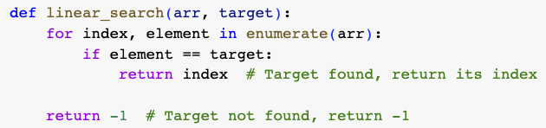
Example – Linear Search
Find an element in a list by iterating through the list.
Time Complexity: O(n)

Slide 24
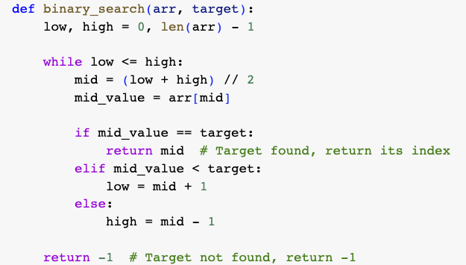
Example – Binary Search
Search a sorted list by repeatedly dividing the list in half.
Time Complexity: O(log n)

Slide 25
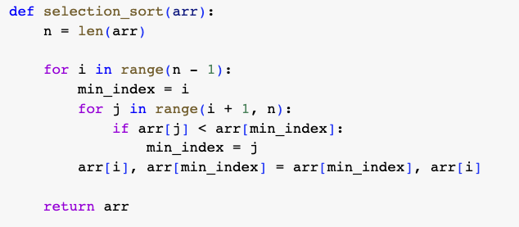
Example - Selection Sort
Sort a list by repeatedly swapping adjacent elements if they are in the wrong order.
Time Complexity: O(n^2)

Slide 26
Summary
Data structures are essential for organizing and managing data efficiently.
Basic data structures in Python: Lists, Tuples, Sets, and Dictionaries.
Algorithms are step-by-step procedures
Study Algorithms improves performance

