Slide 1
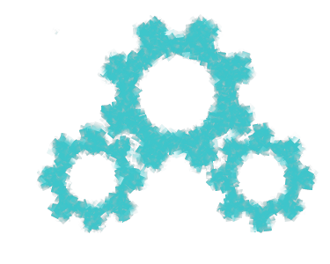
Modules
ISYS2001, School of Marketing and Management

Slide 2


Slide 3
I acknowledge the traditional custodians of the land on which I work and live, and recognise their continuing connection to land, water and community. I pay respect to elders past, present and emerging.

Slide 4
Today
Modules
Packages
Modular Design

Slide 5
Recall Modules
The module we want to use
Import keyword
import random
random.choice([1,2,3])
Call the choice() function from the random module

Slide 6
Recall Convenience
Import keyword
Module
‘as’ keyword followed by an alias
import matplotlib.pyplot as plt
plt.plot([1,3,5,7,9], [1,9,25,49.81])
Alias, followed b dot, followed by function

Slide 7
Specific Import
from keyword
Module
import keyword
function
from datetime import time
X = time(hour=15)

Slide 8
Module
A file containing Python code
Typically functions, variables and classes
Logically organise your code

Slide 9
Creating a Module
Define the function(s)
Save to file
Import file
Create notebook
Import notebook
  %run
  Margo_loader

Slide 10
Create the module (file: hello.py)
# Define a function
def greeting():
  print("Hello, World!")
  #Define variable
  Name = “Steve”

Slide 11
Use Module
# Import the modules
import hello
# call the function
hello.greetting()
# Print variable
print(hello.name)

Slide 12
Package
Collection of Python files
Directory structure
__init__.py
Bundled together uploaded to PyPi

Slide 13
Modules and Packages
One job
Hide internal workings
Application Programmers Interface (API)
Also called library
Python Path

Slide 14
Appending Paths
import sys
sys.path.append(‘/user/steve/’)
import hello
…

Slide 15
Modular design
use to manages complexity
break large problem into small problems
small problems become functions
group related functions into a module
group related modules into a package

Slide 16
Today
Modules
Packages
Modular Design

