Slide 1
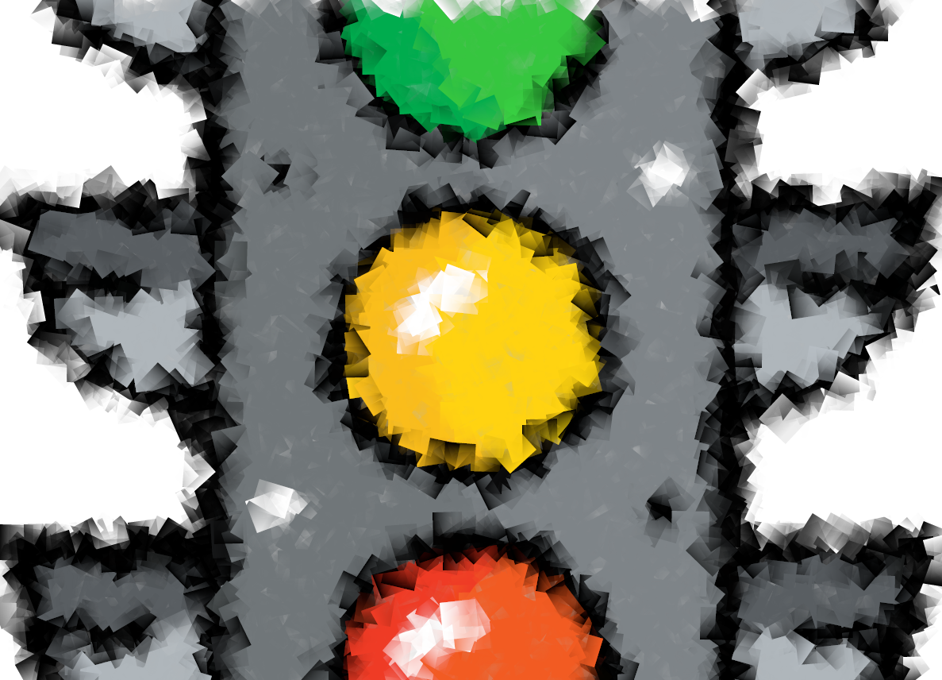
Testing
ISYS2001, School of Marketing and Management

Slide 2


Slide 3
I acknowledge the traditional custodians of the land on which I work and live, and recognise their continuing connection to land, water and community. I pay respect to elders past, present and emerging.

Slide 4
Today
Understand the difference between testing and debugging
Describe one approach of debugging
State why we test
List common testing strategies

Slide 5
Problem Solving Methodology
State the problem clearly
Describe the input and output
Work a simple example by hand
Develop and algorithm (and convert to Python)
Test solution with a variety of data
Feedback Loop(s)

Slide 6
"I'm not a great programmer, I'm just a good programmer with great habits"
Kent Beck

Slide 7
Great Habits
Comments
Docstrings
Use/Create functions
Use/Create modules
Make small frequent commits

Slide 8
A software bug is an error, flaw or fault in computer software that causes it to produce an incorrect or unexpected result, or to behave in unintended ways.
Wikipedia https://en.wikipedia.org/wiki/Software_bug

Slide 9
Debugging is the process to correct the bugs found during testing.

Slide 10
Types of Errors
Syntax Errors
Run-Time Errors
Logic Error

Slide 11
Debugging
Step/Trace through code
  print()
  logging()
Inspect Objects
  type()
  inspect module
Python debugger – pdb
  breakpoint()
  traceback and other methods not enough

Slide 12
Debugging Strategies
Apply Trail and Error
Compare to similar code
Copy and paste for working code
Ask for help (peer, forum, google)
Use IDE
  Syntax Highlighting
  Auto completion
  Linting

Slide 13
Program testing can be used to show the presence of bugs, but never to show their absence! Dijkstra (1970)

Slide 14
Why Test
Reliable
Reproducible
Shareable
Testing leads to failure, and failure leads to understanding.
Burt Rutan

Slide 15
What to test?
ALGORITHM
INPUTS
OUTPUTS
Notes:
Requirements
Design
Code/Implementation
Documentation

Slide 16
You already doing tests!
Validate input
Try variety of inputs (data)
We check output meet requirements
We are provide more structure to the process

Slide 17
Types of Test
Unit – test an individual isolated component
Integration – test multiple units work together
End-to-End – act as user, test entire stack
Acceptance Test – verify user store works as expected
Notes:
Unit Test an individual, isolated component
Integration Test that multiple units work together OR "tests that confirm our code works against code we don't own" (like external APIs, databases, caches, etc)
End-to-End Tests that act as a user actually using the application; tests the entire stack from top-to-bottom
Acceptance Domain-driven tests that verify a user story (also comparable to a use case, customer test, command/query, feature, or vertical slice) works as expected.

Slide 18
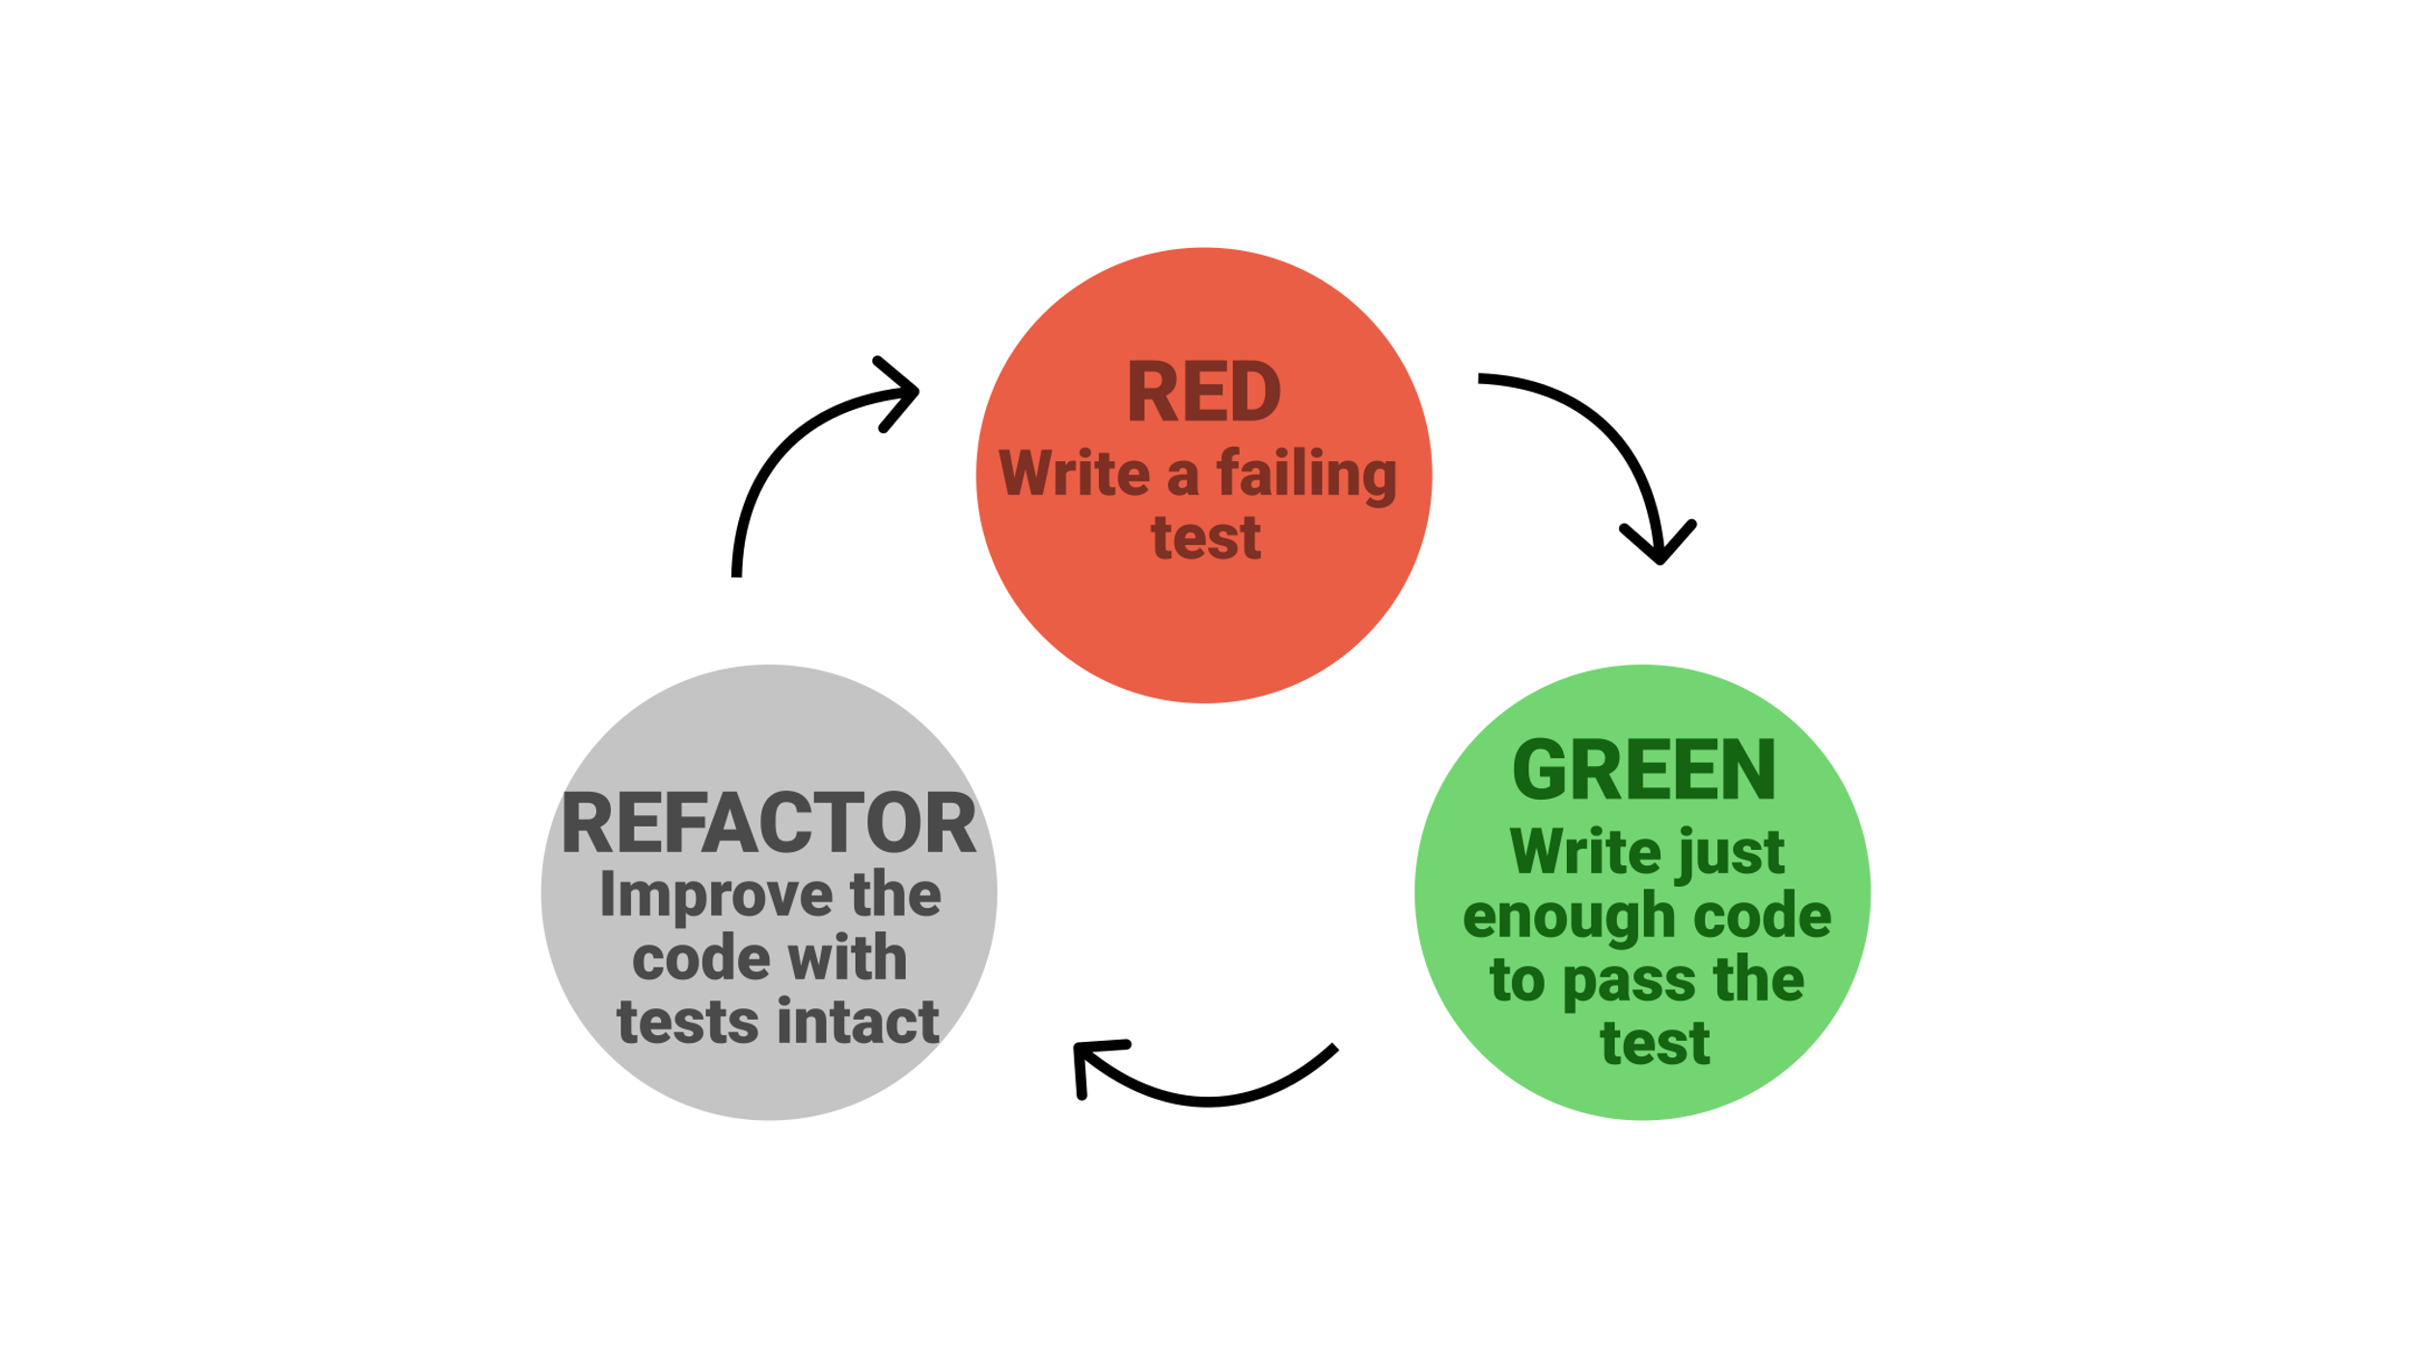
Test Driven Development
A discipline where you grow software in small increments (steps) where you write the test before the implementation.

Slide 19
Approach Notebooks
Write python script to test notebook
  Package: testbook
Write test and code in one notebook
  Packages: assert(), doctest, unittest, nose2 etc..
‘Testing Notebook’ and import notebook(s)
  Packages: assert(), doctest, unittest, nose2 etc..
Notes:
Write test script to import notebook
Write test and code in one notebook
Add ‘noise’
Run notebook, always run tests
Refactor notebook into modules, independently test modules

Slide 20
Testing Everything
Build up a suite of Tests
Run all test with one cell/notebook/script
Regression testing
Test Table
  Sane test, then edge cases

Slide 21
Can you…
Understand the difference between testing and debugging
Describe one approach of debugging
State why we test
List common testing strategies

