Slide 1

Managing Code
ISYS2001, School of Marketing and Management

Slide 2


Slide 3
I acknowledge the traditional custodians of the land on which I work and live, and recognise their continuing connection to land, water and community. I pay respect to elders past, present and emerging.

Slide 4
Today
Enterprise Software
Features of Software Ecosystem
Development → Production Workflow
Deployment
Future
Notes:
Our focus is notebooks, but most of what we discuss today is common across all software ecosystems.

Slide 5
Enterprise Software Today
Cloud Based
Complex
Independent of Operating System
  Browser Based

Slide 6
Features of Software Ecosystem
Reliability
Accessibility
Reusability
Interpretability
Flexibility
Agility
Notes:
Note to instructor: I am NOT implying these features not exist in languages, rather more advocating the notebooks are ready!
RELIABIILTY: Jupyter's way more stable now than it was a few years ago, but it still introduces more ways for code to break, especially if your notebook server is not something you're spinning up uniquely for every project. Virtual environments (containers and VM instances) solve a lot of the issues
ACCESSIBILITY: While apps like Github and nbviewer have made it easier to share notebooks, there's still a lot more flexibility to be had from exporting results into text files, spreadsheets, databases, or saved images
REUSABIILTY: Modules and packages exist because copied-and-pasted code is inefficient to produce and nearly impossible to maintain
INTERPRETABILTY: By putting code alongside documentation and results, notebooks make it much easier for others (or future you) to figure out what your code does, and that's as valuable for production as development
FLEXIBILITY: Notebooks have a Swiss Army Knife quality to them - you can do almost anything in them, but they're not the best tool for every job
AGILITY: We love notebooks because they make data analysis simpler and faster, and getting something new into production quickly is a big deal

Slide 7
Ecosystem Considerations
How do you get the data?
Where does the code run?
How is your code organised?
Where do your outputs go?
Notes:
HOW DO YOU GET THE DATA?
Are you using an extract? Connecting to a database? Pulling from a data store like S3?
And is it already prepped for you? Do you do it before or after you import it to Python?*
WHERE DOES THE CODE RUN?
Are you doing production work on your personal machine? Running it server? Deploying it with a service?
How are you handling dependencies? Creating environments? Making Docker containers?
HOW IS YOUR CODE ORGANIZED?
Are you calling Python as a Jupyter kernel, or converting it into a standard Python script?
Is all your code in one file? Are you using functions? Objects? Are your parameters in the same file or a different one? Are you making packages?
WHERE DO YOUR OUTPUTS GO?
Are the outputs something that can be represented in notebook or do you need them in another format? Are you sharing them? Using for multiple purposes?
service like AWS Lambda?
Are there supplemental outputs (descriptive stats, validation checks, etc.) that work well in a notebook?

Slide 8
Application
Development
Production
Interface - Widgets + Code
Deployment
Notes:
These are high level concepts common across languages, compiled or interpreted. Your software ecosystem needs to provide this functionality
Move from Development to Beta/Staging [Optional] to Production
Business rules enforce the difference commonly implemented with branches in version control software. Line between Development and Production – See CI/CD
We think of Graphical Application, but could be services
Way to deploy the application, how can we handle all the diverse environment?

Slide 9
Virtual environments
Create virtual environment
Activate virtual environment
Install required packages
Deactivate environment
Notes:
Only install what is necessary to reduce library/package conflicts
Simulate production environment verse a custom local development environment
Python Specific – venv, pyenv (Local CLI tools)
Notebook Specific – Jupyter Lab, Paperspace, Colab
Containers - Docker
General Cloud – Google Compute, AWS etc

Slide 10
Typical Workflow
Development
Prototype model and outputs
Extract Data
Develop Notebook
Notebook → Script → exe
→ Web App
→ Container
Production
Live Data
Store Outputs
Run App
Notes:
Tradition/Old way, Notebook to Script
New way use container technology and webapps
Other things to consider
DATA PREPARATION. You could run a distinct ETL step at the start of production, have it as a totally separate pipeline, or include it in your main analysis / modeling code.
VERSION CONTROL AND CI. Often the split between dev and prod isn't nearly as clean, so you may go back and forth between the two using tools like Jenkins or Travis. (That also means adding tests into the workflow!)
CONTAINERS AND ENVIRONMENTS. At production time, you'll probably want to package up all your dependencies along with your scripts, especially if you plan to automate
SERVICES AND DEPLOYMENT. These patterns describe your typical batch workflow, but in more complex use cases "production" will also include on-demand or streaming use, and services like APIs and Lambda have unique requirements

Slide 11
Development
Local Environment
  Jupyter Lab, VSCode,
Cloud Environment
  AWS, Google Compute, Asure
Notebook Specific
  Paperspace, Colab

Slide 12
Deployment
Notebooks as Packages
  NBDev
Notebooks as (Web) Apps
  Ipywidgets, Voila, Appmode, Anvill
Deploy/Share
  nbviewer, GitHub, Binder, Docker
  nbconvert → Script → Package/Exe

Slide 13
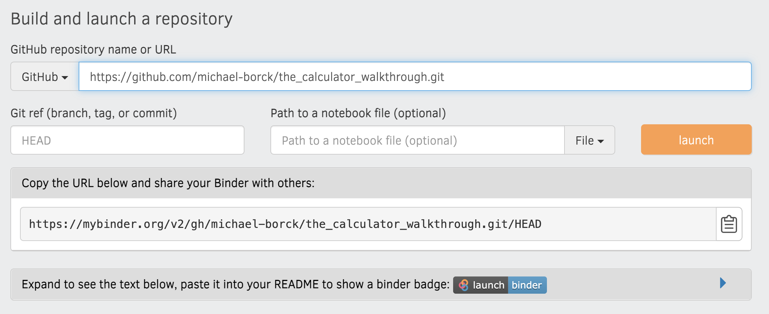
Binder
1
2
4
3
Notes:
Binder allows you to open those notebooks in an executable environment, making your code immediately reproducible by anyone, anywhere.
Make sure GitHub selected
Copy URL form repository
Copy URL to share
Click Launch

Slide 14
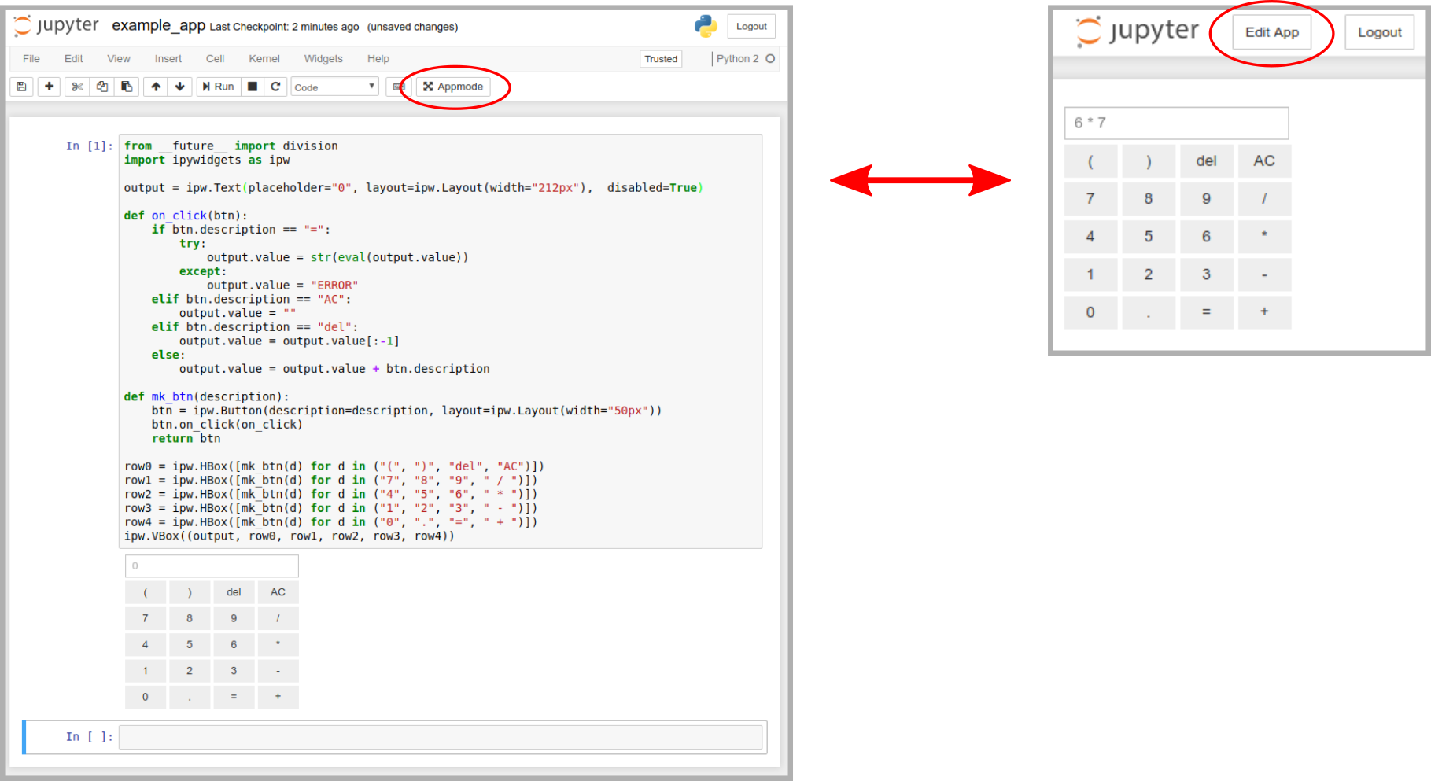
Appmode
Notes:
We will look at GUIs in later lecture, but here is a teaser
Widgets + Appmode = Application
When a notebook is opened in Appmode:
a dedicated kernel is launched to allow for concurrent views.
code cells and the toolbar are hidden to provide a clean UI.
all cells are executed automatically.
Multiple notebooks can be linked via url parameters to create even more sophisticated user experiences.

Slide 15
Future
Notebooks as Applications
Rise of Containers
New Platforms
New Capabilities
Notes:
As notebooks grow from development to shareable applications they are becoming the end products
Container technology continues to expand in the ecosystem, notebooks become practical
New platforms are making notebooks first-class part of the toolkit
Jupyter blurring the lines between development and production (extensions verse packages)

Slide 16
Can you?
State the direction of enterprise software today
List the features of software ecosystem
Describe a development to production workflow
Suggest how to deploy and share code
Outline a possible future for notebooks
Notes:
Our focus is notebooks, but most of what we discuss today is common across all software ecosystems.

