Slide 1

Using the Web
ISYS5002, School of Marketing and Management

Slide 2


Slide 3
I acknowledge the traditional custodians of the land on which I work and live, and recognise their continuing connection to land, water and community. I pay respect to elders past, present and emerging.

Slide 4
Today
Accessing/Download Data
  3 methods in Python
Create Webpage
Web Scraping

Slide 5
urllib.request.urlretrieve
from urllib import request
# Define the remote file to retrieve
remote_url = 'https://www.google.com/robots.txt’
# Define the local filename to save data
local_file = 'local_copy.txt’
# Download remote and save locally
request.urlretrieve(remote_url, local_file)
Notes:
Python’s urllib library offers a range of functions designed to handle common URL-related tasks. This includes parsing, requesting, and — you guessed it — downloading files. Let’s consider a basic example of downloading the robots.txt file from www.google.com
Note: urllib’s urlretrieve is considered “legacy” from Python 2 and, in the words of the Python documentation, “might become deprecated at some point in the future.” In my opinion, there’s a big divide between “might” become deprecated and “will” become deprecated. In other words, this is probably a safe approach for the foreseeable future.

Slide 6
requests.get + manual save
import requests
# Define the remote file to retrieve remote_url = 'https://www.google.com/robots.txt’
# Define the local filename to save data
local_file = 'local_copy.txt’
# Make http request for remote file data
data = requests.get(remote_url)
# Save file data to local copy
with open(local_file, 'wb')as file:
file.write(data.content)
Notes:
The Python Requests module is a super-friendly library billed as “HTTP for humans.” Offering very simplified APIs, Requests lives up to its motto for even high-throughput HTTP-related demands. However, it doesn’t feature a one-liner for downloading files. Instead, one must manually save streamed file data as follows.
There are some important aspects of this approach to keep in mind — most notably the binary format of data transfer. When a web browser loads a page (or file), it encodes it using the specified encoding from the host.
Common encodings include UTF-8 and Latin-1. This is a directive aimed at web browsers that are receiving and displaying data that isn’t immediately applicable to downloading files.
Note: Downloaded files may require encoding in order to display properly. But focus on csv/txt files.

Slide 7
wget.download
import wget
# Define the remote file to retrieve
remote_url = 'https://www.google.com/robots.txt’
# Define the local filename to save data
local_file = 'local_copy.txt’
# Make http request for remote file data wget.download(remote_url, local_file)
Notes:
The wget Python library offers a method similar to urllib and attracts a lot of attention due to its name being identical to the Linux wget command. This module was last updated in 2015.
Note: The wget.download function uses a combination of urllib, tempfile, and shutil to retrieve the downloaded data, save to a temporary file, and then move that file (and rename it) to the specified location.

Slide 8
Website Development
Django
  Fast, secure
Flask
  minimalistic
Notes:
Two popular frameworks.
Discuss for completeness. Not assessable.

Slide 9
from flask import Flask
app = Flask(__name__)
@app.route("/")
def home():
return "Hello, World!"
if __name__ == "__main__":
app.run(debug=True)
Notes:
Simple ‘hello world’. Just for reference.

Slide 10
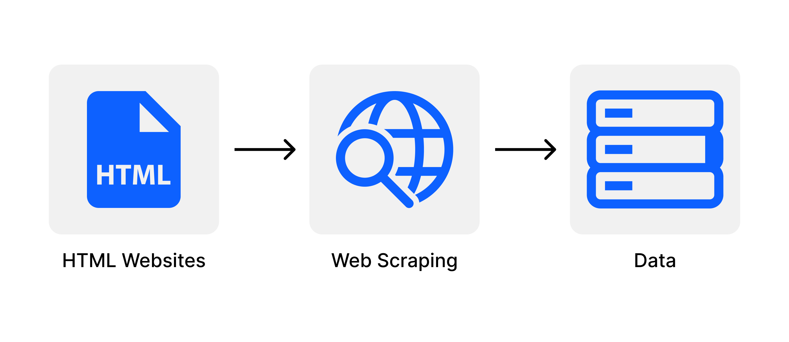
What is Web Scraping
Image Source: https://i.imgur.com/6zM7JBq.png
Notes:
Web scraping is an automated method used to extract large amounts of data from websites. The data on the websites are unstructured. Web scraping helps collect these unstructured data and store it in a structured form. There are different ways to scrape websites such as online Services, APIs or writing your own code. In this article, we’ll see how to implement web scraping with python.

Slide 11
Why is Web Scraping Used?
Price Comparison
Email address gathering
Social Media Scraping
Research and Development
Job Listings

Slide 12
Is Web Scraping Legal?
Copyright law protects original work
  Fair dealing
Data not consider original work
Read Website Terms of Service
Check robots.txt

Slide 13
Is Python Good for Web Scraping
Ease of Use
Large Collection of Libraries
Dynamically Typed
Small code large Task
Community

Slide 14
How Scrape
Find URL
Inspect the Page
Find the data want to extract
Write the code
Run code and extract the data
Store data in the required format

Slide 15
Libraries
Selenium – automate browser activities
BeautifulSoup – parsing HTML and XML documents
Requests – make HTTP request simpler

Slide 16
Anatomy of URL
Scheme
  https://developer.mozilla.org
Domain
  https://developer.mozilla.org/en-US/docs/Learn/
Path
  https://developer.mozilla.org/en-US/docs/Learn/
Parameters
  https://developer.mozilla.org/en-US/search?q=URL

Slide 17
HTML Tags
<!DOCTYPE html>
<html>
<head>
<title>Page Title</title>
</head>
<body>
<h1>This is a Heading</h1>
<p>This is a paragraph.</p>
</body>
</html>

Slide 18
Can you
Explain Download Data
Understand Create Webpage
Describe Web Scraping

