Slide 1
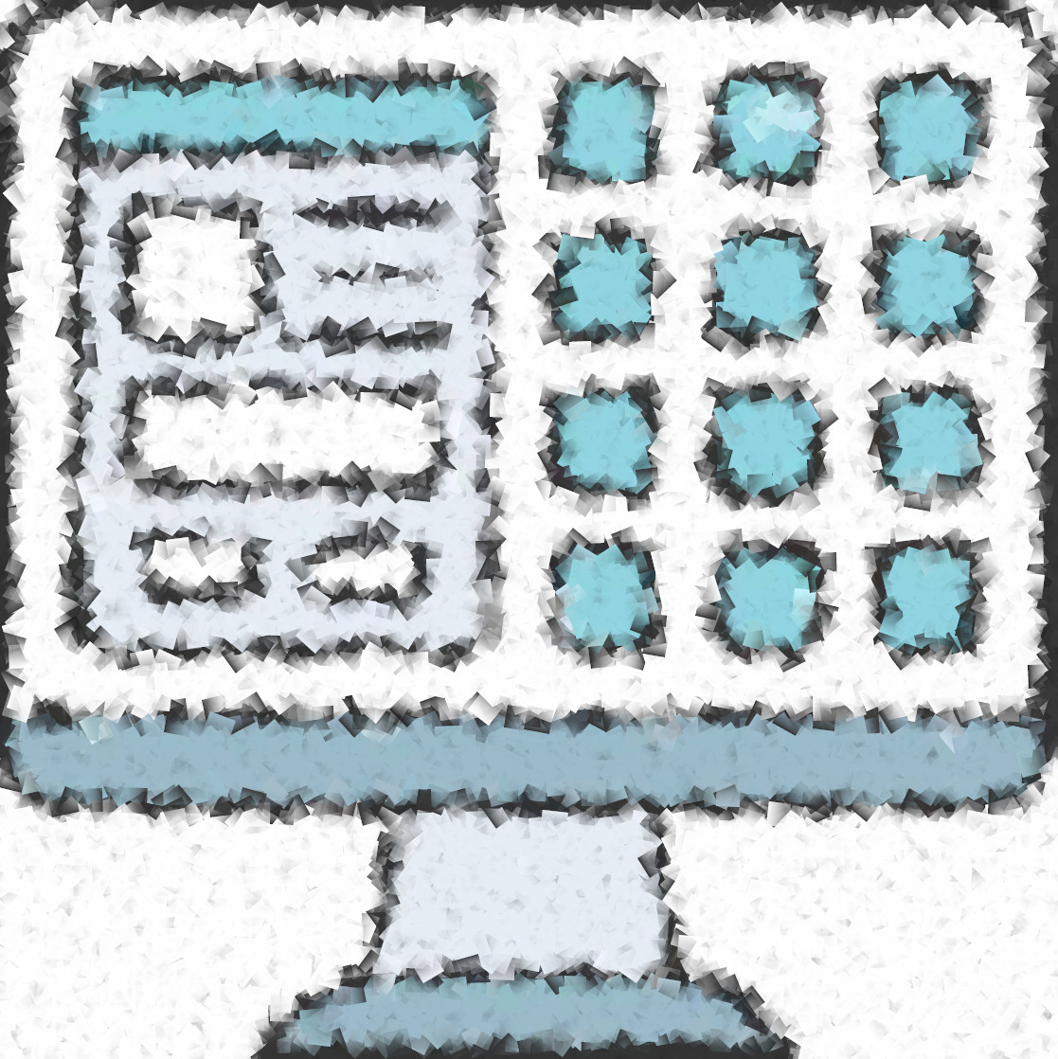
Graphical User Interfaces
ISYS5002, School of Marketing and Management

Slide 2


Slide 3
I acknowledge the traditional custodians of the land on which I work and live, and recognise their continuing connection to land, water and community. I pay respect to elders past, present and emerging.

Slide 4
Today
Discuss User Interfaces
Explain different interaction styles
User support which should be built-in to user interfaces
See how to create an ‘app’ using Python notebooks
Notes:
Today we will be diving into the world of user interfaces - the visual and interactive elements that allow us to interact with our computers and devices. From traditional desktop interfaces to mobile apps, user interfaces are a fundamental aspect of modern computing.
There are many different interaction styles used in user interfaces. From touch-based interfaces on mobile devices to the more traditional mouse and keyboard inputs on desktop computers. Each style has its strengths and weaknesses, and designers must carefully consider which one to use based on the needs of the user and the task at hand.
But what happens when a user gets stuck? That's where built-in user support comes in. Good user interfaces provide intuitive guidance to users, with helpful prompts and error messages to prevent frustration and mistakes.
And if you're interested in creating your own user interfaces, you may be surprised to learn that you don't need to be a seasoned software developer to do so. In fact, with tools like Python notebooks, you can create simple but effective apps with just a few lines of code.
Throughout this discussion, we'll explore all of these topics and more, helping you to understand how user interfaces work and how to create your own. So, whether you're a seasoned programmer or a curious newcomer, get ready to dive into the fascinating world of user interfaces.

Slide 5
The User Interface
System users often judge a system by its interface rather than its functionality
A poorly designed interface can cause a user to make catastrophic errors
Poor user interface design is the reason why so many software systems are never used
Notes:
The user interface (UI) is the point of interaction between the user and a computer system. A well-designed interface should be intuitive, user-friendly, and visually appealing, enabling users to complete tasks easily and efficiently. However, if the interface is poorly designed, users can find it difficult to use, and they may be more likely to judge the entire system based on their experience with the interface alone.
Even if a system has excellent functionality, a poorly designed interface can lead to serious errors. For example, a confusing or unclear interface in a medical system could result in a doctor making an incorrect diagnosis, or a mistake in medication dosage. In industries such as finance or transportation, a small interface error could have catastrophic consequences.
Furthermore, if a system's interface is poorly designed, users are more likely to abandon it altogether. This is because they may not have the patience or the motivation to figure out how to use it. Instead, they will opt for a different system that is easier to use, even if it has fewer features or lower functionality.
In summary, a system's interface plays a significant role in its adoption and success. A poorly designed interface can lead to user errors, abandonment of the system, and even catastrophic consequences. Therefore, designers and developers must prioritize interface design as much as they prioritize system functionality to ensure that users have a positive experience and use the system to its full potential.

Slide 6
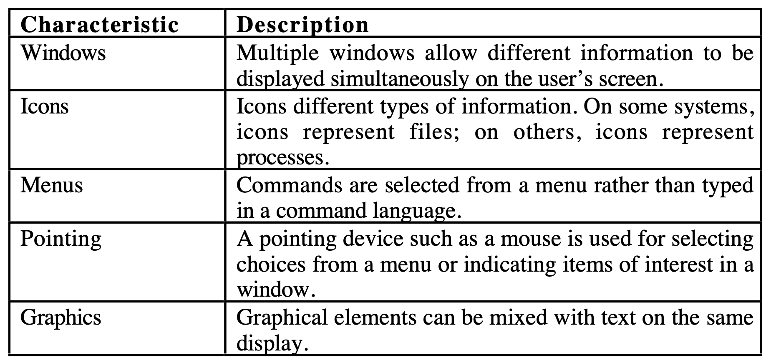
Graphical User Interface
Notes:
WIMP is an acronym that stands for Windows, Icons, Menus, and Pointers. It is a term used to describe the basic components of a graphical user interface (GUI) that allow users to interact with software applications.
Windows refer to the rectangular areas on the computer screen that display the interface of an application. Each window typically contains the controls and content for a specific task or function.
Icons are graphical symbols or representations of an application, file, or folder. They allow users to quickly identify and launch the application or access the file or folder.
Menus are lists of commands or options that are displayed in a drop-down or pop-up format when the user clicks on a menu bar. Menus allow users to perform a wide variety of functions, from opening files to changing application preferences.
Pointers are graphical elements that indicate the current location and actions of the mouse or other pointing device. The most common pointer is the arrow, which changes shape to indicate different actions such as selecting, resizing, or scrolling.
Together, these four components create the foundation for modern GUIs. By using a combination of windows, icons, menus, and pointers, software developers can create powerful and user-friendly applications that allow users to interact with technology in intuitive ways. The WIMP interface has become the standard for most modern operating systems and is used by millions of people around the world.

Slide 7
Advantages
They are easy to learn and use. Users without experience can learn to use the system quickly.
The user may switch quickly from one task to another and can interact with several different applications.
Information remains visible in its own window when attention is switched.
Fast, full-screen interaction is possible with immediate access to anywhere on the screen
Notes:
Graphical User Interfaces (GUIs) offer several advantages over traditional command-line interfaces, including:
1. Ease of use: GUIs provide a visual representation of the interface and allow users to interact with the system by clicking on icons, menus, and buttons. This makes it easy for users to learn and navigate the system.
2. Increased productivity: With a GUI, users can perform tasks more quickly and efficiently. This is because GUIs often provide shortcuts and easy access to frequently used commands, reducing the time it takes to perform a task.
3. Consistency: GUIs provide a consistent interface across applications, making it easy for users to switch between programs without having to learn a new interface every time.
4. Accessibility: GUIs can be made accessible to users with disabilities. For example, users with visual impairments can use screen readers or magnifiers to navigate the interface.
5. Reduced errors: GUIs can help reduce errors by providing visual cues and feedback to users. This can help prevent users from making mistakes or entering incorrect data.
6. Increased functionality: GUIs can provide access to more advanced features and capabilities than command-line interfaces. This is because GUIs can display complex visualizations, multimedia, and other graphical elements that are not possible in a command-line interface.
Overall, GUIs are a more user-friendly and efficient way to interact with software applications. By providing a visual representation of the interface and easy access to frequently used commands, GUIs help users complete tasks more quickly and efficiently, reducing errors and increasing productivity.

Slide 8
UI Design Principles
User familiarity
Consistency
Minimal surprise
Recoverability
User guidance
User diversity (Accessibility – ISYS3004)
Notes:
UI design principles are a set of guidelines that designers follow to create user interfaces that are intuitive, user-friendly, and effective. Here are six important UI design principles:
1. User familiarity: The interface should be designed with the user in mind. This means that designers should take into account the users' prior experience with similar systems and create an interface that is familiar and easy to use.
2. Consistency: The interface should be consistent across different parts of the system. This means that similar actions should be performed in a consistent manner, and the same icons, menus, and buttons should be used throughout the system.
3. Minimal surprise: The interface should be designed in a way that minimizes surprises and unexpected behaviors. Users should be able to predict what will happen when they interact with different elements of the interface.
4. Recoverability: The system should be designed with recoverability in mind. This means that users should be able to recover from errors easily and without losing their work.
5. User guidance: The interface should provide clear and concise guidance to users. This means that help messages, prompts, and error messages should be displayed in a way that is easy to understand and use.
6. User diversity: The interface should be designed with different types of users in mind. This means that designers should consider the needs of users with disabilities, non-native speakers, and other groups that may have unique requirements.
By following these design principles, designers can create interfaces that are easy to use, intuitive, and effective, regardless of the user's level of experience or background.

Slide 9
Interaction Styles
Direct manipulation (video games)
Menu selection (general software)
Form fill-in (loan application, stock control)
Command language (operating systems)
Natural language (Siri, Hey Google)
Notes:
Consider two questions:
How should information from the user be provided to the computer system?
How should information from the computer system be presented to the user?
User interface metaphor
Direct Manipulation: Users feel in control of the computer and are less likely to be intimidated by it. User learning time is relatively short Users get immediate feedback on their actions so mistakes can be quickly detected and corrected. Direct manipulation interfaces can be complex to program and make heavy demands on the computer system
Menu Systems: Users make a selection from a list of possibilities presented to them by the system. The selection may be made by pointing and clicking with a mouse, using cursor keys or by typing the name of the selection. May make use of simple-to-use terminals such as touchscreens. Users need not remember command names as they are always presented with a list of valid commands. Actions which involve logical conjunction (and) or disjunction (or) are awkward to represent. Menu systems are best suited to presenting a small number of choices. If there are many choices, some menu structuring facility must be used
Form Based Systems: A common user interface metaphor. Data entry, advanced search. Way to structure the input.
Command Language: User types commands to give instructions to the system e.g. UNIX. May be implemented using cheap terminals. Easy to process using compiler techniques Commands of arbitrary complexity can be created by command combination. Concise interfaces requiring minimal typing can be created Not suitable for occasional users. Users have to learn and remember a command language. System interaction is through a keyboard so typing ability is required
May be provided as an alternative to menu commands (keyboard shortcuts). In some cases, a command language interface and a menu-based interface are supported at the same time
Natural Language: The user types a command in a natural language (changing with modern AI, use speech). Generally, the vocabulary is limited and these systems are confined to specific application domains (e.g. timetable enquiries). NL processing technology is now good enough to make these interfaces effective for casual users but experienced users find that they require too much typing

Slide 10
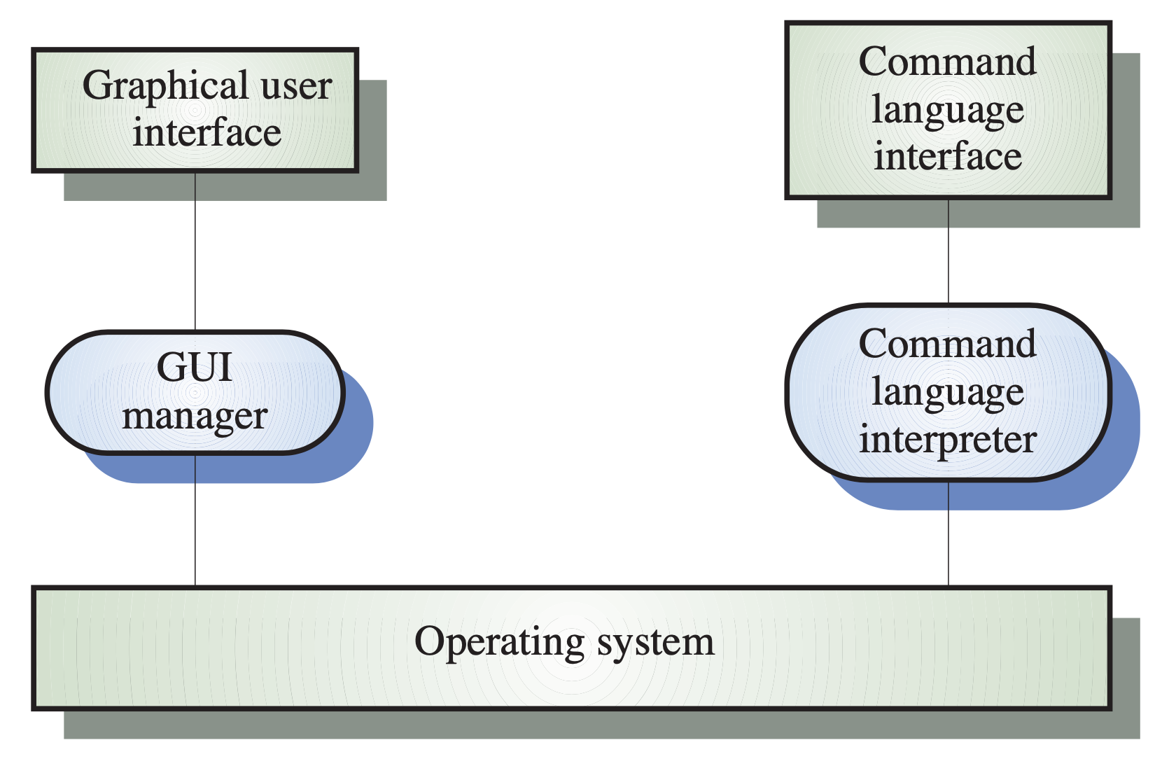
Modern Systems - Multiple Interfaces
Notes:
Modern systems often provide both a Graphical User Interface (GUI) and a Command-Line Interface (CLI) to give users different options for interacting with the system.
The GUI is a visual representation of the interface that allows users to interact with the system using icons, menus, buttons, and other graphical elements. The GUI is often designed to be intuitive and easy to use, making it an excellent option for novice users who are not familiar with command-line interfaces.
On the other hand, the CLI allows users to interact with the system by entering text-based commands. CLI is often used by more advanced users or developers who need more control and flexibility over the system's operations. CLI provides faster access to system features and allows for scripting and automation of tasks.
In many modern systems, the GUI and CLI are integrated, allowing users to switch between the two interfaces as needed. For example, users may perform tasks using the GUI for common tasks but switch to the CLI for more advanced tasks that are not available in the GUI.
This integration between the GUI and CLI provides users with the best of both worlds: the ease of use and visual representation of the GUI and the power and flexibility of the CLI. As a result, users can choose the interface that works best for them, depending on their level of experience and the task at hand.

Slide 11
User Support
Guidance (Tool Tips)
Help System
  I want information
  I need help!
Error Messages
User Documentation
Notes:
User support is an essential component of any user interface. User guidance refers to the set of system facilities designed to help users understand and use the interface effectively. This includes on-line help, error messages, manuals, and other forms of documentation.
The user guidance system should be seamlessly integrated with the user interface, allowing users to access help and guidance as needed. For example, a help button or menu item could be provided to give users quick access to relevant information.
The help and message system should be integrated into the interface to provide users with timely and relevant information when they need it. This means that error messages should be clear, concise, and constructive, providing users with helpful suggestions for resolving the issue.
Messages should be polite, consistent, and designed to meet the needs of the user. The background and experience of users should be taken into account when designing messages. For example, if the system is designed for novice users, messages should be written in plain language and avoid jargon.
In addition to on-line information, paper documentation should be supplied with the system. This includes user manuals, quick reference guides, and other materials that provide users with an overview of the system's features and functions.
Overall, effective user guidance is an essential component of any user interface. By providing clear, concise, and relevant information, users can learn to use the system more effectively and resolve issues quickly and easily.

Slide 12
GUI - History
Punch Cards
Text-Based (Teletype)
Text-Based (Monitor)
Sketch Pad (Ivan Sutherland’s light pen)
Stanford Online System (hyperlinks)
Xerox PARC (first mouse)
….
Notes:
The history of user interfaces dates back to the earliest days of computing. Here is an overview of the most significant milestones in the development of user interfaces:
1. Punch Cards: In the early days of computing, data was input using punch cards. These cards contained holes in specific locations that represented data and instructions.
2. Text-Based (Teletype): In the 1950s and 1960s, computers became more accessible to businesses and organizations. Users interacted with computers through text-based interfaces using teletype machines that printed output on paper.
3. Text-Based (Monitor): In the 1970s, text-based interfaces shifted from teletype machines to computer monitors. Users could interact with the computer through a keyboard and see output on a monitor.
4. Sketch Pad (Ivan Sutherland's light pen): In 1963, Ivan Sutherland developed Sketch Pad, which was the first system to use a light pen to interact with a computer. Users could draw on a monitor using the light pen, which was a significant breakthrough in computer graphics.
5. Stanford Online System (hyperlinks): In the 1960s and 1970s, Stanford University developed the Stanford Online System (SOS), which was the first system to use hyperlinks to navigate between documents. This innovation paved the way for the modern internet.
6. Xerox PARC (first mouse): In the 1970s, Xerox PARC developed the first graphical user interface (GUI), which included the first mouse. The mouse allowed users to interact with the computer by moving a cursor on the screen and clicking on icons and menus.
These milestones represent significant advancements in the development of user interfaces, leading to the modern interfaces we use today. The development of graphical user interfaces and pointing devices such as the mouse has made computers more accessible and user-friendly, allowing people to interact with technology in more natural ways.

Slide 13
Common Widgets
Buttons
Radio buttons
Check Boxes
Text Boxes
Sliders
Date Pickers
Colour Pickers
Tabs
Canvas
Plots/Charts
Notes:
A widget is a graphical user interface (GUI) element that displays information or provides a way for users to interact with an application. Widgets can be used to display text, images, videos, or other types of content, or to provide a way for users to input data or make selections.
Some common widgets include:
1. Buttons: A button is a graphical element that represents an action that can be performed. When a user clicks on a button, the action is executed.
2. Radio/Check Boxes: Radio and check boxes allow users to select one or more options from a list of choices. Radio buttons allow users to select only one option, while check boxes allow users to select multiple options.
3. Pickers (Date, Color): Pickers are widgets that allow users to select a specific value from a list of options. For example, a date picker might allow users to select a specific date from a calendar, while a color picker might allow users to select a specific color from a color palette.
4. Dropdowns: A dropdown is a widget that displays a list of options when a user clicks on it. Users can then select one option from the list.
These widgets can help reduce user input error by limiting the choices to only valid input. For example, radio buttons and check boxes limit users to selecting only from a predetermined set of options, reducing the chance of user error. Date pickers and color pickers ensure that users input valid dates or colors, respectively, without having to manually enter the information.
In summary, widgets are essential components of modern graphical user interfaces. By providing a way for users to interact with applications and limiting user input to valid options, widgets help to create intuitive and user-friendly interfaces. There is a vast array of widgets available, so there is likely to be a widget for every type of input or interaction needed in an application.

Slide 14
App (in a notebook)
Change variables
Use input()
Colab forms
Widgets
  Forms
  Dashboard
Share
  Module/Package (Nbdev -> PyPi)
  Interactive (Binder, NBViewer)
  Report (Slides, HTML, PDF)
Notes:
Bold items will demonstrate in this weeks lab!
When using Python notebooks, there are several ways to create an app 'in a notebook'. Here are some examples:
1. Change variables: One simple way to create an app in a notebook is to create a set of variables that control the behavior of the app. Users can change these variables to modify the app's behavior.
2. Use input(): The input() function can be used to prompt the user for input, allowing users to provide information that the app uses to make decisions.
3. Colab forms: Colab forms are a feature of Google Colaboratory that allows users to create a form-based interface for an app in a notebook. Users can input data using the form, and the app uses the data to generate output.
4. Widgets: Widgets are GUI elements that can be used to create interactive apps in a notebook. Widgets can be used to create buttons, sliders, drop-down menus, and other types of user input elements.
5. Forms: Forms can be used to create more complex interfaces for apps in a notebook. Forms can include text fields, check boxes, and other types of user input elements.
6. Dashboard: Dashboards are a type of interface that provides a graphical representation of data. Dashboards can be used to create interactive visualizations of data in a notebook.
7. Share: Notebooks can be shared with others, allowing multiple users to interact with the app at the same time.
8. Module/Package (Nbdev -> PyPi): Notebooks can be converted into modules or packages that can be shared and installed like any other Python module or package.
9. Interactive (Binder, NBViewer): Notebooks can be made interactive by using services like Binder and NBViewer, which allow users to run the app in a web browser.
10. Report (Slides, HTML, PDF): Notebooks can be converted into reports that can be shared in various formats, including slides, HTML, and PDF.
In summary, Python notebooks provide a flexible and powerful environment for creating apps. By using a combination of variables, input prompts, widgets, forms, dashboards, and other features, users can create interactive and engaging apps in a notebook that can be shared with others.

Slide 15
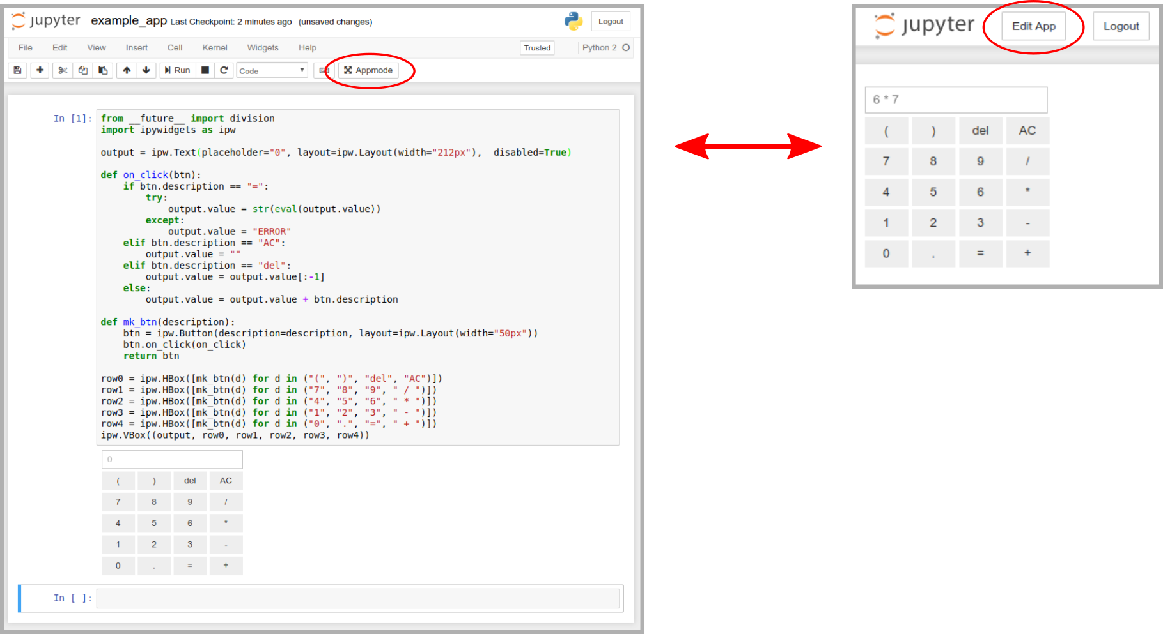
App in a notebook
Notes:
We will look at GUIs in later lecture, but here is a teaser
Widgets + Appmode = Application
When a notebook is opened in Appmode:
a dedicated kernel is launched to allow for concurrent views.
code cells and the toolbar are hidden to provide a clean UI.
all cells are executed automatically.
Multiple notebooks can be linked via url parameters to create even more sophisticated user experiences.

Slide 16
App (from a notebook)
Native GUI (tkinter, pyQT, wxPython, PySide )
  Cross platform can be difficult
Web Page (cherrypy, bottle, flask, Django, pyscript)
  Need to know some HTML and CSS
Web App (Anvil, Streamlit, Volia, Dash, Panel)
Native Cross Platform App (Kivy, Beeware)
Notes:
An app from a notebook refers to the creation of a software application using a notebook interface, typically using Python. This approach allows developers to create apps quickly and easily by using the notebook environment to write code, design user interfaces, and test the application's functionality.
There are several ways to create an app from a notebook. One approach is to use a native GUI toolkit such as tkinter, pyQT, wxPython, or PySide to create a desktop application. These toolkits provide a set of graphical components that can be used to create the user interface, such as buttons, text boxes, and menus. While these toolkits offer a native look and feel on the platform they were designed for, creating cross-platform apps can be challenging.
Another approach is to create a web page or a web app using frameworks such as cherrypy, bottle, flask, Django, or pyscript. These frameworks allow developers to create web-based applications that can be accessed from any device with a web browser. While this approach requires some knowledge of HTML and CSS, it offers the advantage of being able to create cross-platform apps that can run on any operating system.
Web apps such as Anvil, Streamlit, Volia, Dash, and Panel provide an even easier way to create web-based applications. These frameworks allow developers to create apps by writing Python code and providing a set of high-level components that can be used to create the user interface. This approach requires less knowledge of web development but may be less flexible than using a lower-level web framework.
Finally, there are native cross-platform app development frameworks such as Kivy and Beeware that allow developers to create desktop and mobile applications that can run on multiple operating systems. These frameworks use Python as the programming language and provide a set of graphical components that can be used to create the user interface. These frameworks offer the advantage of being able to create cross-platform apps that can run on desktops and mobile devices, but may require more specialized knowledge of app development.
In conclusion, creating an app from a notebook offers several advantages, including the ability to create applications quickly and easily using a familiar interface. Depending on the requirements of the app, developers can choose from a range of options, including native GUI toolkits, web-based frameworks, web apps, and native cross-platform frameworks.

Slide 17
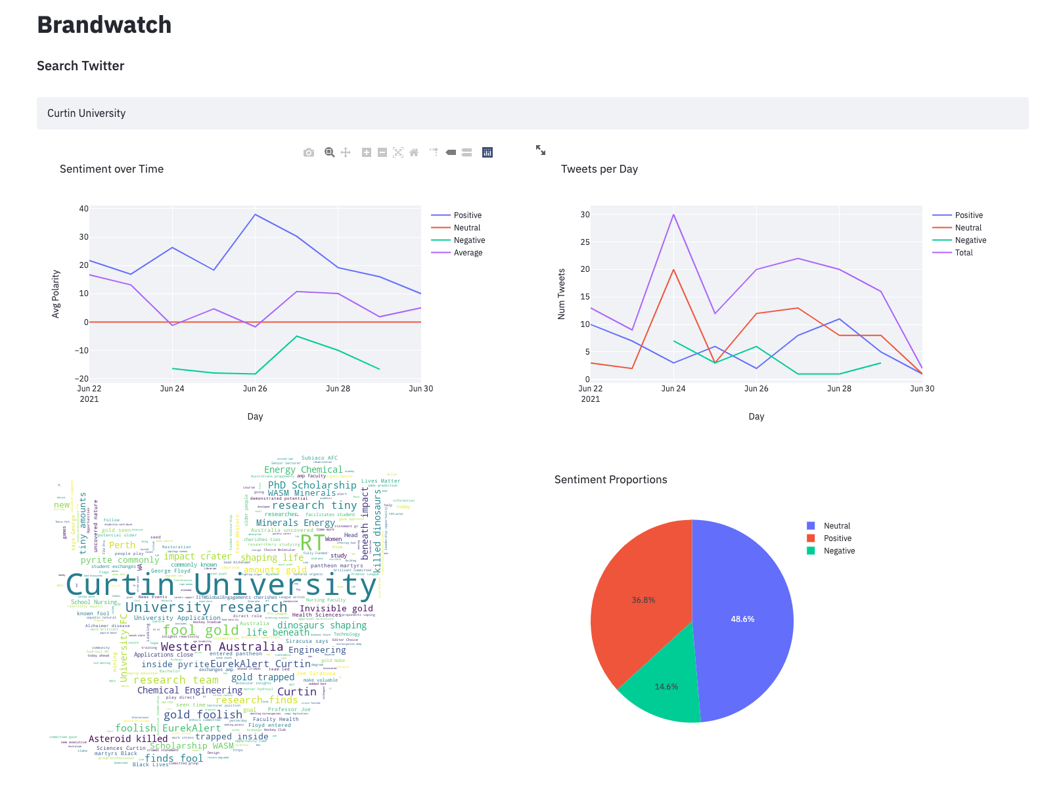
App from a Notebook. (streamlit)
Notes:
Streamlit is a popular open-source Python library used to create data visualization dashboards. Here are the steps to create a dashboard using Streamlit:
1. Install Streamlit: To use Streamlit, you will need to install it first. You can install it using pip, a package installer for Python. You can run the following command to install Streamlit: `pip install streamlit`
2. Import Required Libraries: After installing Streamlit, you need to import it along with other required libraries such as pandas, matplotlib, and seaborn. You can do this by adding the following lines at the top of your script:
```
import streamlit as st
import pandas as pd
import matplotlib.pyplot as plt
import seaborn as sns
```
3. Load Data: Next, you need to load the data that you want to visualize in your dashboard. You can load data using pandas, a popular data manipulation library for Python. You can use the `pd.read_csv()` function to load data from a CSV file or `pd.read_excel()` to load data from an Excel file.
4. Create Widgets: Streamlit allows you to create widgets to interact with the data. You can create widgets using the `st.` functions such as `st.slider()`, `st.selectbox()`, and `st.checkbox()`. These widgets allow users to filter the data and update the dashboard in real-time.
5. Visualize Data: After creating widgets, you can use the visualization libraries such as matplotlib and seaborn to create interactive charts and graphs. You can use the `plt.plot()` function to create line charts, `sns.barplot()` to create bar charts, and `sns.scatterplot()` to create scatter plots.
6. Run the App: Finally, you can run the Streamlit app using the `streamlit run` command followed by the name of the Python script. The app will be launched in the web browser, allowing users to interact with the widgets and view the visualizations.
In summary, Streamlit is an easy-to-use Python library for creating data visualization dashboards. By following the above steps, you can quickly create a dashboard that allows users to interact with the data and view visualizations in real-time.

Slide 18
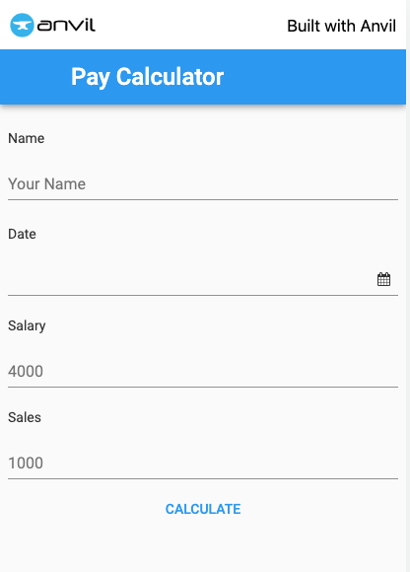
App from a Notebook (anvil)
Notes:
Anvil is a platform for building full-stack web applications with nothing but Python. It allows developers to create web applications using only Python, without the need for HTML, CSS, or JavaScript. With Anvil, developers can create web apps that interact with databases, APIs, and other systems, without having to write complex web code.
Here are the steps to create a web app with Anvil:
1. Sign up for Anvil: You can sign up for a free account on the Anvil website.
2. Create a new app: After signing up, you can create a new app by clicking on the "New App" button on the Anvil dashboard. You can choose to create a new app from a template or start from scratch.
3. Design the user interface: Anvil provides a drag-and-drop interface for designing the user interface of your app. You can choose from a wide variety of UI components, such as buttons, forms, and text boxes, and customize their appearance and behavior using Python code.
4. Write the server-side code: Anvil allows you to write the server-side code for your app using only Python. You can use Python code to manipulate data, perform calculations, and interact with other systems.
5. Publish the app: Once you've finished designing the UI and writing the code, you can publish your app to the web with just one click. Anvil will automatically host your app on its servers and provide you with a URL that you can share with others.
In summary, Anvil is a powerful platform that allows developers to create web apps using only Python. By providing a drag-and-drop interface for designing the UI and allowing developers to write the server-side code in Python, Anvil makes it easy to create sophisticated web apps without the need for HTML, CSS, or JavaScript.

Slide 19
Can you
Suggest some general design principles for user interface design
Explain different interaction styles
Describe the user support which should be built-in to user interfaces
Outline some of the ways create an ‘app’ using notebooks
Notes:
The presentation covered several topics related to user interface design. It began by suggesting some general design principles for creating effective user interfaces, including user familiarity, consistency, minimal surprise, recoverability, user guidance, and user diversity.
Next, the presentation described different interaction styles, including command-line interfaces, graphical user interfaces, and natural language interfaces. It explained the advantages and disadvantages of each style and when each might be appropriate to use.
The presentation then discussed the importance of providing user support in user interfaces, including on-line help, error messages, and manuals. It emphasized the need for these features to be integrated with the user interface and for messages to be polite, concise, consistent, and constructive.
Finally, the presentation outlined some of the ways to create an app using notebooks, including changing variables, using input(), creating widgets, creating forms, creating a dashboard, and sharing the app in various formats such as slides, HTML, and PDF. It highlighted some of the popular libraries and frameworks used to create apps from Python scripts and notebooks, including Streamlit and Anvil.

